Slide 1
Benchmarking Post-Hoc Explainability for
ESG Text Classification with DistilBERT:
SHAP, LIME, and Attention
Group 44
Abhishek Nagare, Ameya Mahesh Bhalgat, Ekta Jichkar,
Jennifer (Yu-Ching) Huang, Mayuresh Mohnalkar, Rashi Mahavir Solanki

Slide 2
Motivation
Why Explaining ESG Models Is Hard – and Important
ESG reports are long, technical, and often strategically written.
NLP models now help analysts scan them and flag potentially “substantive” claims.
But when a model labels a sentence as substantive ESG evidence, regulators and investors still ask: “Which words actually convinced the model?”
We have popular tools like SHAP, LIME, and attention maps, but we don’t yet know which explanations we can trust for ESG text.
Our project directly stress-tests these explanation methods on a real ESG classification task.

Slide 3
Research Question
Our Setup:
Fix the Model
Compare the Explanations
We deliberately freeze everything except the explainer:
One ESG dataset
One fine-tuned DistilBERT classifier
Three explanation methods:
  SHAP
  LIME
  attention
Then we ask three questions:
Faithfulness
When an explainer says a token is “important”,
does deleting that token actually change the model’s prediction?
Agreement
When all three explainers look at the same sentence, do they highlight the same evidence or different pieces of text?
Practicality
Considering runtime, stability, and visual clarity,
which method would an ESG analyst realistically want in their workflow?

Slide 4
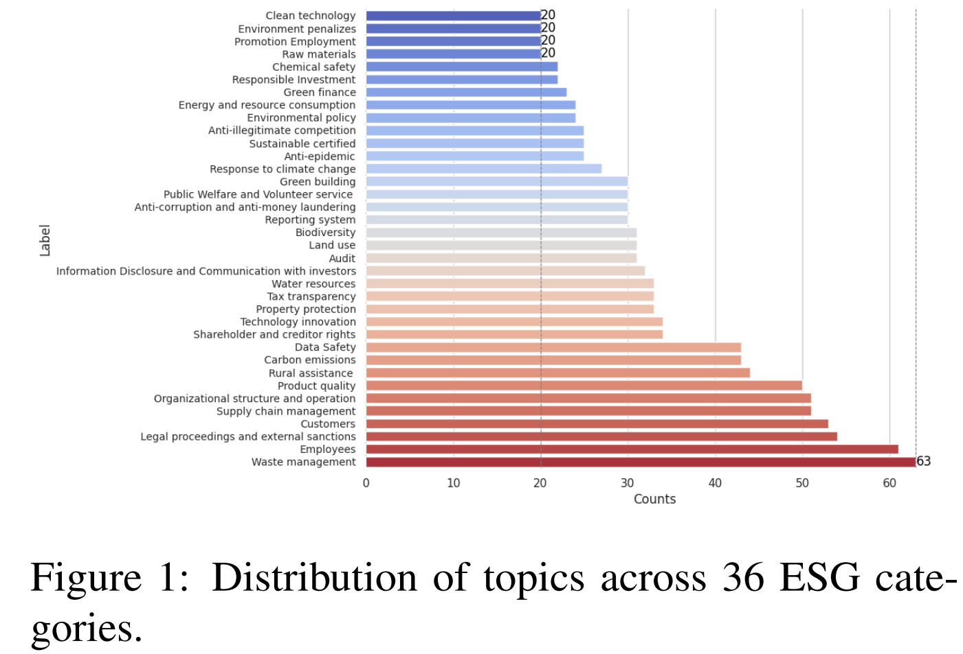
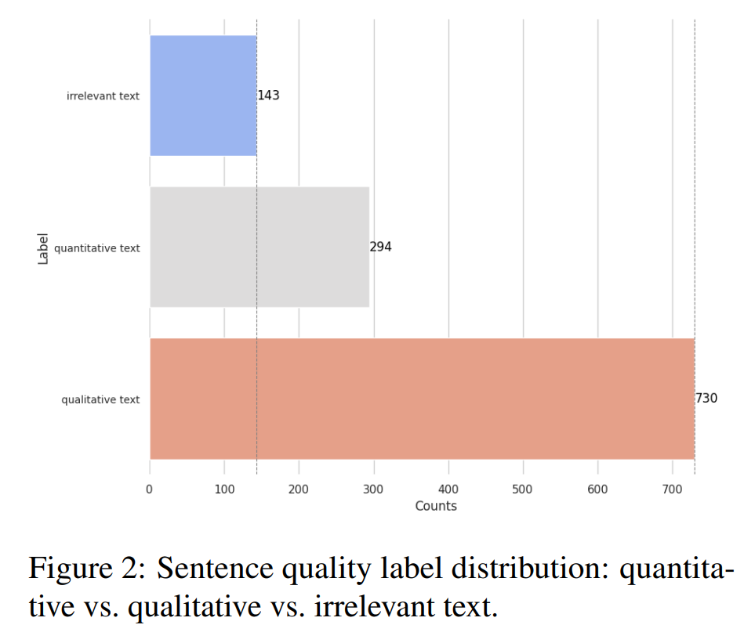
Dataset
Dataset from Github - https://github.com/LCYgogogo/ESG-dataset
Corporate ESG disclosures from Chinese sustainability reports (Wind Information)
8,467 English-translated sentences, all experiments use the English text
Each sentence has two labels:
  Topic: 36 ESG categories, organized into E / S / G via an ESGTree
  Quality: Quantitative, Qualitative, or Irrelevant
Most sentences are qualitative, reflecting narrative and promotional ESG reporting styles

Slide 5
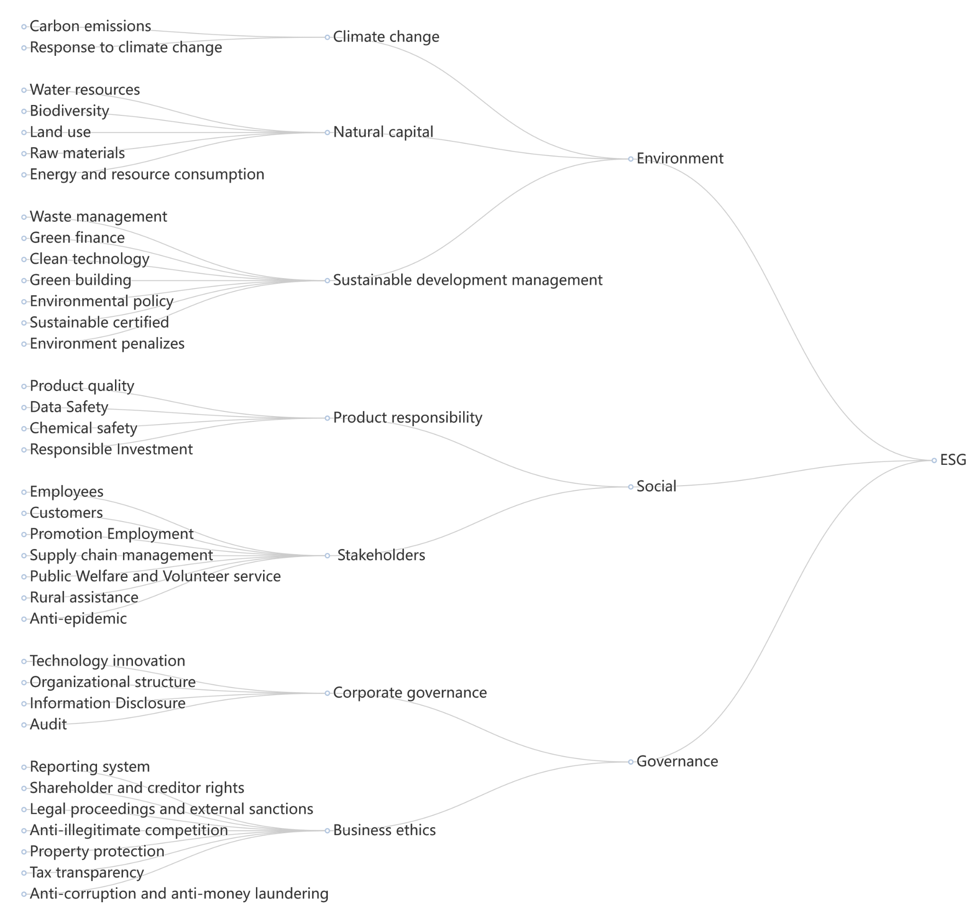
Topic Labels

Slide 6
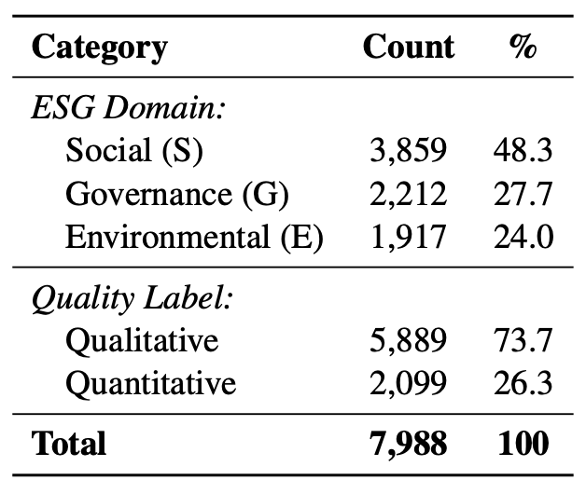
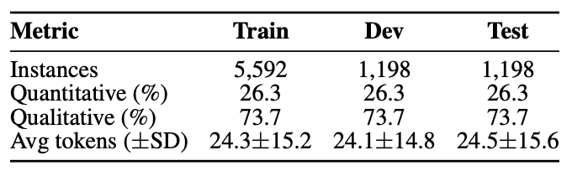
Preprocessing Pipeline
Removed 483 irrelevant sentences
→ 7,988 ESG-relevant samples remain
Mapped quality labels to a binary task:
Quantitative → Substantive (1)
Qualitative → Vague (0)
Lower-cased text, removed 127 duplicates, kept stopwords for interpretability
Created stratified 70 / 15 / 15 train–dev–test splits with consistent class ratios
Applied inverse-frequency class weights to handle label imbalance in training

Slide 7
Models & Explainability Methods
Classifier
Task: | Baseline: | Main model:
Substantive (1) vs Vague (0) | TF–IDF + Logistic Regression (uni/bi-grams) | DistilBERT-base-uncased class-weighted loss, max length 128 best checkpoint reused for all explanations
Explanation Methods
Method | Type | How we get token importance
SHAP | Model-agnostic | Text masker + small dev background → Shapley scores
LIME | Model-agnostic | ~200 perturbed samples → sparse local linear model, top-10 tokens
Attention | Model-internal | CLS→token attention (final layer, heads averaged); used as correlational, not causal

Slide 8
Evaluation Protocol
Faithfulness: delete top-k tokens (k ∈ {1,2,3,5}) → measure drop in predicted probability
Agreement: Spearman ρ between token rankings (SHAP, LIME, attention)
Plausibility: 10–12 visually inspected sentences, side-by-side explanations
Runtime: average time per instance on CPU-only setup

Slide 9
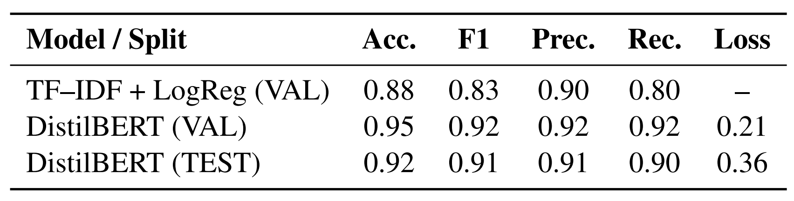
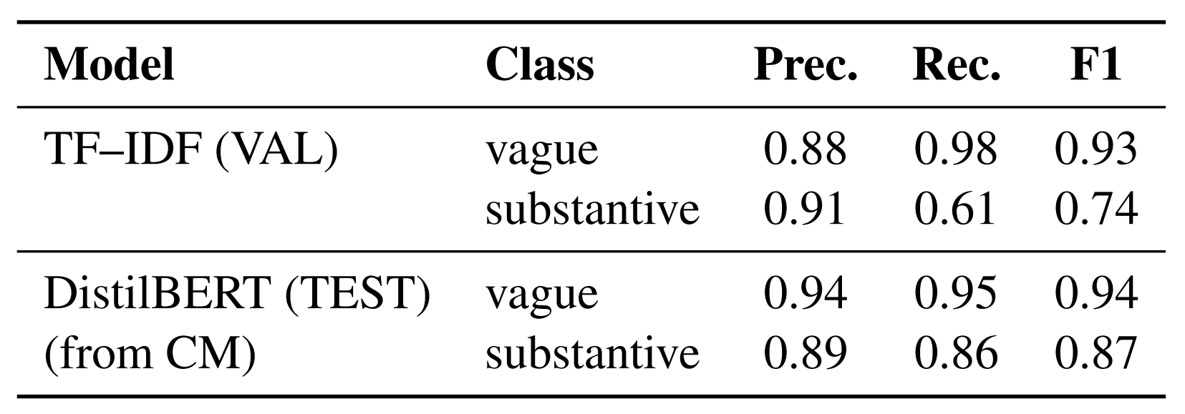
Initial Results – Classifier & Early Explanations
Classifier Performance
- DistilBERT improves macro-F1 by +0.09 over TF–IDF.
- Per-class: baseline often misclassifies substantive sentences; DistilBERT is much more balanced (substantive F1 ~0.87 vs 0.74).

Slide 10
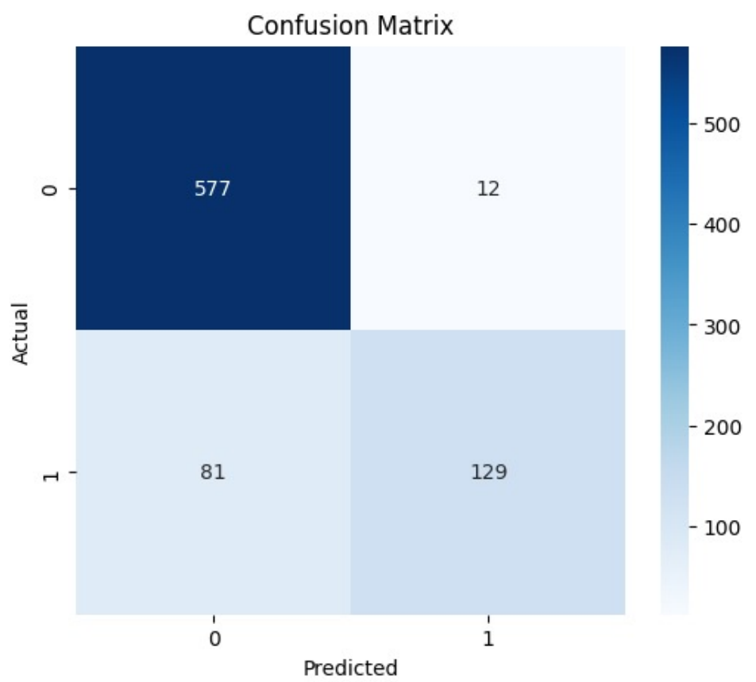
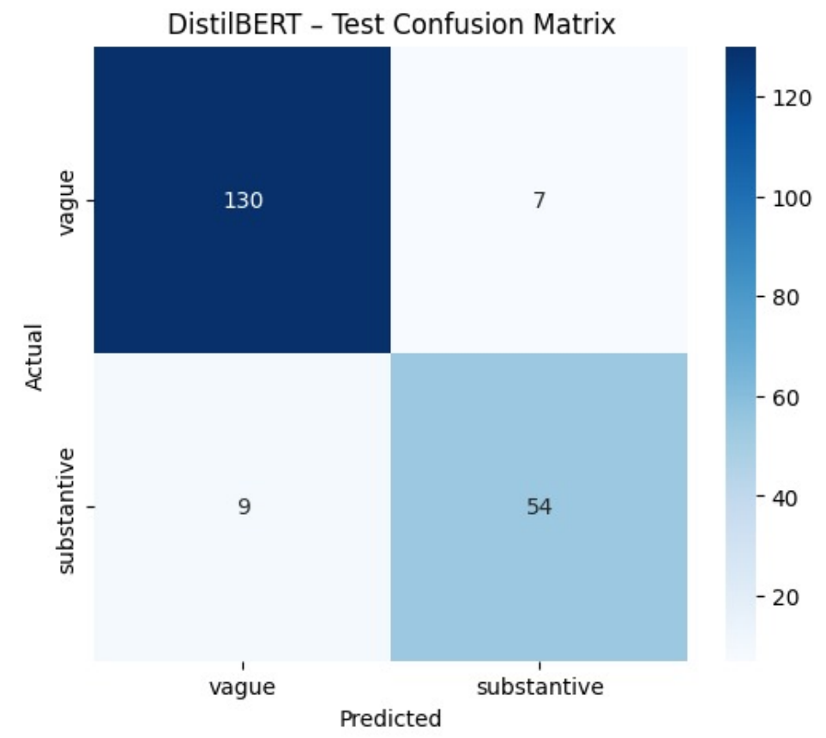
Initial Results – Classifier & Early Explanations
Confusion matrices for TF–IDF baseline (left) and DistilBERT (right)

Slide 11
Initial Results – Classifier & Early Explanations
Early Explanation Findings (50 balanced test samples)
Faithfulness (probability drop after deleting top tokens):
SHAP ≈ 0.12 > LIME ≈ 0.09 > Attention ≈ 0.07
Agreement (Spearman ρ between token rankings):
ρ(SHAP, LIME)=0.42, ρ(SHAP, Attn)=0.35, ρ(LIME, Attn)=0.31
Qualitative example – “We aim to reduce carbon emissions by 30% by 2030”
SHAP: “reduce”, “30%”, “2030”
LIME: phrase “reduce carbon emissions”
Attention: “carbon”, “emissions”
→ Explanations focus on different but complementary cues; SHAP appears most causally aligned with the model.

Slide 12
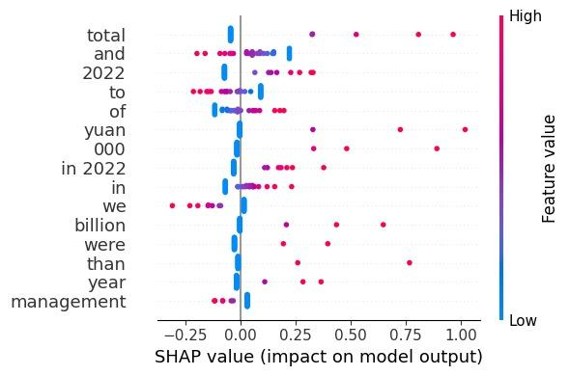
Findings - Global Token Importance with SHAP
Y-axis: most influential words/bigrams across ~30 sentences.
Each dot: one sentence; more dots → word appears in many examples.
X-axis (SHAP value):
– Positive → pushes prediction toward substantive.
– Negative → pushes toward vague.
We see clear quantitative cues (numbers, amounts, time horizons, etc.) with strong positive SHAP values.
Words near zero have little impact → good separation between signal and noise.

Slide 13
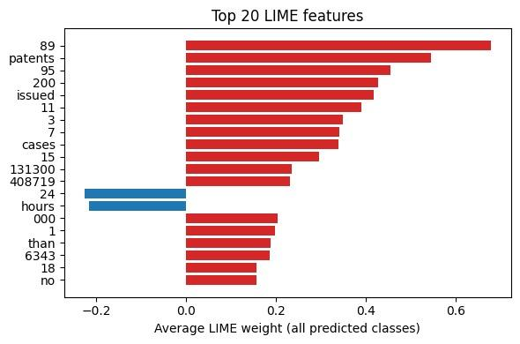
Findings - Global LIME Weights

Slide 14
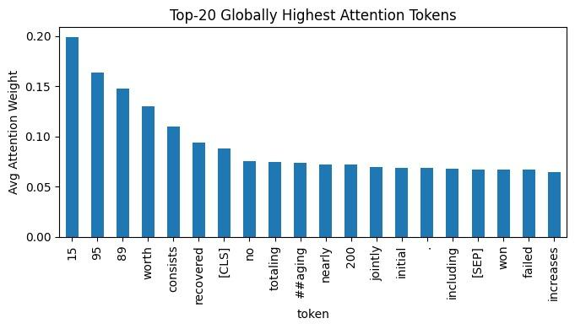
Findings - Global Attention Tokens

Slide 15
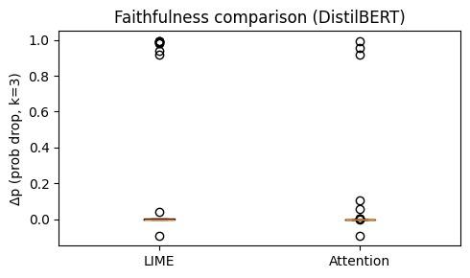
Results – How Faithful Are the Explanations?

Slide 16
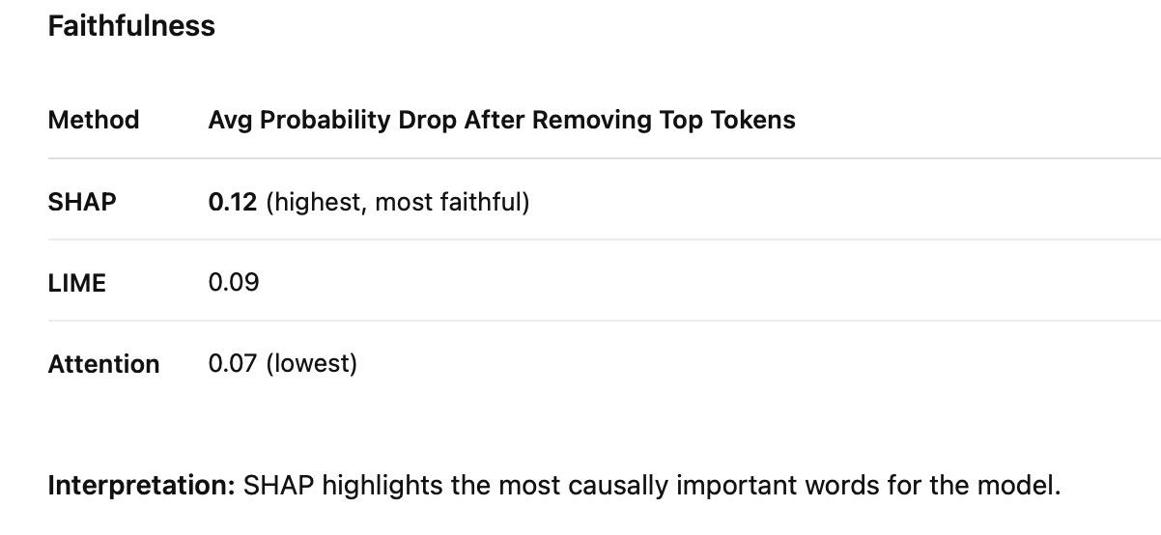
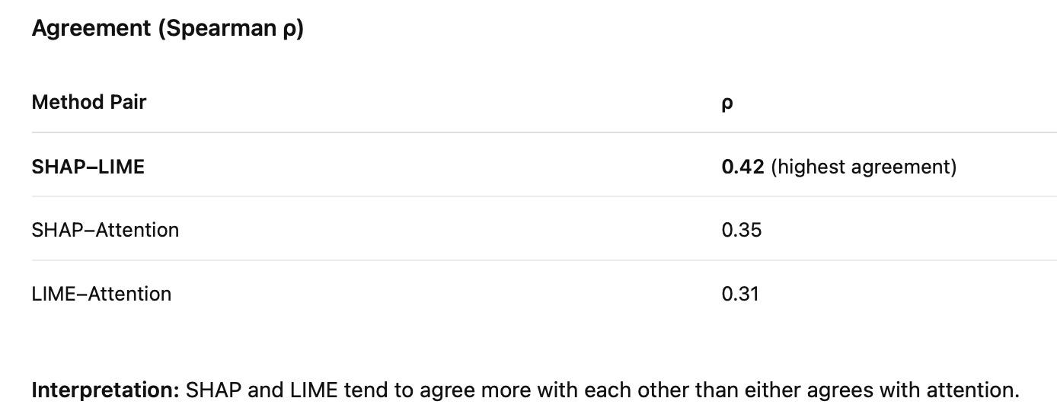
Results – Faithfulness, Agreement & Behavior
Deletion tests: remove top-3 tokens each method says are “most important” → measure drop in predicted probability (Δp).
Higher Δp ⇒ explainer found truly causal tokens.
SHAP consistently causes the largest confidence drop → best aligns with the model’s real decision boundary.
LIME and attention sometimes remove crucial words (Δp≈1) but, on average, are less reliable.
Correlations are moderate, not high → methods often highlight different tokens.
SHAP and LIME agree most with each other;
attention is the outlier in many sentences.
The three methods offer complementary but uneven views of the same prediction.

Slide 17
Conclusion – Which Explanations Should We Trust?
Faithfulness:
SHAP gives the most faithful explanations (highest Δp).
LIME and attention are less causally aligned with the model.
Agreement:
Only moderate agreement (ρ ≤ 0.42).
SHAP & LIME are closer to each other than either is to attention.
Practicality (what to use in ESG workflows):
Attention – Easiest: built-in, almost free to compute, but weakest as an explanation.
LIME – Flexible but noisy: intuitive phrases, yet sensitive to configuration and randomness.
SHAP – Most trustworthy: more setup and runtime, but stable and most faithful to the model’s reasoning.

Slide 18
Conclusion – Which Explanations Should We Trust?
Bottom line: When explaining ESG text with DistilBERT, SHAP is the most reliable explainer, with LIME and attention best used as supporting, not primary, explanations.

Slide 19
Next Step & Future Work
Evaluate on larger ESG datasets – Test methods across diverse document types (e.g., 10-K filings, Bloomberg articles, Twitter posts) to assess generalizability
Incorporate human evaluation studies – Validate explanation methods with ESG domain experts using metrics like faithfulness scores and human agreement rates
Explore integrated explainability approaches – Combine multiple techniques (e.g., SHAP + Attention weights, LIME + Integrated Gradients) for more robust explanations
Extend to multi-label ESG classification – Apply methods to multi-category predictions (e.g., simultaneous E, S, G labels) and analyze feature interactions

Slide 20
Team Contributions
Member | Responsibilities
Abhishek | Faithfulness experiments, presentation slides
Ameya | Agreement metrics, runtime analysis
Ekta | Project proposal, progress report (idea reiterated), presentation slides
Mayuresh | Attention extraction & visualization
Rashi | TF-IDF + Logistic Regression, DistilBERT model training & tuning
Jennifer (Yu-Ching) | Project topic ideas, written report, presentation slides

Slide 21
References
Borg, L. L., Kautzmann, G., & Mostaghim, S. (2024). Engagement-focused benchmarking for explainable AI. engrXiv Preprints.
Dmejchal, V., Ulman, M., Hlavac, J., & Katina, M. (2023). Text classification using explainable convolutions. Applied Sciences, 15(13), 7329.
Dhaini, M., Hussain, K. Z., Zaradoukas, E., & Kasneci, G. (2025). EvalxNLP: A framework for benchmarking post-hoc explainability methods on NLP models. arXiv preprint arXiv:2505.01238.
Galli, S., Vinci, G., & Moro, G. (2025). Fine-tuning LLMs for personalized explanation generation. arXiv preprint arXiv:2508.09231.
Gao, T., Fisch, A., & Chen, D. (2020). Making pre-trained language models better few-shot learners. arXiv preprint arXiv:2009.13295.
Suli, E., & Levy, O. (2024). LLM explainability via faithfulness-aware controllable perturbation. arXiv preprint arXiv:2405.08468.
Wang, L., Zhang, Z., Sun, K., Yu, W., Zhu, Y., Hong, Y., Su, D., Bengio, S., & Fu, J. (2025). Intrinsic explainability in transformer-based language models. arXiv preprint arXiv:2507.18932v1.
Wang, X., Wang, S.-M., & Roth, D. (2023). Augmenting language models with long-term memory. arXiv preprint arXiv:2303.15190.
Xu, R., Pang, B., & Yang, Y. (2025). OpenPrompt 2.0: An open-source framework for prompt-learning-based NLP. arXiv preprint arXiv:2506.13917.

Slide 22
Thank you!
Q & A

