Slide 1
Media Content Analytics Platform
A Data-driven Approach to Content Analysis
By: Abhishek Niraj

Slide 2
Table of Contents
Introduction
Architecture
Methodology
Schema
Analysis
Challenges
Conclusions / Findings

Slide 3
Introduction
A focused media content analytics platform to process and analyze data from YouTube and News Articles.
Uses Python for metadata normalization, content attribute extraction, and usage statistics transformation.
Implements a dimensional model in MYSQL for content performance and audience engagement analysis.
Primary Data Sources:
YouTube Data API v3: REST API with JSON responses, real-time API calls.
News Category Dataset: JSON file with 200k+ news articles, one-time download.

Slide 4
Architecture
High-Level Architecture:
Data Ingestion:
YouTube API for real-time data.
News Dataset for historical data.
Data Processing:
Python for metadata normalization and feature extraction.
Big Query for dimensional modeling.
Analytics Engine:
Topic modeling, sentiment analysis, and popularity scoring.
Visualization:
Streamlit dashboard for content analytics.

Slide 5
Methodology
Core Functional Requirements:
Content Metadata Processing:
Extract and normalize metadata from YouTube and News Dataset.
Create a unified content catalog.
Performance Data Collection:
Collect YouTube metrics (views, likes, comments).
Simulate engagement metrics for news articles.

Slide 6
Methodology
Content Analysis Engine:
Topic modeling, text analysis, sentiment analysis, and popularity scoring.
Dimensional Modeling:
Star schema with content, time, and category dimensions.
Data Charts and Analytics:
Performance metrics, trend analysis, and content recommendations.

Slide 7
Schema
Dimensional Model :
Content Dimension:
Video and article metadata with categorization.
Time Dimension:
Granularity for daily, weekly, and monthly analysis.
Source and Category Dimensions:
YouTube vs. News, and article categories.

Slide 8
Schema
Fact Tables:
Content performance (views, likes, comments) and engagement metrics.
Star Schema Diagram:
Central fact table connected to dimension tables (Content, Time, Source, Category).

Slide 9
Star Schema Design:
Fact Table : fact_content
Headline ID, Headline, Date ID, Category ID, Engagement ID
Dimension Tables:
dim_engagement(Views, Likes, Comments, Engagement Rate)
dim_date(Publish_Date, Day, Month, Year, Week, Day of Week)
dim_content(Grouped Category)
Normalization:
Reduced redundancy & Optimized Queries

Slide 10
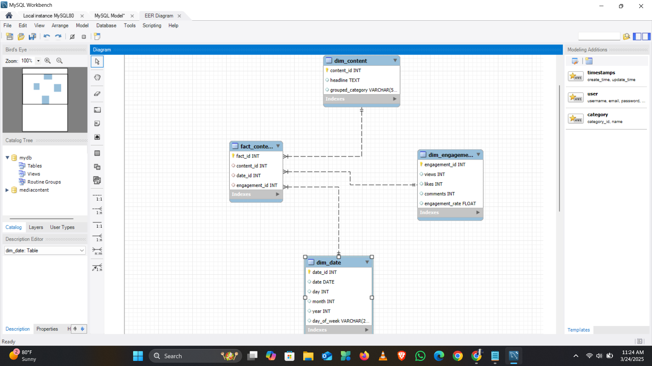
Star Schema Diagram:

Slide 11
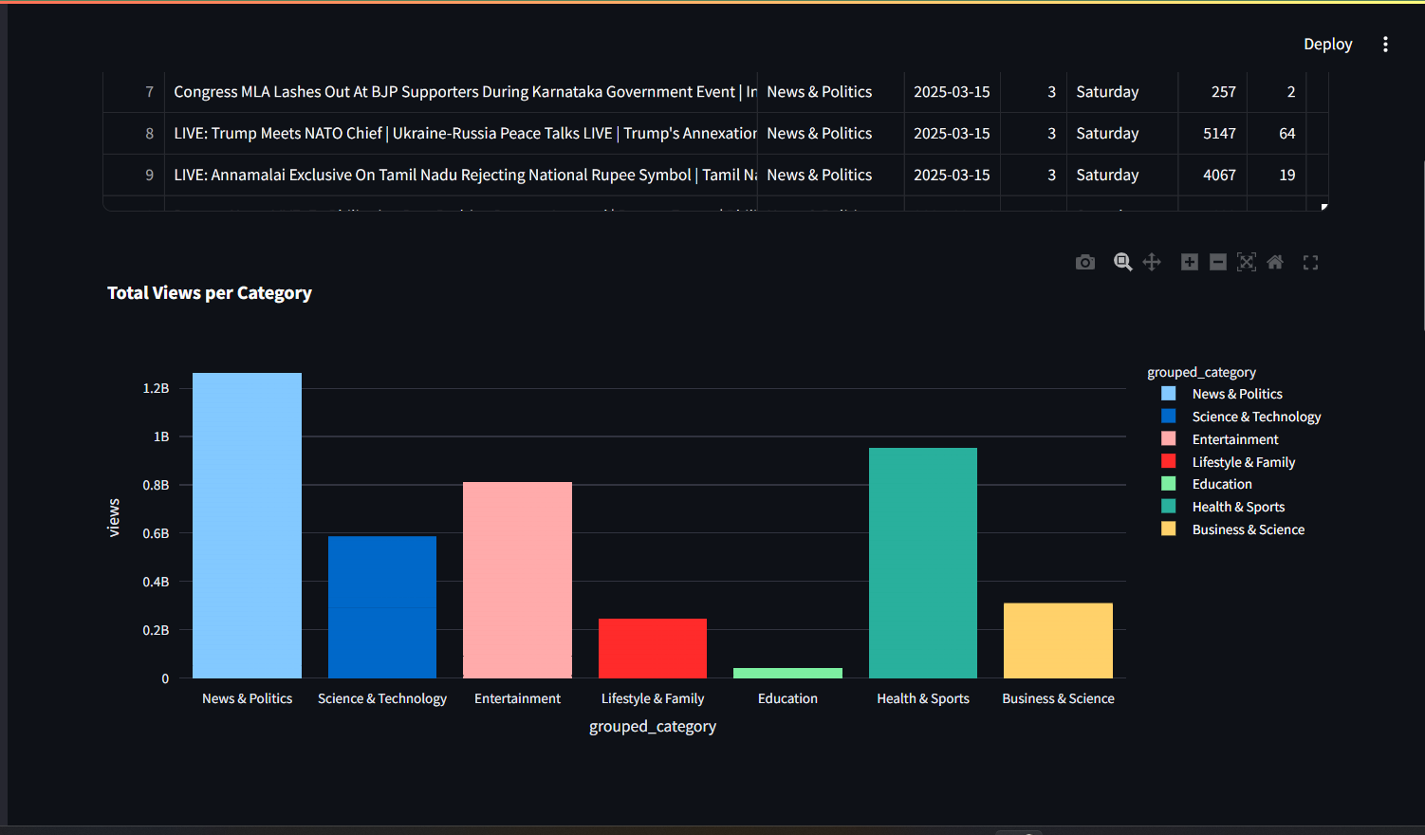
Bar Chart:

Slide 12
Analysis
Content Performance Analysis:
YouTube video metrics (views, likes, comments) over time.
Simulated engagement metrics for news articles.
Content Categorization:
Topic modeling for YouTube videos and news articles.
Sentiment analysis for comments and descriptions.
Trend Identification:
Temporal analysis for content performance trends.
Content Recommendations:
Similarity metrics for content recommendations.

Slide 13
Challenges
Data Integration Challenges:
Normalizing metadata from different sources (YouTube API and News Dataset).
API Limitations:
YouTube API quota limits (10,000 units/day).
Text Analysis Complexity:
Topic modeling and sentiment analysis for large datasets.
Performance Optimization:
Ensuring MYSQL query performance for large-scale data.

Slide 14
Conclusions / Findings
Key Achievements:
Successful integration of YouTube and News Dataset.
Unified content catalog with consistent metadata.
Advanced text analysis (topic modeling, sentiment analysis).
Streamlit dashboard for interactive content analytics.
Future Enhancements:
Expand data sources (e.g., social media platforms).
Implement machine learning for predictive analytics.
Optimize MYSQL performance for larger datasets.

Slide 15


