Slide 1

An Introduction of Intermediate Fabrics
Shen Yue, Li Xiangwei (Louis)
Overlay Reading Group,
School of Computer Engineering,
Nanyang Technological University
16th October 2014

Slide 2
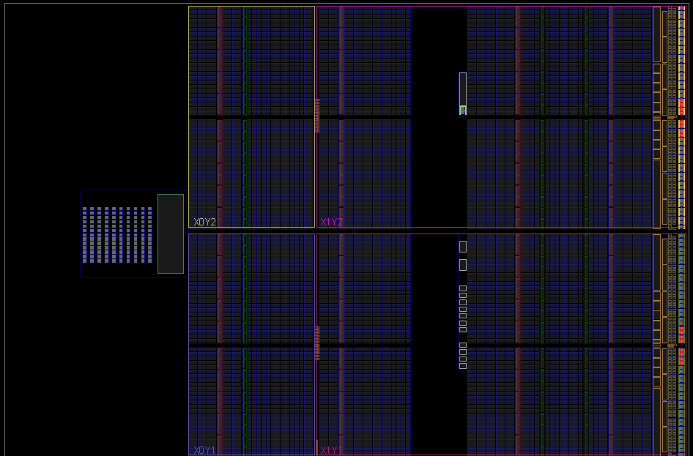
Motivations
FPGA Productivity Bottlenecks:
  Long compile time
    Synthesis, Placement and Routing (PAR)
  Lack of portability
    Different devices need recompiling
Solution:
  Overlay Architectures or Virtual Reconfigurable Architectures
    Intermediate Fabrics (IFs)

Slide 3
Objectives
  Provide near-instant FPGA compilation
  Maximize the speedup of PAR
  Enable portability across multiple FPGAs
  Bit-stream portability

Slide 4
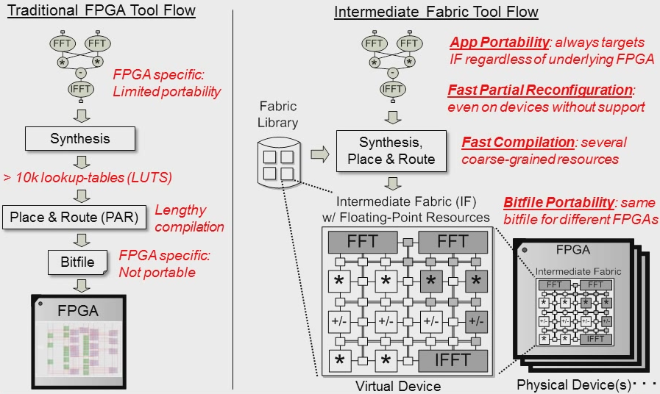
Tool Flow

Slide 5
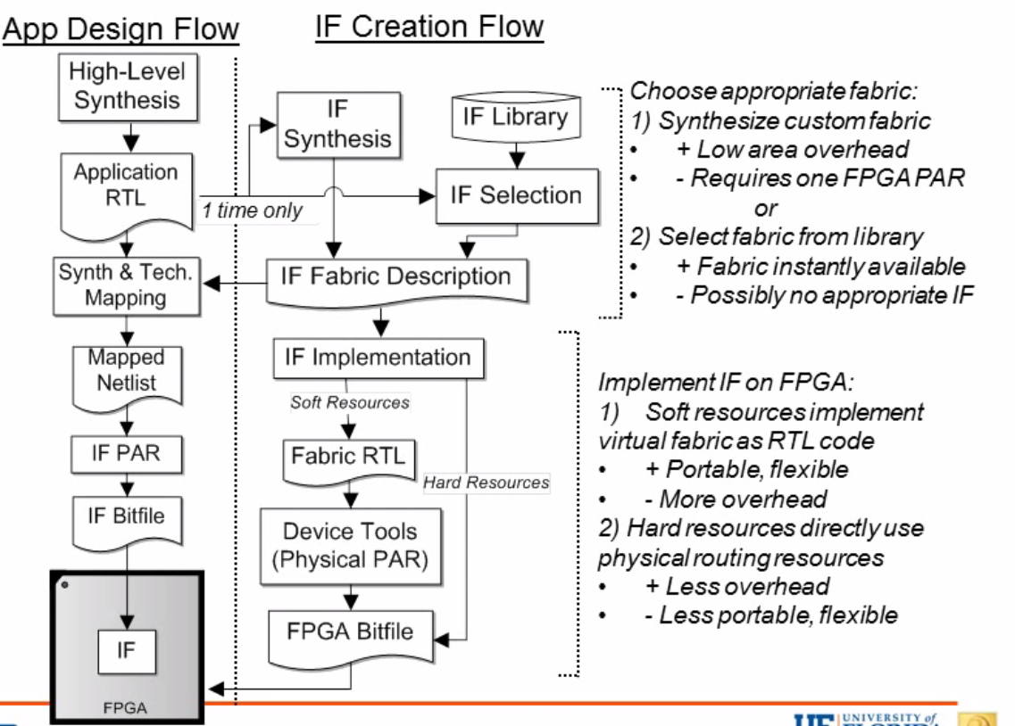
IF Tool Flow

Slide 6
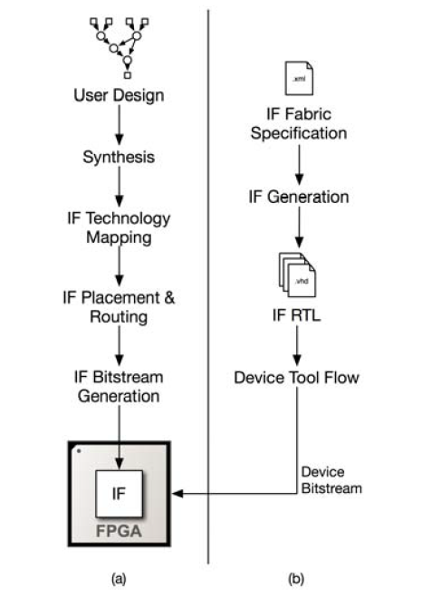
IF Tool Flow
App Design Flow
IF Creation Flow
Designers targeting IFs use the
IF tool flow to create a configuration bitstream for an IF that has been
implemented on a physical FPGA by synthesizing the corresponding IF RTL using the FPGA device tool flow (e.g. Quartus, ISE).

Slide 7
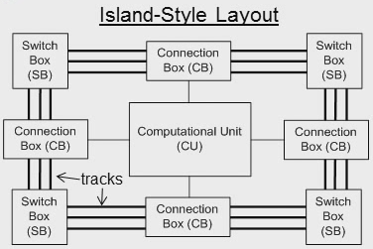
Architecture
Island-Style Topology
  Grid of CUs
    E.g., ALUs, multipliers, adders
  Routing resources in
  between CUs
    Tracks connect CUs
    Switch boxes connect tracks
    Connection boxes connect
    I/O from CUs to tracks
Early FPGAs
Fine grain
Fine grain
Current FPGA
Mixed grain
Fine grain
 | Early FPGAs | Current FPGA | IF
Logic
Routing
IF
Coarse grain
Coarse grain

Slide 8
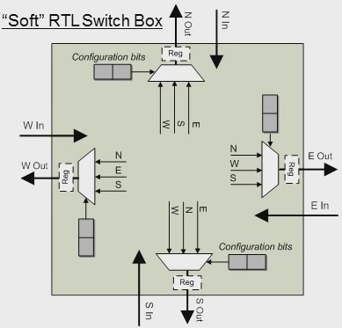
Virtual Routing: Hard or Soft?
Area Overhead!
For 1-bit track with 4 possible sources (2 tracks per channel), circuit occupies 4 1-bit MUX
Assume m-bit track with 2n possible sources (n tracks per channel), circuit will occupy 2n m-bit MUX

Slide 9
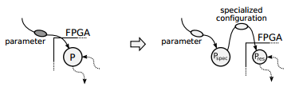
TLUT Tool Flow
TLUT tool flow was developed to implement Dynamic Circuit Specialization (DCS) on FPGAs.
DCS specialize values called parameters for the circuits which can be smaller and faster.
Notes:
Dynamic Circuit Specialization is a technique to dynamically specialize an FPGA configuration according to the values of a set of parameters.
TLUT flow divides the conventional tool flow into two parts. One is responsible for generating a specialized configuration, while the other one represents the functionality of the FPGA resources.

Slide 10
Parameterizable HDL design
module multiplexer (in0, in1, in2, in3, sel, out);
input in0, in1, in2, in3;
//PARAM
input [1:0] sel;
//PARAM
output reg [M-1:0] out;
always @ (i0 or i1 or i2 or i3 or sel)
case (sel)
2'b00: out = i0;
2'b01: out = i1;
2'b10: out = i2;
2'b11: out = i3;
default: out = 2'b00;
endcase
endmodule
in₀
in₁
out
in₂
in₃
sel₀
sel₁
Notes:
The parameter inputs is defined by adding the annotation upside and downside.

Slide 11
Synthesis
in₃
in₂
sel₀
in₁
in₀
Two types of inputs:
Regular inputs
  in₀, in₁, in₂, in₃
Parameter inputs
  sel₀, sel₁
A
A
N
A
A
O
O
sel₁
A
N
A
O
out
Notes:
According to the HDL in previous slide, we have defined two types of inputs, regular inputs and parameter inputs.
The parameter inputs can be reconfigured at run time and they are keys to reduce the number of LUTs.

Slide 12
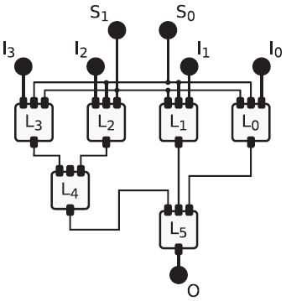
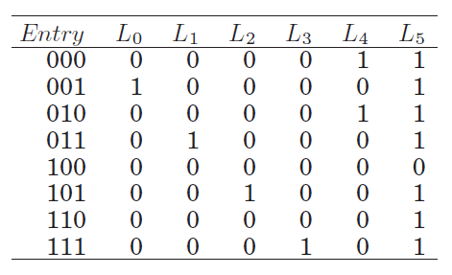
Conventional technology mapping
K-input LUT:
  Can implement any Boolean function with K regular inputs.
  Has fixed functionality determined by a static truth table.
S₁S₀I_{x}

Slide 13
TMAP: Tunable LUT mapping
in₃
in₂
sel₀
in₁
in₀
K-input Tunable LUT (TLUT):
  Can implement any Boolean function with K regular inputs and any number of parameter inputs.
  Has dynamic functionalities determined by a tunable truth table.
A
A
N
A
A
O
O
sel₁
A
N
A
O
out

Slide 14
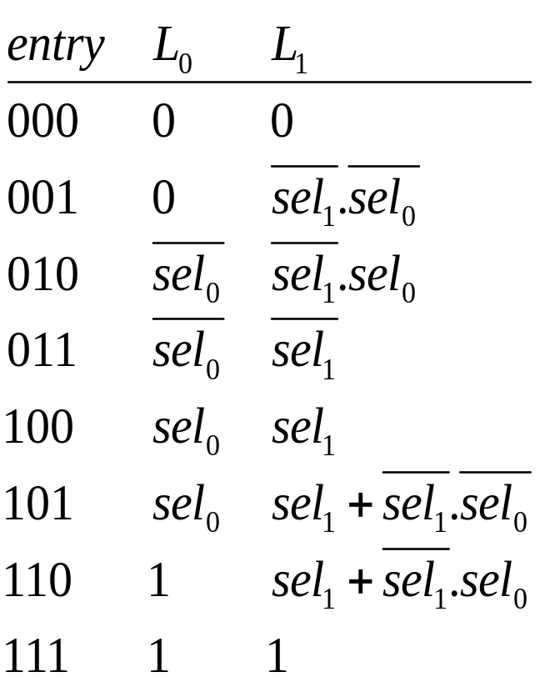
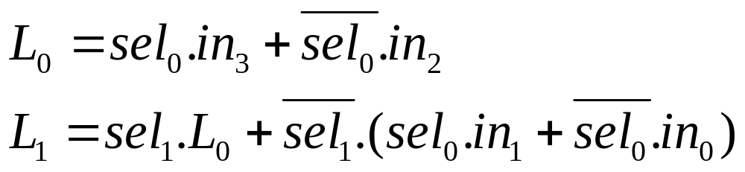
Tunable Truth Table
in₃
in₂
in₁
in₀
L₀
sel₀
sel₁
L₁
out

Slide 15
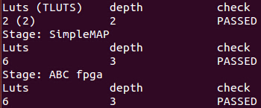
Standalone Results
TLUT mapper: the proposed TLUT tool flow
SimpleMAP: Conventional mapping techniques
ABC fpga: similar to SimpleMAP, but with some optimizations
Notes:
Depth stands for the number of LUTs in the longest path of the circuit. It is a measure for the maximum delay in a circuit.

Slide 16
Current Work
Understanding TLUT tool flow
Setting it up and running with examples
Implementing Xilinx-integrated TLUT tool flow to see how much space would be saved in our overlay

Slide 17
References
[1] Coole, James, and Greg Stitt. "Intermediate fabrics: Virtual architectures for circuit portability and fast placement and routing." Hardware/Software Codesign and System Synthesis (CODES+ ISSS), 2010 IEEE/ACM/IFIP International Conference on. IEEE, 2010.
[2] Bruneel, Karel, Wim Heirman, and Dirk Stroobandt. "Dynamic data folding with parameterizable FPGA configurations." ACM Transactions on Design Automation of Electronic Systems (TODAES) 16.4 (2011): 43.

Slide 18
Thank you!

