Slide 1

Overlay Architectures for FPGA Virtualization
presentation by
Abhishek Kumar Jain
3rd Year PhD Student
School of Computer Engineering, NTU
Centre for High-Performance Embedded Systems (CHiPES)
Supervisor: Assoc. Prof. Douglas L Maskell
Co-Supervisor: Asst. Prof. Suhaib A Fahmy
Notes:
Good afternoon all of you.
My name is Abhishek. I am working as a PhD student under guidance of Professor Douglas Maskell and Professor Suhaib Fahmy.
My research topic is Overlay architectures for FPGA virtualization.

Slide 2
Background
FPGA: Promising solution for hardware acceleration of applications
However, FPGAs are not becoming mainstream accelerators. Why?
  Difficulty in programming
  Poor design productivity due to time consuming design process
Design process is time consuming (hours to days depending on the application size)
Iterative process and involves verification at multiple levels
High level Synthesis (HLS) tools: automation of some of these tasks to reduce design time
However, RTL to bit-stream compilation time heavily affects the design time
Solution: Coarse Grain Overlay Architectures
Notes:
FPGAs have been shown as a promising solution for hardware acceleration of applications.
However, FPGAs are not becoming mainstream accelerators. The main reasons are
Difficulty in programming at low level (RTL)
Poor design productivity due to time consuming design process
Let’s first try to understand how this process works.
It starts with profiling an application described in a high level language such as C or C++ and finding out which part of the application is suitable for HW acceleration by doing HW-SW partitioning.
And then designing and verifying the HW accelerator using hardware description languages such as Verilog/VHDL.
An interface also needs to be designed to attach the HW accelerator with the system so that system can handle the run time management of the accelerator.
By run time management, I mean:
loading the bitstream of the accelerator to the FPGA
and managing the data communication through the accelerator
In the end, the RTL of the interface and the accelerator needs to be converted to bitstream using vendor tools.
This complete process is an iterative process and involves verification at multiple levels.
High level synthesis tools are becoming popular to automate some of these tasks to reduce the overall design time.
However, RTL to bitstream compilation time heavily affects the overall design time.
And It happens mainly because of the fine granularity of FPGA devices.
Researchers are exploring the concept of coarse grain overlay architectures to solve this issue. Let’s look at some of these projects.

Slide 3
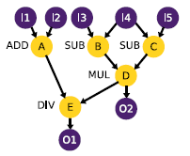
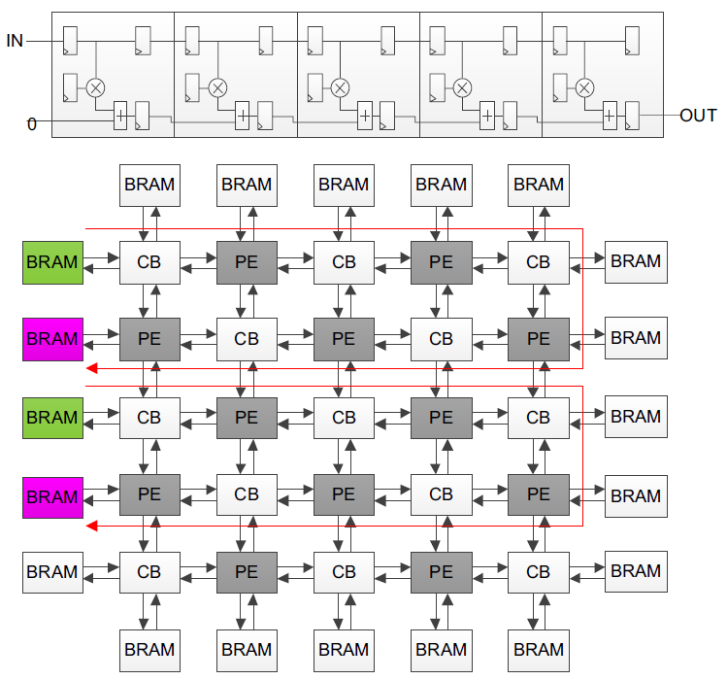
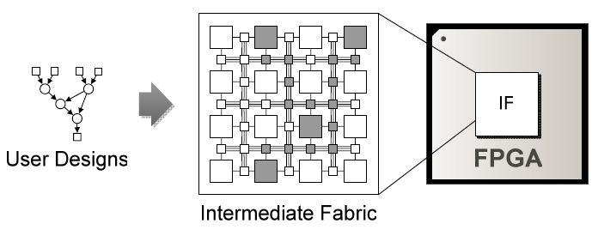
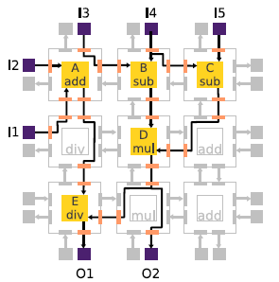
Background: Coarse Grain Overlay Architectures
Virtual Dynamically Reconfigurable
(VDR) Overlay
(University of Toronto)
Intermediate Fabrics (IF)
(University of Florida)
Proposed Overlay
Notes:
One such project is VDR overlay.
Overlay is just a programmable network of processing elements, implemented on top of FPGA fabric.
Computations represented in data flow graph are normally gets mapped to the overlay.
This project demonstrated 10 times speedup in application execution time on overlay compared to NIOS II soft core processor.
Another project is Intermediate fabric in which the concept was same but the main goal was to demonstrate fast application mapping on overlay.
IF project demonstrated 500 times speedup in mapping time compared to direct mapping on FPGA.
We proposed another overlay for mapping streaming applications such as systolic FIR filter.

Slide 4

Overlay Architecture for FPGA Virtualization
Operating System (OS)
Use of overlay architecture can enable:
  Fast application mapping to hardware
  Application Portability across different FPGA devices
  Sharing of overlay resources among multiple tasks
Integration of overlay architecture with an embedded processor is crucial
Software API abstractions for run time management of Overlay
_{Memory Interfaces}
AXI interconnect
_{Common Peripherals}
_{ARM Dual Cortex-A9}
Comm. Interface
High Speed AXI ports
Overlay
FPGA fabric
Notes:
So we have seen that the use of overlay can enable fast application mapping to hardware.
However, it can also enable
Application portability across different FPGA devices.
And sharing of limited resources among multiple tasks.
In order to share overlay resources among multiple tasks at runtime, integration of overlay with an embedded processor is crucial.
So that software API abstractions can be used for run time management of the overlay.

Slide 5
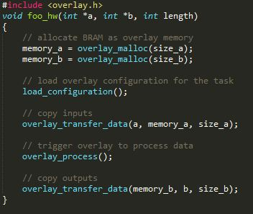
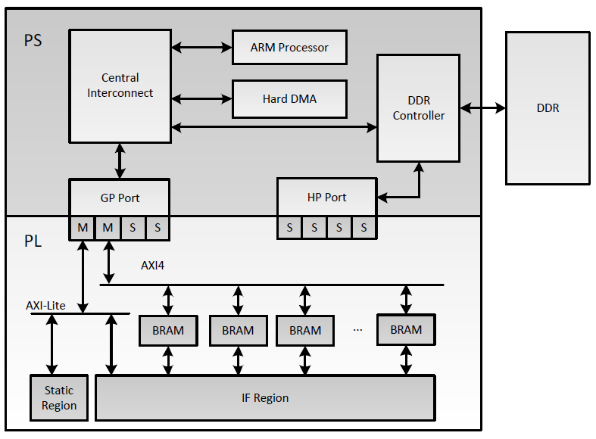
Run time management using software APIs
Notes:
Here we show, how we do the run time management of IF using SW APIs.
Figure on the left hand side shows the usage of our software APIs.
Figure on the left side shows the integration of overlay with the overall system via AXI interfaces.
We use FPGA block RAMs as local memories to buffer the configuration and the data.
SW application first allocates BRAM 2 and 3 as data buffers.
And then it calls an API to load the configuration from external memory to BRAM 1.
After that it calls another API to transfer data from external memory to BRAM 2.
Then it triggers a state machine sitting is static region by setting a control register.
It takes configuration data from BRAM 1 and configures the IF.
Then it stream the data from BRAM 2 to BRAM 3 through the IF. After that it notifies the SW the completion of task by setting a status register.
In the end SW reads the result back from BRAM 3.
This figure shows each component of the task. We measured the complete task execution time for different filters for different number of samples.
We use two techniques for data transactions:
First techniques uses processor to transfer data sample by sample.
Second technique uses DMA to transfer data in burst mode.

Slide 6
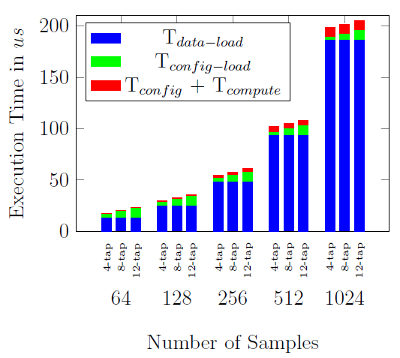
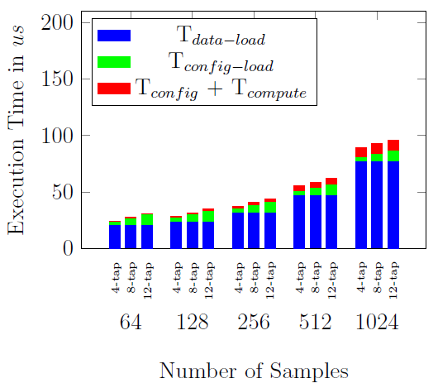
Communication overheads
GP Port without DMA
GP Port with PS-DMA
Notes:
Here are the results.
Y axis shows the execution time in micro-seconds.
And X axis shows the variation of number of samples for each filter.
Each vertical bar shows three components:
Blue component shows the data-load time from external memory to BRAMs.
Green component shows the configuration-load time external memory to BRAM.
Red component shows the compute time and time to load the configuration into IF from BRAM.
It’s clear from the figure that data communication is the major overhead and which can be improved further.
We implemented the same filters to process 1K samples on ARM processor and measured the speedup over ARM only implementation.

Slide 7
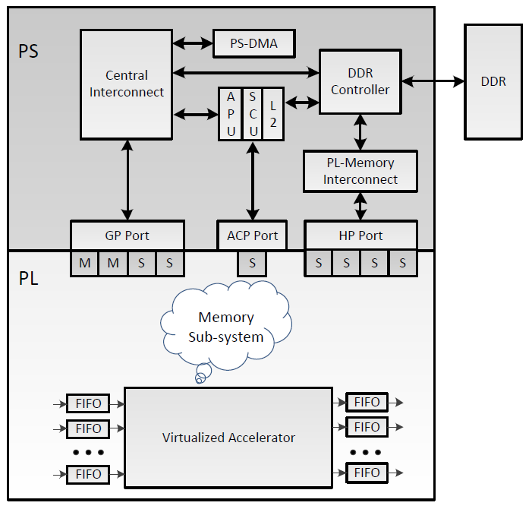
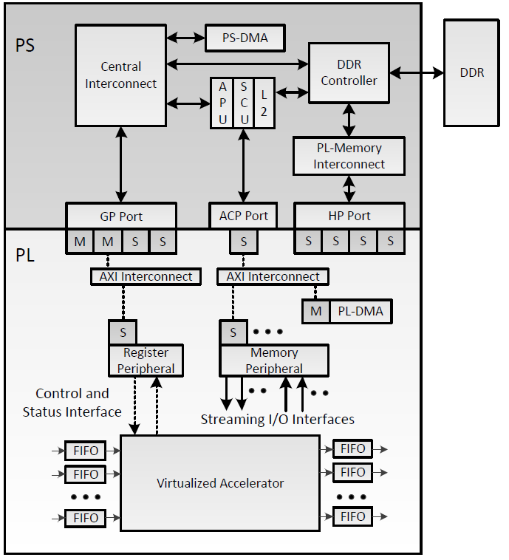
HW-SW communication on Zynq Platform
Notes:
Zynq provides different kind of interfaces for HW-SW communication.
The mechanism of interfacing the accelerator with the system affects the performance.
There are couple of ways to connect the accelerator with the system and depends on the memory subsystem.
Here we show a memory sub-system which acts as a bridge between accelerator and the overall system.
Accelerators normally requires two kinds of interfaces:
Control and status interface which we implemented using a register peripheral (this would be used for configuring and controlling the operation of the IF)
Streaming I/O interfaces which we implemented using a memory peripheral (this is for high speed data through the IF)
Memory peripheral contains dual port block RAMs.
One port is used to communicate with the PS.
Another port is used to communicate with the accelerators.
We characterized all three interfaces present on Zynq:
General purpose (GP) interfaces
High performance (HP) interfaces
And accelerator coherency port (ACP) interfaces
We start with the GP port. It allows two methods:
Processor IO (PIO) method: where processor transfers the data on a sample by sample basis
PS-DMA based method: where DMA handles the transactions

Slide 8
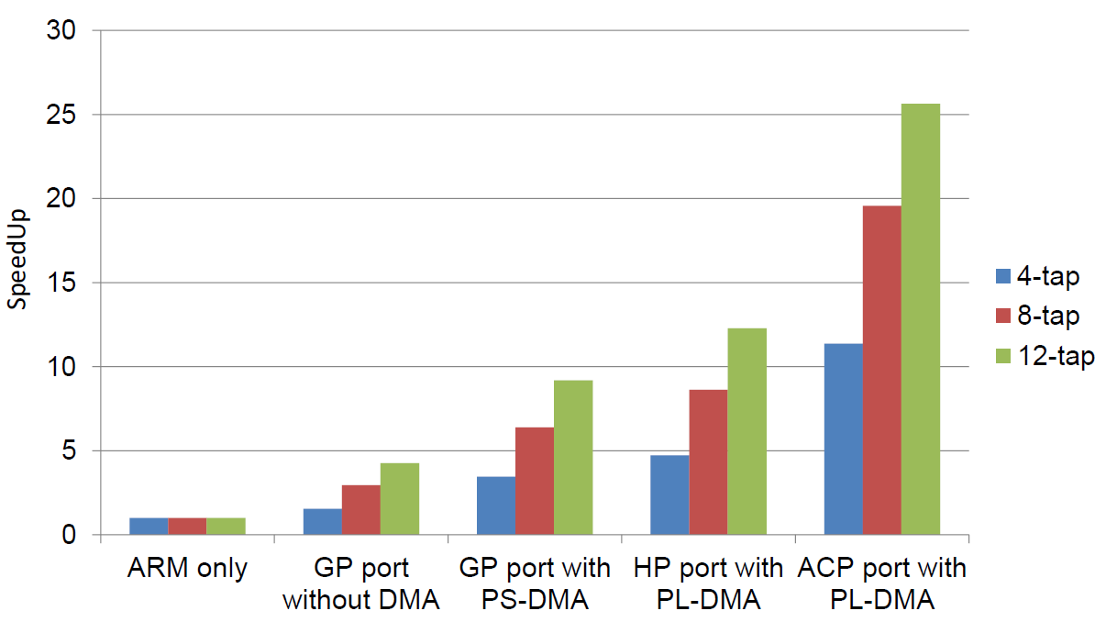
Speedup over ARM only implementation
_{Applications}
Processing
System
_{Memory Interfaces}
AXI interconnect
_{Common Peripherals}
_{ARM Dual Cortex-A9}
Comm. Interface
High Speed AXI ports
Overlay
Programmable
Logic
Notes:
We observed a maximum speedup of 25x.

Slide 9
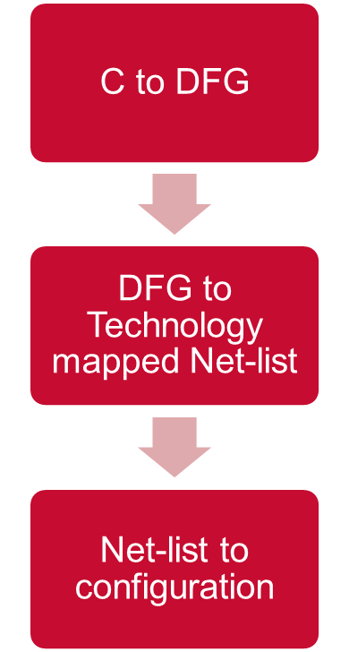
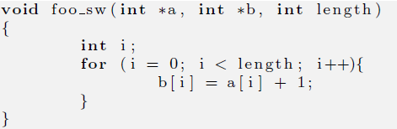
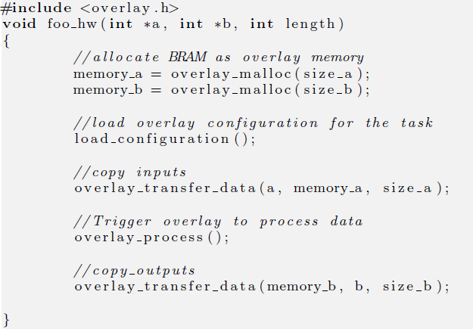
Automated Mapping of Applications on Overlay
SW function & corresponding HW kernel driver

Slide 10
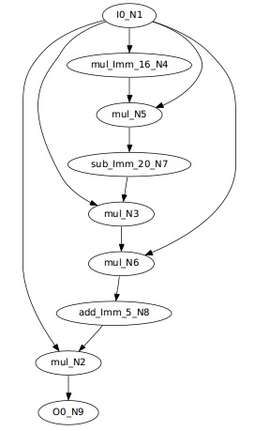
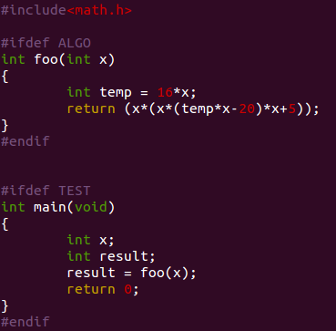
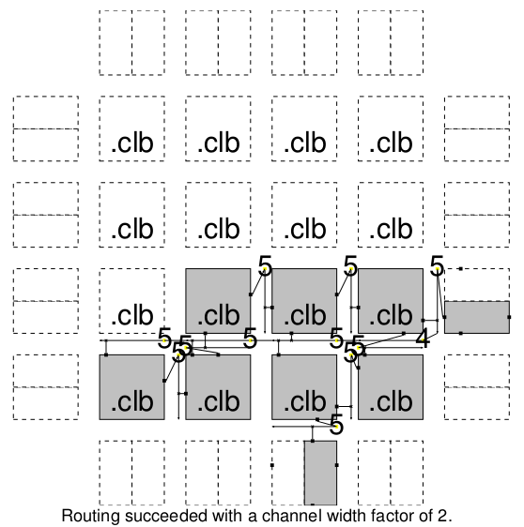
Example: Automated Mapping to Overlay

Slide 11
Conclusion
A design methodology using the overlay concept, with
  runtime management of overlay using software APIs
  Automated mapping from C description to overlay
  Characterization of software API overheads
  Maximum speedup of 25x of an application using overlay and software APIs

Slide 12
Publication
A. K. Jain, K. D. Pham, J. Cui, S. A. Fahmy, and D. L. Maskell. Virtualized Execution and Management of Hardware Tasks on a Hybrid ARM-FPGA Platform, in Journal of Signal Processing Systems, vol. 77, no. 1-2, pp. 61–76, October 2014, Springer.

Slide 13
Thank you!

