Slide 1
Coursera Capstone Project
IBM Data Science Certificate
Abhishek Padala
28-OCT-2020

Slide 2
REPORT CONTENT
1. Introduction : The “business problem” to be solved by this project and who may be interested.
2. Data : Describe data requirements and data sources to solve the problem.
Methodology : Data processing, EDA analysis, Inferential statistical testing performed, machine learnings used.
Result : discuss the results and finding the solution.
Discussion : observations noted and any recommendations to consider
Conclusion: Answer chosen and concludes the findings.

Slide 3
Introduction
1.1 Scenario and Background
I am currently working In India, I wanted to move to Canada someday, Like me there are many students and working professionals wanted to move but mostly people consider suitable province, location based on someone’s/website suggestions. Canada is a large country with many provinces and cities, I wanted to find suitable province, city and neighborhood based on my requirements
1.2 Problem to be resolved
How to find a location to move based on the following conditions:
Province and city should have many job opportunities related to data science
Neighbourhood should be near to the companies that are hiring data scientists
Neighbourhood Venues like coffeeshop, grocery store, gym, bar and restaurant and etc should be near.
1.3 Interested Audience
I believe the methodology, tools and strategy I used in this project is relevant to Immigration consultants and entity who like to move to Canada, USA, Asia, Europe. This project approach helpful to understand the job openings market of the country, rental locations, neighbourhoods of selected cities and venues.

Slide 4
2.0 Data
2.1 Data Requirements
Job posting data from job portals
Available rental apartments data from real estate websites
Latitude and longitudes of rental apartments, companies and neighbourhoods, Venues for each neighbourhood
2.2 Data Sources, Data Processing and Tools used
Toronto data and maps is to be created with use of Nominatim, Foursquare and folium mapping.
Geocodes to be created using google maps api, Neighbourhoods data gathered from Wikepedia
List of available apartments data from rental.ca and job posting data from indeed.ca, geolocation(lat, long) was found with an algorithm coding using Nominatim and GoogleMaps.

Slide 5
3.0 Methodology
The Strategy: Finding the Province and City based on the job postings data. I have mapped data into packed bubbles for province selection, side by side bars chart to find the city based on highest job postings.
After selection of the city, rental locations and job posted companies, Neighbourhoods of the selected city will be gathered, wrangled and mined.
Venues of the neighbourhoods will be gathered and clustered. Distance is one of the important feature. So by geolocation the distance will be calculated between company & neighbourhood, company & rental apartments.
K-means Clustering is a process of grouping similar things into one group. Once the clusters revealed, find out the venues which are important, this selection may vary based on activities and hobbies.
Finally the available rental locations will be displayed on map based on neighbourhoods selection.

Slide 6

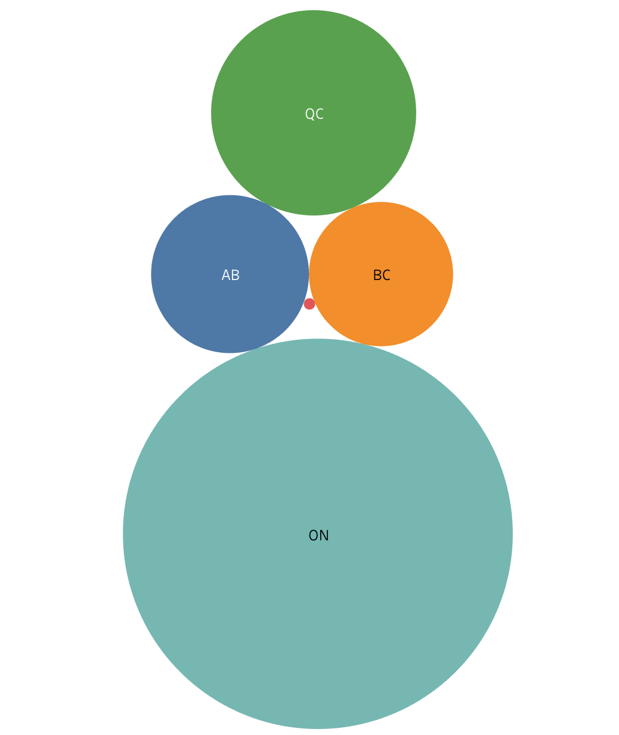



Results: Province finding

Slide 7
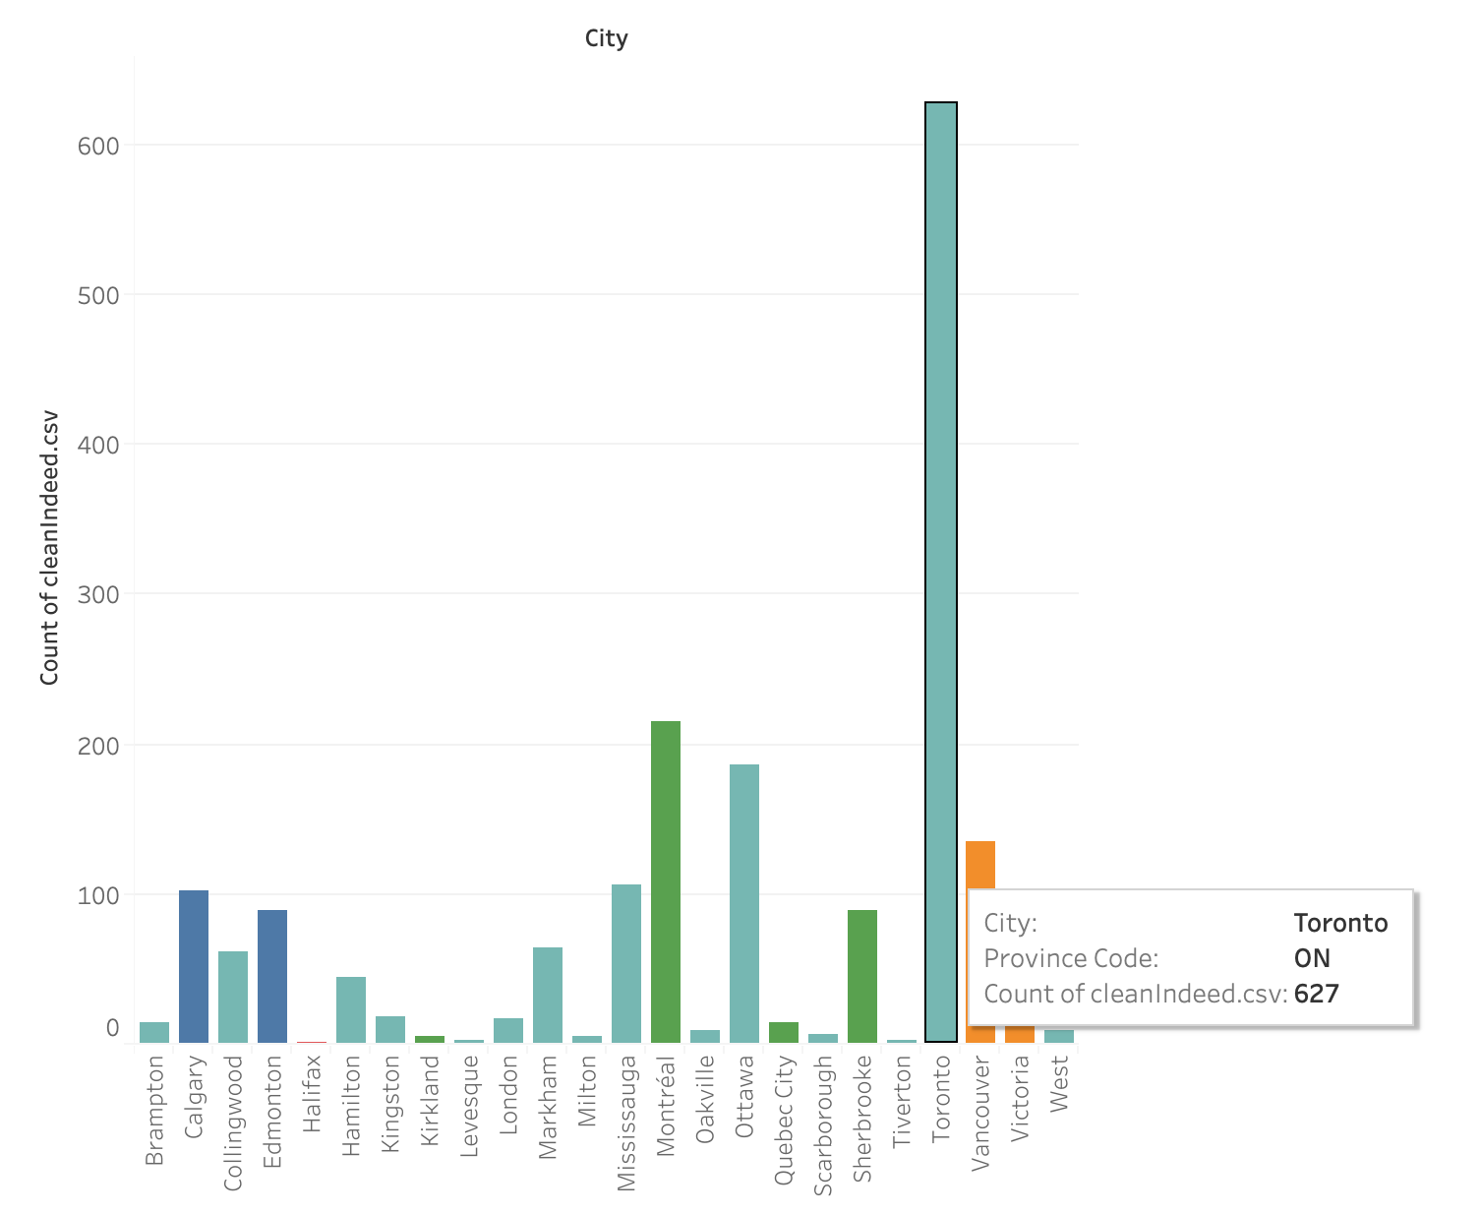
Results: City finding

Slide 8
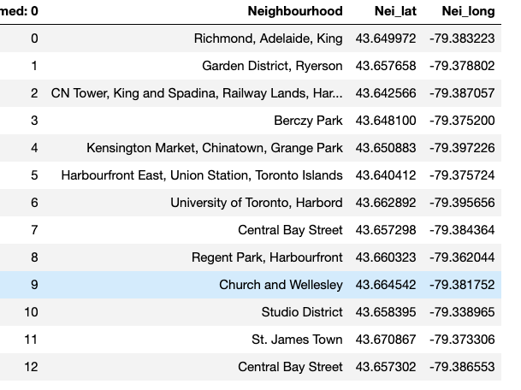
Results: Unique Neighborhoods

Slide 9
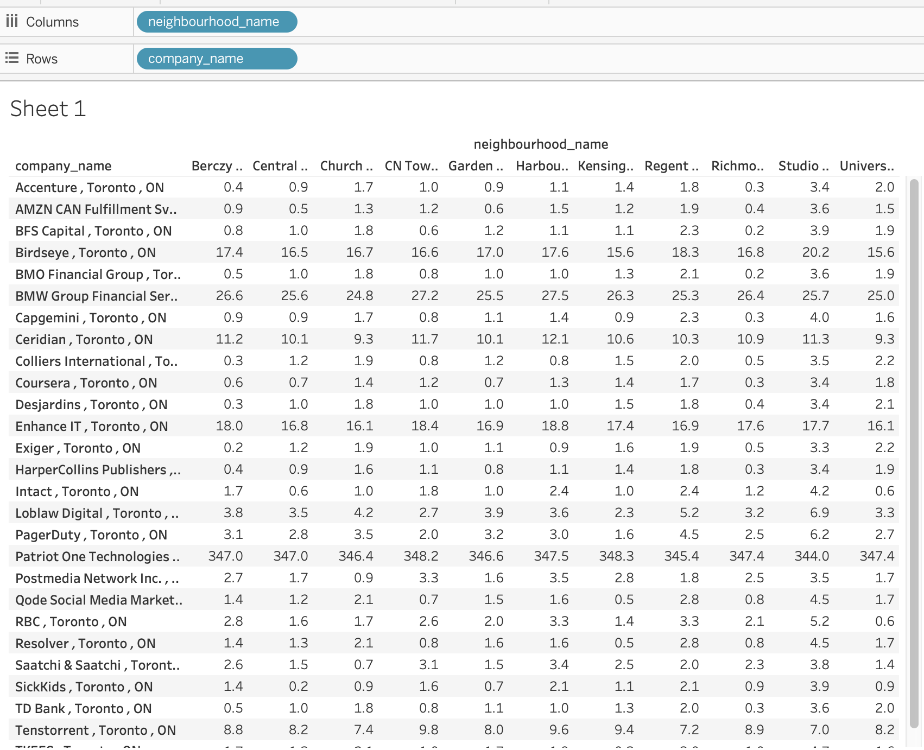
Results: Job posting companies and distance to neighborhoods

Slide 10

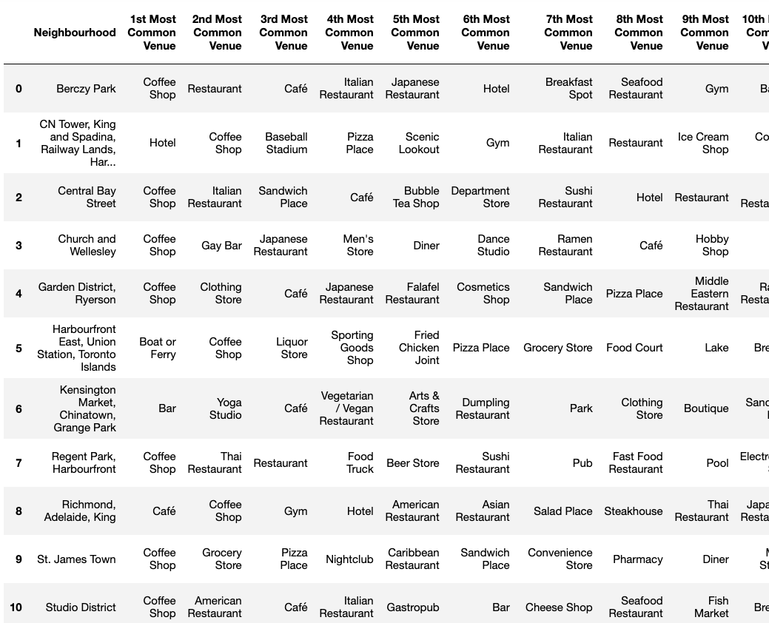
Results: Neighborhood venues

Slide 11
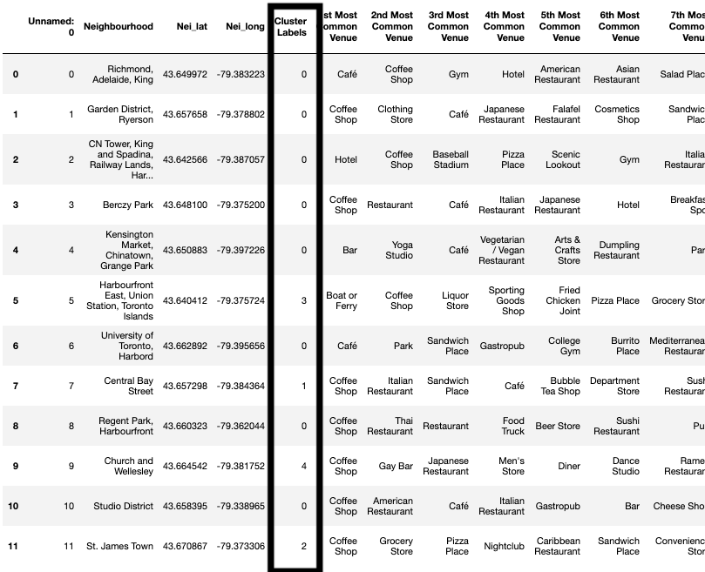
Results: Neighborhood Clustering

Slide 12
Observation and Discussion
Cafe, Restaurants, Coffee shops, food business are very famous in every Neighborhood.
9 neighborhoods are with in 1.5km to select company (Amazon).
Based on cluster 0 Neighborhood’s venues mapped rental locations to find out better transport and happening place to live.
The final selection of rental location and neighborhood changes person to person.
I am okay with cluster 0 neighborhoods they are very near to the company and one rental location which is suitable to me, i.e. 1 king West, 1 king street west, Old Toronto, rent is 1800 CAD.

Slide 13
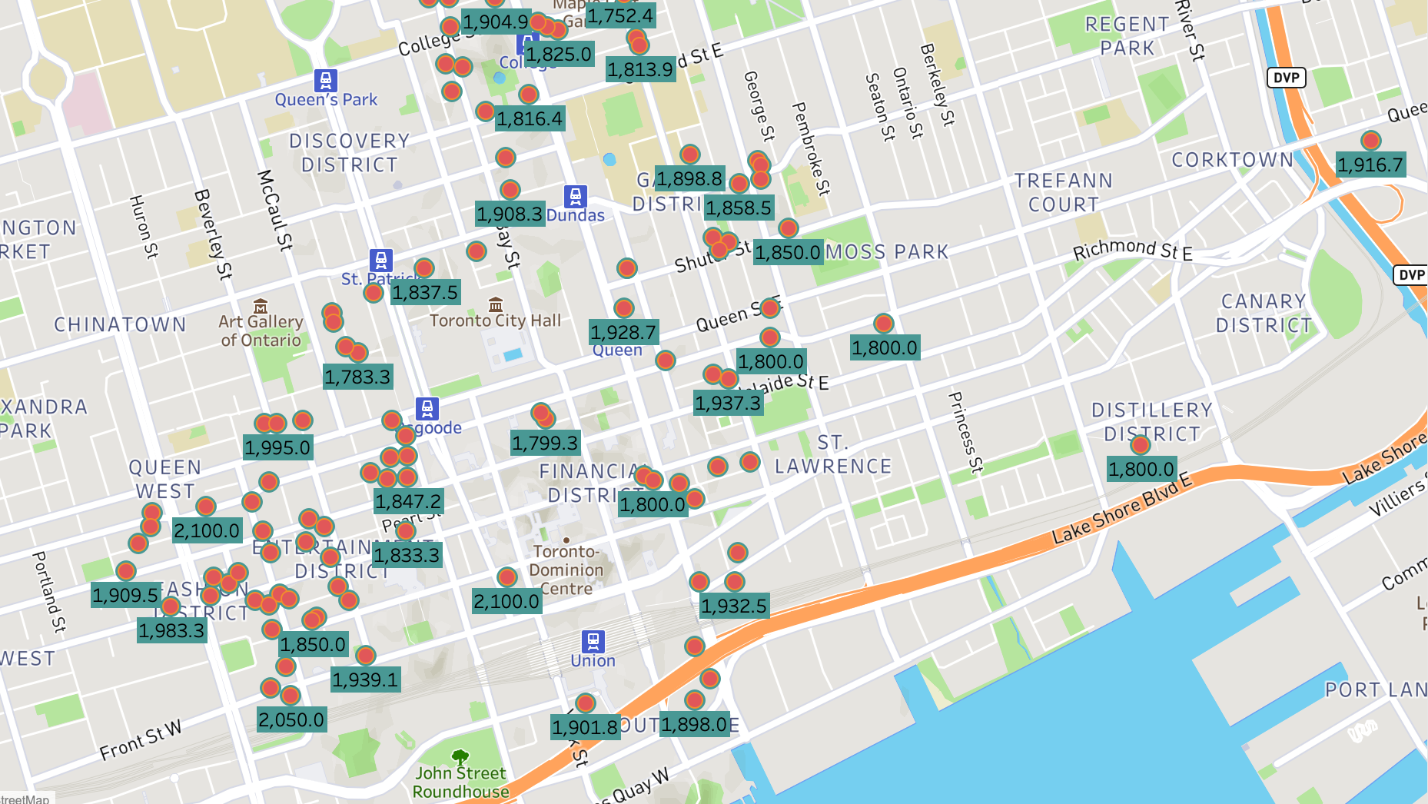
Results: Rental locations from selected neighborhoods

Slide 14
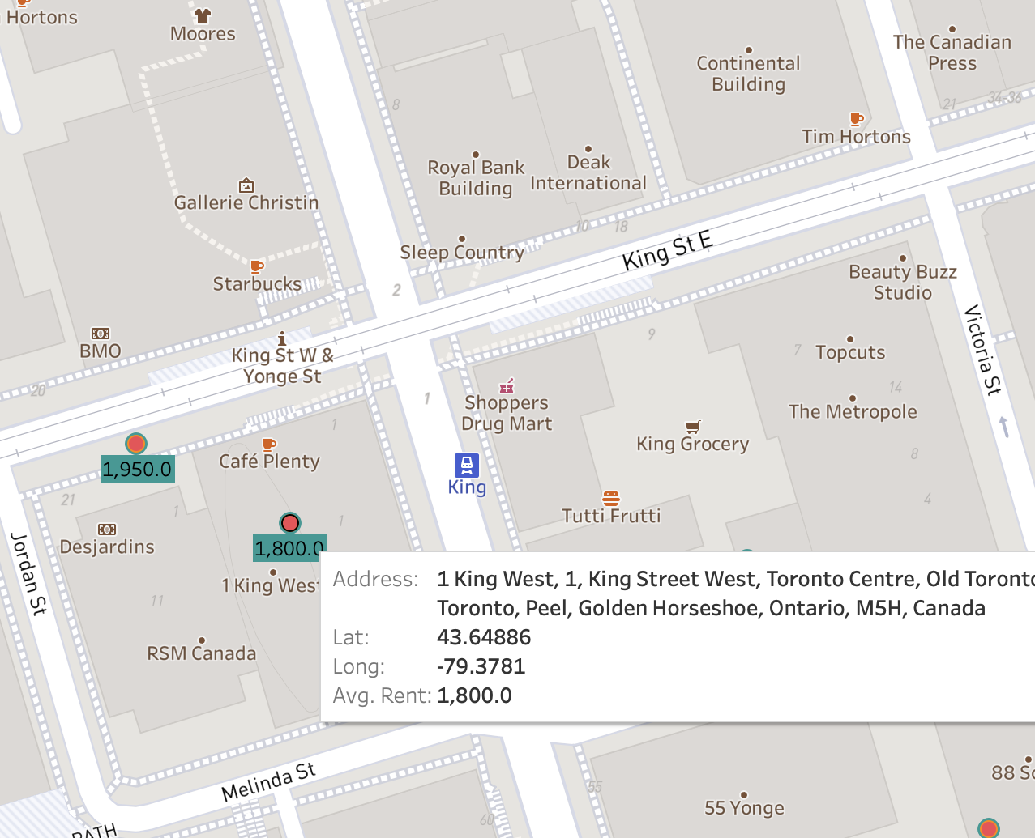
Conclusion: Finalized rental place to move.
Near to metro
Near to company
Near to grocery, bank, coffee ships
The venues I wanted are with in 1.5 km like dance school, pool and shopping malls, yoga center.

