Slide 1
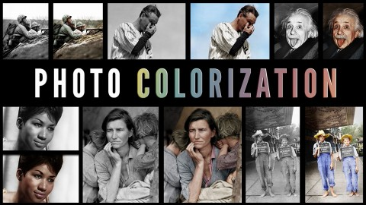
HEURISTICS
IMAGE COLORIZATION

Slide 2
PROBLEM STATEMENT
Given a grayscale photograph as input, we shall attack the problem of hallucinating of plausible color version of the photograph.
We will start with the image set of the animal kingdom and potentially expand it to all images subject t availability of better architecture.
The problem we want to solve is a fully automatic approach to colorization devoid of any human help.

Slide 3
EXISTING LITERATURES
Zhang, Isola, Efros: Colorful Image Colorization: In ECCV, 2016
Predicting distribution of possible colors for each pixel and finally producing a colorization by taking the annealed mean of the distribution.
Tiny Clouds: Automatic Colorization
Extraction of hyper-columns from image layers and detection of UV attributes to generate the final image.
Convolutional Neural Networks for Visual Recognition: CS 231n
Basic structure and working of Convolutional Neural Networks and break up of VGG-16 layers.
Cheng, Yang, Sheng: Deep Colorization: IEEE International Conference on Computer Vision, 2015
Finds most similar pixels from image database and transfers its color to the target pixels.
Notes:
Tinyclouds.org/colorize

Slide 4
TOOLS AND DATASETS
Datasets
ImageNet 2014 Dataset
Tools
We have explored various tools:-
Tensor flow
Caffe
Torch 7
Theano
CNN Benchmarks
Finally, we will be using Tensor flow as a lot of documentation is available and implementation of VGG-16 is available in Tensor flow.

Slide 5
DEPTH OF PROBLEM UNDERSTANDING
VGG-16 designed by Visual Geometry group, Oxford university is a classifier based on Very deep convolution networks. It came second in ILSVRC 2014. It is a 16 layered classifier.
Our dataset, ImageNet-2014 has 150,000 images.
All the images of the dataset will be converted to grayscale images. Our training set will constitute of black and white saturated images and their corresponding color images.

Slide 6
KEY CHALLENGES
Averaging approach for colors of objects existing in different contexts in the datasets may lead to a final gray color.
Using another approach of Maximum likelihood, we run into the problem of assigning the color which may represent one of the possible representations but may not match with the original image.
Training is a challenge due to the limited processing power at hand.
Scarcity of introductory blogs and materials.
Accuracy of classifier suffers when two different animals are visually similar to each other.

Slide 7
FEASIBILITY
Pre-trained CNN classifiers are available
Standard dataset for training is available
There has been a tremendous research done in this field and available as journals and research papers
We have tested the VGG-16 CNN Classifier on our personal computers and the target can be accomplished in manageable time.

Slide 8
ROADMAP

Slide 9
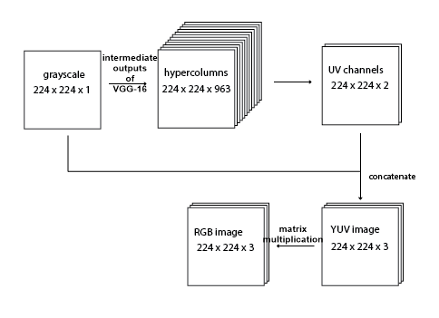
MODEL

