Slide 1
City Health Clinic – IT Infrastructure Project
Complete Coursework Presentation

Slide 2
Part A – Benchmarking Summary
• Your laptop CPU score: 1317
• Modern devices outperform older ones
• Slow devices recommended for replacement

Slide 3
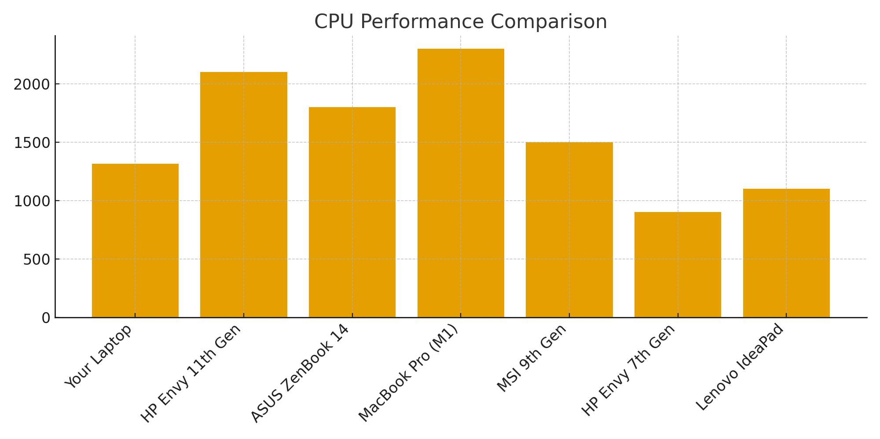
CPU Performance Comparison Chart

Slide 4
Part B – Parallel Computing Needs
• Radiology needs parallel image processing
• Emergency requires fast access
• CUDA, OpenMP, MPI recommended

Slide 5
Part C – Network Design
• VLAN segmentation
• Secure Wi-Fi + Firewalls
• Department‑based IP ranges

Slide 6
Part D – Budget Summary
• Total estimated: £15,500
• Cost reduction using cloud + selective replacement
• Contingency budget: £9,000

