Slide 1

School of Electronics Engineering (SENSE)
MTech VLSI design
Low-Power 8-bit SAR ADC at 1 MS/s in 90-nm CMOS for Biomedical Applications
Presented by:
Guided by:
Abhishek Patnaik (23MVD0049)
Dr. Prachi sharma
Ass0ciate professor grade 1
Sense

Slide 2
OUTLINES
Implantable medical devices rely heavily on efficient signal acquisition and digitization, where the analog-to-digital converter (ADC) plays a crucial role but is also one of the most power-hungry components. The Successive Approximation Register (SAR) ADC is well-suited for such applications as it provides an excellent trade-off between power efficiency, conversion accuracy, and design simplicity. In this project, a low-power single-ended 8-bit SAR ADC is proposed, supporting a sampling rate of 1 MS/s using a 90-nm CMOS process with a 1.2 V supply voltage. The design is modeled and simulated using Cadence tools, making it suitable for biomedical and other low-power applications.

Slide 3
INTRODUCTION
ADC Importance: ADCs are critical in medical devices to digitize physiological signals.
SAR ADCs: Energy-efficient, medium-resolution and speed, ideal for portable biomedical devices.
Uses: Medical applications like ECG, EEG, and wearable biosensors.
Why Low Power? Battery-powered medical devices require extended operation.
90 nm CMOS Process:Offers better density, reduced voltage requirements, and potential for lower power compared to 130 nm.

Slide 4
SAR ADC Architecture
Successive Approximation Register (SAR) ADCs offer low power, moderate speed, and simple design, making them ideal for medical and portable devices.
Typical structure includes:
Sample & Hold circuit
Capacitive DAC
Comparator
SAR Logic
Advantages for Biomedical Applications
Small resolution (8–10 bits) sufficient for signals like ECG, EEG
Power-efficient due to charge redistribution technique
Compatible with battery-powered systems

Slide 5
LITERATURE REVIEW
Title,Author,Year
1. M. Alioto et al., “Energy-Efficient SAR ADCs for Low-Power Biomedical Applications: A Survey,” IEEE TCAS-I, 2020.
2. Y. Chen et al., “A 10-bit 0.7-µW 1-kS/s SAR ADC for Medical Implant Devices,” ISSCC 2012.
Key Findings
Reviews ultra-low power SAR ADCs (<10 µW) for wearable devices.
Highlights power and energy efficiency as key metrics.
Suggests using capacitor splitting and dynamic comparators
Demonstrates ultra-low power (0.7 µW), low-speed ADC in 180-nm CMOS.
Focus on energy efficiency and comparator design
Trade-off: Low speed not suitable for real-time acquisition
Contd…

Slide 6
LITERATURE REVIEW
Title,Author,Year
3. Y. Zhang et al., “A 0.6V 8b 4MS/s SAR ADC with Adaptive Power Comparator in 90nm CMOS,” IEEE JSSC, 2015.
4. Banik S, Rasel MMH, Mahmud T, Hasanuzzaman M (2020) Design and implementation of a low-power 1V, 77.26 µW 6-bit SAR ADC in Cadence 90 nm CMOS process for biomedical application. In: IEEE region 10 symposium (TENSYMP), Dhaka, Bangladesh
Key Findings
Designed in 90nm; achieved 4 MS/s with excellent energy efficiency
Introduces adaptive comparator biasing for low power
Power consumption: ~8 µW
Consumes only 77.26 µW at 1 V (ultra-low power)
Achieves ENOB ≈ 5.9 and SQNR 37.3 dB
Simple, optimized 6-bit SAR ADC architecture for biomedical devices.
Contd…

Slide 7
LITERATURE REVIEW
Common Challenges Observed:
High comparator power in conventional SAR ADCs
Inefficient DAC switching leading to power loss
Limited energy efficiency in some designs
Motivation for Current Work:
Leverage 90-nm CMOS to balance speed and power
Design an 8-bit, 1-MS/s SAR ADC optimized for medical-grade applications
Achieve low power through simulations

Slide 8
METHODOLOGY- PROPOSED SYSTEM
The proposed 8-bit SAR ADC in 90 nm CMOS consists of four key functional blocks integrated to achieve low-power, accurate conversion.
Block Overview :
Sample & Hold (Bootstrap Switch): Captures the analog input and holds it stable; bootstrap action ensures constant on-resistance and low distortion.
Dynamic Comparator: Compares input with CDAC output; operates in reset and regeneration phases; consumes zero static power.
Capacitive DAC (CDAC): Binary-weighted capacitor array; generates reference voltages by charge redistribution; controlled by SAR logic.
SAR Logic (D-Flipflops): Implements binary search algorithm; sequentially sets and resets bits from MSB to LSB based on comparator feedback.

Slide 9
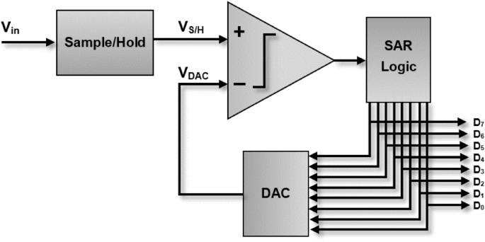
BLOCK DIAGRAM
Contd…

Slide 10
BLOCK DIAGRAM- DESCRIPTION
Sample & Hold (S/H) Block:
Captures input analog signal at clock edges.
Holds sampled value stable during conversion.
MOS switch + capacitor implementation.
Bootstrapped switch reduces distortion and ensures constant on-resistance.
Contd…

Slide 11
BLOCK DIAGRAM- DESCRIPTION
Comparator Block:
Compares sampled input voltage with CDAC output.
Implemented using a dynamic latch comparator.
Operates in reset and regeneration phases.
Very low static power consumption.
Accuracy and offset strongly impact ADC resolution.
Contd…

Slide 12
DESIGN OBJECTIVE
Objective: To design an energy-efficient, 8-bit, 1-MS/s single-ended SAR ADC schematic in 90-nm CMOS for medical applications.
Key design goals:
Resolution: 8-bit – suitable for biomedical signals such as ECG, EMG, etc.
Sampling Rate: 1 MS/s – supports real-time signal acquisition.
Low Power Consumption: Low power for wearable/portable use.
Single-Ended Input: Simplifies front-end design and system integration.
CMOS Technology: Implemented in standard 90-nm CMOS process.
Simulation-Based Verification: All performance parameters validated at schematic level using simulation tools (e.g., Cadence/Spectre).

Slide 13
BLOCK DIAGRAM- DESCRIPTION
Capacitive DAC Block:
Binary-weighted capacitor array.
Uses charge redistribution to approximate input voltage.
Each capacitor switched between Vref and ground.
Determines output step-by-step for each bit.
Low power and good linearity → ideal for biomedical/portable systems.
Contd…

Slide 14
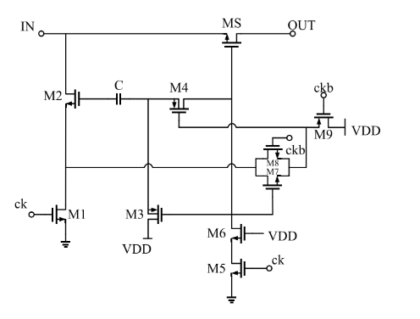
BOOTSTRAP SWITCH SCHEMATIC
Contd…

Slide 15
BOOTSTRAP SWITCH -DESCRIPTION
A bootstrap switch is used in the Sample & Hold circuit to reduce distortion and improve linearity.
The main switch (MS) connects the input signal (IN) to the output (OUT).
A bootstrap capacitor (C) and auxiliary transistors (M1–M9) generate a boosted gate voltage for MS.
When the clock (ck) is active, the bootstrap capacitor charges and drives the gate of MS to IN + VDD, ensuring the switch remains strongly on.
This keeps the on-resistance (Ron) nearly constant, independent of input voltage.
Advantages:
Improved sampling accuracy,
lower distortion, and
wider input range compared to a simple MOS switch.

Slide 16
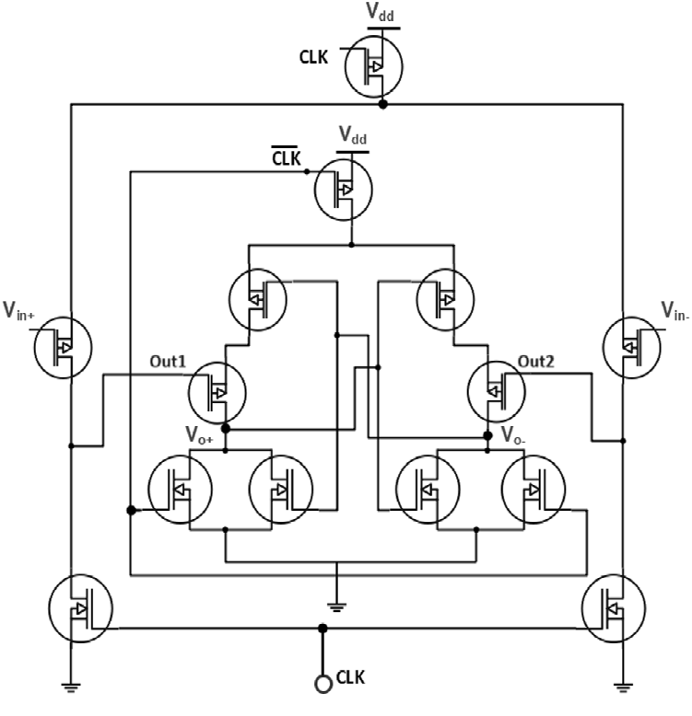
COMPARATOR SCHEMATIC
Contd…

Slide 17
COMPARATOR - DESCRIPTION
A dynamic comparator converts the differential analog input (Vin+,Vin-) into a digital logic output.
The circuit operates in two phases:
Reset Phase (CLK = 0): Internal nodes (Out1, Out2) are precharged; outputs (VO+,VO-) are held low.
Regeneration Phase (CLK = 1): The differential input pair steers current, causing one output node to discharge faster → latch regenerates to full digital levels.
Operation Principle: Positive feedback from cross-coupled inverters rapidly amplifies small voltage differences.
Advantages:
Zero static power → consumes power only during switching.
High-speed operation with strong regenerative action.
Compact and suitable for low-power ADCs.

Slide 18
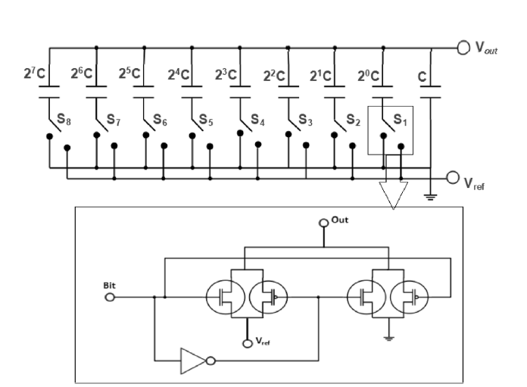
CAPACITIVE DAC SCHEMATIC
Contd…

Slide 19
CAPACITIVE DAC - DESCRIPTION
The CDAC is a binary-weighted capacitor array that generates reference voltages by charge redistribution.
Top plate is connected to the comparator input, while bottom plates are switched between Vref and ground.
Each capacitor value is scaled by powers of 2 (2⁷C … 2⁰C) to represent different bit weights.
During conversion:
The array first samples the input signal.
Then, switches (S1–S8) toggle capacitors to Vref or ground under SAR logic control.
Comparator checks whether Vout is above or below Vin to decide each bit.
Advantages:
Simple architecture.
Low power consumption.
Good matching and linearity → ideal for medium-resolution SAR ADCs.

Slide 20
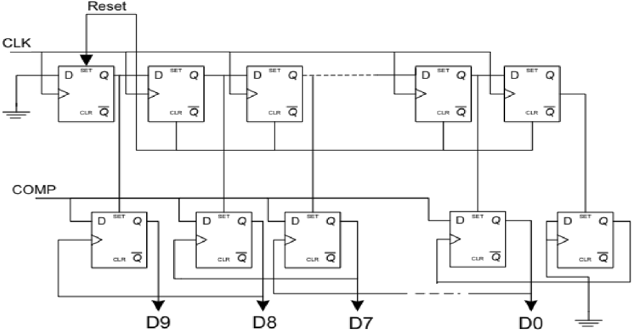
SAR LOGIC SCHEMATIC
Contd…

Slide 21
SAR LOGIC - DESCRIPTION
SAR Logic controls the binary search algorithm of the ADC.
Implemented using D flip-flops and sequential control logic.
Operation:
At the start, the MSB (D9) is set high.
Comparator output (COMP) decides whether to keep or reset the bit.
Clock (CLK) shifts control to the next bit (D8, D7 … D0).
This continues until the LSB (D0) is resolved.
Each decision updates the CDAC and narrows the approximation range.
After N cycles, the digital output (D9…D0) represents the sampled analog input.
Advantages:
Simple sequential operation.
Easy hardware implementation with flip-flops.
Low-power digital control.

Slide 22
Relevance of the Problem Statement w.r.t SDG
SDG 3: Good Health and Well-being
Enables compact, battery-powered medical monitoring devices
Supports remote diagnostics and portable health care systems
SDG 9: Industry, Innovation, and Infrastructure
Encourages innovation in low-power VLSI design for biomedical systems

Slide 23
Analytical and Theoretical Description
SAR ADC Operating Principle
Converts an analog input to a digital output using a step-by-step approximation.
Works like a binary search: one bit is resolved per clock cycle.
The analog input is compared with an internal DAC voltage; based on the comparator’s result, each bit of the digital output is determined sequentially.
Main Functional Blocks
Sample-and-Hold Circuit – Captures and holds the input signal during conversion.
DAC (Digital-to-Analog Converter) – Internally generates reference voltages for comparison.
Comparator – Compares the input signal with the DAC output.
SAR Logic – Controls the sequencing of bit decisions and overall conversion process.
Why SAR for Medical Applications?
Offers low power, medium resolution, and simple design.
Ideal for use in portable and wearable medical devices such as ECG or EEG monitors.
Contd…

Slide 24
Analytical and Theoretical Description
Capacitive DAC
A digital-to-analog converter made using capacitors, operating on charge redistribution.
Converts digital codes into corresponding analog voltages during the approximation process.
Directly impacts accuracy, resolution, and power consumption.
Balanced design ensures stable operation and signal linearity without excessive power.
Comparator
A fast, low-power circuit that decides whether the input voltage is higher or lower than the DAC output.
Activated briefly during each conversion cycle to save power.
Must be designed to operate reliably with small voltage differences and minimal delay.
Design Objectives
Ensure reliable decision-making in each cycle.
Avoid static power consumption.
Minimize offset and noise to maintain ADC accuracy
Contd…

Slide 25
Analytical and Theoretical Description
SAR Logic
A simple control unit that sequences through each bit decision.
Begins with the most significant bit (MSB) and progresses to the least significant bit (LSB).
Updates the DAC code based on comparator feedback after each step.
Power Efficiency Approach
SAR ADCs naturally consume less power due to their event-driven nature.
Only one comparison per bit – no continuous operation of analog components.
Digital control logic and dynamic components (e.g., dynamic comparator) help keep power low.
Suitable for low-voltage operation common in 90-nm CMOS technology.
Summary
The SAR ADC schematic is designed to meet low-power and adequate-resolution requirements for biomedical signal acquisition.
Performance will be verified through simulations, with focus on signal accuracy, conversion speed, and power consumption.

Slide 26
Advantages of the Proposed System
Low Power Consumption – Dynamic comparator eliminates static current, reducing overall power.
Low Delay – Fast regeneration in the comparator ensures quick decision making.
High Sampling Accuracy – Bootstrap switch maintains constant on-resistance, minimizing distortion.
Compact Architecture – Single-ended design reduces circuit complexity and area.
Scalable Design – Architecture can be extended to higher resolutions with minimal modifications.
Application Ready – Well suited for biomedical, IoT, and portable low-power systems.

Slide 27
Applications of the Proposed System
Implantable medical devices (pacemakers, neural sensors).
Wearable electronics (ECG, EEG monitors).
IoT data converters.
Portable data acquisition systems.

Slide 28
SIMULATION SETUP
Tool: Cadence Virtuoso (Spectre)
Technology: 90 nm CMOS
Supply voltage: 0.9V
Clock frequency / Sampling rate : 1 MS/s

Slide 29
Schematics

Slide 30
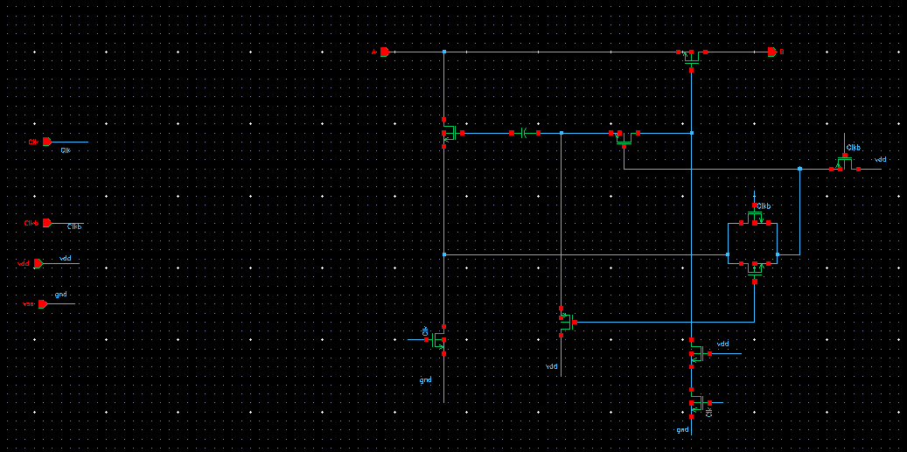
BOOTSTRAP SCHEMATIC

Slide 31
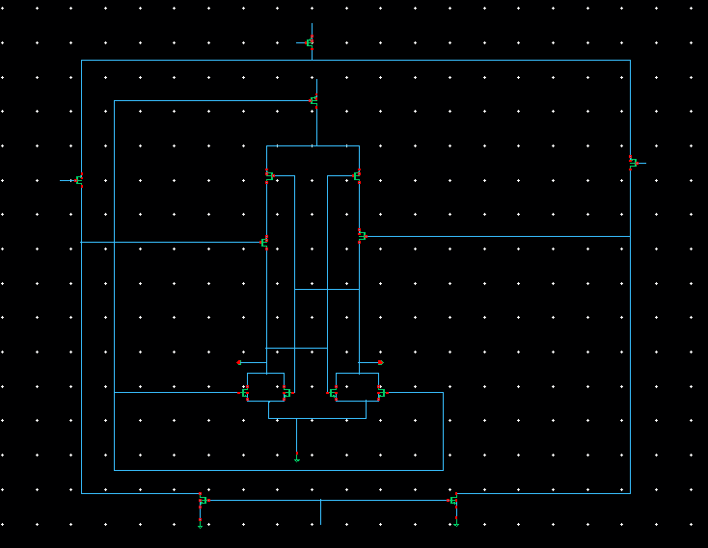
COMPARATOR SCHEMATIC

Slide 32
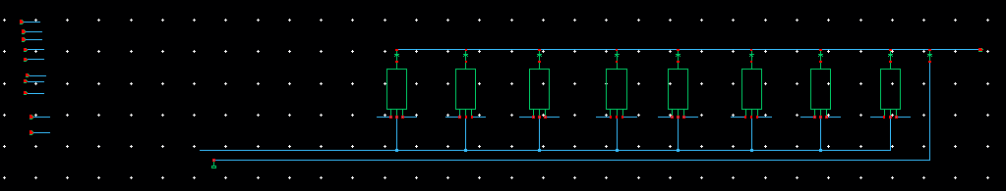
CAPACITIVE DAC SCHEMATIC

Slide 33
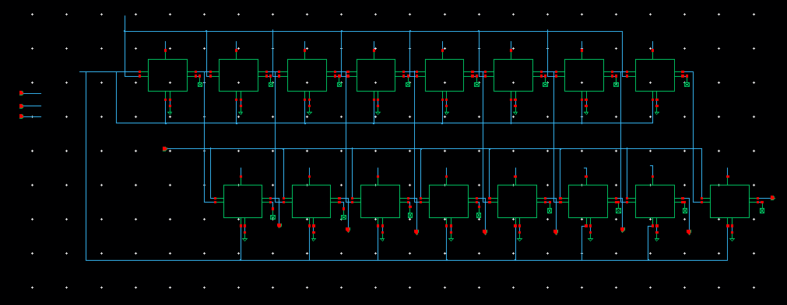
SAR LOGIC SCHEMATIC

Slide 34
RESULTS

Slide 35
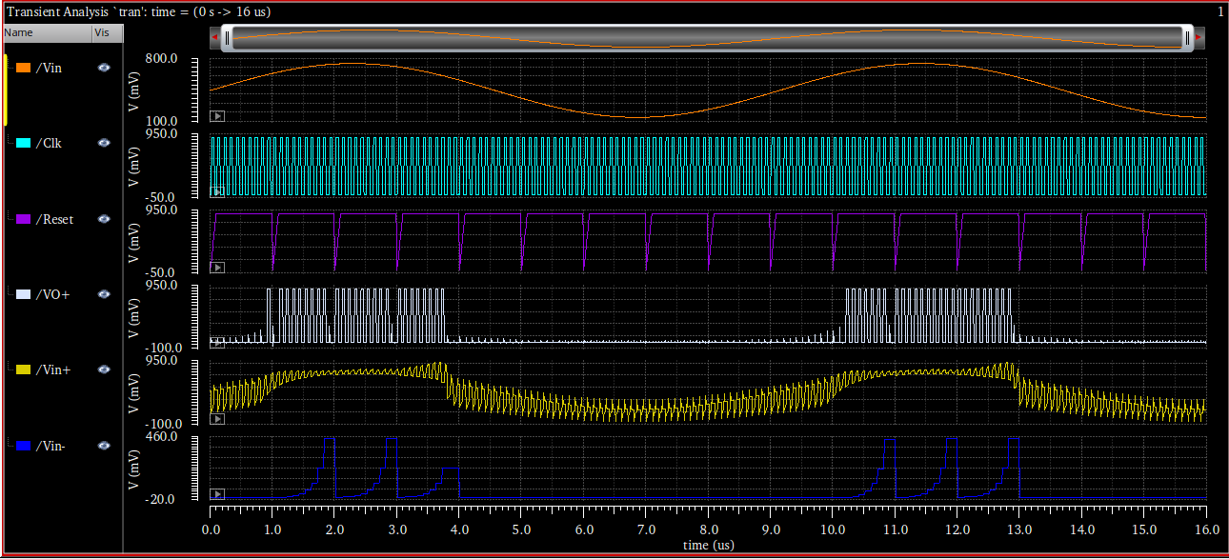
FULL SAR ADC TRANSIENT

Slide 36
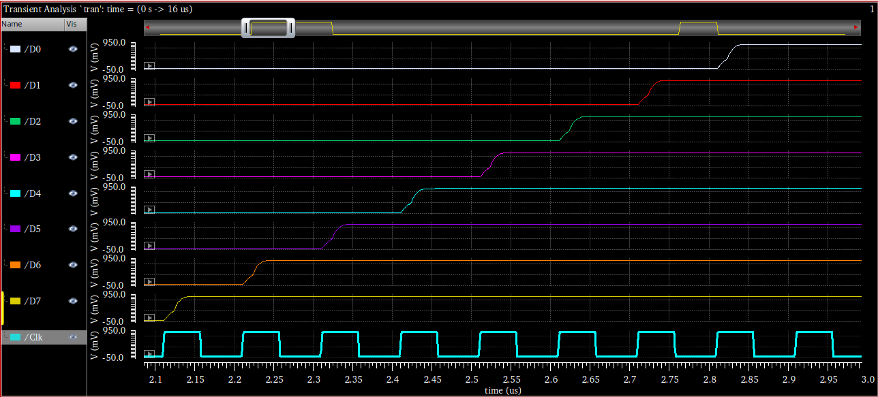
8-BIT OUTPUT CONVERGENCE PER CYCLE

Slide 37
PERFORMANCE METRICS
Measurement | Value
ENOB | 7.342(bits)
SINAD | 45.964(dB)
SNR | 45.964(dB)
SFDR | 50.791(dBc)
Average Power | 1.01486m

Slide 38
DISCUSSIONS

Slide 39
DISCUSSIONS
Reduced Power Consumption:
The use of a dynamic comparator eliminates static current, so power is only consumed during decision-making.
The bootstrap switch lowers on-resistance variation, minimizing switching losses in the Sample & Hold.
Overall, the proposed SAR ADC achieves significantly lower power compared to conventional static comparators.
Contd…

Slide 40
DISCUSSIONS
Single-Ended Architecture:
Simplifies circuit design and reduces capacitor count in CDAC.
Occupies less area and lowers complexity at schematic level.
Well-suited for implantable biomedical devices and IoT sensors where compactness is critical.
Contd…

Slide 41
DISCUSSIONS
Overall Performance:
Simulations validate that the ADC meets design objectives of low power, low delay, and functional correctness.
Results are consistent with reported literature in similar technology nodes.

Slide 42
CONCLUSION
A low-power, 8-bit, 1-MS/s single-ended SAR ADC schematic is being designed using 90-nm CMOS technology, targeting medical device applications such as ECG, EEG, and other bio-signal monitoring systems.
It also promotes innovation in low-power VLSI design for biomedical applications.
In short, my design will help in creating energy-efficient medical devices that can run longer on batteries and provide reliable health monitoring.

Slide 43
Impact of the Project on Society and Environment
Enables low-cost, portable diagnostic devices
Improves accessibility of healthcare in rural areas
Reduces carbon footprint via battery-efficient electronics
Promotes energy-efficient design practices

Slide 44
Future Scope
Include sizing optimization for better accuracy.
Layout design and post-layout verification.
Fabrication and experimental validation.

Slide 45
Possible Outcomes
Research Publication
Potential to publish in student journals, VLSI/EDA symposiums, or biomedical electronics journals.
Focus of publication
Low-power SAR ADC architecture
Power-performance tradeoffs
Simulation-based performance evaluation in 90-nm CMOS

Slide 46
REFERENCES
[1] M. Alioto, et al., “Energy-Efficient SAR ADCs for Low-Power Biomedical Applications: A Survey,” IEEE Trans. Circuits Syst. I, 2020.
[2] Y. Chen et al., “A 10-bit 0.7-µW 1-kS/s SAR ADC for Medical Implant Devices,” ISSCC, 2012.
[3] Y. Zhang et al., “A 0.6V 8b 4MS/s SAR ADC with Adaptive Power Comparator in 90nm CMOS,” IEEE JSSC, 2015.
[4] B. Gosselin et al., “Low-Power Integrated Circuits for Implantable and Wearable Biomedical Devices,” MDPI Sensors, 2011.

Slide 47
THANK YOU

