Slide 1

A project report on
PERFORMANCE OPTIMIZATION OF EFFICIENT PIPELINED TURBO ENCODER AND DECODER
Submitted in partial fulfilment of the requirements for the degree of
Masters of Technology
In
VLSI Design
By
ABHISHEK PATNAIK (23MVD0049)
Under the guidance of
Dr. Prachi Sharma
SCHOOL OF ELECTRONICS ENGINEERING
JULY, 2025

Slide 2
A project report on
PERFORMANCE OPTIMIZATION OF EFFICIENT PIPELINED TURBO ENCODER AND DECODER
Submitted in partial fulfilment of the requirements for the degree of
Masters of Technology
In
VLSI Design
By
ABHISHEK PATNAIK (23MVD0049)
Under the guidance of
Dr. Prachi Sharma
SCHOOL OF ELECTRONICS ENGINEERING
JULY, 2025

Slide 3
DECLARATION
I hereby declare that the thesis entitled “PERFORMANCE OPTIMIZATION OF EFFICIENT PIPELINED TURBO ENCODER AND DECODER” submitted by me, for the award of M.Tech in VLSI DESIGN is a record of Bonafide work carried outby me under the supervision of Dr. Prachi Sharma.
I further declare that the work reported in this thesis has not been submitted and will not be submitted, either in part or in full, for the award of any other degree or diploma in this institute or any other institute or university.
Place: Vellore
Date: 23-07-2025 Signature of the Candidate
Abhishek Patnaik

Slide 4
CERTIFICATE
This is to certify that the MVLD699J - <Dissertation-2> entitled “PERFORMANCE OPTIMIZATION OF EFFICIENT PIPELINED TURBO ENCODER AND DECODER” submitted by ABHISHEK PATNAIK 23MVD0049, School of Electronics Engineering, Vellore Institute of Technology, Vellore, for the award of the degree of M.Tech (VLSI Design), is a record of Bonafide work carried out by him, under my supervision during the period, 13. 04. 2025 to 23.07.2025, as per the VIT code of academic and research ethics.
The contents of this report have not been submitted and will not be submitted either in partor in full, for the award of any other degree or diploma in this institute or any other institute or university. The dissertation fulfills the requirements and regulations of the University and in my opinion meets the necessary standards for submission.
Place: Vellore
Date: Signature of the Guide
Internal Examiner External Examiner
Head of the Department
Department of Micro Nanoelectronics

Slide 5
ABSTRACT
Turbo encoders and decoders play a crucial role in modern wireless communication systems, particularly in 4G and 5G networks, where they provide robust error correction capabilities. While polar codes typically implemented with Successive Cancellation Decoders (SCD) offer benefits such as low decoding complexity and latency due to their limited block length, turbo codes remain highly effective for high-reliability transmission. The Maximum A Posteriori (MAP) and Max-Log-MAP algorithms are commonly employed in turbo coding to enhance decoding performance. This project proposes a pipeline-based architecture for turbo codes, aimed at optimizing throughput and improving overall efficiency in wireless communication environments. By leveraging pipelining techniques, the design achieves reduced latency and increased data processing capabilities, addressing key challenges in next-generation network systems.
i

Slide 6
ACKNOWLEDGEMENT
It is my pleasure to express with deep sense of gratitude to Dr. Prachi Sharma., Associate Professor Grade 1, SENSE Vellore Institute of Technology, for her constant guidance, continual encouragement, understanding; more than all, she taught me patience in my endeavor. My association with her is not confined to academics only, but it is a great opportunity on my part of work with an intellectual and expert in the field of VLSI Design.
I would like to express my gratitude to Dr. G. Viswanathan, Mr. Sankar Viswanathan, Dr. Partha Sharathi Mallick, and Dr. Jasmin Pemeena Priyadarsini M, SENSE, for providing with an environment to work in and for his inspiration during the tenure of the course.
In jubilant mood I express ingeniously my whole-hearted thanks to Dr. Jasmin Pemeena Priyadarsini M,Dean, all teaching staff and members working as limbs of our university for their not-self-centered enthusiasm coupled with timely encouragements showered on me with zeal, which prompted the acquirement of the requisite knowledge to finalize my course study successfully. I would like to thank my parents for their support.
It is indeed a pleasure to thank my friends who persuaded and encouraged me to take up and complete this task. At last, but not least, I express my gratitude and appreciation to all those who have helped me directly or indirectly toward the successful completion of this project.
Place: Vellore
Date: 23-07-25 Name of the student
ABHISHEK PATNAIK
ii

Slide 7
TABLE OF CONTENTS
ABSTRACT
i
ACKNOWLEDGEMENT LIST OF FIGURES
ii v
LIST OF ACRONYMS
vi
1 INTRODUCTION
1.1 Motivation
1
1
1.2 Digital Communication
1.2.1 History of Coding
1.3 Turbo Encoders and Decoders
2
3
3
3
1.3.1 History of Turbo Codes
3
1.3.1 History of Turbo Codes
1.3.2 Turbo Encoder
4
1.3.3 Classification of Concentrated Codes
1.4 Problem statement
6
1.5 Forward Error Correction (FEC) Codes
7
1.5.1 History of Turbo Codes
7
1.6 Motivation of the project
8
1.7 Objective of the project
9
1.8 Scope of the project
9
2 LITERATURE SURVEY
2.1 Turbo codes and Ldpc codes
10
10
2.2 Review Works
12
iii

Slide 8
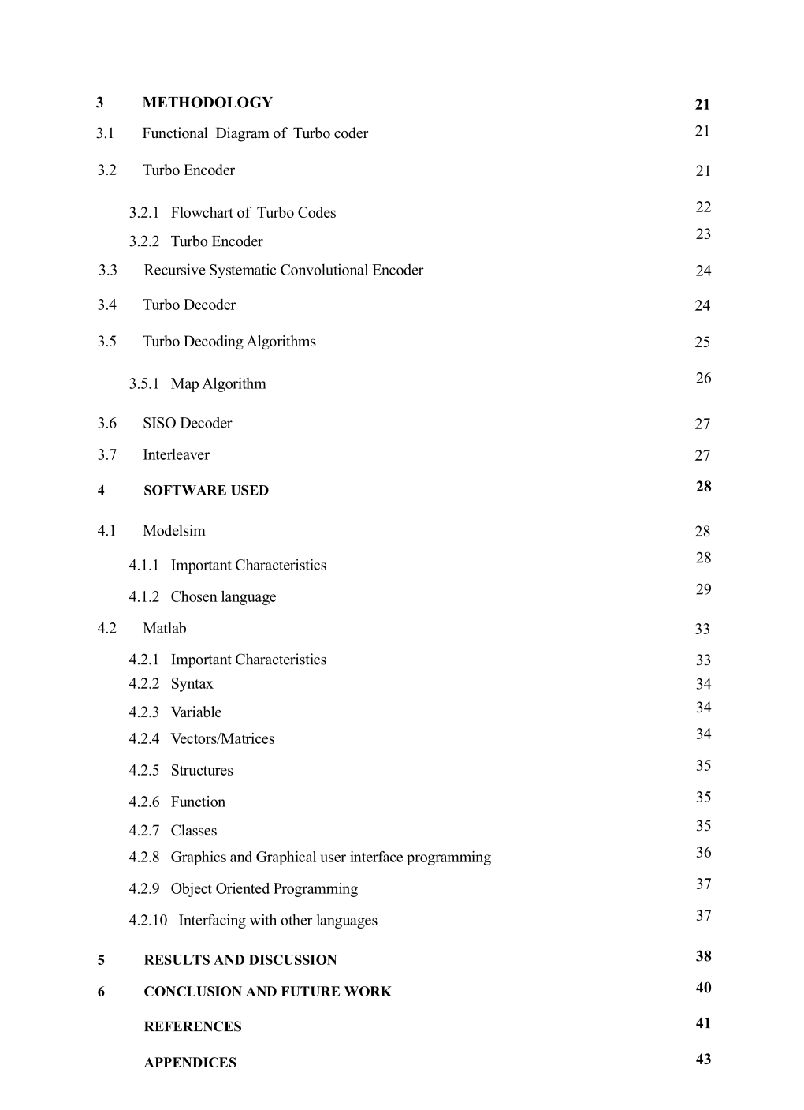
iv

Slide 9
LIST OF FIGURES
1.1 Functional Pattern of Data Communication Sustem
2
1.2 Encoder Structure of PCCCs
5
1.2 Encoder Structure of CCCs
6
3.1 Functional Diagram of Turbo Encoder
21
3.2 Functional Diagram of Turbo Encoder 2
22
3.3 Flow Chart of Turbo Encoder
23
3.4 Functional Diagram of Turbo Decoder
25
3.5 Turbo Decoder Algorithm
26
5.1 Simulation
38
1 Matlab code for Turbo Encoder
43
2 Matlab Output for Turbo Encoder
44
3 Matlab code for Turbo Decoder
45
4 Matlab Output for Turbo Encoder
46
v

Slide 10
LIST OF ACRONYMS
ARQ FEC SNR BER RSC DCS PCCCs SCCCs ECC MAP SISO HCCCs PCCCs LDPC MIMO
Automatic Repeat reQuest
Forward Error Correction
Signal To Noise Ratio
Bit Error Rates
Recursive Systematic Convolutional
Digital Communication System
Parallel Concentrated Convolutional; Codes
Serial Concentrated Convolutional Codes
Error Correcting Code
Maximum A Prostiriori
Soft Input Soft Output
Hybrid Concentrated Convolutional Codes
Parallel Concentrated Convolutional Codes
Low Density Parity Check
Multiple Input Multiple Output
vi

Slide 11
Chapter 1
INTRODUCTION
1.1. MOTIVATION
Today’s world thrives on information exchange. A communication system's core purpose is to transmit information from a source to one or more users through a designated channel. These systems are broadly classified into two types: analog and digital. Analog systems represent information with continuous signals that vary in amplitude and time, often modulating a carrier wave. Digital systems, on the other hand, encode information as discrete, countable sequences of symbols, like binary code. To ensure reliable data transmission in noisy environments, redundancy is added to information bit streams. This can be achieved through Automatic Repeat reQuest (ARQ), where errors are detected and the sender is prompted to retransmit, or through Forward Error Correction (FEC), which allows for error detection and correction without retransmission. While FEC requires a larger bandwidth, it can significantly reduce the Signal to Noise Ratio (SNR) and lower transmission power, which is crucial for extending battery life and minimizing interference in wireless systems.
By increasing codeword length and employing good codes, it's theoretically possible to achieve channel capacity, but finding and implementing such codes in real-time is challenging. Turbo codes, notable for their error-correcting capabilities, enable near-Shannon limit communication with acceptable Bit Error Rates (BER). These codes achieve this by using "soft-input/soft-output" decoding and parallel concatenation of recursive systematic convolutional codes. Turbo codes are constructed by parallel concatenation of two Recursive Systematic Convolutional (RSC) codes, with an interleaver placed between them. This interleaver shuffles the input data before it enters the second RSC encoder, which is crucial for the performance of turbo codes. A key distinction from convolutional codes is that, while convolutional code performance improves with increasing constraint length, turbo codes achieve strong performance even with relatively short constraint lengths. This, combined with their lower coding rate, allows turbo codes to achieve significant coding gains. The "soft-input/soft-output" decoding algorithm, which produces soft decisions, is crucial to this performance advantage.
1

Slide 12
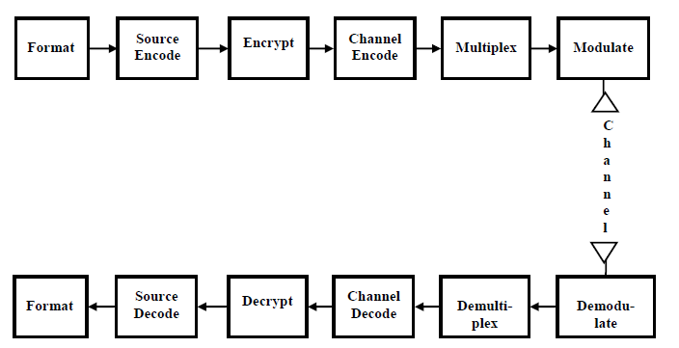
1.2. DIGITAL COMMUNICATION
Recent advancements in Digital Communication System (DCS) design heavily rely on software algorithms rather than specialized hardware. In a typical DCS, digital signal processing is used, offering flexibility and processing capabilities not found in analog systems. The core function of a DCS is to transmit a waveform from a limited set within a specific time frame, whereas analog systems can utilize any waveform. The receiver's task is to identify which of these predefined waveforms was sent.
A typical DCS can be understood by examining its signal flow and processing steps, as depicted in Figure 1.1. This figure would illustrate how information is encoded, modulated, transmitted, received, and decoded, all within the digital domain.
Figure 1.1 Functional Pattern of a Data Communication System
In a Data communication system, signal transformations at the transmitter and receiver end involve a series of processing steps. The information source, initially analog, is converted into bits for compatibility. Redundancy is removed through source coding (quantization and compression).Data privacy and integrity are ensured via encryption, while channel coding adds redundancy for error control. Finally, multiplexing combines signals from different sources for efficient transmission.
2

Slide 13
Digital communications exhibit superior error correction capabilities compared to analog communications due to the nature of their signals and the techniques employed. Digital systems can use error detection and correction codes to identify and fix errors introduced during transmission, whereas analog systems struggle to distinguish between intended signals and noise, making error correction difficult. Data transmission using discrete messages, characteristic of digital signals, offers superior signal processing capabilities compared to analog signals. This is because digital signals, with their defined levels, allow for easier manipulation, error correction, and multiplexing, leading to more efficient and reliable communication systems. Digital systems generally outperform analog systems in terms of data processing speed, cost-effectiveness, and reliability due to their inherent immunity to noise and interference. Turbo codes are indeed utilized in 3G, 4G, and 5G mobile communication systems (Sudheer Kumar Terlapu, 2015). They are a kind of forward error recovery code designed to achieve reliable data transmission over channels with bandwidth and latency limitations, where noise can corrupt the data. These codes are known for their ability to approach the theoretical limits of reliable communication, known as the Shannon limit, under noisy conditions.
1.2.1 HISTORY OF CODING
Digital communication systems are superior to analog systems in their ability to detect and correct errors during transmission. Analog systems generally lack this capability, making them more susceptible to data corruption. This difference arises from the fundamental nature of digital signals, which can be easily manipulated for error checking and correction. This ability stems from the use of error detection and correction codes in digital communication, which add redundant information to the relayed data. This permits a receiver to identify and correct errors caused by noise or interference on the channel. Analog systems, lacking this capability, are more susceptible to errors that can degrade the quality of the received signal.
Forward error correction (FEC) is crucial in system design for data integrity in noisy or unreliable channels, optimizing bandwidth usage, and reducing power consumption. Coding theory, a field pioneered by Claude Shannon, deals with the design of efficient and robust data transmission methods. Shannon's work, particularly the channel coding theorem, is foundational in understanding and implementing FEC.In 1948 Shannon
3

Slide 14
published a groundbreaking paper which showed the maximum, theoretical data rate for which reliable communications could take place [1]. Shannon demonstrated that for an AWGN channel, arbitrarily small error probabilities are achievable when the data rate is below the channel capacity. This result, part of Shannon's groundbreaking work on channel capacity, relies on the concept of jointly typical sequences and random code construction. Specifically, Shannon showed that by using randomly generated codewords and a sub-optimal decoding method, the decoding regions for different codewords overlap minimally, leading to a vanishingly small probability of error. While Shannon's coding theorem proves the existence of codes that can achieve channel capacity, it doesn't provide a method for constructing them. Random codes, while theoretically sound, are impractical due to decoding complexity. Structured codes, though easier to decode, often fall short of the theoretical capacity limit.
1.3. TURBO ENCODERS AND DECODERS
Turbo encoders and decoders are essential components in information transmission systems, enabling reliable data transmission with minimal errors. In the proposed Turbo System, an encoder combines the outputs of two encoders, one processing direct data and the other processing interleaved data, into a single, multiplexed output. Error Correcting Code is a technique used in data transmission to improve reliability by adding redundant data to the original information [1]. This redundancy permits the receiver to identify and fix errors without needing to ask for the data to be resent. Essentially, FEC acts as a built-in error correction mechanism (Sudheer Kumar Terlapu, 2015).
1.3.1 HISTORY OF TURBO CODES
While Shannon's work established the theoretical maximum rate for error-free communication using error-correcting codes, previous coding schemes didn't achieve this limit. In 1993, French scholars introduced a new type of code, turbo codes, which neared this Shannon limit. These codes were developed as a VLSI design project by C. Berry and A. Glove at, France, according to multiple sources.
1.3.2 TURBO ENCODER
Turbo codes, known for their near-Shannon-limit performance, utilize a generic encoder structure with two identical, systematic convolutional encoders separated by an
3

Slide 15
an interleaver. These codes are linear, meaning the modulo-2 addition of either of the two codewords remains a valid codeword. A good linear code, like a turbo code, typically has a high proportion of high-weight codewords, which are those containing a large number of "1"s. The Hamming weight of a codeword is the number of non-zero elements (or 1s) in the codeword. Therefore, the Hamming weight of '000' is 0, as it contains no 1s. The Hamming weight of '101' is 2, as it has two 1s.High-weight codewords are preferable because their increased distance from other codewords makes them easier for a decoder to differentiate. While some low-weight codewords are unavoidable, they should be kept to a minimum to maintain good error detection and correction capabilities. In essence, turbo codes combine the principles of linear codes, systematic encoding, recursive convolutional encoders, and interleaving with an iterative decoding strategy to achieve near-optimal error correction performance.
In error correction coding, an interleaver is crucial for improving performance. It shuffles the order of bits before encoding by a second encoder, preventing both encoders from producing low-weight outputs simultaneously. This "interleaver gain" increases reliability through reduced error rates. Additionally, it ensures that the outputs of the two encoders are uncorrelated, which enhances iterative decoding by providing more reliable information exchange between decoders[1]. Common interleaver types include row-column, helical, and odd-even interleavers.
Turbo codes leverage three key ideas: parallel or serial concatenation of codes to simplify the translation process, rendering to improve the allocation of code weights, and soft decoding to enhance decoder decisions and maximize gains from incremental decoding. These techniques allow turbo codes to achieve optimal data transmission with practical complexity.
1.3.3 CLASSIFICATION OF CONCENTRATED CODES
Concatenated codes, used in error correction, are broadly categorized into Parallel Concatenated Convolutional Codes (PCCCs) and Serial Concatenated Convolutional Codes (SCCCs). These codes enhance error correction capabilities by combining simpler codes in either a parallel or serial fashion. PCCCs employ two encoders operating on the same data, while SCCCs link encoders serially. The term "turbo code"
4

Slide 16
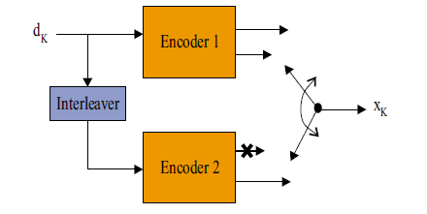
is commonly linked with PCCCs, and for the rest of this document, "turbo code" will also be referred to PCCCs.
Parallel concatenated convolutional codes (PCCCs), or turbo codes, use multiple input bits simultaneously, increasing throughput separated by pseudo-random interleavers. Systematic encoding is chosen because it simplifies puncturing the systematic bits of the second encoder. While feedforward systematic convolutional codes have poor distance properties, RSC codes (which are feedback or recursive) do not, making them ideal for turbo codes. PCCCs prioritize minimizing low Hamming-weight codewords rather than maximizing free distance, and interleavers help prevent both encoders from simultaneously producing low-weight parity sequences, achieving excellent performance, even when those constituent codes have relatively small free distances.
Serial concatenated convolutional codes (SCCCs) and Parallel concatenated convolutional codes (PCCCs) both utilize the same fundamental convolutional encoders as their constituent components[2]. However, a key distinction lies in how these encoders are connected. In SCCCs, the encoders are linked serially, meaning the result of one encoder feeds into the input of the next, with a pseudo-random interleaver placed between them. This interleaver scrambles the data bits before they are encoded by the second encoder, which is a characteristic feature of SCCCs. Figure 1.2 and Figure 1.3 depicts the encoder structures for PCCCs and SCCCs.
Figure 1.2 Encoder Structure of PCCCs
5

Slide 17

Figure 1.3 Encoder Structure of SCCCs
Serially-Concatenated Convolutional Codes (SCCCs), investigated by Forney in [2], offer a performance advantage over Parallel Concatenated Convolutional Codes (PCCCs) because their error rate decreases more rapidly as the frame size (N) increases. Specifically, SCCCs don't suffer from as shallow an error floor as PCCCs, according to studies. While the outer code in an SCCC doesn't need to be recursive, the inner code must be recursive to leverage this interleaver gain. In PCCCs, the interleaver's gain is typically limited to N-1, where N is the frame size. SCCCs, on the other hand, exhibit a diminishing slope in their Bit Error Rate (BER) curves as N increases, indicating a greater reduction in errors with larger frame sizes.The error floor refers to the point on the BER curve where further increases in signal-to-noise ratio no longer significantly improve error rates. SCCCs' steeper BER curves, due to the continued reduction in slope with increasing N, mean they reach a lower error floor than PCCCs.The recursive nature of the inner code is crucial for SCCCs to achieve this interleaver gain[2]. It allows for the iterative decoding process to effectively exploit the interleaver's reordering of the data. The outer code, however, doesn't have this same constraint.
1.4. PROBLEM STATEMENT
As technology advances and the number of users grows rapidly, data transmission between systems becomes increasingly vital, but this surge also leads to significant challenges in digital communication due to data corruption. To address this issue, telecommunications employ error correcting codes, and one of the most recognized and effective algorithms for decoding convolutional codes is the Turbo algorithm. This algorithm's dual implementation capability – both in software and hardware – enables efficient and reliable data transmission, particularly in challenging, noisy environments. Its ability to handle data transmission and error correction ensures robust communication.
6

Slide 18
1.5. FORWARD ERROR CORRECTION (FEC) CODES
Forward Error Correction (FEC) codes are crucial for efficient spectrum utilization in modern communication systems. FEC adds redundant data to the relayed information enabling the receiver to identify and rectify errors during transmission without needing to request retransmission, thus improving reliability and spectral efficiency. Claude Shannon's work established theoretical limits for channel coding and modulation. While it was theoretically proven that reliable communication with data rates below channel capacity is possible using error correcting codes (ECC), the initial work didn't provide practical construction methods. Since then, coding theorists have focused on creating codes that achieve near Shannon capacity limits. However, many proposed powerful ECCs had complex decoding algorithms, making their hardware implementation challenging. Recent advances in high-performance Very Large Scale Integration (VLSI) technologies have successfully addressed the challenges associated with implementing complex digital architectures. These advancements have enabled the efficient hardware realization of sophisticated systems and architectures. VLSI's ongoing progress has made it possible to overcome previous limitations and create more powerful and compact electronic devices. Hence High throughput, low latency, and energy-efficient data communication can be achieved by carefully exploring the design space, particularly in the development of decoders that approach the Shannon limit. The growing demand for these features from emerging data communication services poses significant design challenges.
1.5.1 ADVANTAGE OF FEC
The primary advantage of Forward Error Correction (FEC), as described by (Sudheer Kumar Terlapu, 2015), is its ability to mitigate errors during data transmission without requiring retransmissions. This is particularly beneficial in scenarios where retransmissions are difficult or impossible, or when they introduce significant delays. While FEC enhances reliability, it does so at the expense of increased bandwidth usage. The encoded output may or may not include the original information, but the redundancy added by FEC allows for error correction at the receiver. Turbo codes are a well-known example of FEC techniques.
7

Slide 19
1.6. MOTIVATION OF THE PROJECT
Claude Shannon's 1948 work on reliable communication over noisy channels revolutionized the field. His Noisy Channel Coding Theorem proved that reliable communication is possible, even in the presence of noise, as long as the transmission rate remains below the channel's capacity[2]. This groundbreaking concept spurred significant research, particularly in the 1980s and 90s, leading to practical advancements in coding methods like binary convolutional and block codes, soft decoding, and iterative decoding techniques. These advancements have had a profound impact on various communication technologies, including wireless, satellite, and space communication.Following Shannon's work on error-correcting codes, research focused on creating practical codes with strong error-correction and efficient decoding. In 1993, turbo codes, a random-like code with efficient iterative decoding, were introduced. These codes achieve near-optimal error-rate performance, within 1 dB of the Shannon limit, according to some researchers. Berrou et al. pioneered the development of turbo codes in 1993. A key characteristic of turbo codes is the use of concatenated constituent codes, linked by a pseudo-random interleaver. This interleaver scrambles the data before it's encoded by the second constituent code, which helps spread errors and improve the code's performance in noisy channels [3]. In the context of turbo codes, the decoding process relies on constituent decoders that are either Maximum A-Posteriori (MAP) or Soft-Input Soft-Output (SISO) in nature. These decoders operate iteratively, exchanging crucial information to refine their estimations of the transmitted data. Major influential-resources on random-like codes and iterative decoding are reported in [3]. Benedetto et al.[3] provide a strong theoretical basis for the near-optimal error-rate performance of turbo codes in their work, cited as references and this work helps to explain why turbo codes achieve performance close to the theoretical limit, particularly in their ability to achieve near-optimal error rates through iterative decoding.
The project's core motivation is to delve into turbo codes, exploring their modeling using computation models and optimizing their implementation for both encoding and decoding. A key challenge is the iterative decoding process in turbo decoders, which
8

Slide 20
contributes to latency. Therefore, efficient implementation is crucial for real-time applications, making it an active research area, according to research papers.
1.7. OBJECTIVE OF THE PROJECT
The primary goal of this project is to design and implement a Turbo encoder and decoder to improve the reliability of data transmission. This involves creating a system that can effectively correct errors introduced during transmission, enabling the accurate retrieval of the original message. The project also aims to optimize the decoding process by minimizing the number of iterations required for error correction.
1.8. SCOPE OF THE PROJECT
The project scope is to implement turbo encoder and decoder architectures, specifically using serial and pipeline designs to achieve improved efficiency in communication systems.
9

Slide 21
Chapter 2
LITERATURE SURVEY
2.1. TURBO CODES AND LDPC CODES
Concatenated codes, pioneered by Forney[4] , combine simpler codes to achieve high coding gain with manageable complexity, particularly in power-limited channels. Serial concatenations, like the combination of Reed-Solomon and convolutional codes, are common[4]. A key development in decoding algorithms for error-correcting codes came in 1992 when John Lodge and colleagues proposed a solution that achieved good performance using iterative decoding with soft-input/soft-output (SISO) decoders[4]. While conventional decoding methods were inadequate, iterative decoding with soft-input/soft-output decoders, as seen in Turbo codes (two recursive convolutional encoders with an interleaver and iterative APP decoding), significantly improved performance. Turbo codes, introduced by Berrou et al.,[4] achieved near-Shannon-limit bit error rates. Product codes, introduced by Elias[9], also offer burst and random error correction capabilities.
In 1974, Bahl, Cocke, Jelinek, and Raviv applied the Maximum A Posteriori Probability (MAP) algorithm [5] to symbol-by-symbol detection of coded sequences. This algorithm, often referred to as the BCJR algorithm, gained prominence in the research community, particularly after the invention of turbo codes.
Following the introduction of turbo codes (Parallel Concatenated Convolutional Codes, PCCCs), Serial Concatenated Convolutional Codes (SCCCs)[5] and Hybrid Concatenated Convolutional Codes (HCCCs) were developed as concatenated codes, offering comparable or even superior error correction capabilities compared to PCCCs[5]. These codes leverage the principle of combining simpler codes to achieve improved performance, particularly in terms of coding gain. At high signal-to-noise ratios, Serial Concatenated Convolutional Codes (SCCCs) and Hybrid Concatenated Convolutional Codes (HCCCs) can achieve better performance than Parallel Concatenated Convolutional Codes (PCCCs) due to their superior distance profile. Beyond binary convolutional codes, other codes like non-binary convolutional codes
10

Slide 22
and block codes (e.g., Hamming, Reed-Muller (RM), and Reed-Solomon (RS) codes) can also be used as constituent codes in concatenated coding schemes.
Gallager's LDPC codes[6], a class of linear block codes, have gained significant attention due to their performance, particularly when combined with iterative message-passing decoding algorithms. These codes, initially proposed by Robert Gallager, offer performance comparable to, and sometimes exceeding, turbo codes, especially with the advancements in computing power and the development of iterative decoding techniques. The extension of Gallagher's density evolution method has been crucial for analysing these decoders and designing powerful LDPC codes. A technique exists to determine a threshold for LDPC codes derived from specific bipartite graphs. This threshold, when translated to a minimum signal-to-noise ratio (SNR), indicates the SNR level above which message-passing decoding will likely succeed for most codes within that LDPC ensemble according to research on LDPC codes[7]. Essentially, it defines the performance limit for a family of LDPC codes based on their graph structure. Optimized graph structures for error-correcting codes can achieve thresholds that are very close to the theoretical Shannon capacity limit, and simulations with long block lengths demonstrate excellent code performance near these thresholds. This indicates that these graph-based codes are highly efficient, approaching the theoretical best achievable performance for a given channel[7].
The iterative decoding principle used in turbo codes and LDPC codes is a powerful concept with broad applications in communication theory, extending beyond just decoding these specific codes. This principle, involving the exchange of soft information between decoding components, is recognized for its ability to achieve near-Shannon limit performance in various communication scenarios. The "turbo principle" in communication systems [7] refers to the iterative exchange of soft information between different blocks within a receiver to improve overall system performance. This principle is fundamental to the success of turbo codes, which are a type of forward error correction code known for their high coding gains. The iterative decoding process refines estimates of the transmitted data by passing soft information (probabilities) between constituent decoders.
11

Slide 23
2.2. REVIEW WORKS
Turbo Codes (TCs), introduced by Berrou in 1993, are Parallel Concatenated Convolutional Codes (PCCC) and are a type of Forward Error Correcting (FEC) code. They are known for their near-optimal performance, approaching the Shannon limit for data transmission, and are used in various communication systems. These communication technologies[7] are valued for their ability to operate close to Shannon's capacity limit, making them suitable for supporting various standards.
Forward Error Correction (FEC) is indeed a crucial technique in modern high-performance communication systems. It enables the detection and correction of transmission errors, allowing systems to approach the theoretical limits of reliable data transfer, often referred to as the Shannon limit. By adding redundant data to the original message, FEC allows the receiver to identify and fix errors without needing to request retransmissions, improving efficiency and reliability[7].
Turbo coding/decoding [8] is a powerful technique in channel coding known for its ability to achieve performance close to the theoretical Shannon limit, making it a promising approach for improving communication reliability. However, this enhanced performance [8] comes at the cost of increased complexity in the encoding and decoding processes. Turbo codes, a powerful type of error-correcting code, are widely adopted in various communication standards due to their ability to achieve near-optimal performance with relatively low decoder complexity [8], [9], [10]. Turbo codes, a powerful error-correcting code, are built on the principle of concatenating two simple convolutional encoders, often using Recursive Systematic Convolutional (RSC) codes, and employing an iterative decoding algorithm. This approach achieves impressive error correction performance, approaching the Shannon limit, without the need for complex encoders with numerous shift registers [10].
In satellite communication systems, the combination of turbo decoding and Frequency-Hopped Spread Spectrum (FH-SS) has been studied in [10], demonstrating improved performance compared to dynamic power allocation schemes. Specifically, a modified iterative algorithm for channel variance and carrier phase estimation, known as "side
12

Slide 24
information," offers superior error rate reduction [11]. Further enhancements are achieved through the use of turbo trellis coded modulation and continuous phase modulation in frequency-hopping packet radio [12]. Additionally, Turbo-Hadamard coding methods have shown promise in achieving high throughput [13].
Akshaya et al. (2020) proposed a VLSI architecture for Turbo decoders that utilizes a soft-in-soft-out decoder, interleaver, and deinterleaver employing the MAP algorithm on the decoder side. The encoder uses two Recursive Convolutional Encoders and a pseudorandom interleaver. The system, implemented in Application Specific Integrated Circuits (ASICs), was designed and simulated using Octave, Xilinx Vivado, and Cadence tools. Timing analysis is performed, and a GDSII file is generated.
A low-memory turbo decoder architecture based on reverse calculation, trellis partitioning, and simplification of the max* operator has been proposed by Zhan et al. (2021),to reduce power consumption in power-constrained applications like LTE. This design merges forward state metrics calculation with two existing decoding schemes and significantly reduces the state metrics cache capacity and power dissipation when implemented on an FPGA, without impacting decoding performance. The reverse calculation method proves effective for improving decoding performance in energy-limited applications.
Kumar et al. (2020), introduced a Turbo encoder as a part of an in-vehicle system (IVS) chip using a Field Programmable Gate Array . They explored both serial and parallel computation methods for the encoding, finding that the parallel approach significantly improved both chip size and processing time, with a 73% increase in logic utilization and a 58% reduction in processing time. The module was designed, simulated, and synthesized using Xilinx tools, and implemented on a Xilinx Zynq-7000 FPGA.
Weith et al. in (2020) [13], explored high-throughput Turbo decoder implementations. They demonstrated a functional parallelization approach at the iteration level, achieving throughputs exceeding several hundred Gb/s in 28 nm technology. Their work also investigated spatial parallelization within fully pipelined, iteration-unrolled decoders using X-windows of size 32, resulting in a 40% area reduction. Further analysis
13

Slide 25
explored area savings with reduced X-window sizes and how area complexity and throughput scale with frame sizes. They maintained a constant target bit error rate across different frame sizes, highlighting the direct relationship between area and error rate.
Tanriover et al. (2002) enhances the performance of turbo codes by making their weight spectrum more closely resemble the ideal random code, leading to better error correction capabilities. The proposed technique aims to bridge the gap between the theoretical ideal of a random code with a binomial weight distribution and the practical implementation of turbo codes by strategically designing the encoder and interleaver.
Yaqin Shi et al. (2018) designed and implemented a memory-reduced LTE-Advanced Turbo decoder on a field programmable gate array (FPGA). By incorporating a reverse recalculation module, they significantly reduced the state metric cache size (by 50%) compared to conventional Turbo decoders. This approach also led to notable power savings; the proposed decoder's power consumption was reduced by 24%, 29.7%, and 31% at 50MHz, 75MHz, and 100MHz, respectively, compared to a Max-Log-MAP decoder. Furthermore, the reverse calculation method exhibited only a minor degradation in bit error rate (BER) performance compared to the optimal Log-MAP algorithm.
Paidmalla et al. (2021) implemented an turbo encoder and decoder with reduced hardware resources while maintaining high throughput. Turbo coding is a powerful error-correcting technique, commonly used in communication systems. The study focused on improving turbo code implementation for higher data rates and reduced area and delay, particularly within the context of wireless communication standards like 3G and 4G. The statement describes a historical limitation of early polar code implementations. Specifically, the use of 8-bit polar codes restricted the decoding process due to the iterative nature of the algorithm, which hindered the ability to achieve high data rates. Furthermore, these early implementations had a significant drawback in terms of decoding accuracy.Hence,this research focuses on developing a high-speed, area-efficient, and low-delay 64-bit turbo encoder and decoder system implemented in an Application Specific Integrated Circuit (ASIC). The proposed system, by utilizing a 64-bit architecture, aims to achieve higher data compilation rates compared to existing
14

Slide 26
systems, while also reducing both the area footprint and latency of the implementation on the ASIC. The comparison with existing systems demonstrates the proposed system's effectiveness in terms of delay and area. The research by Paidmalla et al. addresses the need for efficient turbo code implementation in communication systems. Turbo codes, known for their excellent error-correction capabilities, are crucial for maintaining reliable data transmission, especially in challenging wireless environments.
Rangachari et al. (2020), introduced a novel state encoding and memory block organization to significantly reduce energy consumption in turbo decoders. When combined with early termination strategies, this approach achieves a 10-20% reduction in energy per decoding operation.
V. Kavinilavu1, S. Salivahanan, V. S. Kanchana Bhaaskaran2, Samiappa Sakthikumaran, B. Brindha and C. Vinoth(2011), proposed a Viterbi decoder, employing the Viterbi algorithm, to decode bitstreams encoded with convolutional codes using Forward Error Correction (FEC). This implementation utilizes Verilog HDL for a convolutional encoder and Viterbi decoder, both with a limited length of 7 and a code rate of 1/2. The design is simulated and synthesized using Modelsim and Xilinx tools, respectively. The core idea is to leverage the Viterbi algorithm's maximum likelihood detection capability to recover the original data stream from the received, potentially corrupted, encoded sequence.
This project Tepoju Vivek Vardhan et al. (2015), implements a Turbo codec, utilizing Verilog-HDL for both the encoder and decoder, and then validates the design on FPGA. The Turbo decoder employs a Viterbi algorithm with hard-input and hard-output, and is designed to correct two-bit errors in the encoded data. The process involves introducing errors in the encoded data to evaluate the error-correction capabilities of the decoder.
Ali, Amer T., and Dhafir Abdul Fatah Alneema (2020) [13], introduced a novel turbo decoder design leveraging a single MAP decoder, exploring both parallel and non-parallel implementations using the HLS tool with various window techniques. They evaluated these designs across different frame sizes, analyzing latency and resource
15

Slide 27
utilization, and found that the new design offers better performance and resource management compared to prior approaches.
A new computational method for the max-log Maximum A Posteriori (MAP) core is proposed by Arash Ardakani, Mahdi Shabany (2015), to enhance the hardware efficiency of turbo decoders used in LTE and LTE Advanced standards. This involves optimizing the max* operator approximation for better performance and reduced hardware complexity. The proposed method offers a more efficient computation for max-log MAP architectures, leading to reduced area and power consumption, and increased throughput in a case study implementation, without compromising performance (BER). The research involved implementing a max-log MAP architecture using both a conventional method and the proposed method to permit for a fair comparison. The output demonstrated that the proposed method significantly improved the efficiency of the max-log MAP architecture.
The authors, Claude Berrou et al. (2005) discusses the maturation of Turbo Codes as a technology widely adopted in commercial transmission systems. The paper offer a general outline of the fundamental concepts behind both Convolutional and Block Turbo Codes, and reviews significant advancements in the field, with a focus on practical aspects like functional difficulties and high-rate circuit design. It also examines the utilization of these codes in the present standards and explores their potential future applications in error-control coding.
This research paper (2019), by Aswathy Narayanan, Senthil Murugan, and Ramesh Bhakthavatchalu explores how the choice of multiplier implementation within a Max log MAP algorithm-based turbo decoder significantly impacts its decoding performance, as different multiplier types like fixed-point, Vedic, and Booth multipliers lead to varying levels of efficiency and accuracy due to advancements in processing technology.
In scenarios where power efficiency is paramount, such as within the Max Log MAP algorithm, fixed-point multipliers are often avoided due to their high power consumption. Instead, Vedic multiplier-based implementations are favored for their lower latency, despite potentially requiring more area. However, in highly resource-
16

Slide 28
utilization, and found that the new design offers better performance and resource management compared to prior approaches.
A new computational method for the max-log Maximum A Posteriori (MAP) core is proposed by Arash Ardakani, Mahdi Shabany (2015), to enhance the hardware efficiency of turbo decoders used in LTE and LTE Advanced standards. This involves optimizing the max* operator approximation for better performance and reduced hardware complexity. The proposed method offers a more efficient computation for max-log MAP architectures, leading to reduced area and power consumption, and increased throughput in a case study implementation, without compromising performance (BER). The research involved implementing a max-log MAP architecture using both a conventional method and the proposed method to permit for a fair comparison. The output demonstrated that the proposed method significantly improved the efficiency of the max-log MAP architecture.
The authors, Claude Berrou et al. (2005) discusses the maturation of Turbo Codes as a technology widely adopted in commercial transmission systems. The paper offer a general outline of the fundamental concepts behind both Convolutional and Block Turbo Codes, and reviews significant advancements in the field, with a focus on practical aspects like functional difficulties and high-rate circuit design. It also examines the utilization of these codes in the present standards and explores their potential future applications in error-control coding.
This research paper (2019), by Aswathy Narayanan, Senthil Murugan, and Ramesh Bhakthavatchalu explores how the choice of multiplier implementation within a Max log MAP algorithm-based turbo decoder significantly impacts its decoding performance, as different multiplier types like fixed-point, Vedic, and Booth multipliers lead to varying levels of efficiency and accuracy due to advancements in processing technology.
In scenarios where power efficiency is paramount, such as within the Max Log MAP algorithm, fixed-point multipliers are often avoided due to their high power consumption. Instead, Vedic multiplier-based implementations are favored for their lower latency, despite potentially requiring more area. However, in highly resource-
17

Slide 29
number of bits in a block and their code rates. The study found that while both codes achieve high efficiency and approach Shannon capacity, Turbo codes generally offer a stronger error-correcting capability compared to Polar codes. The research concluded that both Turbo and Polar codes are effective in achieving performance close to the theoretical Shannon capacity, but Turbo codes exhibit a superior error-correcting capability compared to Polar codes, according to the study.
Shrimali, Yanita et al. (2021) designed a turbo-coded MIMO-OFDM system architecture that prioritizes high throughput and low complexity. They achieved this by integrating an efficient Log-MAP turbo encoder/decoder and a pipelined FFT processor. Specifically, a single delay feedback-based pipelined memoryless FFT/IFFT processor contributed to enhanced area and power efficiency, while the Log-MAP turbo decoder enhanced speed and error correction capabilities. The proposed system's efficiency was validated through simulations utilizing Xilinx ISE Design Suite and comparison with existing leading-edge architectures.
Verma, Anuj et al. (2020) introduced a VLSI architecture for a quasi-cyclic LDPC decoder that processes log-likelihood ratios (LLRs) from a soft demodulator. This decoder, designed for 5G New Radio, achieves a BER of 10^-6 between 2-4 dB Eb/N0 with 10 iterations for different code rates (1/3, 2/5, 1/2, 2/3, 3/4, 5/6, and 8/9). It was prototyped on an FPGA and demonstrated lower hardware utilization compared to existing designs, with claims of being the first VLSI architecture for 5G eMBB LDPC decoding. A VLSI architecture designed for decoding quasi-cyclic Low-Density Parity-Check (LDPC) codes, prevalent in 5G New Radio, processes log-likelihood ratios (LLR) from the soft demodulator to recover the original data. These LLRs, representing the likelihood of each bit being 0 or 1, are the input to the decoder, which then performs calculations on the data, referred to as "CARs", to achieve error correction and data recovery. The proposed architecture is designed for the enhanced Mobile Broadband (eMBB) service class within 5G, which requires high data rates and reliability. The decoder achieves a bit error rate (BER) of 10^-6 at a signal-to-noise ratio (SNR) between 2 and 4 dB with 10 decoding iterations for different code rates. Furthermore, the design was implemented on an FPGA, a type of programmable hardware, and its performance was compared to other existing LDPC decoder designs. The results showed that the new architecture achieved lower hardware utilization, specifically up
18

Slide 30
to 87% less hardware usage. This work is notable as it is the first reported VLSI architecture for a 5G New Radio compliant LDPC decoder specifically designed for eMBB services.
Le Gal et al. (2020), introduced a novel distributed processing for turbo decoders on x86 multi-core processors, achieving high throughput and reduced delay. Compared to existing CPU and GPU implementations, their method demonstrates a significant reduction in processing latency (50x) and energy consumption (2x), alongside a 1.5 to 2 times increase in throughput. This improvement is achieved through optimized parallelization strategies tailored for x86 architectures.
Dheeb et al. (2020), presented a novel LTE turbo decoding implementation utilizing the Log-MAP algorithm, achieving a 75% reduction in required cycles through serial-to-parallel conversion and further optimized with polynomial regression for complexity reduction. The system was designed with a 40-bit input block size and implemented using Xilinx System Generator (XSG) with both Hardware Co-Simulation and HDL Netlist approaches on Xilinx Kintex-7, Spartan-6, and Artix-7 devices.
Boudaoud et al. (2020) [12], investigated the impact of adding a Turbo-type channel decoder to an Alamouti MIMO (Multiple-Input, Multiple-Output) system. Specifically, they analyzed the performance of two Alamouti OSTBC (Orthogonal Space-Time Block Code) structures: a 2x1 (2 transmit, 1 receive antenna) and a 2x2 (2 transmit, 2 receive antennas). The turbo decoder, based on Difference Set Codes-One Step Majority Logic Decodable, improved the Bit Error Rate (BER) performance compared to systems without the decoder. Adding a single receiving antenna to the 2x1 structure provided a 1 dB gain, while the turbo decoder itself offered a 5.5 dB gain at the first iteration.
19

Slide 31
According to Joseph, Senoj et al. (2021), in a communication system, an error might occur at the recipient end when text is read from intermediate nodes, and Turbo codes are employed to recover the original transmitted data due to their high error-correcting power as opposed to other codes; Turbo codes are utilized in various applications, including NASA space communication, and consist of an encoder with two recursive convolutional encoders and an interleaver.
Salija, P. (2020) introduced a novel reliability-based decoding algorithm for short block length turbo codes, achieving a 2.45 dB coding gain at a BER of 10⁻³ and lower computational difficulty than conventional methods. This combination of improved performance and reduced complexity makes the algorithm highly appealing for practical applications. The algorithm leverages reliability information from the demodulator, enabling it to perform better, especially with short block lengths where conventional algorithms struggle. The algorithm's channel adaptive complexity demonstrated to achieve 82% decreasing decoding time at 3 dB SNR for a rate 1/4 code, making it suitable for resource-constrained environments.
A novel algorithm called the local soft-output Viterbi algorithm has been proposed by Le et al. (2020), specifically designed for reduced-complexity, high-radix turbo decoding. This algorithm leverages the forward and backward state metric recursions of the Max-Log MAP (MLM) algorithm while producing soft outputs using update rules. The local SOVA offers a reduction in computational complexity compared to MLM for high-radix decoding, with equivalent error correction performance in turbo decoding and the potential for complexity-performance trade-offs through simplifications. The proposed local State Output Value Algorithm uses the same forward and backward state metrics as the conventional Max-Log-MAP algorithm, generating soft outputs via update rules. This approach achieves reduced functional difficulties than the Max-Log-MAP, particularly beneficial for high-radix decoding to improve throughput, while maintaining the same error correction performance, even within a turbo decoding framework.
20

Slide 32
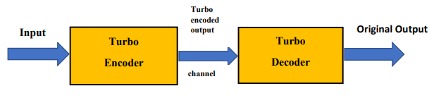
Chapter 3
METHODOLOGY
3.1. FUNCTIONAL DIAGRAM OF TURBO CODER
A fundamental turbo coding system depicted in Fig 3.1, incorporates a turbo encoder and a turbo decoder, with a channel connecting the two. The encoder transforms input data into a coded format, which is then sent through the channel. The decoder receives the coded data, and using an iterative MAP algorithm, it decodes the data, removing errors and aiming to retrieve the original input, potentially with fewer iterations than a non-iterative approach.
Fig 3.1 Functional Diagram of Turbo Encoder
A turbo encoder utilizes two identical Recursive Systematic Convolutional (RSC) encoders and a pseudorandom interleaver to produce codewords with seemingly random properties. The corresponding decoder employs iterative decoding with soft-output values, incorporating two SISO (Soft-Input Soft-Output) decoders, each with its own interleaver (and likely, the same pseudorandom interleaver as the encoder). Essentially, the decoder iteratively refines its estimates of the transmitted bits by passing information between the two SISO decoders, improving overall decoding performance[14].
3.2. TURBO ENCODER
Turbo codes use a parallel concatenation of two encoders separated by an interleaver to create an encoded output that is then fed into a turbo decoder. The two encoders are typically identical, Recursive Systematic Convolutional (RSC) codes. One encoder
21

Slide 33
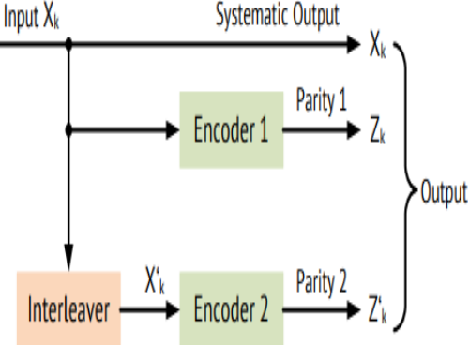
collects the initial data, while the other collects an interleaved, or scrambled, version of the data. This interleaving process, which uses a specified algorithm, is a crucial part of the turbo code and helps improve error correction. LTE (Long-Term Evolution) utilizes a 1/3 rate turbo code.
The turbo encoder, as depicted in Fig 3.2, uses pseudorandom interleavers and convolutional encoders (RSC). It employs two RSC encoders that operate on distinct data sets; one obtains the original information, while the other obtains the interleaved version of the same data. The interleaver, a core component, shuffles data bits, significantly impacting the decoder's performance. The result of the turbo encoder, consisting of 8 bits (systematic input, and outputs from both RSC1 and RSC2), is transmitted to the turbo decoder through the communication channel.
Fig 3.2 Functional Diagram of Turbo Encoder 2
3.2.1 FLOWCHART OF TURBO ENCODER
In Turbo encoding, the input data is first processed by a Recursive Systematic Convolutional (RSC) encoder. This encoded data, along with the original data (which may or may not be interleaved), is then passed through a data assembler. The process also involves another RSC encoder, but this time it receives an interleaved version of the input data. The outputs of both RSC encoders, along with the original input data, are combined to produce the final encoded output. A flowchart in Fig. 3.3, illustrates this process.
22

Slide 34
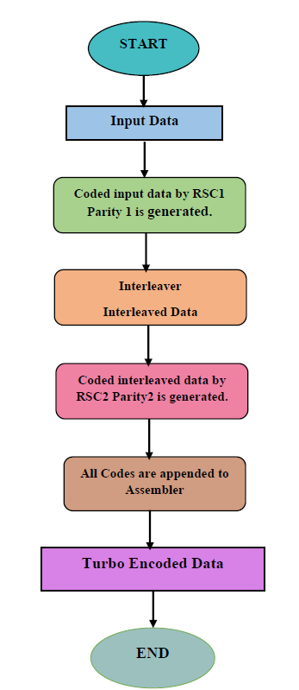
Fig 3.3 Flow Chart of Turbo Encoder
23

Slide 35
3.3. RECURSIVE SYSTEMATIC CONVOLUTIONAL (RSC) ENCODER
A non-recursive, non-systematic convolutional encoder can be transformed into a Recursive Systematic Convolutional (RSC) encoder by feeding back one of its encoded outputs to the input.
3.4. TURBO DECODER
A turbo decoder utilizes two iterative soft-input soft-output (SISO) decoders. The result of the initial decoder is directed towards the secondary decoder, forming a single iteration of the decoding process. Iterative exchange of data between component decoders is a defining characteristic of turbo decoding. Turbo codes, a type of forward error correction code, are decoded using iterative decoding based on Maximum Likelihood Detection . The process involves two decoders that work in parallel. Filtered signals are passed to these decoders, which then analyze the signal's amplitude to produce a "soft decision". These decoders utilize a priori probabilities of input symbols to calculate a reliability score, which is then exchanged between the decoders in each iteration. Turbo codes employ Maximum a-posteriori Probability (MAP) decoding, not Maximum Likelihood (ML) decoding, despite the latter's conceptual simplicity. The complexity of ML decoding stems from the intricate trellis structure introduced by the interleaver between the two constituent codes. In iterative decoding, two soft-in/soft-out (SISO) decoders work together, exchanging reliability information about their coded sequence estimations during each decoding cycle. This exchange of "soft" information between the decoders allows them to refine their individual interpretations of the received data and improve the overall decoding accuracy.
24

Slide 36
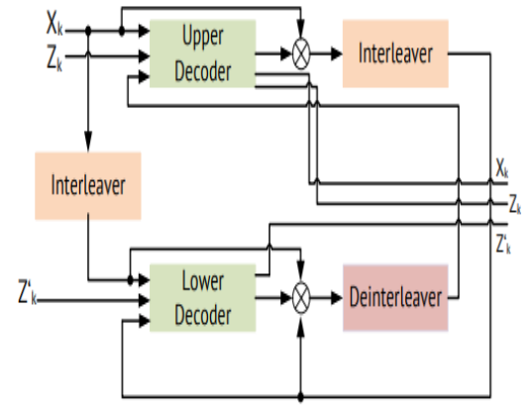
Fig 3.4 Functional Diagram of Turbo Decoder
As seen from Fig. 3.4, the result of the first (upper) decoder is directed into the second (lower) decoder as part of an iterative decoding process. This process also utilizes interleavers and deinterleavers to rearrange the data. The decoding itself employs two Maximum A Posteriori (MAP) algorithms: LogMAP and MaxLogMAP.
An iterative decoding process using two soft-decision decoders operates simultaneously. The decoders work together by exchanging soft-decision information, also known as extrinsic information. One decoder's output (Z_{k}) initializes the other, and the process continues until the soft decisions stabilize. The rearmost extrinsic data from a decoder is not the end of the decoding process; it's a stepping stone to the next stage, contributing to the overall error correction capability of the system.
3.5. TURBO DECODING ALGORITHMS
When implementing a Turbo decoder, the first crucial step is selecting an appropriate decoding algorithm. The two main types of decoding algorithms employed in the iterative decoding of turbo codes is displayed in Fig 3.5. Each and every algorithms utilize the trellis-based estimation.
25

Slide 37
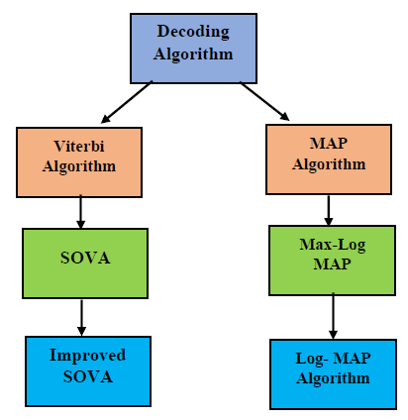
Fig 3.5 Turbo Decoding Algorithms
Trellis-based estimation algorithms are broadly classified into two categories: sequence estimation algorithms and symbol-by-symbol estimation algorithms. The Viterbi algorithm,, and improved are sequence estimation algorithms, while MAP, Log-MAP, and Max-Log-Map are symbol-by-symbol estimation algorithms.
3.5.1 MAP ALGORITHM
The decoding process of the turbo codes is based on iterations, performed by the MAP algorithm. This is implemented for every constituent code. The MAP algorithm is indeed used by the SISO decoders to determine the reliability of received information, particularly in the context of turbo codes. To reduce the computational complexity of decoding trellis diagrams, specifically in the context of MAP (Maximum A Posteriori) algorithms, the Max Log-MAP and Log-MAP algorithms are employed. These algorithms offer lower complexity compared to the MAP algorithm by simplifying the calculations involved in the trellis diagram implementation, particularly the multiplication and exponential operations[14].
26

Slide 38
3.6. SISO DECODER
In turbo decoding, the SISO (soft-in, soft-out) component decoders use the MAP (maximum a posteriori) algorithm to estimate the probability of each data bit being one, based on the soft input values received from the channel. While the Viterbi decoder selects a single, most likely path through a trellis, the MAP algorithm considers the entire received sequence to make its bit estimates, minimizing the probability of bit error.
3.7. INTERLEAVER
In turbo code design, the interleaver is crucial because it shuffles data in a pseudorandom way, preventing adjacent bits from having similar patterns at the encoder's input. This interleaver is utilized in both the encoder and decoder, with the encoder using it to create a longer data sequence and the decoder using it to compare outputs from two SISO (soft-in-soft-out) decoders. The deinterleaver, which functions inversely to the interleaver, is also used in the decoder. In digital communication, interleaving is a technique used at both the encoding and decoding stages. The encoder rearranges data bits to create a longer data block, while the decoder reverses this process. This interleaving process helps error-correcting codes (like convolutional codes) by distributing burst errors across multiple codewords, making them easier to correct. The interleaver is often used in conjunction with two decoders at the output to further enhance error correction capabilities. In iterative decoding, after an initial decoding pass, only some errors are corrected. Interleaving is then used to rearrange the data, and a subsequent decoding pass through a different decoder can correct further errors. This process repeats iteratively, with each pass potentially correcting more errors due to the interleaver's ability to disperse error patterns. The interleaver's length or depth impacts the distribution of parity bits from the constituent encoders.
27

Slide 39
Chapter 4
SOFTWARE USED
4.1. MODELSIM
ModelSim is a hardware description language simulator that supports behavioral, RTL, and gate-level simulations, enabling users to improve design quality and debugging that can significantly boost a developer's productivity. It features a platform-independent compile process and a Single Kernel Simulator (SKS) that allows for the seamless integration of VHDL and Verilog within the same design.
4.1.1 IMPORTANT CHARACTERISTICS
Single kernel architecture technology
ModelSim packs an unprecedented level of verification capabilities into a cost-effective HDL simulator and is ideally suited for the verification of small and medium-sized FPGA designs – especially designs with complex, mission-critical functionality.
2. Comprehensive Code Coverage
ModelSim’s advanced code coverage capabilities provide valuable metrics for systematic verification. Plus, ModelSim’s ease of use lowers the barriers for leveraging verification resources. All coverage information is stored in the highly efficient database. Coverage results can be viewed interactively, post-simulation, or after a merge of multiple simulation runs.
3. Combining different language simulation
Comprehensive support of Verilog, System Verilog for Design, VHDL, and SystemC provide a solid foundation for single and multi-language design verification environments. An easy-to-use and unified environment provides FPGA designers the advanced capabilities they need for debugging and simulation.
4. User-Friendly debugging tool
28

Slide 40
ModelSim eases the process of finding design defects with an intelligently engineered debug environment that efficiently displays design data for analysis and debug of all hardware description languages. A broad set of intuitive capabilities for Verilog, VHDL and System C make it the ideal choice for ASIC and FPGA design.
4.1.2 CHOOSEN LANGUAGE
Verilog is a hardware description language used to model digital systems and circuits in a textual format. It was created by Gateway Design Automation in the 1980s and later became part of Cadence Design Systems. Verilog allows designers to describe the structure and behavior of hardware at various levels of abstraction, from gate-level to system-level. It's a standard language used in the electronic design automation (EDA) industry for designing, modeling, and verifying digital circuits.
Verilog is a widely used hardware description language for designing and verifying both digital and mixed-signal systems, including ASICs and FPGAs. It supports various levels of abstraction, from gate-level structural descriptions to high-level behavioral models. Verilog is employed in both simulation-based design flows, where the system is tested through simulation, and synthesis-based design flows, where the Verilog code is translated into physical hardware.
This description applies to Verilog, a hardware description language (HDL). Verilog is utilized to design digital circuits at various levels of abstraction, from basic logic gates to complex systems, using techniques like gate-level, RTL, and behavioral modeling. It allows for hierarchical design, enabling the construction of complex systems from simpler modules.
Verilog is a Language primarily utilized for modeling and verifying digital circuits, including those implemented in Field Programmable Gate Arrays (FPGAs) and Application-specific Integrated Circuits . It allows for the creation of Register Transfer Level (RTL) models, which represent the data flow and control logic of a digital system, and also enables the development of test benches for verifying the functionality of these designs.
29

Slide 41
In Verilog, there are three primary levels of abstraction that represent different perspectives on how a design is implemented, from high-level descriptions to low-level gate-level details.
Gate Level Representation
Data-flow Representation
Behavioral Representation
Note: Before diving into the abstraction levels, let us first learn what is RTL.
Register Transfer Level (RTL): Register Transfer Level (RTL) is a design abstraction used in digital circuit design. It focuses on describing the behavior of a digital system by detailing how data moves between registers, and the operations performed on that data. It's a way to represent a circuit's functionality at a low level, bridging the gap between high-level specifications and the physical implementation.
Gate Level Modeling
When a circuit's functionality is described using only basic logic gates like AND, OR, and NOT, it's referred to as gate-level modeling. For instance, a half adder, which performs binary addition of two single bits, can be implemented using an XOR gate (for the sum) and an AND gate (for the carry).
Half-Adder
A half adder circuit, described at the gate level, utilizes XOR and AND gates. The XOR gate produces the sum output, while the AND gate generates the carry output, based on two input bits. This level of abstraction provides a concrete representation of the circuit's structure and logic using these fundamental logic gates.
Data-Flow Modeling
Data-flow modeling in Verilog describes combinational circuits by specifying the flow of data from inputs to outputs, rather than by the explicit instantiation of gates. This approach uses continuous assignment statements and the keyword assign to define the relationships between signals. Essentially, it focuses on how data moves and is processed within the circuit, often mirroring logical equations.
30

Slide 42
Behavioral Modeling
In Verilog, behavioral modeling represents the highest level of abstraction. It allows designers to describe a circuit's functionality using algorithms and procedural statements (like if and case statements) without detailing the underlying gate-level or structural implementation. This approach focuses on what the circuit should do, rather than how it should do it, enabling a more abstract and high-level design process.
Why is Verilog Better?
Verilog improved upon prior hardware description languages (HDLs) by offering better features for digital circuit design and verification, leading to its widespread adoption. These enhancements include a more user-friendly syntax, support for hierarchical design, and advanced modeling techniques, making it a preferred choice for both design and simulation.
Verilog is often preferred over its predecessors due to its simpler syntax, better support for behavioral modeling, and higher level of abstraction, making it easier to learn and use for digital circuit design and verification. Additionally, Verilog benefits from extensive industry adoption and strong tool support.
Here's a more detailed look:
Simpler syntax: Verilog's syntax is generally considered more compact and less verbose than VHDL, which can lead to shorter code and potentially faster development times.
Better support for behavioral modeling: Behavioral modeling in Verilog allows describing a digital circuit's functionality using algorithms and control structures, rather than explicitly detailing its gate-level implementation.
Higher level of abstraction: Verilog utilizes a higher level of abstraction compared to older hardware description languages. It allows designers to describe digital circuits using modules and ports, which simplifies the design process and improves efficiency.
31

Slide 43
Better tool support: Due to its widespread adoption, Verilog enjoys superior tool support compared to older hardware description languages, offering a wider selection of integrated development environments (IDEs) and simulation tools. This abundance of tools makes it easier to create and validate digital circuits with Verilog. .
Advantages of Verilog
Concise Syntax: Verilog's syntax is designed to be relatively simple and easy to learn, allowing for faster coding of digital circuits.
Best Practice: Verilog is a universally recognized standard in the semiconductor industry, meaning designs created in Verilog can be readily shared and understood by other professionals in the field.
Simulation and Synthesis: Verilog code can be used to simulate the behavior of a digital circuit, allowing designers to identify and fix errors before physical implementation. It also supports synthesis, which translates the Verilog code into a netlist that can be used to create actual hardware (like an FPGA or ASIC).
Hierarchical Design: Verilog allows designers to complex digital systems that encapsulate specific functionalities, making the overall system easier to understand, debug, and modify. This modularity makes it easier to manage large designs and promotes reusability of components.
Uses of Verilog
Embedded Systems: It is utilized in embedded systems, such as microcontrollers and FPGAs, to design hardware components.
Digital Signal Processing: It is commonly utilized to implement Digital Signal Processing (DSP) algorithms in hardware.
Networking: It allows engineers to describe and model the functionality of digital circuits, including those found in network devices.
ASIC Design: Verilog serves as a powerful tool for translating abstract design ideas into a physical, custom-built integrated circuit.
Autonomous Vehicles: Verilog is applied in automotive electronics, including engine control units and ADAS systems.
32

Slide 44
4.2. MATLAB
MATLAB is a computational environment and programming language introduced by MathWorks. It's designed for matrix manipulations, plotting, algorithm implementation, user interface creation, and interfacing with other languages like C, C++, Java, and Fortran. Essentially, it's a high-level tool for numerical computation, visualization, and programming.
MATLAB, primarily a numerical computing environment, utilizes the MuPAD symbolic engine through an optional toolbox to provide symbolic computing capabilities. This means while MATLAB excels at numerical calculations, it can also handle symbolic computations when the MuPAD toolbox is integrated.
Simulink provides a visual interface with customizable block libraries, enabling users to build models by connecting blocks that represent mathematical and logical operations, physical components, and other system elements. It allows users to build virtual prototypes, explore design concepts, and generate code for embedded systems. Simulink is integrated with MATLAB, enabling users to incorporate MATLAB code and analyze simulation results within MATLAB.
According to data from 2004, MATLAB had approximately one million users spanning various fields including engineering, science, and economics. This software is prevalent in both academic and research institutions, as well as industrial companies, demonstrating its broad usage across sectors.
4.2.1 HISTORY
MATLAB was initially introduced by Cleve Moler in the late 1970s at the University of New Mexico, aiming to provide students access to LINPACK and EISPACK without needing to learn Fortran. It gained popularity among applied mathematicians and other academics. In 1983, Jack Little, upon seeing its potential, joined Moler and Steve Bangert. They improved MATLAB in C, creating MathWorks in 1984 to further develop it. The rewritten libraries were initially called JACKPAC. In 2000, MATLAB was updated to use the newer LAPACK libraries for matrix computations.
33

Slide 45
MATLAB, initially popular among control engineering specialists, expanded its reach to diverse fields like education and image processing. It's now widely used in teaching linear algebra and numerical analysis, as well as by scientists in image processing.
Initially developed for control engineering, MATLAB's capabilities in matrix manipulation, algorithm development, and data visualization quickly attracted researchers and practitioners in various domains. Its ease of use and powerful numerical computation features made it a valuable tool for scientists and engineers.
4.2.2 SYNTAX
MATLAB, a programming and numeric computing platform, primarily utilizes its own language. Users interact with MATLAB by either typing commands directly into the Command Window (acting as an interactive mathematical shell) or by running scripts (text files holding MATLAB code and functions).
4.2.3 VARIABLES
In MATLAB, variables are assigned values utilizing the equals sign (=), and it's considered a weakly typed and dynamically typed language. This means that variable types are implicitly converted, and you don't need to declare a variable's type before assigning it, except when dealing with symbolic objects. The type of a variable can also change during program execution. Values can originate from constants, calculations using other variables, or the results of functions. The assignment operator (=) in MATLAB is used to assign a value to a variable. For instance, a = 3 assigns the integer value 3 to the variable a.
4.2.4 VECTORS / MATRICES
In MATLAB, vectors are fundamental data structures used to represent ordered lists of numbers. They can be either row vectors (1xN) or column vectors (Nx1), formed by square brackets and elements divided by spaces or commas for rows, and semicolons for columns. MATLAB offers different methods for creating, manipulating, and operating on vectors, making them necessary for data analytics and mathematical computations.
34

Slide 46
4.2.5 STRUCTURES
In MATLAB, structures are a powerful data type that permits you to group relevant data of types under a single variable name. Think of them like a container holding various pieces of information, each labeled with a meaningful name called a field. This makes your code more organized and easier to understand, especially when dealing with complex data sets.
For example, imagine you want to store information about students. Instead of having separate variables like student name, student, and student, you could create a structure called student with fields like name, id, and gpa. This keeps all the student-related data together and simplifies data management
4.2.6 FUNCTIONS
MATLAB incorporates elements of lambda calculus through the use of function handles, which act as references to functions. These handles can be created for functions defined in separate .m files, or for anonymous or nested functions. This allows for flexible function manipulation and passing, mirroring the concept of function abstraction and application in lambda calculus.
4.2.7 CLASSES
MATLAB supports object-oriented programming (OOP), allowing you to create custom data types and functions to model real-world objects and systems. In MATLAB, a class serves as a blueprint for creating objects. It defines the properties (data) and methods (functions) that each object of that class will possess.
MATLAB supports two kinds of classes:
Value Classes: Value objects contain the object's data. If you copy a value object, MATLAB creates an independent copy of the original object. Changes to the copy will not affect the original object. Built-in numeric types, strings, and structures are examples of value classes.
35

Slide 47
Handle Classes: Handle objects are references to the object's data. If you copy a handle object, MATLAB copies the handle, but not the data itself. Both the original and copied handles will refer to the same object. Modifying the object through one handle will affect the object referenced by all other handles. Graphics objects are a good example of handle classes.
4.2.8. GRAPHICS AND GRAPHICAL USER INTERFACE PROGRAMMING
MATLAB is a powerful tool for creating visualizations and interactive applications with graphical user interfaces (GUIs). It provides various functions and tools to generate plots, design interactive elements, and build standalone applications
MATLAB offers extensive capabilities for creating various types of plots and visualizations, including:
2D Plots: Line plots, scatter plots, bar charts, histograms, and more.
3D Plots: Surface plots, mesh plots, contour plots, and other representations of 3D data.
Image Processing: Displaying and manipulating images.
MATLAB allows to build interactive applications with graphical interfaces, enabling users to interact with your code using point-and-click controls instead of relying on command-line interfaces. MATLAB offers two primary ways to develop GUIs:
App Designer: This is a recommended interactive development environment for designing the layout and programming the behavior of your applications. It provides a drag-and-drop interface and a rich component library, including buttons, sliders, text fields, axes, gauges, and more. You can easily switch between design view and code view, add callback functions, and customize component properties.
GUIDE (Graphical User Interface Development Environment): While App Designer is now the recommended tool, GUIDE was an older interactive environment that facilitated the design of UIs. It also offered a visual interface for arranging elements and generating callback code[15].
36

Slide 48
4.2.9 OBJECT ORIENTED PROGRAMMING
Object-Oriented Programming in MATLAB is a design approach that helps organize and manage complex applications by creating structures called objects. These objects combine data (properties) with functions (methods) that operate on that data. MATLAB's OOP capabilities allow you to model real-world systems and devices, making your code more modular, reusable, and easier to maintain.
4.2.10. INTERFACING WITH OTHER LANGUAGES
MATLAB is designed to be highly interoperable, allowing you to integrate with code written in other programming languages. This flexibility enables you to:
Reuse existing code written in C, C++, Python, Java, or other languages.
Enhance performance by integrating optimized code written in compiled languages.
Leverage specialized libraries or toolboxes available in other languages.
Collaborate with teams that use different programming languages.
37

Slide 49
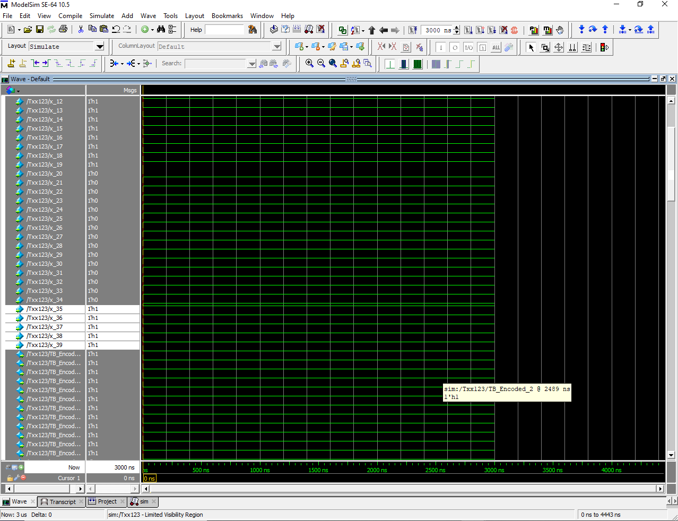
Chapter 5
RESULTS AND DISCUSSION
In this work, it provides brief discussion on one of the optimal channel coding technique such as Turbo Design and Implementation of Turbo Coder for LTE/4G/5G and provides a short review on the turbo encoder and decoder.
Turbo encoding and decoding, implemented in Verilog HDL, utilizes the MAP algorithm for decoding, which identifies the most probable transmitted bit. The original MAP algorithm is preferred due to its efficiency in reducing the number of decoding iterations. Approximations like Max-Log MAP, which operate in the logarithmic domain, are used to simplify implementation. The decoder successfully recovers the original message by correcting errors
Fig 5.1 Simulation
38

Slide 50
In the turbo encoder side, systematic, upper encoder bit, lower encoded bits are generated. In decoder side, the Encoded bits are given as input. The decoded output for interlever is generated and the simulation results are verified with the MATLAB results.
The described system utilizes a turbo coding scheme with two Recursive Systematic Convolutional (RSC) encoders and a decoder that iteratively processes the interleaved data. The encoder, visualized in Fig 5.1, produces a codeword through parallel concatenation of two RSC encoders. The decoder, depicted in Fig 5.2, employs a two-stage decoding process. Initially, one RSC decoder processes the received data. The output of this decoder, along with the original input, is then passed through an interleaver, and this interleaved data is fed into a second RSC decoder. Finally, the result of the second decoder is passed through a de-interleaver to produce a hard decision output.
39

Slide 51
Chapter 6
CONCLUSION AND FUTURE WORK
T his work of Turbo codes, highlights the use of Recursive Convolutional Encoders (RCE) and a pseudo-random interleaver in the encoder structure. The analysis includes a discussion of the Maximum A Posteriori (MAP) decoder and the iterative decoding process. The encoder structure consists of two RCEs operating on separate input streams, with the first encoder receiving the original message. The 8-bit transmitter and receiver are also addressed. The designed decoder is able to receive and accurately interpret the same information that was transmitted by a transmitter. This is the core function of a decoder in any communication system. The simulation results are carried out in modelsim and the output is verified using Matlab software.In addition,the proposed architecture utilizes a pipeline structure composed of independent components to enhance FPGA resource utilization and design efficiency. Integer arithmetic simulations were used to validate the design, and the results matched those of the software simulation, confirming the architecture's effectiveness.
Future advancements in decoding techniques, particularly for satellite communication, will leverage FPGA devices and hybrid microprocessors to enhance power efficiency and performance. Adaptive array techniques will mitigate multipath fading, while Turbo decoding, implemented in reconfigurable hardware, will be optimized for specific noise levels and algorithmic parameters. Non-binary codes and optimized architectures will further improve decoding capabilities, reducing complexity and noise effects, especially in mobile devices.
40

Slide 52
REFERENCES
Sudheer Kumar Terlapu(2015).Verilog Implementation of Turbo Encoder and Decoder Using Log Map Based Iterative Decoding,Journal of Technological Advances & Scientific Research,eISSN- 2454-1788, pISSN- 2395-5600, Vol. 1, Issue 04,pp. 322-327.
C. Berrou, A. Glavieux, and P. Thitimajshima(1993).Near Shannon limit error-correcting coding and decoding: Turbo-codes, IEEE Int. Conf.Commun. (ICC), Geneva, Switzerland, vol. 2, May 1993, pp. 1064–1070.
S. Benedetto and G. Montorsi(1996).Unveiling turbo codes: Some results on parallel concatenated coding schemes,IEEE Trans. Inf. Theory, vol. 42, no. 2, pp. 409–428.
C. E. Shannon(1948).A mathematical theory of communication,Bell Syst. Tech. J., vol. 27, no. 4, pp. 623–656.
Digital Video Broadcasting (DVB); Implementation guidelines for Satellite Services to Handheld devices (SH) below 3GHz(2011), Standard ETSI EN 302 583 V1.1.0 (2008-01).
C. E. Shannon(1948).A mathematical theory of communication,Bell Syst. Tech. J., vol. 27, no. 3, pp. 379–423.
C. Berrou, A. Glavieux, and P. Thitimajshima(1993).Near Shannon limit error correcting coding and decoding: Turbo-codes. 1, IEEE Int. Conf. Commun. (ICC), vol. 2, May , pp. 1064–1070.
C. Berrou and A. Glavieux(2003). Turbo Codes. Hoboken, NJ, USA: Wiley.
R. W. Hamming(2010). Error detecting and correcting codes,Bell Sys. Tech. J. Vol. 29, pp. 147–160, 1950 18, pp. 794-807.
41

Slide 53
Sadjadpour, H. R. Sloane, N. J. A. Salehi, and M. Nebe(2003). Interleaver design for turbo codes, IEEE Journal on Selected Areas in Communications, Volume: 19, Issue: 5, pp. 831-837.
J. H. Kang and W. E. Stark(1998).Turbo codes for noncoherent FH-SS with partial band interference,IEEE Trans. Commun., vol. 46, no. 11, pp. 1451–1458.
H. El Gamal and E. Geraniotis(1998).Turbo codes with channel estimation and dynamic power allocation for anti-jam FH/SSMA,IEEE Mil.Commun. Conf. (MILCOM), vol. 1, pp. 170–175.
J.H Gass, P. J. Curry, and C. J. Langford().An a1999pplication of turbo trellis coded modulation to tactical communications,MILCOM. IEEE Mil. Commun. Conf., pp. 530–533.
S. Jiang, P. W. Zhang, F. C. M. Lau, C.-W. Sham, and K. Huang(2018).A turbo Hadamard encoder/decoder system with hundreds of Mbps throughput,IEEE 10th Int. Symp. Turbo Codes Iterative Inf. Process. (ISTC),pp. 1–5.
A. Louliej, Y. Jabrane, V. P. Gil Jiménez, and A. García Armada(2018).Practical guidelines for approaching the implementation of neural networks on FPGA for PAPR reduction in vehicular networks, Sensors, vol. 19, no. 1,p. 116.
Altera(2010).AN 505: 3GPP LTE Turbo Reference Design,AN-505-2.0
42

Slide 54
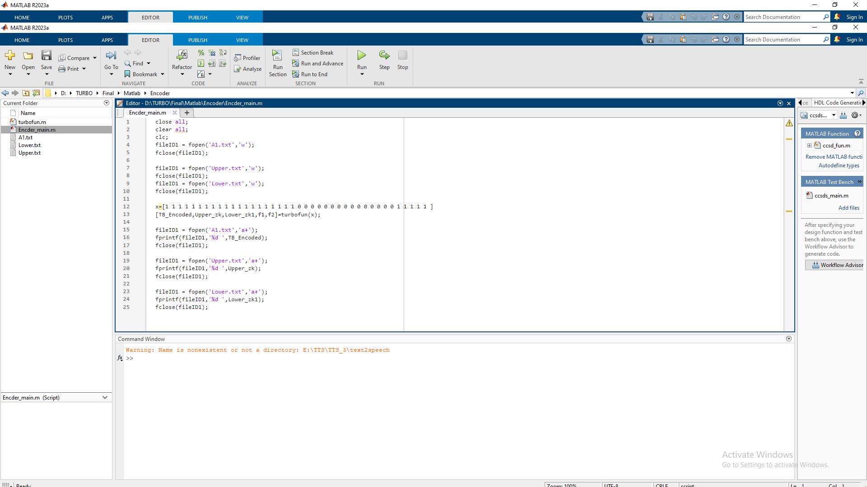
APPENDICES
Fig 1. Matlab Code for Turbo Encoder
Fig 1
43

Slide 55
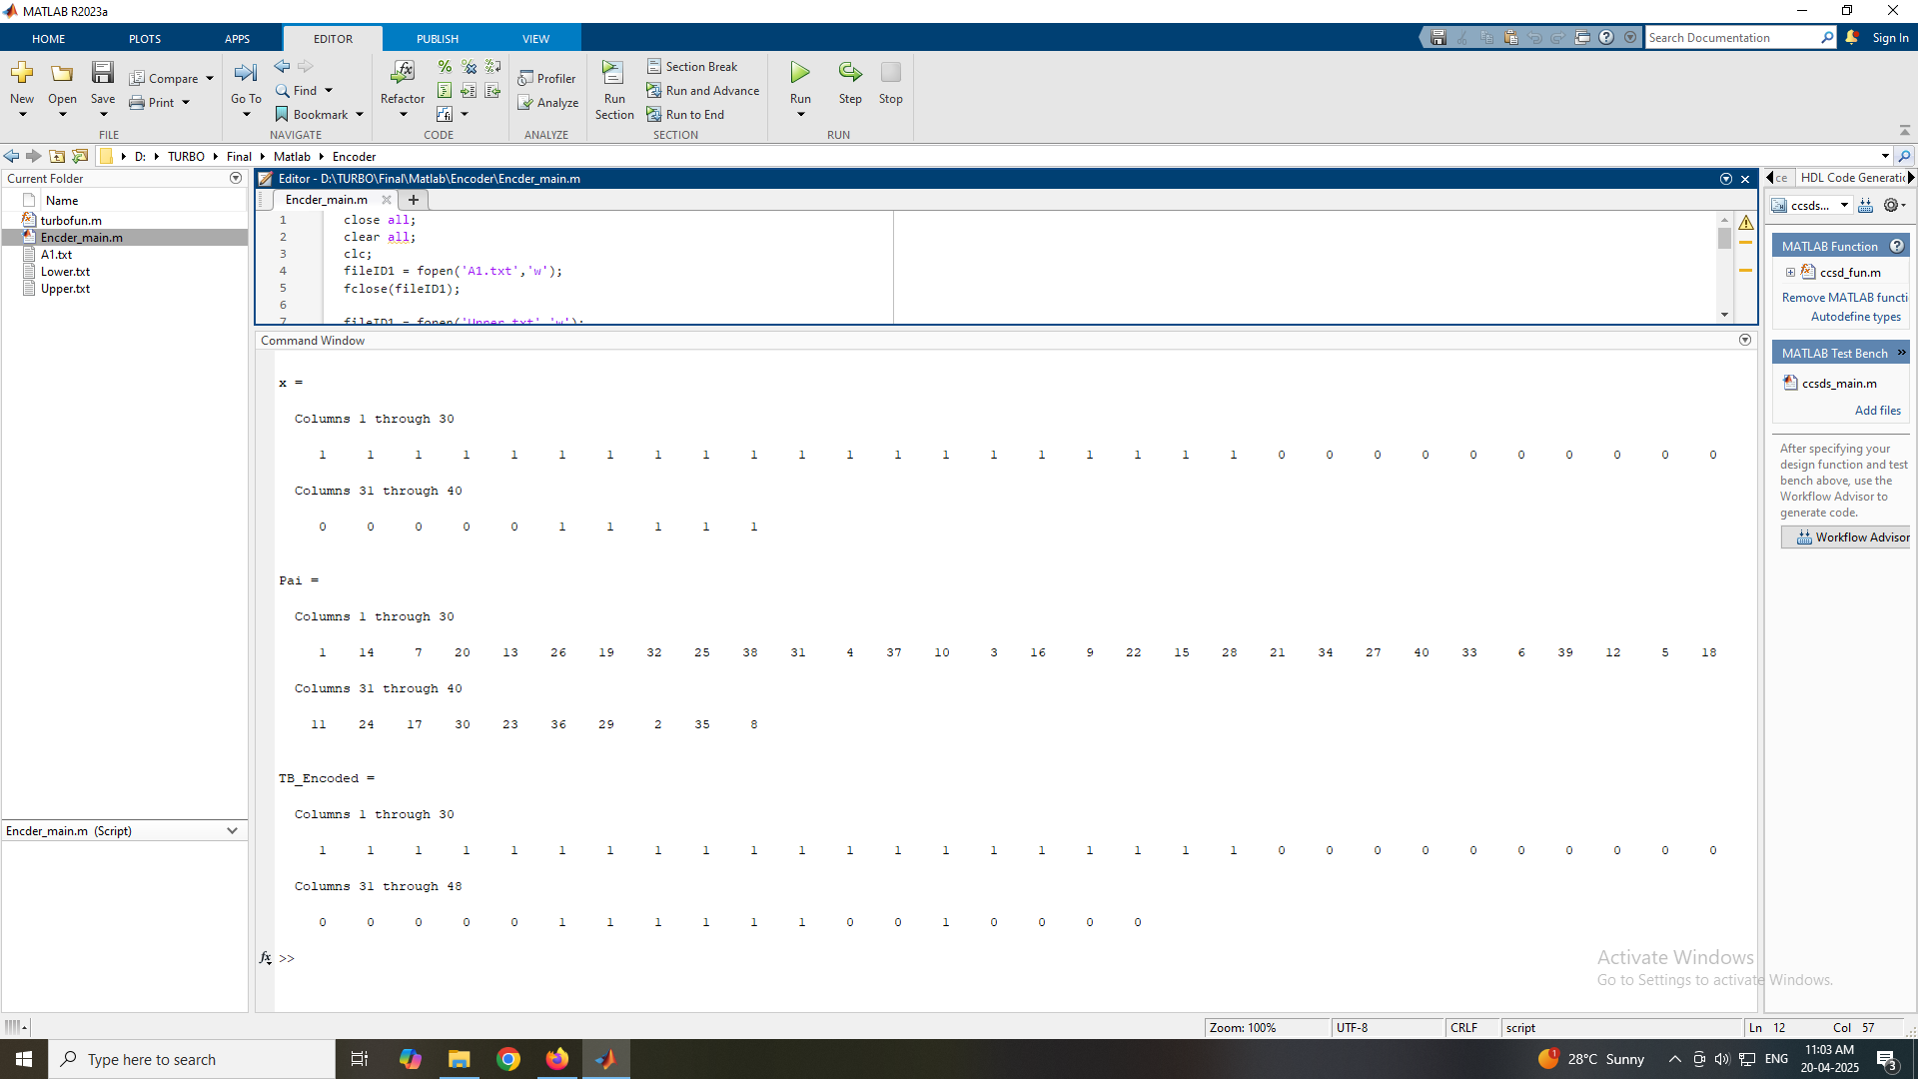
Fig 2 Matlab Output for Turbo Encoder
Fig 2
44

Slide 56
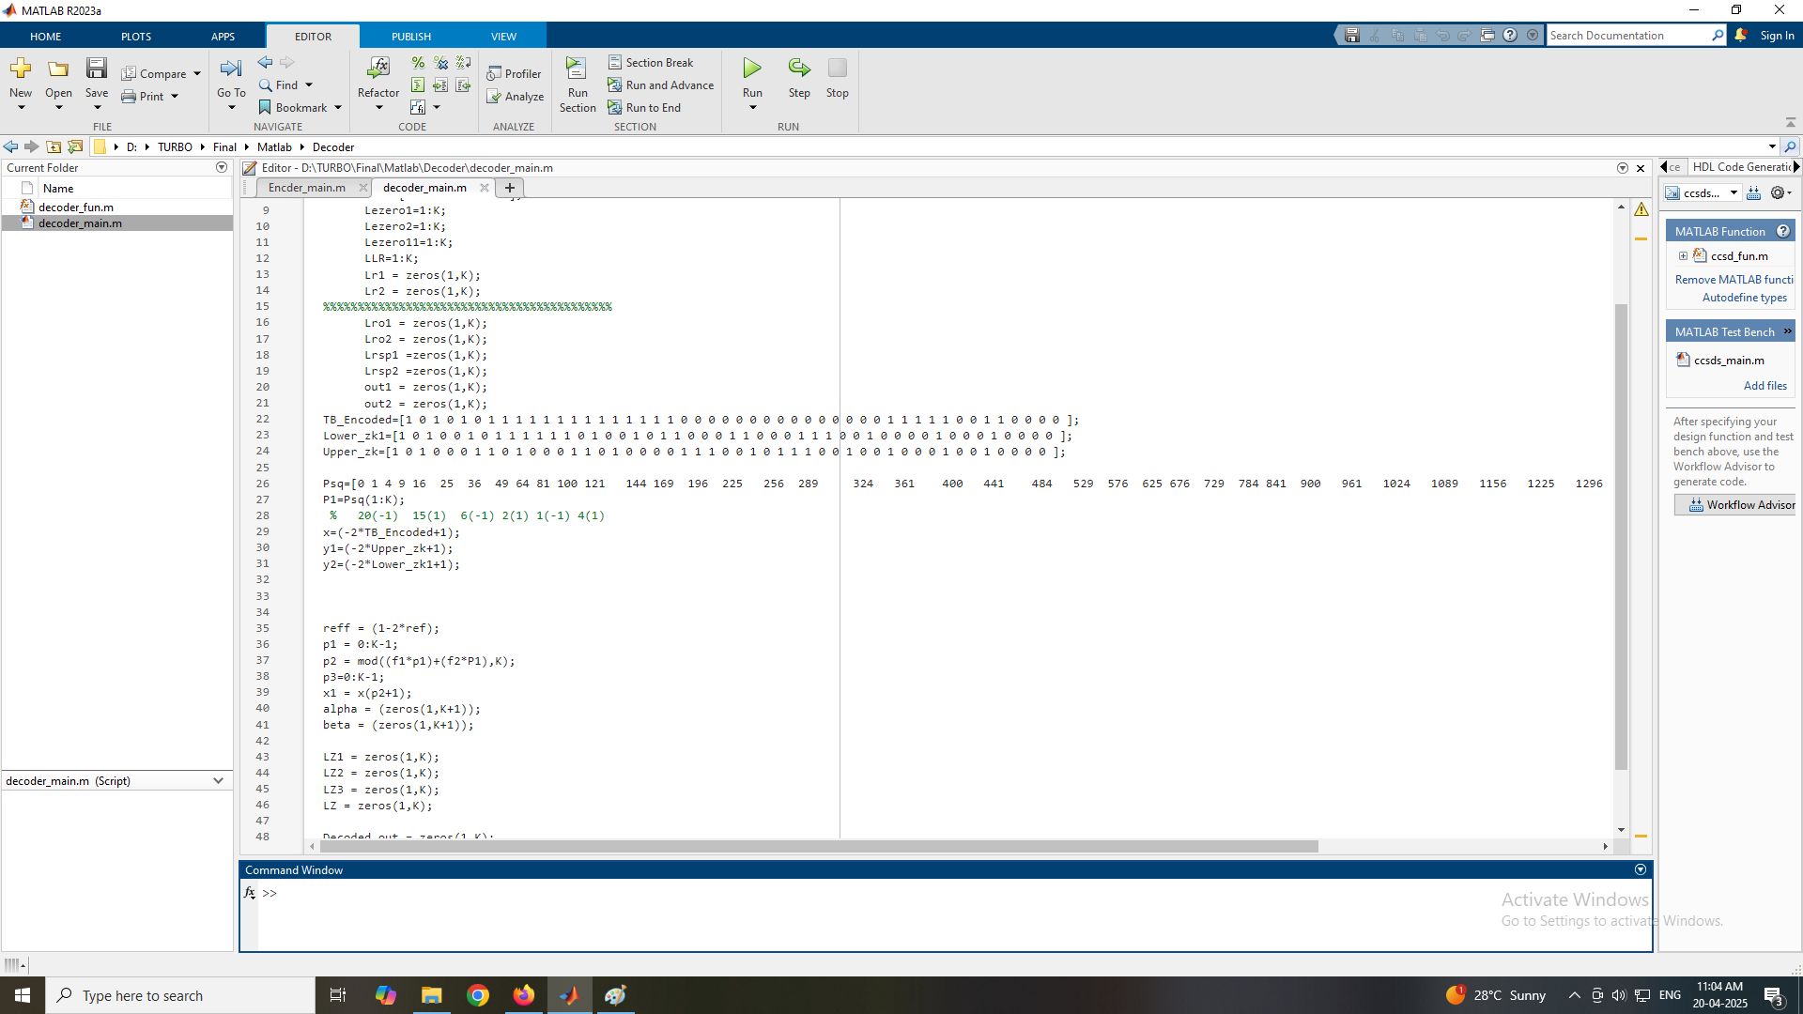
Fig 3 Matlab Code for Turbo Decoder
Fig 3
45

Slide 57
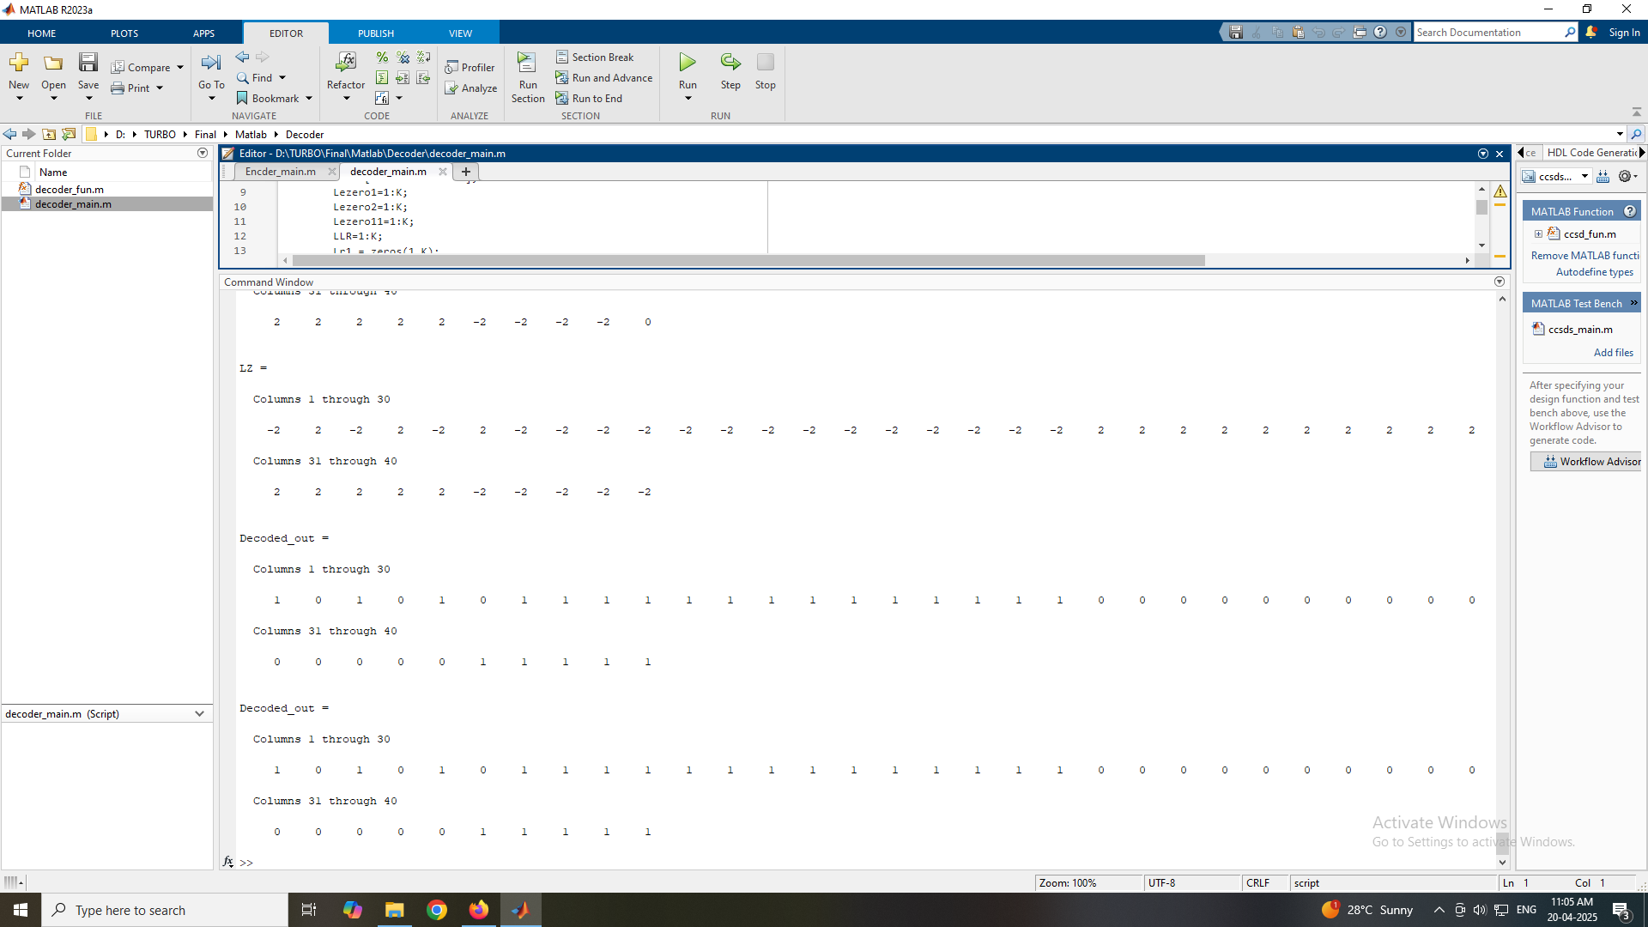
Fig 4 Matlab Output for Turbo Decoder
Fig 4
46

