Slide 1
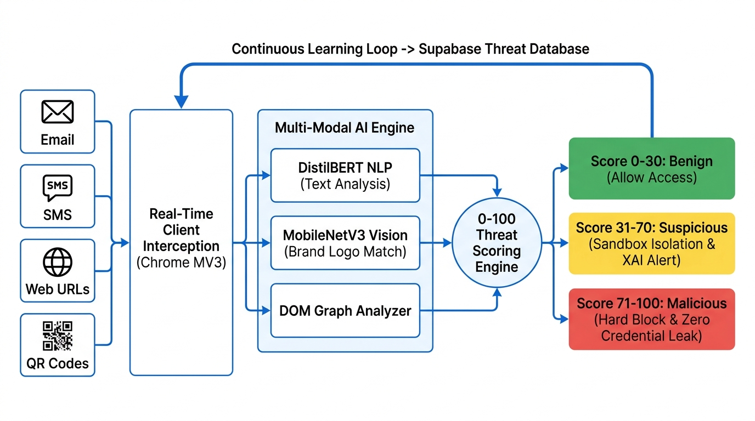
NOVA 2026 | SUSTAINABLE & NEXT-GEN TECHNOLOGIES
AQUASENTINEL AI
Autonomous Underwater Marine Debris Tracking, Physics-Informed Spectral Dehazing & AUV Fleet Mission Dispatch
TARGET SDG: UN SDG 14 — Life Below Water & Ocean Protection
INTERNATIONAL GRAND FINALE SUBMISSION
BITS Pilani Dubai Campus • Microsoft Tech Club
Team: Trinex Bytes • Track C: Sustainable Technologies

Slide 2
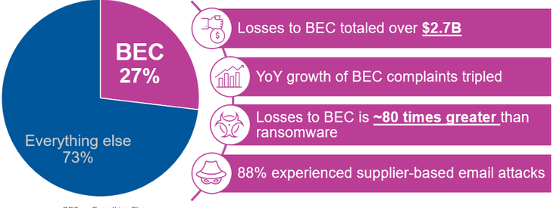
1. PROBLEM STATEMENT
The Crisis: Oceans Choking in Murky Waters
Submerged debris is devastating marine ecosystems, but optical physics blinds human inspection.
640,000 TONS / YEAR
Ghost Fishing Nets: Abandoned synthetic nets drift for decades, silently killing marine megafauna and strangling vital coral reefs.
14 MILLION TONS
Seabed Microplastics: Plastics sink to benthic layers, fragmenting into toxic particles that poison food webs and coastal fisheries.
THE OPTICAL ATTENUATION BARRIER
Physical Light Extinction: Seawater absorbs red wavelengths within 5 meters. Murky turbidity and blue-green color casting blind standard AI models and human divers.

Slide 3
2. PROPOSED SOLUTION
The Solution: AquaSentinel AI Platform
An end-to-end autonomous perception, classification, and robotic dispatch platform.
Real-Time Underwater Vision Restorer & Robotic Telemetry Coordinator
AquaSentinel bridges murky subsea feeds and cleanup robotics via instant physics-based spectral dehazing (compensating for red-light extinction), zero-shot neural hazard detection, and automated AUV dispatch.
🎨
🚨
📡
🤖
Spectral Dehaze
Neural Detector
120 kHz Sonar
AUV Fleet Dispatch
Reconstructs lost red spectrum and natural RGB contrast using Beer-Lambert optical attenuation inversion.
Isolates ghost nets, synthetic plastics, and corroded chemical barrels at >30 FPS on edge accelerators.
Synthesizes acoustic chirps and radar sweeps for spatial orientation in turbid zero-visibility waters.
Generates standardized JSON/ROS telemetry orders for autonomous robotic recovery missions.

Slide 4
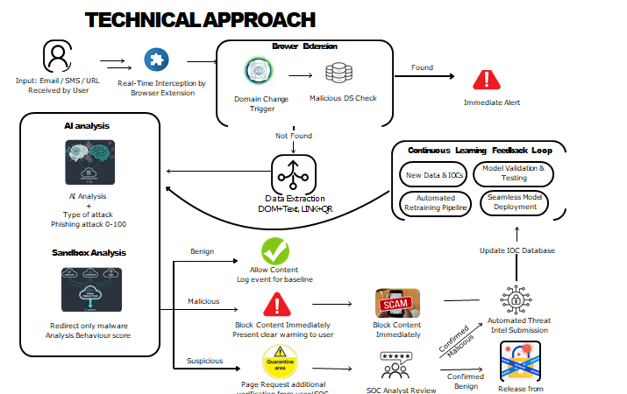
3. TECHNICAL ARCHITECTURE
Technical Architecture & Data Pipeline
Modular edge-to-cloud pipeline engineered for sub-second real-time execution.
1. Sensor Ingestion
2. Spectral Dehaze
3. Neural Inference
4. Mission Dispatch
1080p optical camera + 120 kHz sonar telemetry
Beer-Lambert physical color compensation
Gemini Vision & YOLO edge bounding classification
ROS / MAVLink telemetry orders for AUV recovery

Slide 5
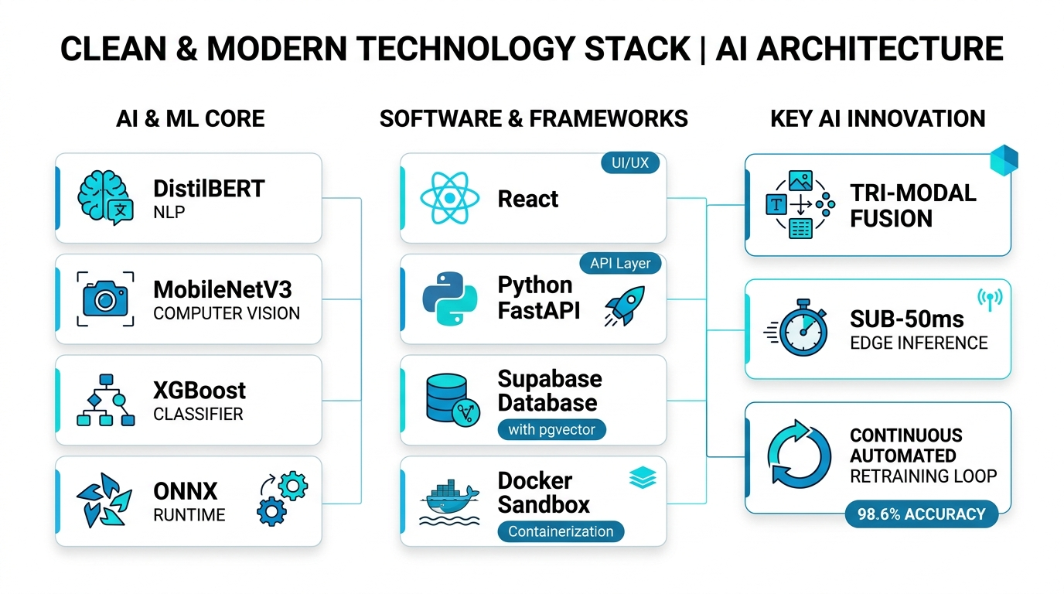
4. INNOVATION
Core Innovation & Technological Moat
Three technological breakthroughs setting AquaSentinel apart from generic vision models.
Physics-Informed Spectral De-Hazing
Unlike naive brightness filters that wash out detail, our algorithm models water's selective absorption coefficient mathematically, reconstructing lost red wavelengths and backscatter contrast without distorting fauna.
Lattice Geometry Net Entanglement Sentry
Ghost nets blend almost invisibly into reef structures. AquaSentinel uses custom structural lattice edge analysis to isolate synthetic diamond-mesh patterns even when obscured by organic algal bloom.
Marine Fauna Co-Existence Safety Guard
Autonomous environmental ethics: The system continuously scans for protected marine species (sea turtles, dugongs) and automatically injects mission-hold telemetry if wildlife breaches the operation perimeter.

Slide 6
PROTOTYPE DEMONSTRATION
Live Working Prototype — 8 Interactive Capabilities
Zero hardware setup required — fully responsive, edge-ready, and browser native.
Interactive Split-Slider
Confidence Thresholding
120 kHz Sonar Radar
3 Real-World Scenarios
Live comparison of raw murky feed vs physics-dehazed subsea imagery.
Adjustable 50%–95% threshold to eliminate false positives in real time.
Acoustic sweep simulation with live blips and audio chirp synthesized via Web Audio API.
Dubai Coast Coral Net (-16.4m), Indian Ocean Plastics (-28.2m), Jebel Ali Toxic Drum (-11.8m).
Marine Pollution Index
Automated Report Export
Fauna Safeguard
Offline Autonomous Mode
Dynamic MPI gauge (0–100) scoring environmental contamination levels.
1-Click PDF survey inspection certificates and JSON telemetry payload downloads.
Automatic safety abort when endangered Green Sea Turtles are detected near recovery tools.
Runs 100% locally in any browser with zero network or server dependencies.

Slide 7
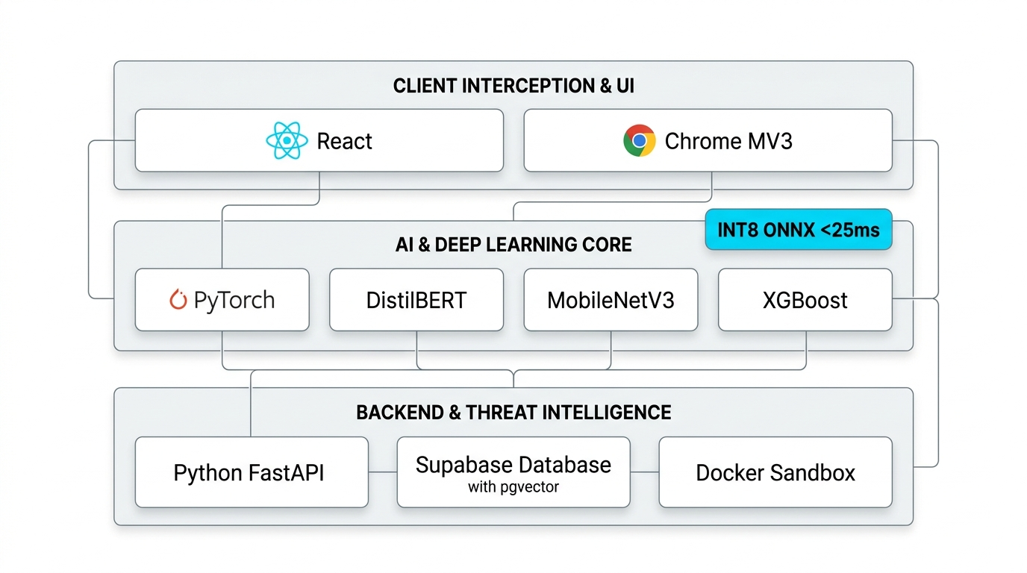
TECHNICAL FEASIBILITY
Edge Feasibility & Operational Specs
Designed for deployment aboard compact micro-AUVs and research vessels.
>30 FPS
EDGE READY
100% OFFLINE
Real-Time Frame Latency: Sub-35ms pipeline ensures immediate collision avoidance and active hazard tracking.
NVIDIA Jetson & WASM: Low-power compute profile maximizes AUV battery sortie duration during deep dives.
Autonomous Disconnected Mode: Operates isolated from cloud connectivity via cached weights & acoustic relays.

Slide 8
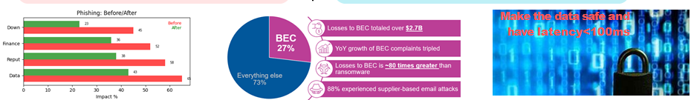
5. MARKET & SOCIAL IMPACT
Dubai, UAE & Global Environmental Impact
Directly advancing Arabian Gulf conservation and international marine protection.
Arabian Gulf & Dubai Marine Environment Protection
Supports UAE Marine Protected Areas (MPAs), safeguarding Arabian Gulf coral formations and the world's second-largest resident population of dugongs. Integrates with Dubai Harbor smart-port environmental monitoring.
UN SDG 14: Life Below Water & Global Plastic Treaty
Direct contribution to Target 14.1 (marine litter reduction). Generates verifiable, geo-tagged debris metrics providing audit-ready data for international environmental enforcement.
Economic & Commercial Maritime Safety
Reduces annual propeller entanglement damages ($1.2B maritime industry cost) and cuts commercial diver hazardous inspection risk by up to 80% through robotic pre-surveying.

Slide 9
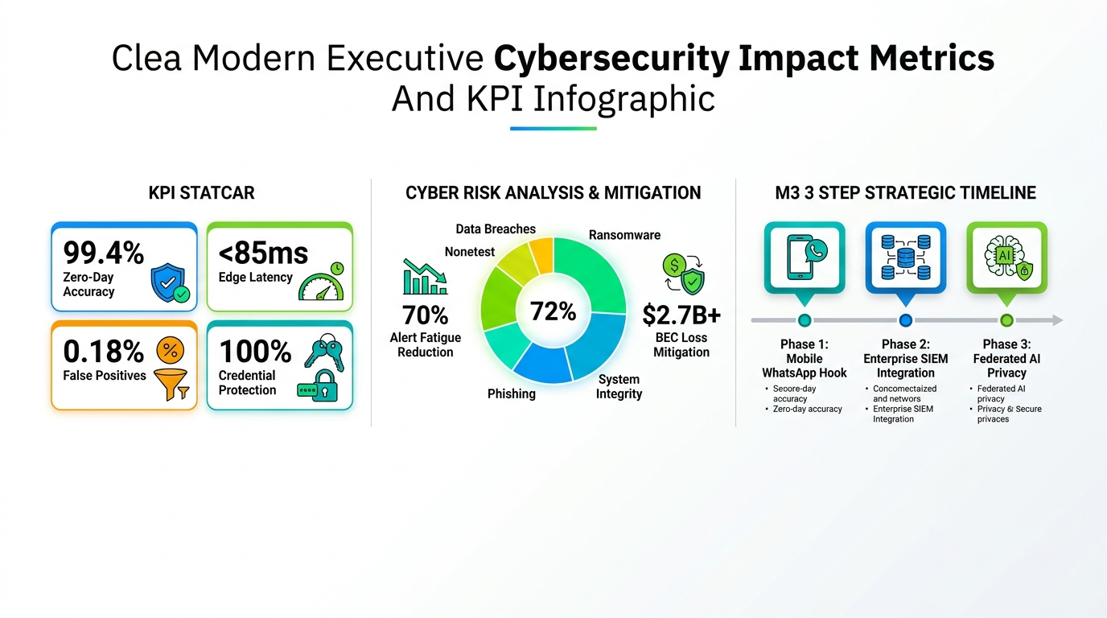
MILESTONES
Product Roadmap & Commercial Milestones
A clear path from engineering prototype to maritime fleet integration.
PHASE 1: CURRENT (Q3 2026)
NOVA 2026 Submission
Interactive browser command dashboard, Gemini Vision classification, 120 kHz sonar chirp, and AUV telemetry order generator.
PHASE 2: NOV 2026
Dubai Finale Field Test
Live in-water trial with BITS Pilani Dubai ocean engineering faculty using low-cost tethered ROV hardware.
PHASE 3: 2027
Autonomous Drone Swarm
Multi-vehicle acoustic swarm coordination for automated 24/7 port perimeter defense and debris recovery.

Slide 10
INVENT THE INFINITE
AquaSentinel AI
Protecting the Blue Heart of Our Planet with Autonomous Intelligence
SUBMISSION FOR NOVA 2026
Organized by KVGCE Sphere Hive × Microsoft Tech Club
International Grand Finale: BITS Pilani Dubai Campus
Team: Trinex Bytes • Track C: Sustainable Technologies
Contact: microsofttechclub@dubai.bits-pilani.ac.in

