Slide 1
CAREER GUIDANCE PLATFORM · PROJECT STATUS
CareerCompass
A Data-Driven Web Platform Guiding 10th & 12th Passout Students
Toward the Right Stream, Career and College
Presented by
Abhishek Pawar
M.Sc. Data Science · Christ University

Slide 2
The Problem We're Solving
?
The Confusion is Real
✓
Our Objective
Right after 10th or 12th, students must pick a stream, degree and college — often based on peer pressure, family opinion, or incomplete information, rather than their own strengths and interests.
Build a completely free, web-based career guidance platform
Assess each student scientifically — interests + aptitude, not guesswork
Recommend the best-fit careers using a data science matching model
The result: mismatched career choices, students switching fields midway, wasted years and money, and low satisfaction in the long run.
Connect students directly to relevant courses and real colleges
Show fees, contact info and an apply-now link for every college match
There is no single free, trustworthy platform that tests a student's real interests and aptitude, then connects them all the way to the right course and college.
CareerCompass — Career Guidance Platform
2

Slide 3
Who Is This For?
The platform serves two distinct groups — each gets its own assessment, tuned to the decision they're actually facing.
10th
10th Passout Students
12th
12th Passout Students
Haven't chosen a stream yet
Already chose a stream
Broad interest + aptitude test to help decide between Science, Commerce and Arts — and point toward a general direction.
Deeper, stream-aware assessment to help choose the right degree, course and specific career direction.
24 Questions
27 Questions
CareerCompass — Career Guidance Platform
3

Slide 4
Tools & Technologies Used
Every tool in this stack is free and open-source — no paid software, APIs or hosting required anywhere in the project.
PY
DB
UI
🔒
Python & Flask
SQLite
HTML / CSS / JS
Flask-Login
Backend web framework
Lightweight database
Frontend interface
Secure authentication
Σ
ML
PDF
☁
pandas & NumPy
scikit-learn
ReportLab
Render / PyAnywhere
Data handling
Similarity matching engine
PDF report generation
Free deployment (planned)
CareerCompass — Career Guidance Platform
4

Slide 5
How the Platform Works — End to End
1
2
3
4
5
6
Register
Login
Assessment
View Profile
Get Matched
Explore & Apply
Signs up, selects 10th/12th
Access personal dashboard
Interest + aptitude test
RIASEC scores, charted
Data science ranks careers
Courses, colleges, fees
Steps 1–4 are fully built and working today. Steps 5–6 are the next phases of this project.
CareerCompass — Career Guidance Platform
5

Slide 6
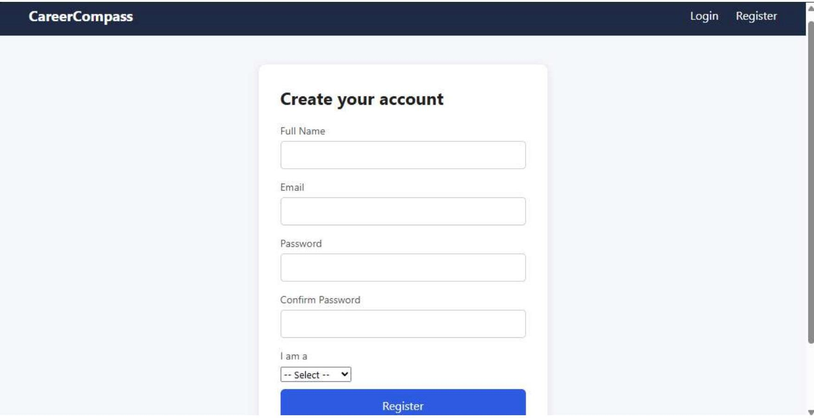
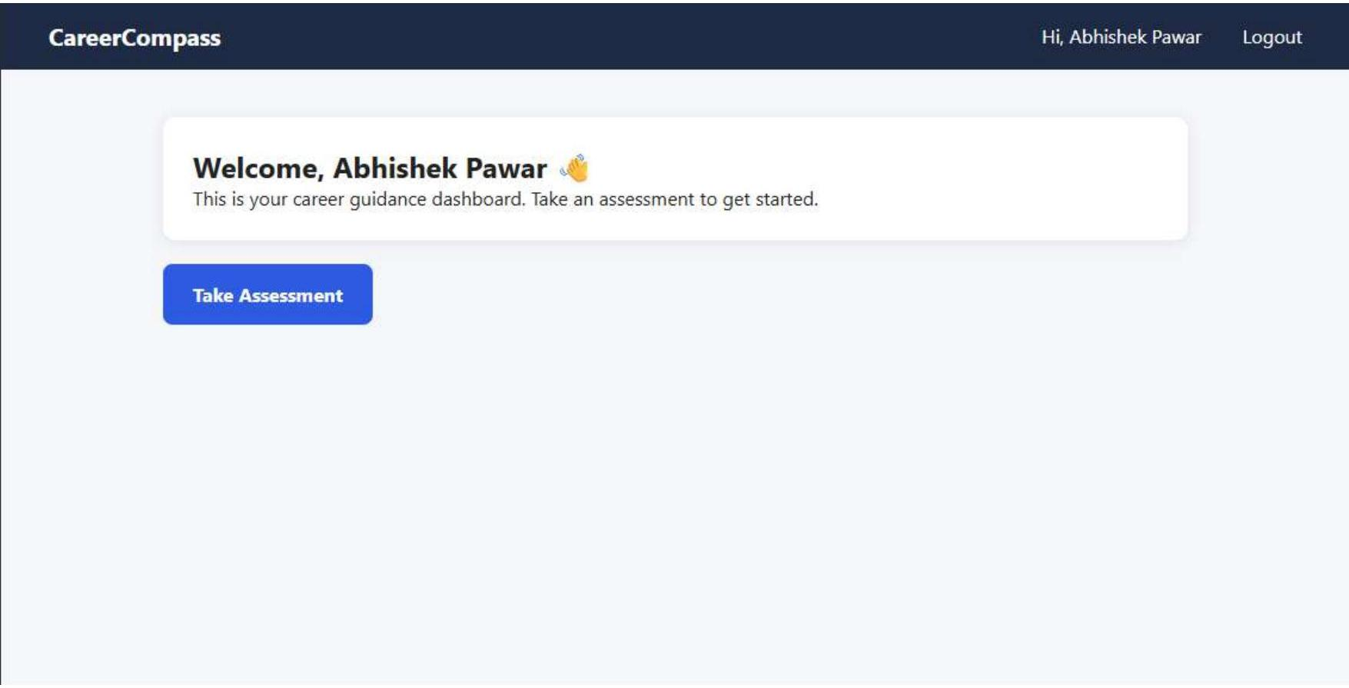
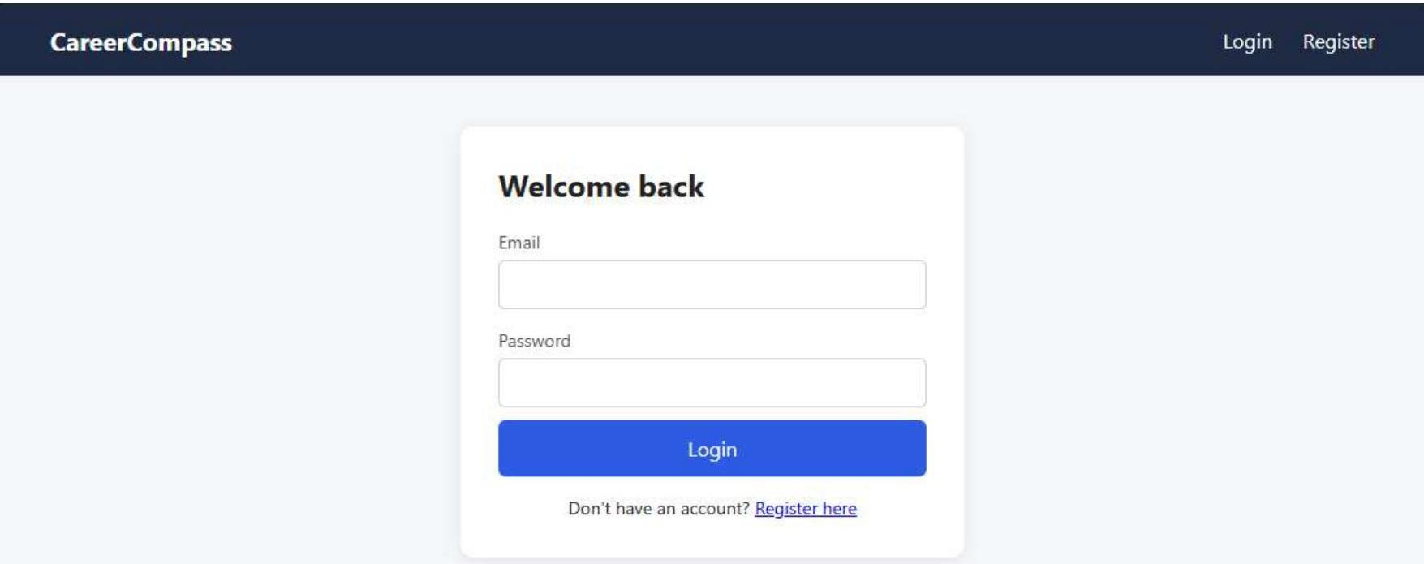
See It In Action — Getting Started
Real screens from the working application — registration, login and the student dashboard.
1. Register
2. Login
3. Dashboard
CareerCompass — Career Guidance Platform
6

Slide 7
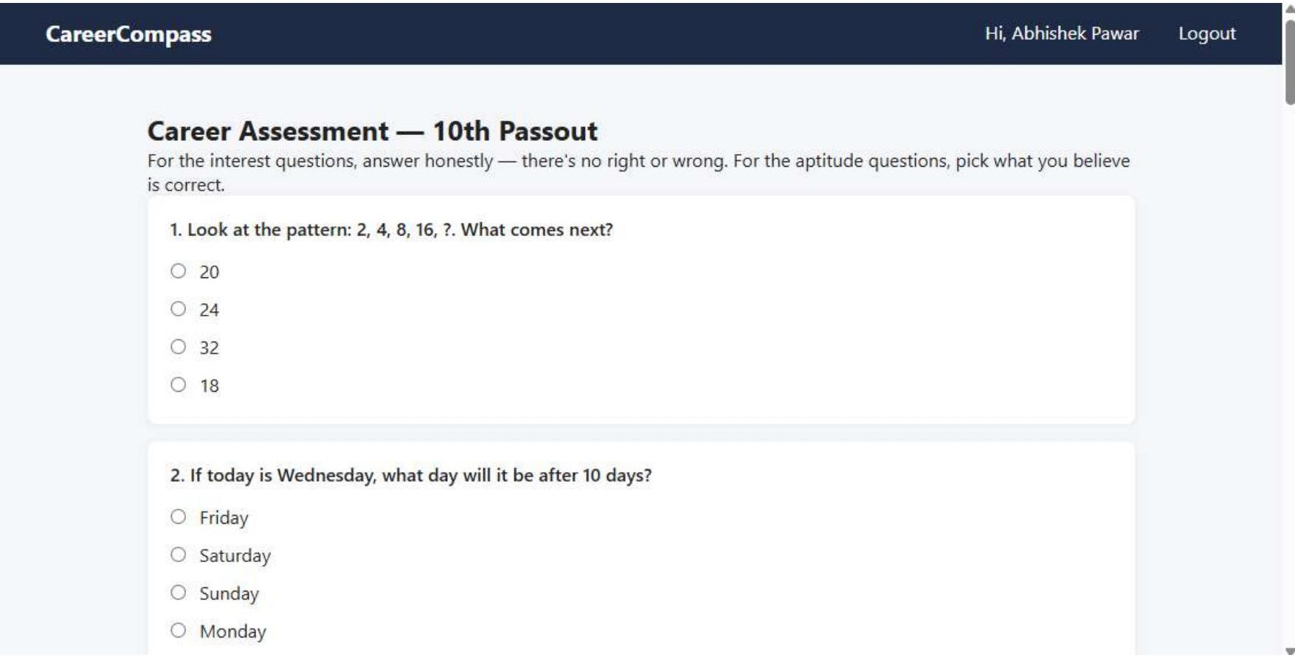
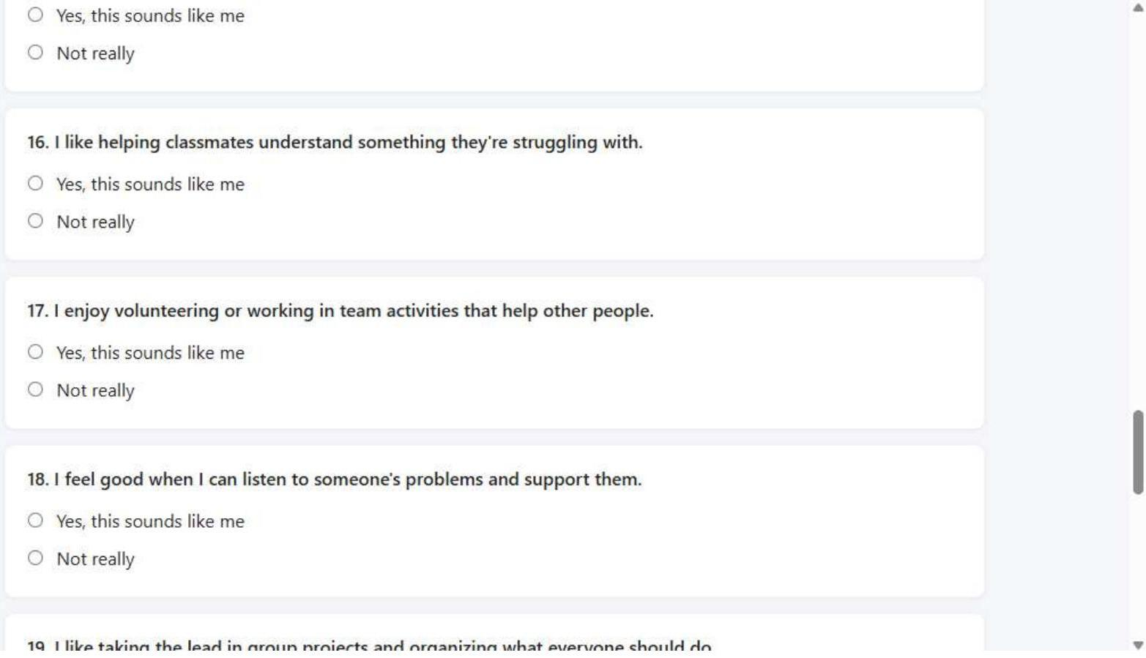
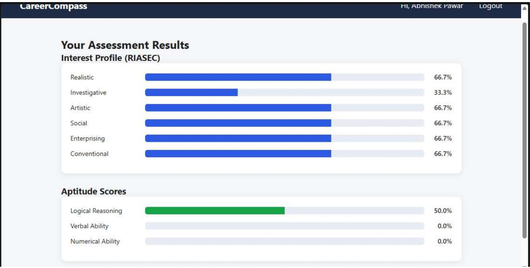
See It In Action — Assessment & Results
The level-specific test in progress, and the auto-generated results page with live score bars.
4. Assessment — Aptitude
4. Assessment — Interest
5. Results
CareerCompass — Career Guidance Platform
7

Slide 8
Work Completed So Far
3 / 10
phases complete
Phase 1 — Project Foundation
✓
Flask application structure set up; full database designed for users, questions, careers, courses and colleges.
Phase 2 — Secure Authentication
✓
Register, login, logout and a protected student dashboard, with passwords stored using industry-standard hashing.
Phase 3 — Assessment Engine
✓
Real 24-question (10th) and 27-question (12th) tests built and auto-scored into an interest and aptitude profile.
CareerCompass — Career Guidance Platform
8

Slide 9
The Assessment's Scientific Backbone
We didn't invent our own categories — the interest test is built on Holland's RIASEC model, a globally recognized framework in career psychology, layered with a logical / verbal / numerical aptitude test.
R
I
A
S
E
C
Realistic
Investigative
Artistic
Social
Enterprising
Conventional
Hands-on & practical
Analytical & research
Creative & original
Helping & teaching
Leading & persuading
Organized & structured
+ Aptitude Layer: Logical Reasoning · Verbal Ability · Numerical Ability
Interest tells us what a student enjoys; aptitude tells us what they're likely to be good at. Combining both gives a far more reliable recommendation than either alone.
CareerCompass — Career Guidance Platform
9

Slide 10
Next Phase: The Recommendation Engine
This is where data science comes in — matching students to careers mathematically, not with hardcoded if-else rules.
Student
Ranked Career Matches
Assessment converted into a 9-number profile:
R · I · A · S · E · C + Logical · Verbal · Numerical
Data Scientist
89%
Cosine Similarity
(scikit-learn)
Research Analyst
82%
[ 7, 9, 2, 4, 6, 3,
8, 5, 6 ]
Measures how closely the student's profile
points in the same direction as each career's
Software Engineer
76%
(illustrative example)
Final match score blends interest similarity (70%) with aptitude fit (30%), so a student isn't pushed toward a career they'd enjoy but aren't suited for.
CareerCompass — Career Guidance Platform
10

Slide 11
Upcoming Phases & Dataset Plan
Remaining Phases
Dataset Plan — Colleges & Courses
Recommendation engine (cosine similarity matching)
There's no free live API offering course-level fee data for Indian colleges, so we're building this honestly:
Detailed report page + downloadable PDF
Real colleges, manually compiled from official college websites & prospectuses
College & course database with fees + apply links
Frontend visual design polish
Fields captured: name, address, contact info, course, brief description, fees, apply-now link
End-to-end testing
Linked directly to the careers they lead to, using our existing database design
Free deployment (live link) & documentation
Expandable over time — more colleges can be added without changing the app's code
CareerCompass — Career Guidance Platform
11

Slide 12
Conclusion
CareerCompass is on track to be a free, end-to-end platform that helps 10th and 12th passout students choose their path using real psychometric science and data-driven matching — not guesswork.
3 / 10
51
100%
Phases Complete
Assessment Questions Built
Free & Open-Source Stack
Next up: building the data science recommendation engine and the real college dataset.
Thank You
Questions welcome

