Slide 1
The procedure for AQTime Analysis
https://smartbear.com/product/aqtime-pro/free-trial/
1. Copy all pdbs (mgxparuntime .pdb, mgcore.pdb, mgxxxx.pdb )at the location from where you will invoke
MgxpaRuntime.exe.
2. Launch the process : MgxpaRuntime.exe

Slide 2
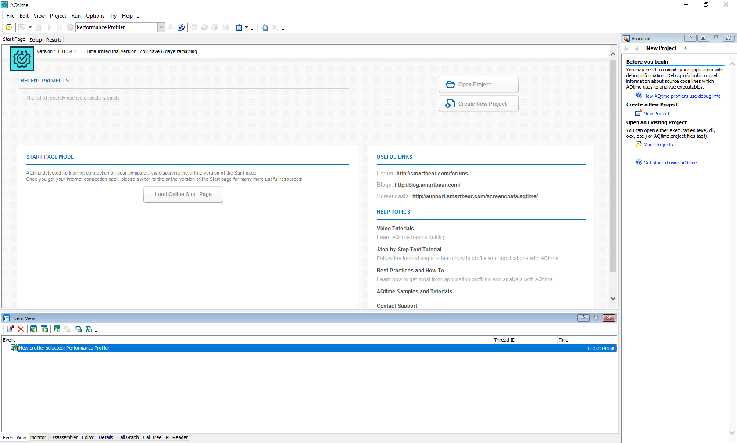
3.Open AQTime

Slide 3
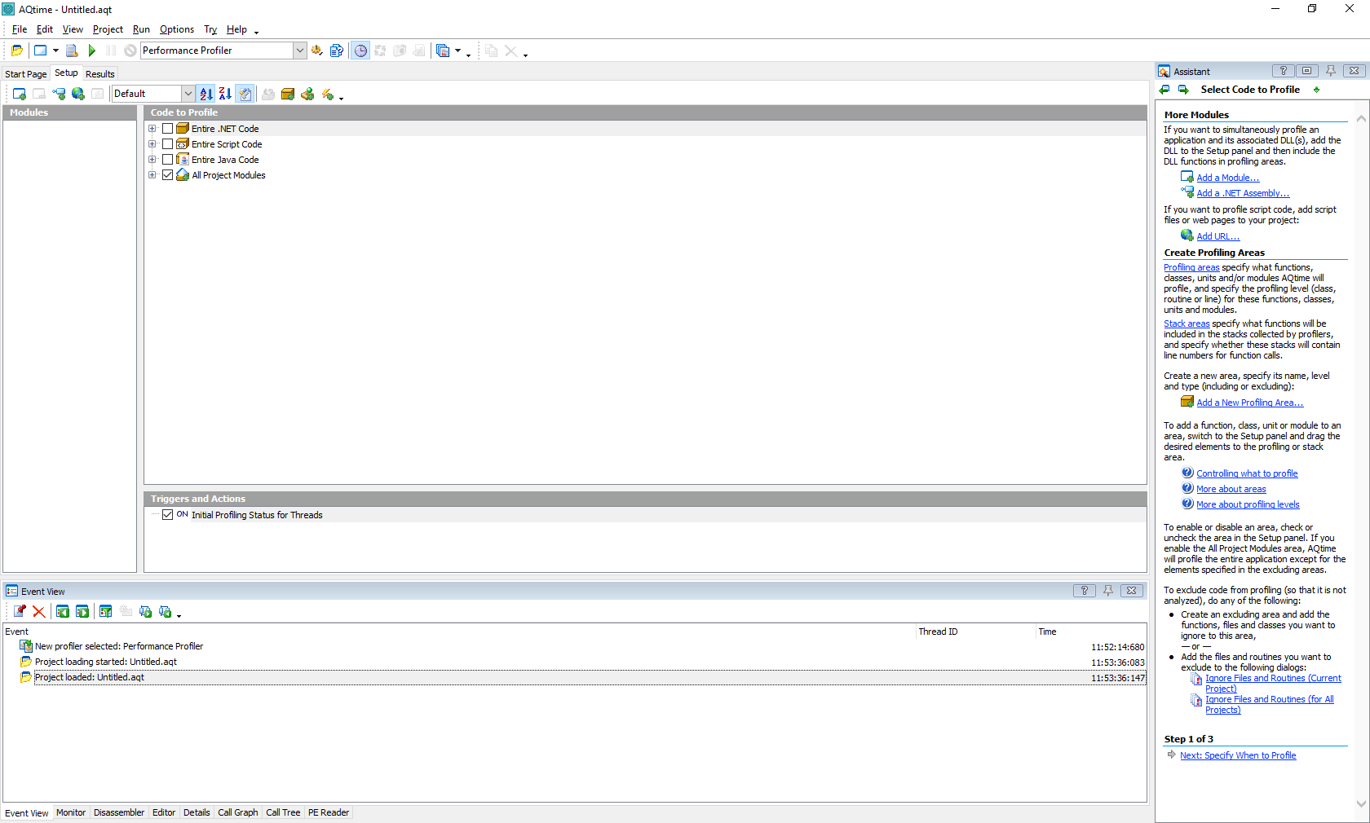
4.Create New Project

Slide 4
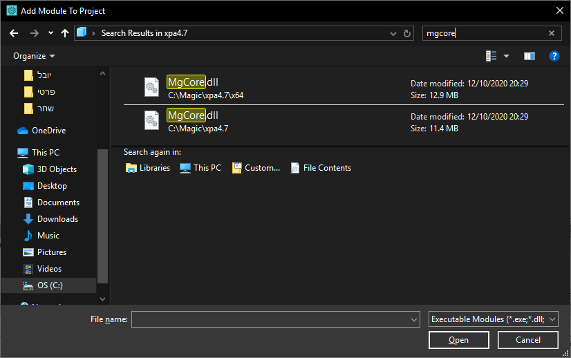
3.Click Menu : Project->Add Module... -- select the dll which you want to analyze for performance.

Slide 5
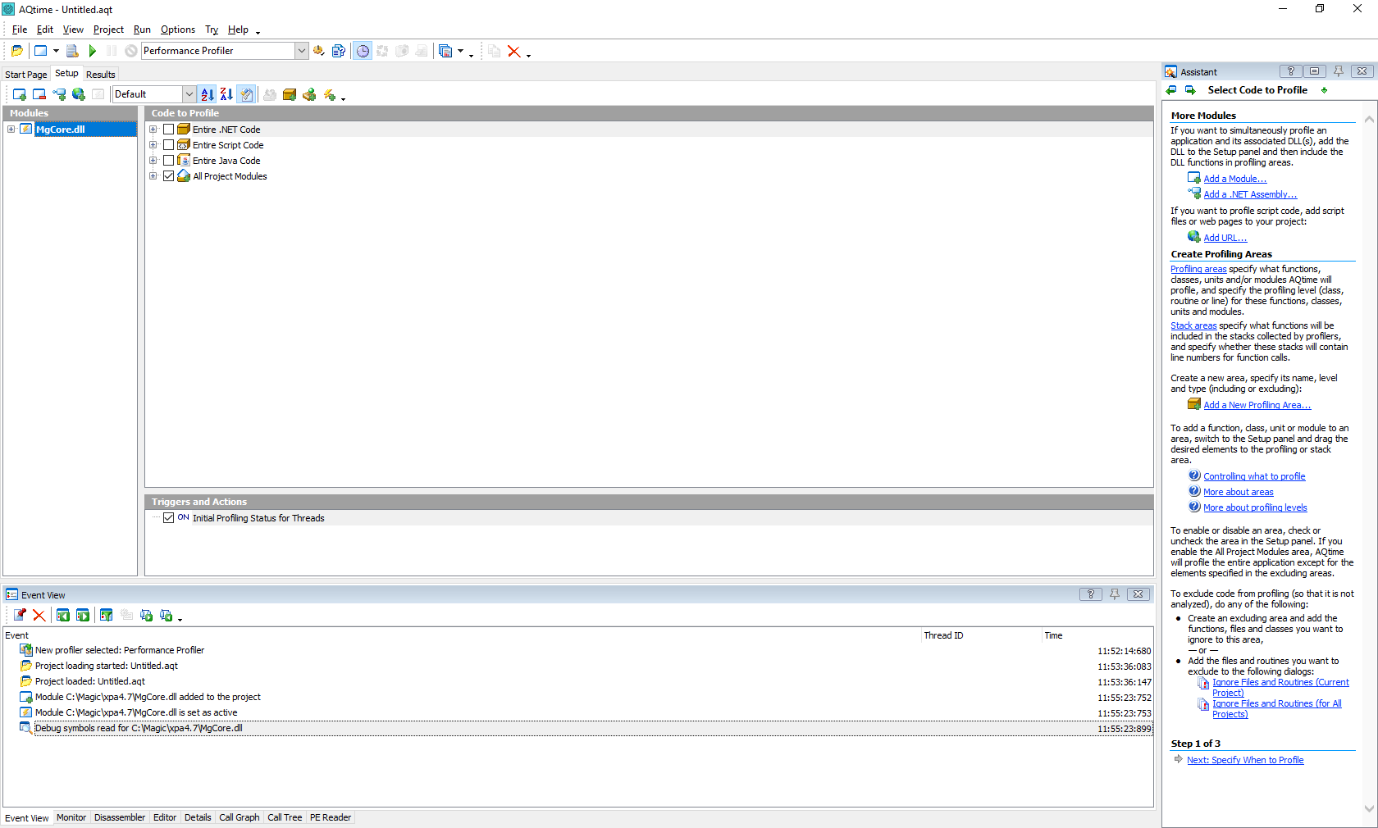

Slide 6
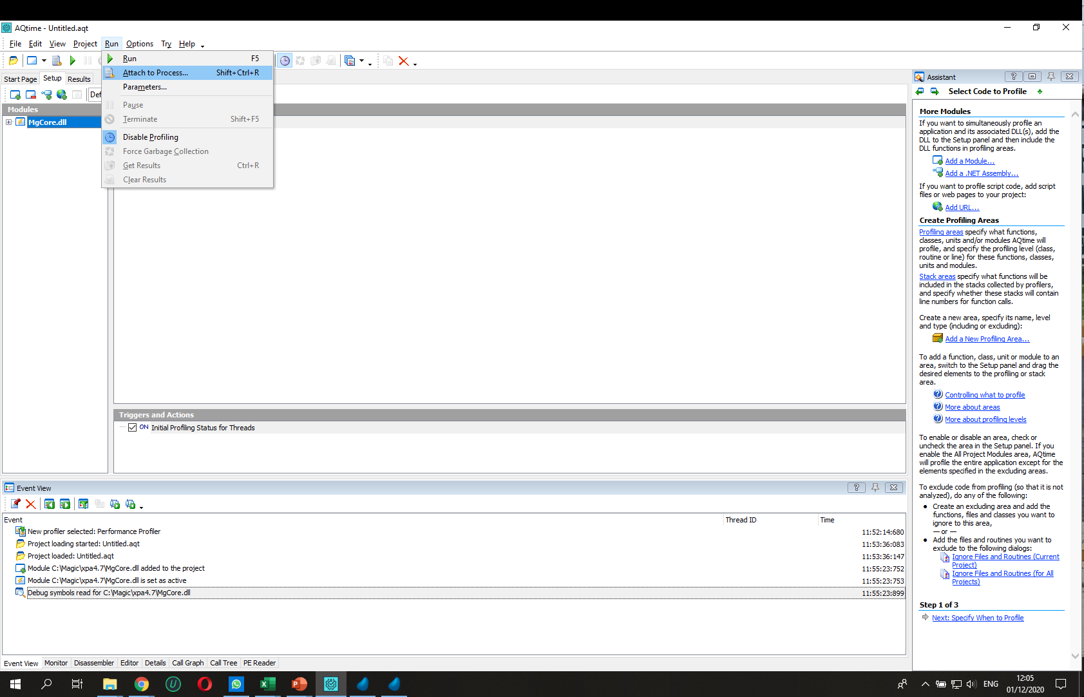
4.Click Menu : Run->Attach to Process… : Select MgxpaRuntime.exe

Slide 7
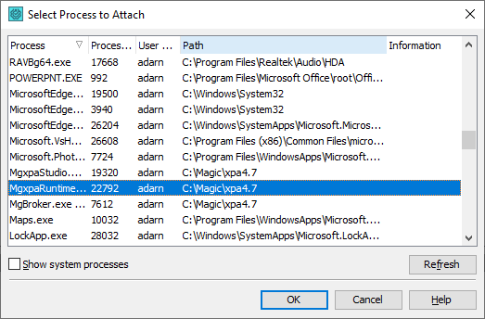

Slide 8
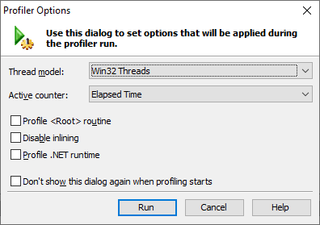

Slide 9
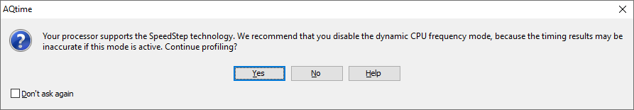
You will get Dialog :
Press 'Run' button. You may get warning message dialog of 'CPU Frequency mode'. Press 'OK' for it
it will continue. And It will perform 'instrumentation'.

Slide 10
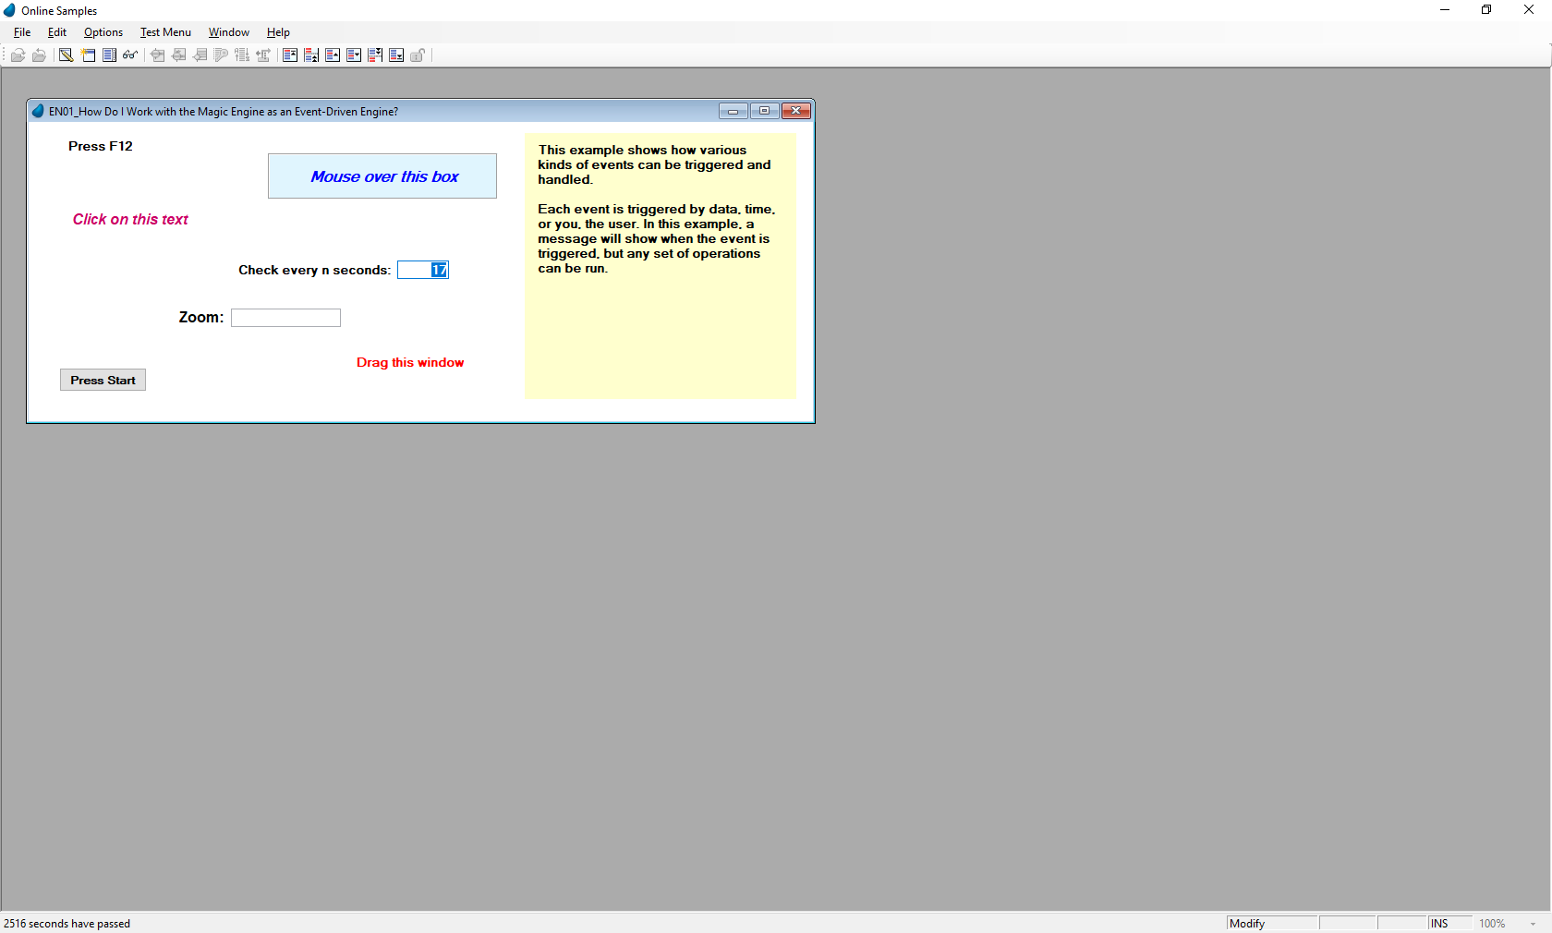
5. Now click on ‘Clear' icon.
6. Now perform the operation in the Mgxparuntime.exe , for which you want to analyze the performance.

Slide 11
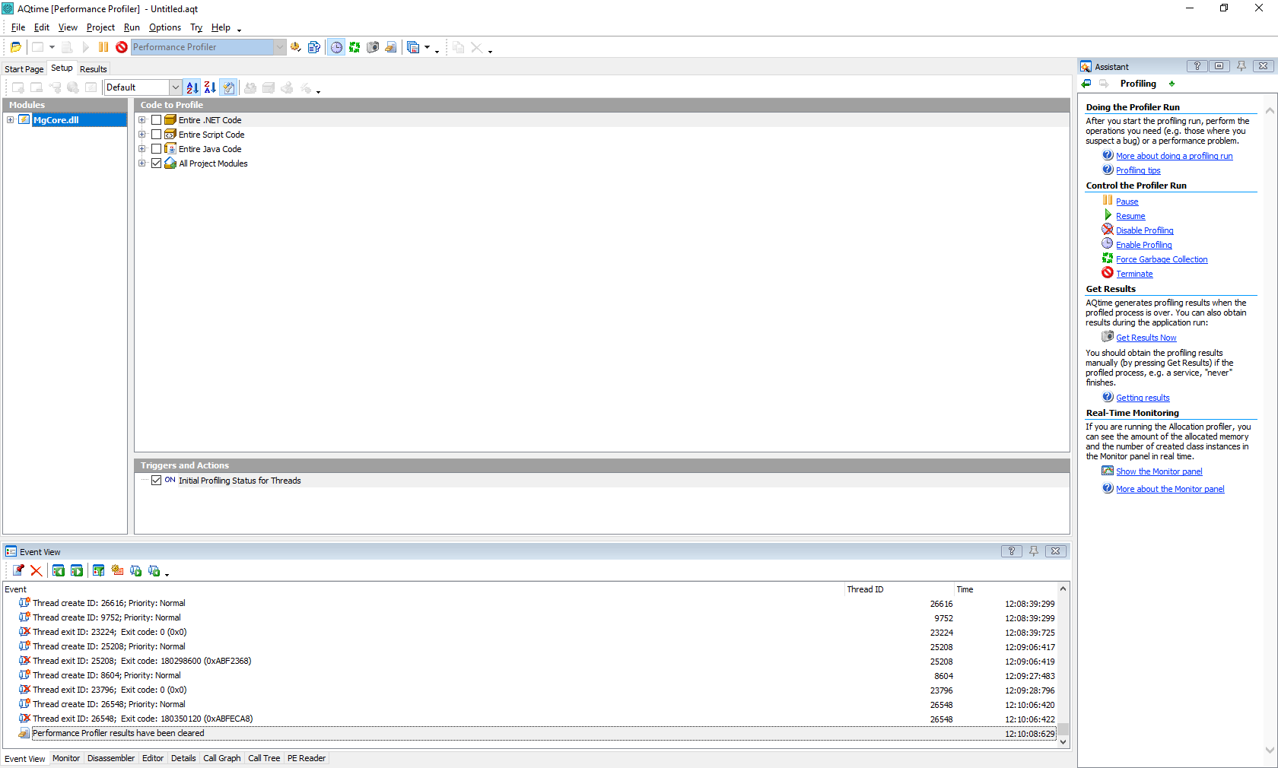
Clear and Camera buttons
Now take snapshot , by clicking on 'Camera' icon.

Slide 12
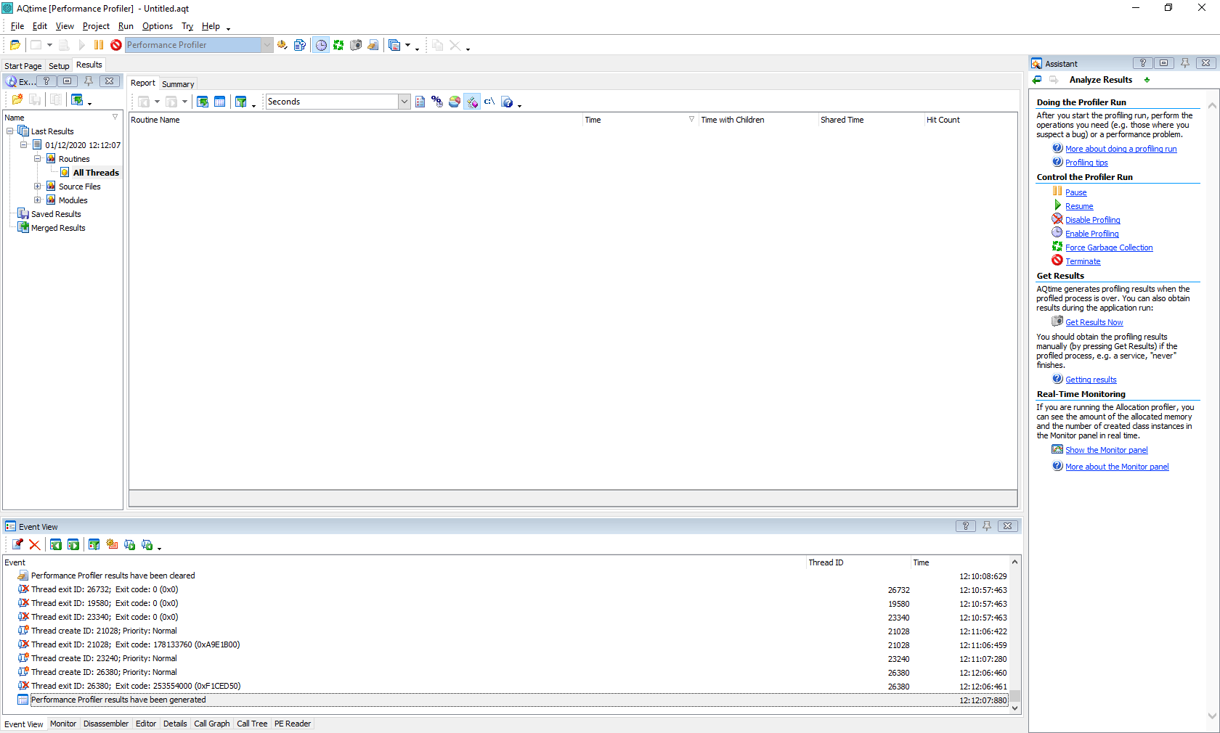
7.Now you will see that performance analysis report is generated

Slide 13
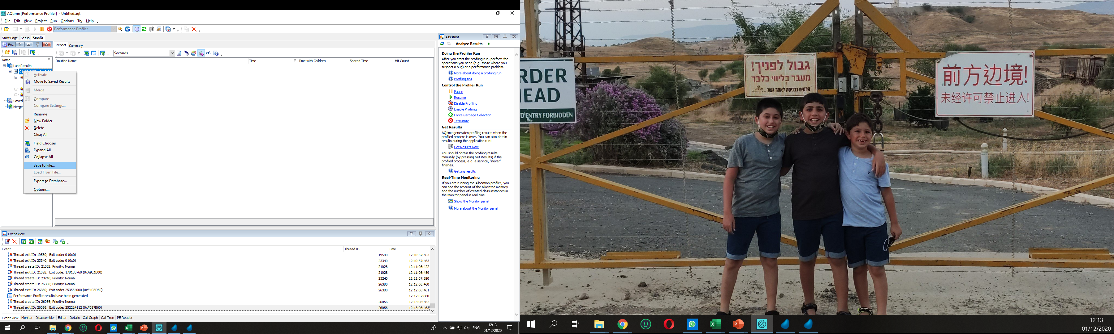
Save it and pass to R&D for Analysis

Slide 14
