Slide 1
Project Title:
Univ. Students Daily Activities
Student’s Name: Abhishek Reddy Pentareddy
Course : CS694AH1 TOPIC: BIG DATA SYSTEMS,
Semester: Spring 2020
Professor’s Name: Prof. Dr. Bhumip KHASNABISH
Presentation Date, Location & Time: 02/29/2020

Slide 2
Outline
Abstract and Summary
Main Focus of the Project
Survey of Previous works
Distinction of the Current Work
Usefulness of the Current Work
Simulation/Emulation Details
Results
Future works
Q&A and Discussion
References
Background and Other Information

Slide 3
Abstract and Summary
The main aim of this project is explain about the 20 university students daily activities information and time spent in weekdays information.
Analysis about all 20 students daily activities and generate the visualized results regarding student activities and time spent details.

Slide 4
Main Focus of the Project
This project main focus is 20 students daily activities.
Generally students spent in different activities. gathered information from some of university students and perform analysis on student daily activities and develop the project for reports.

Slide 5
Distinction of the Current Work
This project provide the details about student daily activities in weekdays.
Provide the each weekday daily spent hours information
Provide the students daily spent information like males and females daily spent information.

Slide 6
Usefulness of the Current Work
Based on this project university management understand about students interests.
Based on that analysis of student daily activity spent reports provide the better and efficient resources to students for spent of more time in studies or sports or other working things.

Slide 7
Simulation/Emulation Details (Environment and Setup)
Implemented code in python programming languages
Installed python command line software and anaconda jypytor notebook

Slide 8
Simulation/Emulation Details (Tools and Monitoring Options)
In this project perform the students daily activity spent simulation details in 3 types.
Perform simulation on student weekday activities spent information.
Perform simulation on student education activity per hour in each day.
Perform simulation on student activity based on gender.

Slide 9
Simulation/Emulation Details [Adjustment(s), Adaptations, etc.]
For this project prepared the 3 datasets and students daily spent activities details and time spent hours information.
If any changed perform changes in prepared input datasets and get the updated and efficient outcomes.

Slide 10
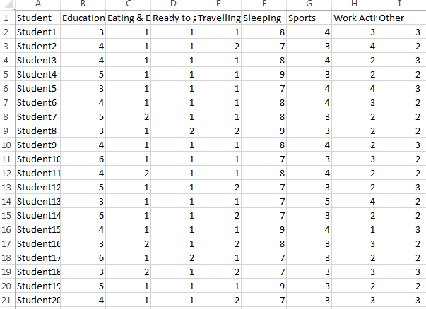
Results
Dataset of Student week day activity

Slide 11
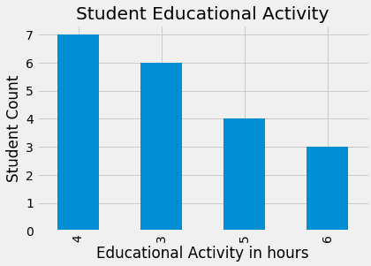
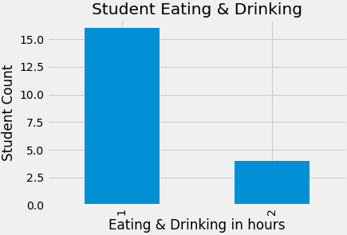
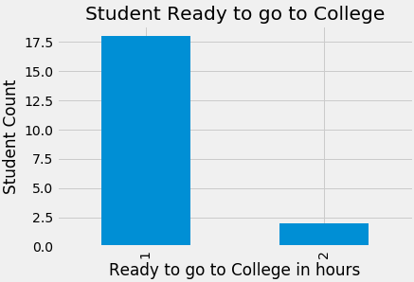
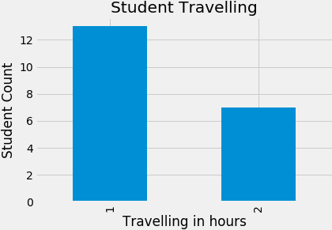
Results
Result of Student week day activity

Slide 12
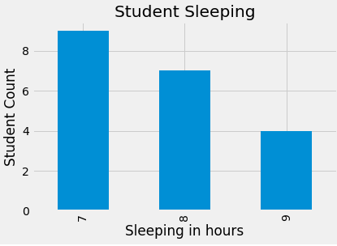
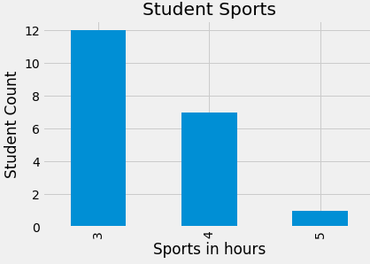
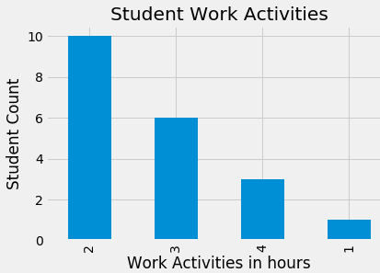
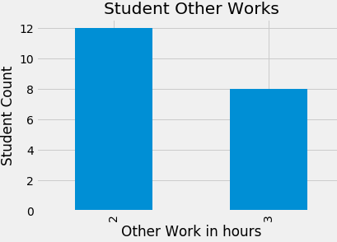
Results
Result of Student week day activity

Slide 13
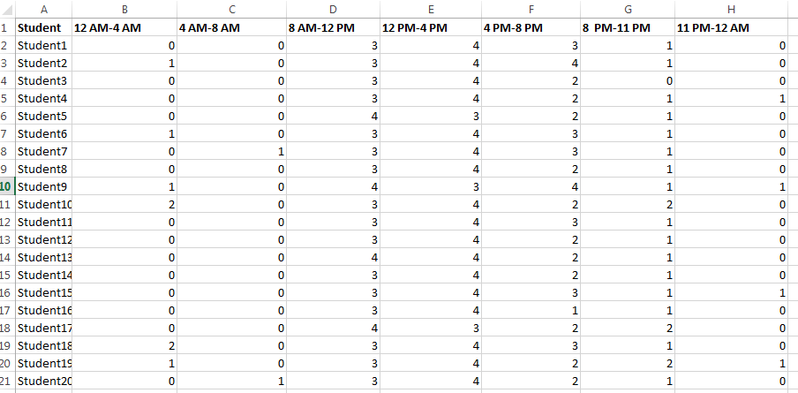
Results
dataset of Student educational activity per hour

Slide 14
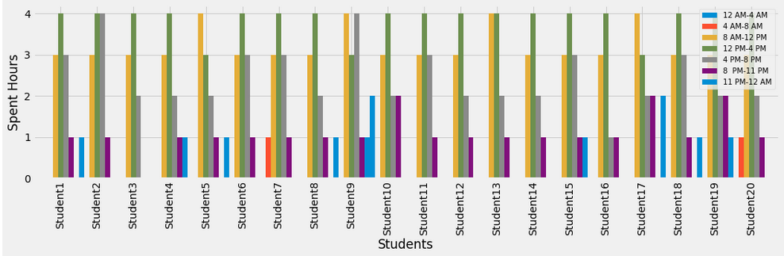
Results
Result of Student educational activity per hour

Slide 15
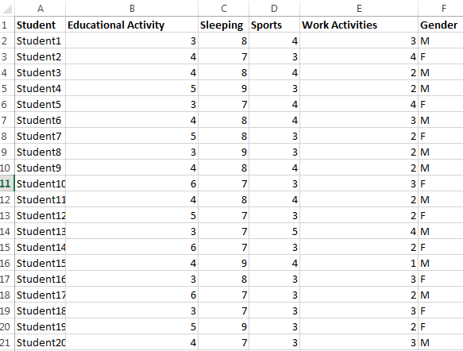
Results
dataset of Student weekday activity based on gender

Slide 16
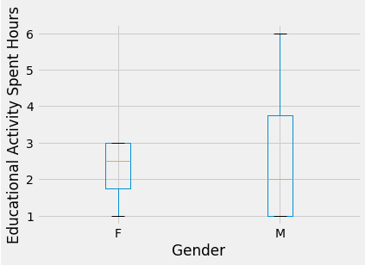
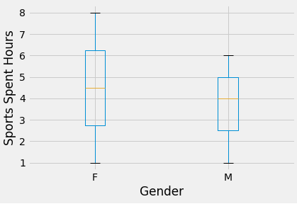
Results
Result of Student weekday activity based on gender

Slide 17
Future Works
This project future enhancements are collected the information about students weekends and holidays activities and will provide the simulations results.

Slide 18





Q&A and Discussion
Thanks for Your KIND Attention
Discussion

Slide 19
References
https://www.programiz.com/python-programming/tutorial
https://www.javatpoint.com/python-tutorial

Slide 20
Background and Other Information

Slide 21
Weekly Activities Log
Week No. | List of Tasks (Planned) | Log of Achievements, Errors, and Learning
02 | Gather the required and needful input data from my university students.
03 | Gathered the information from males and females students and their daily activities information.

Slide 22
Weekly Activities Log
Week No. | List of Tasks (Planned) | Log of Achievements, Errors, and Learning
04 | Based on gathered information design the input dataset and create the input dataset.
05 | Created input dataset in 3 categories and perform students daily activities in 3 types of simulations.

Slide 23
Weekly Activities Log
Week No. | List of Tasks (Planned) | Log of Achievements, Errors, and Learning
06 | For students educational activity each hour daily activity spent simulation implement python programming source.
07 | For students weekdays daily activity spent hours based on males and females gender simulation implement python programming source.

Slide 24
Weekly Activities Log
Week No. | List of Tasks (Planned) | Log of Achievements, Errors, and Learning
08 | Test the project results and validate the results

