Slide 1
Ishare demo app
Application Features to Database mappings

Slide 2
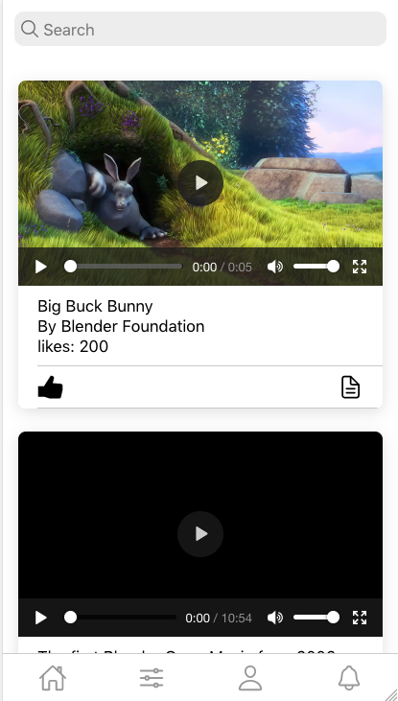
Search indexes for content is maintained in Elasticsearch
Elasticsearch
Assets like images and video are stored in Object store
S3
Actions like A likes B’s post or A comments on B’s post or A follows B will be stored internally in Neptune
Neptune
Actual text of Document can be stored in a Document Store or a key values store
DynamoDB

Slide 3
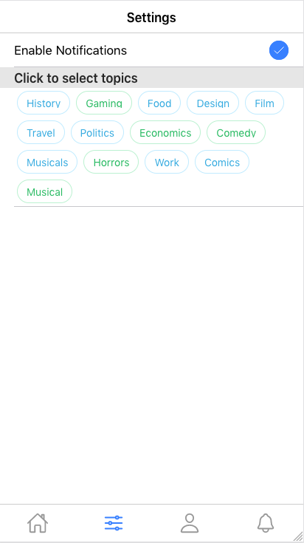
User preference can be stored in DynamoDB and Cached inside Elasticache
DynamoDB

Slide 4

Fast lookup for any pending alerts can be done using Elasticache
Elasticache

