Slide 1
Build your Social Graph on AWS <Month> <Year>

Slide 2
Application Overview

Slide 3




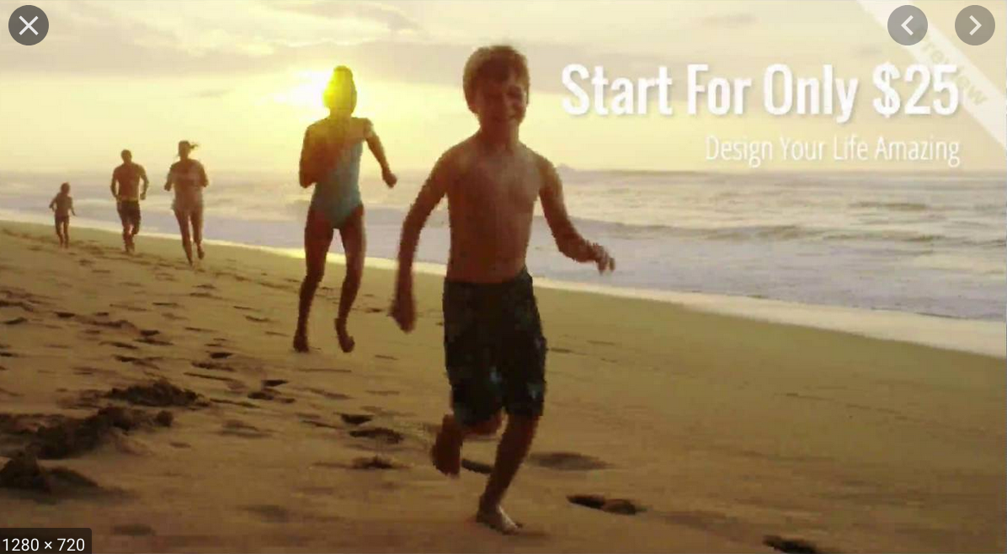




Feature Overview
Learning Objectives
search videos
videos are pre-uploaded by admin from backend or user by accessing upload page
Define Workflow to store and retrieve video to/from persistent store
users can like a video, tags associated with liked videos are auto-added to users preferences
Define Workflow to retrieve videos based on users preferences
Define Workflow to capture users like and build users preferences based on likes
comments in videos are captured and shared with everyone
Funny Bunny Video!!
By: XYZ
Likes: 15
Like
Comment
Make choice of databases for storing user connections
Define workflow to store and retrieve user connections based on likes
Define workflow to generate events when user likes a video
Beach fun
By: XYZ
Likes: 15
Like
Comment
Define Workflow to search video based on tags or text or connections

Slide 4
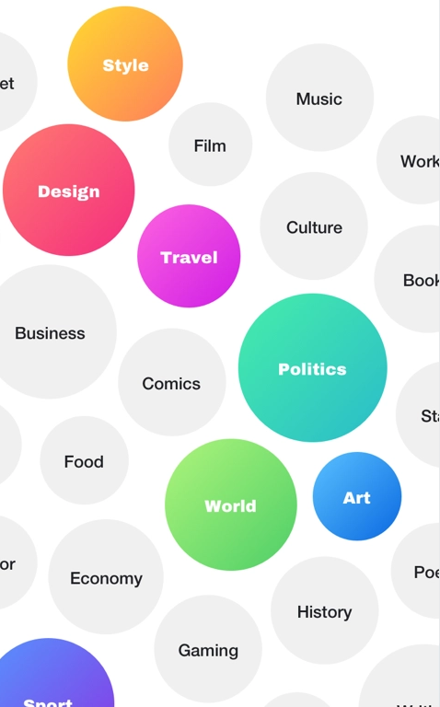
Feature Overview
Learning Objectives
Preferences
Later
Screen populates pre-defined preferences
Define a DB model to store Users Preferences
Users can select more than one preferences
Make choice of database to appropriately store user preferences
Preference will be used to populate videos for user on landing page
Design workflow to store and retrieve user preferences
Design workflow to handle any changes to users preferences

Slide 5
Feature Overview
Learning Objectives
Notifications
User is notified if a new video is uploaded based on his preferences or connections
Define Workflow to send notification to user browser/phone
A new video has been uploaded by <XYZ> you might like
2 min ago
User is notified if someone likes his/her video
Define Workflow to capture events generated in the backend
Someone Like Your Video, see who
30 min ago
Define Workflow to capture user activity

Slide 6

Name
OTP
Phone number
enter phone number
Sign-in
Join
Confirm
New to App? Join
Already a Member? Sign-in
Already a Member? Sign-in

Slide 7
Feature Overview
Learning Objectives
User can Sign-Up using their mobile phone numbers
Create backend for storing user credentials
User is verified via an OTP sent to mobile app
Define workflow for user Sign-Up
Once OTP verification is complete user signup is done and user is taken to Preferences screen
Define workflow for user Sign-In
enter phone number
Sign-in
New to App? Join

Slide 8

Feature Overview
Learning Objectives
People
Show List of People who are connected to user based on video likes
Define workflow to get list of user based on users connections
FOLLOWING
Me
FOLLOWED BY

Slide 9


Feature Overview (Future)
Learning Objectives
Allow people to capture videos from their devices and upload
Define workflow to security upload video to persistent store
Once captured user can attach tags to videos

Slide 10
Workflows
ID | Title
1 | As an App User I should be able to Log in using my Facebook/Google ID
2 | As an App User I should be able to capture video on Device and save it
3 | As an App User I should be able to follow other users of App and see content shared by them based on my preferences and my connections
4 | As an App User I should be notified of new video uploaded by based on my preferences via notification on the application
5 | As an App User I should be notified of new video uploaded by people I follow via notification on the application
6 | As an App User I should be able to see my preference on multiple devices
7 | As an App User I should be able to Log in using my Facebook/Google ID
Note: EPICs can be accessed here https://app.asana.com/0/1184838807682443/board

Slide 11

High Level Solution Overview
Web App
API Security
Record Management APIs
Auth APIs
Event and Messaging APIs
Logging
Recommendation APIs
Data Security
User Meta Store
Network Store
App Cache

Slide 12
High Level Solution Overview
Record Management APIs
APIs to manage CRUD operations for storing application data in persistent store
Event and Messaging APIs
APIs to capture events and relay them . This can be modelled as a message queue to temporarily stored messages and send them to message handlers
Auth APIs
APIs to Authenticate, authorize a user’s principal and control access to application
Logging
Component to log all API calls centrally, capability to generate reports
Recommendation APIs
Based on users preferences and their connections send recommendation to people

Slide 13
Technical Architecture
Progressive Web App
API Security
Event Processor
API Gateway
API Handlers
Data Retriever
Graph Store
Message Queue
Message Processor
User Meta Store
Media Store

Slide 14
Technical Architecture @ AWS
Progressive Web App
[Ionic Framework/React JS]
[AWS Amplify]
API Security
[Amazon Cognito]
Event Processor
[AWS Lambda]
API Gateway
[AWS API Gateway]
API Handlers
[AWS Lambda]
Data Retriever
[AWS Lambda]
Graph Store
[Amazon Neptune]
Message Queue
[Amazon SQS]
Message Processor
[AWS Lambda]
User Meta Store
[Amazon DynamoDB/
DocumentDB/S3]
Media Store
[Amazon S3]

Slide 15
Brief Overview of AWS Services
ID | Title | Details
1 | Demo of Amazon Neptune Capabilities | Bulk upload Data Gremlin Queries Setting up Gremlin client Amazon Neptune streams
2 | Demo of setting up Amazon Amplify for Progressive Web App
3 | Demo of AWS Code Star
4 | Demo of AWS CodeGuru

Slide 16
Data Models-User Connections
Danny
Funny Cat
Label: Video
Label: Person
Label: owns
Label: follows
Label: likes
Abhishek M
Label: Person

Slide 17
Data Models-User Preferences

Slide 18
Thanks

