Slide 1
Columbia University IEOR4742 – Deep Learning for OR & FE Project Summary (Group 14)
Portfolio Construction
Authors contributing to this work:
Abhishek Mukherjee, Xueru Wang, Sie Hendrata

Slide 2
Idea
Given past stock prices + technical + analyst predictions + real EPS + fundamentals
We were able to predict EPS for the next month pretty well
Want to:
Apply this to portfolio construction techniques, with SP500 as benchmark
Main questions:
How to construct weights
How to extend our prediction to multiple stocks?
Currently very cumbersome and manual

Slide 3
Portfolio Weights
Training Start Date: 1/1/2004
Before this, a lot of data is missing
Portfolio Start Date: 1/1/2010 ← fund “inception”
Portfolio End Date: 1/1/2018 ← “today”
Should really be 2019, but need to clean data a little bit before we can do this
Monthly rebalance, even though EPS changes quarterly
For month T, we use daily data from 1/1/2004 to end of month T-1 to train regressor
Use data from first week of month T to predict EPS
That way regressor cannot “see the future”
Regressor constantly being updated / trained anew

Slide 4
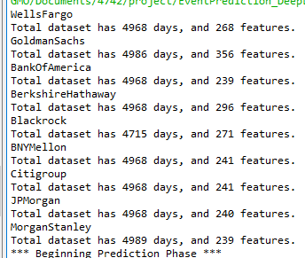
Scale of data

Slide 5
Portfolio Weights, flavor A
From EPS, we can calculate P/E
High EPS → low P/E → desirable
Weights proportional to 1/ P/E (normalized to add up to 1)
Later if we have a lot of stocks
Consider truncating so that we don’t own 1 bps of a stock OR
Choose 50 best P/E ← our “stock picking”

Slide 6
Portfolio Weights, flavor B
Calculate (EPS Prediction – Analyst Prediction) / EPS Prediction
High → tends to increase stock price after earnings call → desirable
Challenges: what about negative? Can we short in our portfolio? How to avoid weird weights?
For now, we truncate it at 1e-4
Then normalize to 1

Slide 7
Portfolio Weights, Flavor C
Calculate (EPS Prediction – Average EPS) / Average EPS
Average = the last 1 year’s worth of EPS
High → looks like going to earn more than usual → desirable
Same challenges as flavor B: what about negative?

Slide 8
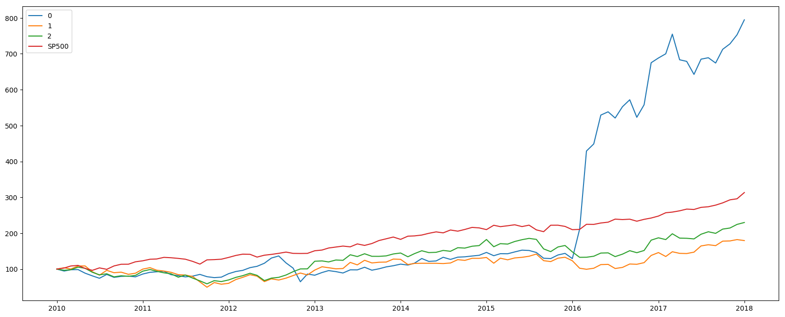
Results:

Slide 9
Analytics
 | Flavor A | Flavor B | Flavor C
Alpha | 1.68 | -0.26 | -0.12
Tracking Error | 0.14 | 0.09 | 0.08
IR | 11.49 | -2.74 | -1.5
Returns* | 2.89 | 0.94 | 1.08
Vols | 0.15 | 0.09 | 0.07
Sharpe | 19.73 | 10.99 | 15.11
Sharpe ratio is not realistic because:
*assumes 0 risk free.
Zero transaction cost. Some turnover is huge (up to 80%)
Our flavor A performance is huge because:
We shorted Citibank right when the stock price dropped big time (-35%)
This is as per flavor A’s weighting scheme. Can we do this in real life?

Slide 10
Challenges
Better way to construct weights?
Long training time
New regressor for each month, per stock
Is there a way to “add training set” to regressor without training it anew?
How can we do this in the cloud? This process is very parallelizable
If we can bring training time down, we can do more frequent rebalance
How to extend to more stocks?

