Slide 1
Coroutines
Basic Concepts
Program- set of instructions which is to be written for achieving a task.
Process- when we run a program a process has been created. Inside that process these set of instructions(programs) were executed.
Inside every process there is at least 1 thread is there

Slide 2
Basic Concepts
Sequential Execution
Process: -> Instruction1,
Instruction3, Instruction4
A problem in this is sequential execution is if any instruction say instruction2 took a longer time to execute then other instructions will get halt until sequential2 gets executed.
Instruction2

Slide 3
Basic Concepts
So, for improving the application performance we can create another thread in which Instruction2 gets executed and all other instructions gets executed in thread1. Now we have 2 threads in our process.
We can also create different threads and assign them different tasks.
By using this we can execute long running tasks in separate thread.
example : If you open a word document and you start writing something to it you can observe that spell checker is also running.
In this scenario, spell checking was running in separate thread and writing task is executed on a main thread.

Slide 4

Basic Concepts
Question: What types of Instructions are we executing these days – I/O Operations
Basically we are using threads for input and output operations.
Suppose we hit the Api and we have to wait until we get the response and when we get the response the next instructions gets start executing.
Until we receive the response our thread will be in waiting state.

Slide 5
Basic Concepts
Similarly, Suppose we have another thread and at moment we start reading a file and suppose our device was slow so it took time to read the file. so, for a longer duration of time our thread was at halt it was waiting till the read from file gets completed so that it will start executing instructions again.

Slide 6
Basic Concepts
So, most of the times our threads were in waiting state for getting the response.
Basically our proper CPU utilization is not there because our thread has to wait for getting the response.
So, the question is
Can we just re-use the thread when it is waiting for some operations or IO operation?
This questions sets the foundation of Coroutines.

Slide 7
Basic Concepts
The threads which are in waiting state. Can we use those threads for executing another tasks.
Suppose 1st red dot is when we hit the Api. And 2nd red dot is when its done.
In between hitting the Api and getting data from API we want to reuse the thread for executing another task. Coroutines work on these concepts.

Slide 8


Coroutines
Thread Pool
Suppose we want to execute multiple tasks on a thread. So we will take a thread and execute those tasks in that thread. So, when it is performing IO operation we will reuse the thread to perform another task until we get the response.
Suppose at that instant we get the response and thread is not available means it was busy in another task, in that case we will get the thread from threadpool and we will peroform remaining task in another thread. In this way the remaining task will be performed in another thread.

Slide 9
Coroutines
In this way we can perform multiple tasks on a thread this concept is known as coroutines.
COROUTINES: are also called as functions.
In Co means Cooperating and Routines means functions.
So coroutines are Cooperating Functions means tasks are cooperating with each other so that they can easily use the thread pool. So that thread which are in thread pool can be used for running the application efficiently and we will not create multiple threads and by using only few set of threads we can perform the task efficiently.
This is known as coroutines.

Slide 10
Coroutines
COROUTINES
Executed inside a thread
One thread can have many coroutines.
Cheap – Because our system has a limitations that it will create only number of threads but we can create multiple coroutines because in each and every thread we can execute multiple threads.
Example:
Means in a single thread we can execute multiple tasks and it starts execution from there only where it had stopped previously.

Slide 11
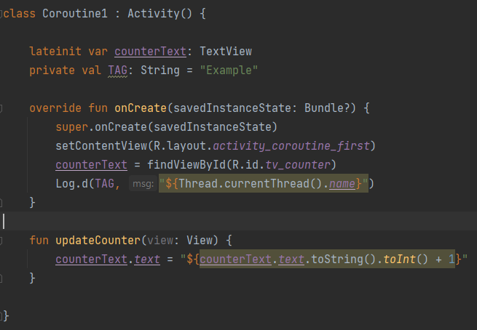
Coroutines

Slide 12

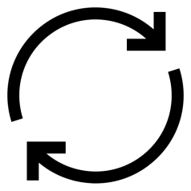
Whenever we run a application a process gets created and in that process we have a thread in which all our code gets executed. This is also called as a Main Thread or UI Thread. Our code gets executed sequentially.
Main Thread
Looper
T1
T2
T3
T4
T5

Slide 13
Coroutines
In Main thread all the instructions are executed one by one. In Android, we have a concept of looper and Message Queue.
Work of Looper is to check Message Queue continuously so that whenever Message Queue gets a message, looper will take it and execute that message in Main Thread.
Suppose you click on a button or you want to update the UI, all these tasks were added in a message queue. So looper will take all these tasks one by one and execute those tasks in a main thread.
All these tasks were executed sequentially.
All the tasks were executed in a main thread with the help of Looper. Looper will always run on infinite loop which take the tasks from message queue and pass it to main thread.

Slide 14
Coroutines
From above diagram, suppose T2 and T4 are used for updating the UI. In between T3 took a lot of time so our UI will not get updated until T3 gets executed completely. So user will think that App got freeze.
Hence we want that all these tasks which are running on a main thread were not long running tasks so that our UI gets updated continously.

Slide 15
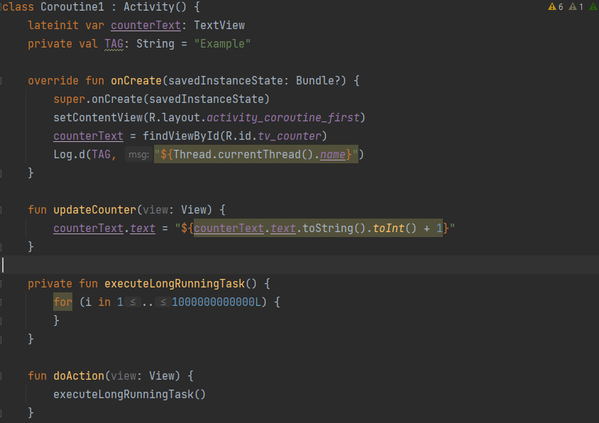
Coroutines

Slide 16
In image shown above, if we click on execute task button and instantly we will click on update we will see that updation of counter gets freeze for few seconds and after that it gets updated.
Similarly if a task will take too long to get execute then other tasks have to wait until the execution gets complete.
So, what we will do, we will create another new thread which will run executeLongRunningTask() method. So that our main thread gets free.
After running the code we can see that even if press on “execute task” button and instantly we will click on update counter, the value of counter gets increases without any problem.
We will fix these types of problem by creating a new thread for long running tasks.
Before coroutines we were solving these type of problems by using background threads like Network call, database operations.

Slide 17
Threads was also a good options for solving these types of problems but there is a issue with thread also.
Like you can create only limited threads because these are OS level threads and took a large space. Each thread is around of 2mb of memory. It totally depends on our system that how many threads it can generate.
This is the limitation with threads. Also, context switching with thread is also difficult.
Context switching means you execute a few lines of code in a background thread and now you want to execute remaining code in a main thread. In that case you have to switch the context.
To solve these kinds of problems we have coroutines.
What’s the solution in Java? – No Solution, we have only threads in Java
What’s the solution in Kotlin? – Coroutines
Coroutines are just like threads(lightweight threads) but not threads.
Coroutines are called light weight threads because they mimick the behaviour of threads.

Slide 18
Means it will acts like threads but they are not threads.
Coroutines run on top of threads- means there is a framework above threads. And we interact with this framework and behind the scene this framework interact with the threads.
For defining the Coroutines we need 2 things.
1. Coroutine Scope
2. Coroutine Context
Coroutine Scope- defines the lifetime of coroutines.
Coroutine Context- tells us that on which thread our coroutine will gets executed.
All our coroutine gets launch in a particular scope.

Slide 19

Scope defines a boundary. Inside that boundary our coroutines gets launch.
Benefit of defining coroutines inside coroutinescope- Suppose in our android application, different components are there like activity, fragments, viewmodels, all these have a lifetime means if you go from 1 activity to another activity then 1st activity gets destroyed. Similarly fragments and viewmodels have their own lifecycles. So whenever our components gets destroyed we want all our coroutines inside those components also gets cancelled. So what we will do here is we will attach this scope with that component. So whenever that component gets destroyed thenall the coroutines inside coroutinescope also gets destroyed.

Slide 20
Coroutine Context
Coroutine Context basically provide us information that on which thread the coroutine gets executed.
Dispatchers
As we know that behind the scene coroutines were using threads.
Dispatchers is a way to define set of threads on which coroutines are to be executed.
From the word “Disptachers” we can understand that dispatching the coroutines over a thread so that they can execute.
Predefined Dispatchers:
Dispatchers.IO
Dispatchers.Main
Dispatchers.Default

Slide 21
IO Dispatcher: starts the coroutine in the IO thread, it is used to perform all the data operations such as networking, reading, or writing from the database, reading, or writing to the files eg: Fetching data from the database is an IO operation, which is done on the IO thread.
Main Dispatcher: starts the coroutine in the main thread. It is mostly used when we need to perform the UI operations within the coroutine, as UI can only be changed from the main thread.
Default Dispatcher: starts the coroutine in the Default Thread. We should choose this when we are planning to do Complex and long-running calculations, which can block the main thread and freeze the UI
Basically Dispatcher is a thread pool which defines the set of threads on which coroutines have to be executed.
For using the coroutines we have to add these dependencies in our app gradle.
“ implementation 'org.jetbrains.kotlinx:kotlinx-coroutines-core:1.5.0‘ ” “ implementation 'org.jetbrains.kotlinx:kotlinx-coroutines-android:1.5.0‘ “

Slide 22
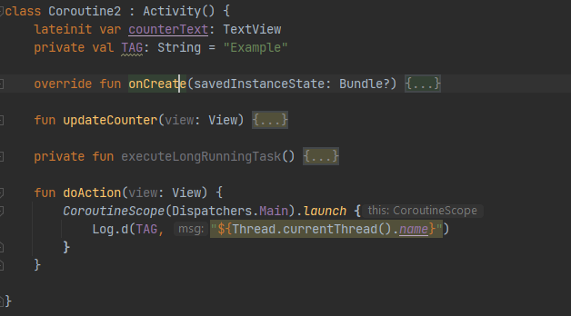

Slide 23


In this way the coroutines gets launch.
As we have predefined dispatchers similarly we also have predefined scopes which are attached to a particular component.
Like: GlobalScope- which is attached to our whole application, with the help of globalscope we can launch a coroutine.
Similarly, we also have a MainScope which is attached to MainActivity
In this way we can execute different coroutines which will execute on different threads.

Slide 24
Suspending Functions and Suspending Modifiers
As we seen before that we can create a coroutine in this way
CoroutineScope(Dispatchers.Main).launch { Log.d(TAG, "${Thread.currentThread().name}") }
For creating a coroutine we need 2 things:
CoroutineScope and Coroutine Context
CoroutineScope defines what will be the lifetime of this coroutine. Like we have a lifetime of a activity, view models. Similarly CoroutineScope defines the lifetime of a coroutine.
CoroutineContext mainly defines on which thread the coroutine will gets execute
So, in above code snippet we were using Dispatchers which define our context.

Slide 25
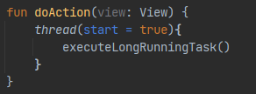
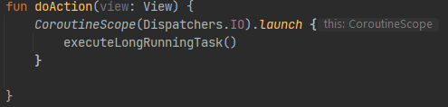
As we seen that if perform a long running task in main thread then our app will gets freeze. So what we done in the past is, we have created a thread. And inside that thread we have executed the executeLongRuningTask() method.
By doing this our Main Thread gets free and the long running task gets execute in background thread.
And when we use coroutines then in case of creating a thread we have launched a coroutine which will execute our executeLongRuningTask()

Slide 26
There is no such major difference in both above code snippet, because in 1st we have created a new thread and in another, as we know that coroutines runs above the threads. So behind the scenes it is also using threads.
Then the question is why we will use coroutines? What other benefit does coroutines will provide us?
Coroutines helps us to implement functionality that can be suspended and later resumed at specified points without blocking the thread
So, while using threads when we hit the api at first red dot, thread goes in waiting state until we got the response (2nd red dot).
So, Coroutine provide us the feature to suspend the task when we reached at first red dot means when we hit the API and resume it when we gets the response.

Slide 27
Functions with suspend modifiers are called suspending functions.
suspending functions helps us coroutine to suspend the computation at a particular point.
Whenever a coroutine reached the suspend point it will assign a task to thread to complete. On a same thread 2nd coroutine will start to execute.
Suspending functions must be called from a coroutine or from other suspending function.
Example:
THREADS:
Task 1
Task 2

Slide 28
Suppose we have Task1 and Task2 and we want to execute these 2 tasks in a thread.
We have started executing Task1 and when it reached at the center, it checks that it is an IO operation, so until it gets the response it remain at the waiting state and after getting the response it will execute the remainiing task.
Similarly, it will work same for Task2 while using threads.
Now with Coroutines:
When task1 see that it is an IO operation, it suspend the task. At that suspended time Task2 start executing and when task2 start perform IO operation that time task1 starts executing and when task1 gets done then task2 starts executing again.
Task 1
Task 2

Slide 29
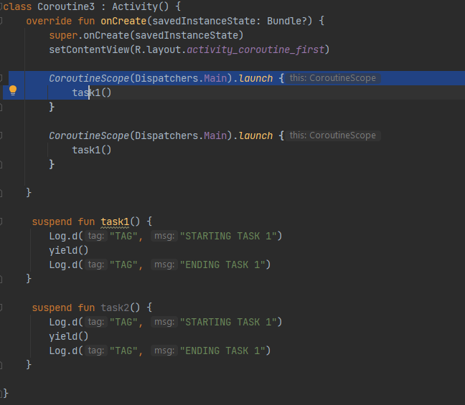
In coroutine we have few built in functions which define the suspension points.
yield() -> yield defines the suspend function which tells the compiler that the function will suspend at this point.

Slide 30

The output of above program is:
Firstly, it start executing Task1 and it will print STARTING TASK 1, then we call a yield() function which defines the suspension point. So, it check do we have any other coroutine. it saw that we have Task2() so it start print STARTING TASK 2 then again we call yield() function which define suspension point for task2. so it check is there any other task and it saw that task1 has a pending code. So it print ENDING TASK 1 and after this it prints ENDING TASK 2.
delay() -> delay also defines a suspension point.
delay(1000) -> time is in milliseconds.
While using delay in the above code, the output would be same.

Slide 31
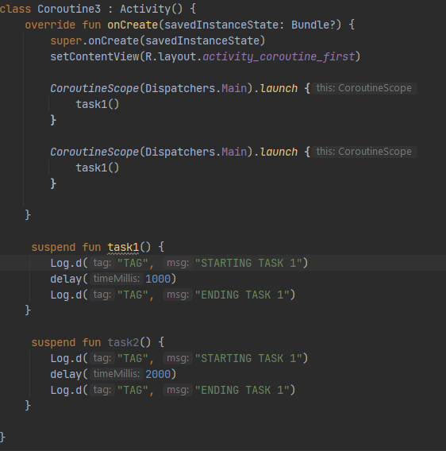

Slide 32
Coroutine Builders - launch, async
Coroutine Builders- Functions that in creating coroutines.
Launch -> Launches a new coroutine without blocking the main thread and returns a reference to the coroutine as a Job
This “Job” object basically helps us in managing the coroutine. Suppose we want to cancel the coroutine or wait for the coroutine to execute the task completely.
val job = CoroutineScope(Dispatchers.IO).launch { }
We have different properties of this Job object which we can use.
job.cancel () -> To cancel the coroutine
Job.join() -> Until the coroutine gets executed completely it will remain us in waiting state without blocking the thread.
Means our thread will not get blocked but coroutine will remain in suspended state.

Slide 33
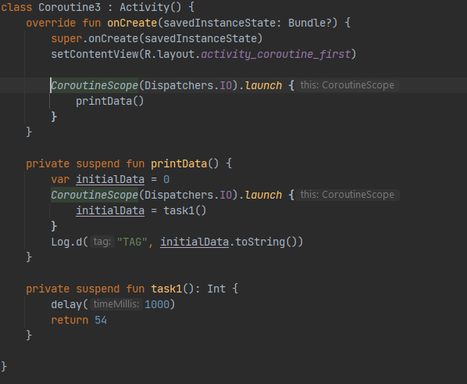

Slide 34
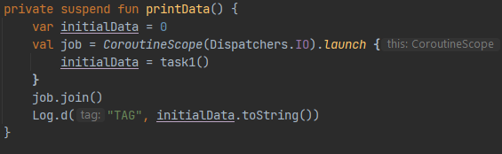
So, when we run the above code we can see that output would be “0” because we provide a delay of 1 second(1000ms) and a coroutine starts execution in parallel so it will print the initialData variable value which is 0.
But now, we want that it will only print Log statement when the task of coroutine gets completed. So we will create the instance of Job object here
Now, it will store the data in Job object and after the complete execution of coroutine. It will execute Log statement and we will get the value as “54”

Slide 35
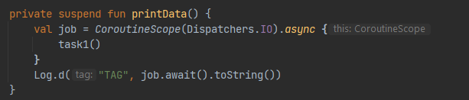
Async Functions
Coroutines from which we are expecting a output or result are called Async Functions
Async is basically performing a task and return a result.. async{ }, which has an await() function returns the result of the coroutine.
Until we get the data we will await for the result. In above code we have started a asynchronous operation which will get completed in future(like in few minutes or seonnds) and it provide us a deffered object ”job”. By using this deferred object we will wait until we get the result.

Slide 36
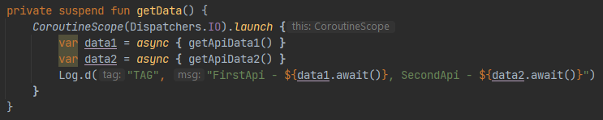
Use case:
Launch – When you do not care about the result. basically fire and forget. launch{} does not return anything
Async – When you expect the result/output from your coroutine.
Suppose we want to execute 2 Api’s in parallel and wants the result and both the API’s are independent of each other. We can do it like this.

Slide 37
Job Hierarchy
We can run multiple coroutines inside a coroutine
Job1() {
Job2 {}
}
Here we have started Job2 inside Job1. Here Job1 is a parent and Job2 is a child.
Job1() {
Job2 {}
Job3 {}
}
Similarly we can start multiple coroutines inside a coroutine, Here Job1 is the parent and Job2 and Job3 are child

Slide 38
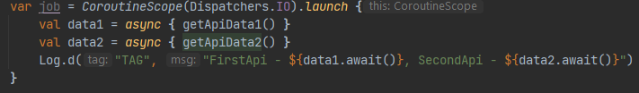
Why there is a need of Hierarchy?
Here, inside a coroutine we have define 2 more coroutines. So the benfit of using this hierarchy is when we want to cancel the coroutine we will directly cancel the parent coroutine and other child coroutines gets cancelled automatically or, If we want to wait until the execution of Job gets completed so it will wait until the execution of both child coroutines gets completed.

Slide 39
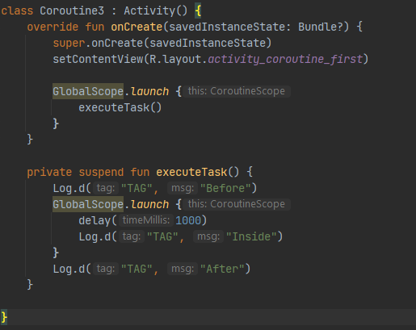
Withcontext and runBlocking

Slide 40

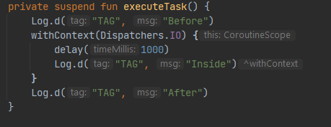
Output of above code is:
Because first it will print “before” then it starts the coroutine in other thread and it will print “After” then there is a delay of 1 second it will print “Inside”.
Launch is basically non blocking by nature and it starts the coroutine in a separate thread and executes the next line. This is called nonBlocking.
But withContext is of blocking nature. Let’s see an example:

Slide 41

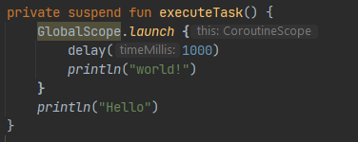
Now, we can see that while using withContext we have to pass dispatchers and it will remain suspended until all the compuattion inside withContext gets completed and then next line will gets execute.
So, the output would be.
runBlocking
We have use a delay function where we pass 1 second. Means it will print world after 1 second, but it will run the coroutine in separate thread and Hello will print first then it will print world after 1 second.

Slide 42
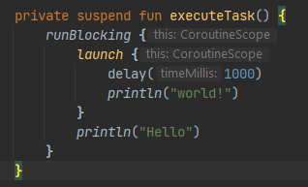
But in above code we can see the output it will print hello and then the application gets finish because it is of non blocking. For solving this issue we can use runBlocking().
Here, we will get the output as
Hello
World
Because runBlocking blocks the thread until execution of all the coroutines gets completed.

Slide 43
ViewModelScope and LifeCycleScope
ViewModelScope:
CoroutineScope attached with your view models.
Coroutines in this scope will be cancelled automatically when viewmodel is cleared. We don’t need to manually cancel the coroutines.
LifeCycleScope:
CoroutineScope attached with lifecycle(Activity or Fragments)
Coroutines in this scope will be cancelled automatically when lifecycle is destroyed. We don’t need to manually cancel the coroutines.

