Slide 1
MVVM Architecture
MVVM stands for Model-View-ViewModel, and it's an architectural pattern commonly used in Android app development
It's an architecture pattern that overcomes all drawbacks of MVC & MVP design pattern.
It promotes a clean separation between the UI components and the underlying data and business logic.
This architecture removes the tight coupling between each component. Most importantly Children do not have direct reference to the parent , they have only reference by observables.
Model -
This represents the data and business logic of the application. It encapsulates the data structures,
databases, network requests, and other data-related operations.
View -
his represents the UI components, which display the data and respond to user actions. In Android
this could be an Activity, Fragment, or custom View.
ViewModel -
This acts as an intermediary between the Model and the View. It holds the presentation logic and state of the
UI. The ViewModel is responsible for preparing and managing the data that the View needs and exposing it
through observable properties.

Slide 2
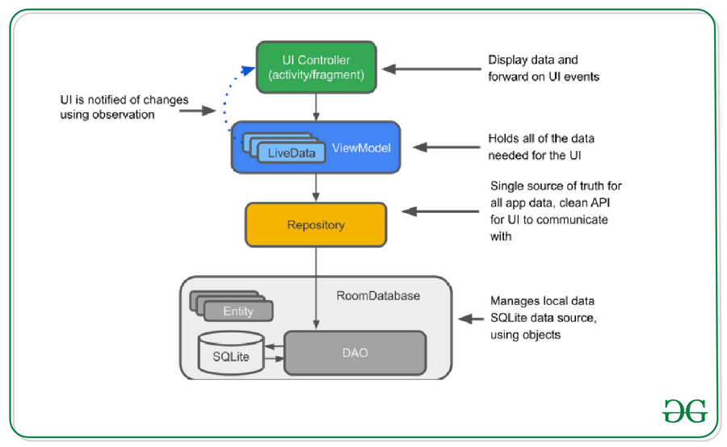

Slide 3
It is designed to store and manage UI related data in a lifecycle aware manner, separate from the UI components such as activity or fragments
The ViewModel helps to address common challenges such as handling configuration changes (e.g screen rotations ) and managing data across the lifecycle of an android app.
The ViewModel class is typically used in conjunction with LiveData observer to provide data to the UI components. It ensures that the data remains available and survive configuration changes without any data loss or unnecessary re fetching.
It's important to that ViewModel is scoped to the lifecycle of the UI component that creates it. For instance, if a ViewModel is created by an activity, it will be retained until the activity is destroyed.
OnCleared() method will be called to clear the ViewModel instance.

Slide 4
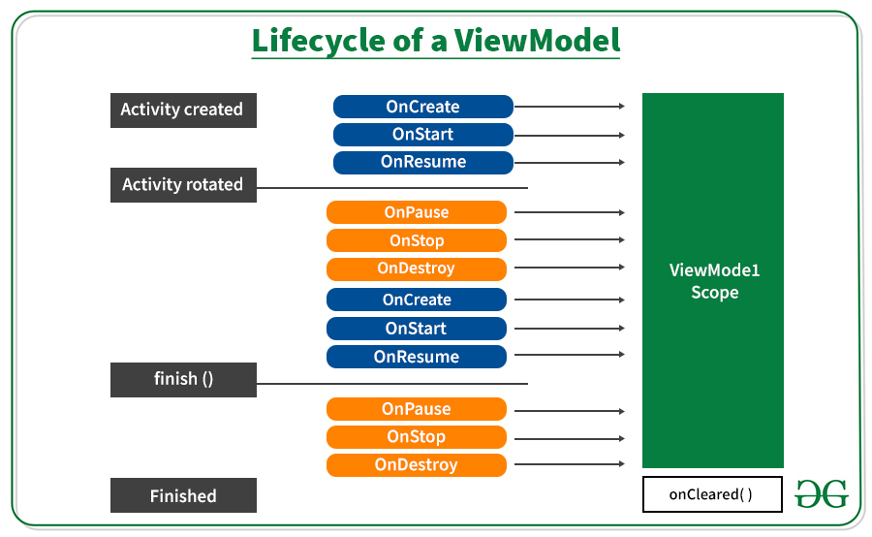

Slide 5
ViewModel Configuration Change
Retained-Instance :
When a UI component (e.g activity or fragment ) is destroyed and recreated due to a configuration change, the ViewModel instance associated with that UI component is not destroyed.
Instead, the ViewModel instance is retained by the system and is made available to the newly created UI component.
This retension allows the ViewModel to hold and manage the data, ensuring that it remains intact and accessible even during the configuration changes.

Slide 6
ViewModel Configuration Change
ViewModelStore :
The ViewModel instances are stored in ViewModelStore associated with UI component.
The ViewModelStore survives configuration changes and is responsible for retaining and managing the ViewModel instances.
When UI component is recreated, it retrieves the ViewModel instance from the ViewModelStore if it already exists or creates a new ViewModel instance if it doesn't .

Slide 7
ViewModel Configuration Change
ViewModelProvider :
The ViewModelProvider is responsible for creating and retrieving ViewModel instances tied to a specific UI component.
It ensures that the same ViewModel instances is provided to the UI component across configuration changes.
The ViewModelProvider is typically used in the onCreate() method of the UI component to obtain a ViewModel instances.

Slide 8
Advantages of using the MVVM architecture
Separation of Concerns: MVVM enforces a clear separation between the UI code, data-related operations, and business logic. This makes the codebase easier to maintain and understand.
Testability: The ViewModel being separate from the Android framework, can be easily unit-tested, as it doesn't have strong dependencies on the Android system.
Lifecycle Management: ViewModels are designed to survive configuration changes, which helps avoid common pitfalls like memory leaks.
Reusability: Since the business logic is decoupled from the UI, it's easier to reuse ViewModel components in different parts of the app or in different apps altogether.
Collaboration: The MVVM architecture can make collaboration between designers and developers smoother. Designers can work on the layout (View) without affecting the logic (ViewModel).

Slide 9
Difference B/w MVC and MVP
MVP | MVVM
One to one relationship exists between the Presenter and View | Multiple View can be mapped with single ViewModel
Presenter has knowledge about the View | ViewModel has no reference to the View
Model layer returns the response of the user's input to the Presenter which forwards it to View | After performing operations according to the user's input, the model layer returns response to the View
Ideal for simple scale projects | Not ideal for small scale project.

Slide 10
For More Information on MVVM, visit below sites
https://developer.android.com/topic/architecture
https://developer.android.com/reference/androidx/lifecycle/ViewModel
https://medium.com/@jecky999/mvvm-architecture-in-android-using-kotlin-a-practical-guide-73f8de1d9c58
YouTube Channel :
https://www.youtube.com/watch?v=A7CGcFjQQtQ

