Slide 1
MVVM Clean Architecture
Why MVVM with Clean Architecture?
Advantages of Using Clean Architecture
Disadvantages of Clean Architecture
The Layers of MVVM with Clean Architecture

Slide 2
Why we need MVVM Clean architecture
MVVM separates your view (i.e., Activity's and Fragments) from your business logic.
It goes one step further in separating the responsibilities of your code base. It clearly abstracts the logic of the actions that can be performed in your app.
You can combine Clean Architecture with the model-view-presenter (MVP) architecture as well. But since Android Architecture Components already provides a built-in ViewModel class, we are going with MVVM over MVP — no MVVM framework required!

Slide 3
Advantages of Using Clean Architecture
Your code is even more easily testable than with plain MVVM.
Your code is further decoupled (the biggest advantage.)
The package structure is even easier to navigate.
Your team can add new features even more quickly.
The project is even easier to maintain.

Slide 4
Disadvantages of Clean Architecture
It has a slightly steep learning curve. How all the layers work together may take some time to understand, especially if you are coming from patterns like simple MVVM or MVP.
It adds a lot of extra classes, so it’s not ideal for low-complexity projects.

Slide 5
The Layers of Clean Architecture
Presentation Layer
Domain Layer
Data Layer

Slide 6
Presentation Layer
This layer contains the user interface, including activities, fragments, and UI components. It's responsible for displaying data to the user and handling user interactions.
This includes our Activity's, Fragments, and ViewModels. An Activity should be as dumb as possible. Never put your business logic in Activity's.
An Activity will talk to a ViewModel and a ViewModel will talk to the domain layer to perform actions. A ViewModel never talks to the data layer directly.

Slide 7

Domain Layer
Also known as the business logic layer, this layer contains the core functionality and rules of the application. It's independent of any specific framework or UI and defines the use cases and business rules.
This layer consists of entities, use cases, and contracts — (abstract) classes of repositories. It's a crime (according to clean architecture rules) for this layer to reference classes, functions, and imports of the presentation or data layer
The purpose of the UseCases is to be a mediator between your ViewModels and Repository's.
The domain layer sits between the UI and data layers. In Android app architecture, the domain layer holds business logic
The domain layer is responsible for encapsulating complex business logic, or simple business logic that is reused by multiple ViewModels.

Slide 8
Data Layer
This layer deals with data management and communication with external sources such as databases, APIs, and repositories. It includes data models, data sources, and repository implementations.
Data Layer contains Repository Implementations and 1 or multiple Data Sources. Repositories are responsible to coordinate data from the different Data Sources. Data Layer depends on Domain Layer.
Classes in the data layer generally expose functions to perform one-shot Create, Read, Update and Delete (CRUD) calls or to be notified of data changes over time.
In some cases, involving more complex business requirements, a repository might need to depend on other repositories.

Slide 9
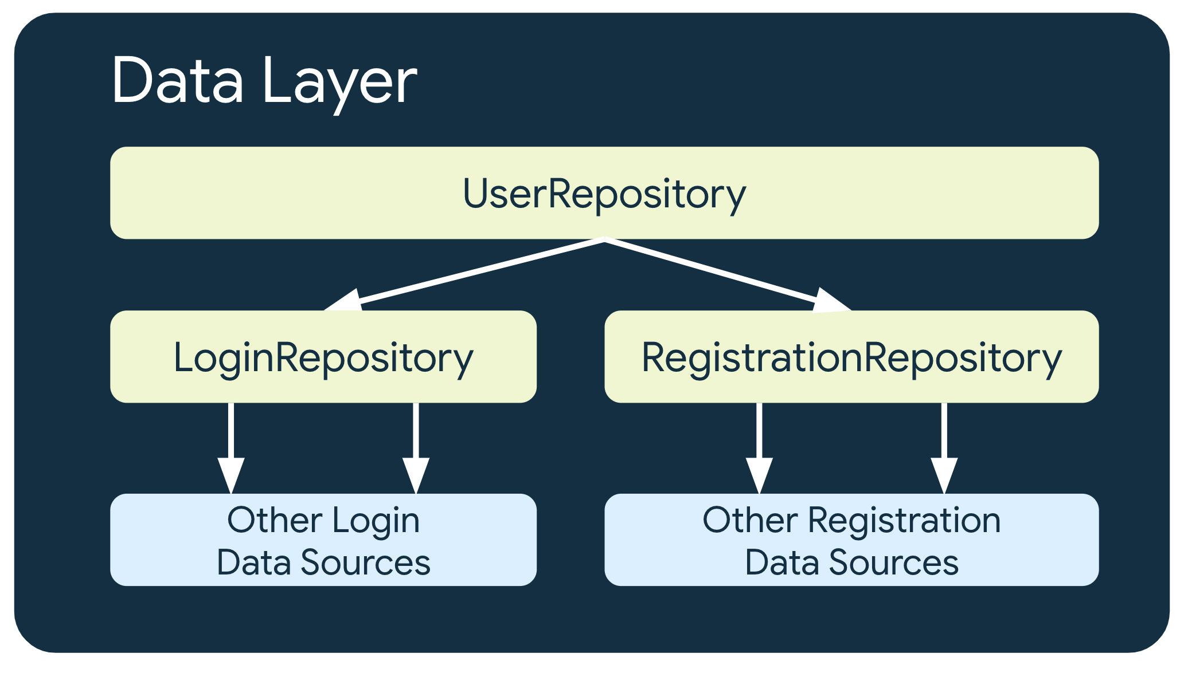

Slide 10
For More Info on MVVM Clean Architecture
https://medium.com/@ruwan.se.uok/android-apps-using-mvvm-with-clean-architecture-e50216f4a52b
https://github.com/topics/mvvm-clean-architecture

