Slide 1
Presentation on railway reservation system
Presented By:
Priyanka Sharma
Meenu Mittal

Slide 2
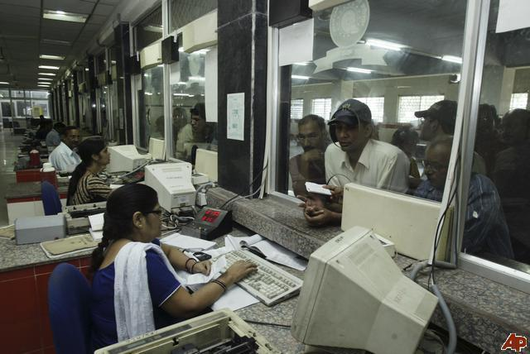
Railway reservation system:

Slide 3
Introduction:
This system is basically concerned with the reservation of railway tickets to the passengers.
In this we are discussing that how the reservation is done.
What are the rules and regulations and procedure for reservation?

Slide 4
Cntd…
In this project we are going to include all the entities related to reservation.
Employees
Customers
Stations
Trains
Forms
Ticket
Fare
Class
Time

Slide 5
Scope & Objectives:
All the manual work should be converted into computerized so that the load of employees should decrease.
The database should be stored in computer rather than in register/manually.

Slide 6
Cntd…
Easy to store information and fast accessing of information.
Centralized management reporting & decision support.
Accurate and timely control program.
To make it easy for fast processing and modification.
List of accounts of all customers is available.
Easy retrieval of accounts.
To make the Railway system is interactive.
Quick feed back.

Slide 7
Features:
Searching of data is easy
Passengers don’t have to wait for a long time.
Information is accurate
It is a fast process
Data efficiency is more

Slide 8
Limitations:
Data Redundancy
Difficulty in accessing the Data

Slide 9
Requirements:
1) Hardware Requirements:
Processor : Pentium IV 2GHz and Above
RAM : 1GB
Monitor : VGA Color Monitor
2) Software Requirements:
Operating System : Windows XP onwards
Developing Tool : VB (front end)
Database : MS-ACCESS (back end)

Slide 10
Data flow diagram:
The data flow diagram is a graphical representation that depicts information flow and the transforms that are applied as data moves from input to output.
Context level or 0-level DFD
1-level DFD
2-Level DFD

Slide 11
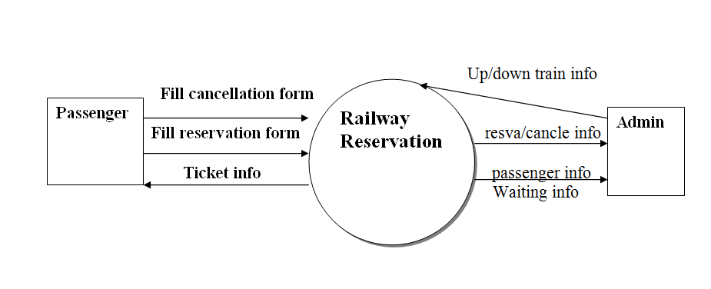
Context level or 0-level DFD:

Slide 12
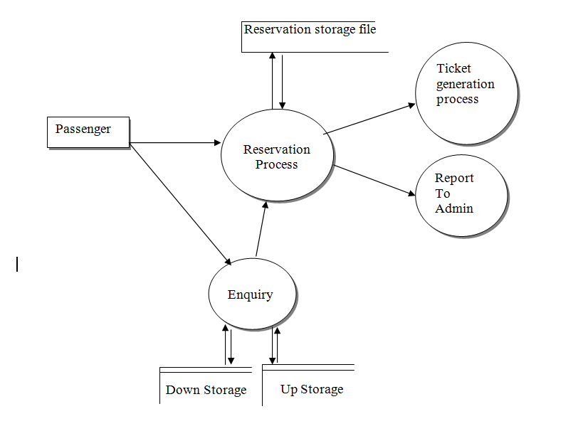
1-level DFD:

Slide 13
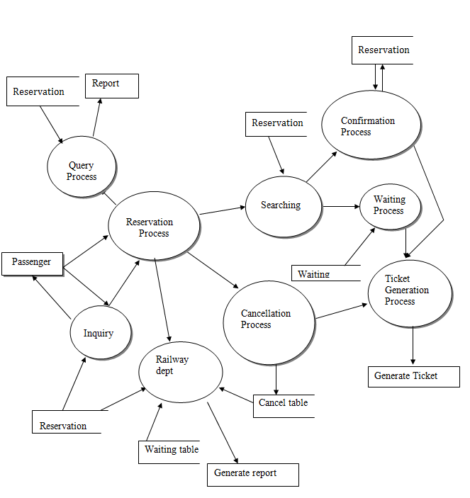
2-level DFD:

Slide 14
Logical Design:
1) EMPLOYEES: In this part we are covering that how the employees are working in reservation section of railway. In this all the details related to employee’s.
Emp_name
Emp_id
Address
Gender
Phone no
Date joined
Salary
Designation
Duty _shift

Slide 15
1)Employee:
Attribute | Data type | Primary key | Foreign key | Constraints
Emp_name | Char(10) |  |  | Not null
Emp_id | Number | Pk |  | Primary key
Address | Varchar(50) |  |  | Not null
Gender | Char(10) |  |  | ‘f’,’m’,‘F’,’M’
Phn_no | Number(10) |  |  | Not null
Date_ joined | Date(8) |  |  | Not null
Duty_shift | Time(10) |  |  | Not null

Slide 16
2)Customer:
In this part we are covering all the details related to customer required for reservation.
Customer_name
Customer_id
Address
Age
Gender
Phone no

Slide 17
Customer:
Attribute | Data type | Primary key | Foreign key | Constraints
cust_name | Char(10) |  |  | Not null
cust_id | Number(10) | Pk |  | Primary key
Ticket_num | Number(50) |  | Ticket(ticket_id) | Not null
Gender | Text(8) |  |  | ‘f’,’m’,‘F’,’M’
Phn_no | Number(10) |  |  | Not null
Emp_id | Number(8) |  | Employee (emp_id) | Not null
Form_id | Number(10) |  | Form(form_id) | Not null

Slide 18
3)Ticket:
This is the part where we are covering the tickets detail. It includes many attributes like id of tickets, class, fare, source stations, destination station etc. Ticket can be booked online as well as onsite.
PNR_no
Ticket_num
Source and destination
Class
Fare
Train_id
Seat_id

Slide 19
Ticket:
Attribute | Data type | Primary key | Foreign key | Constraints
Ticket_num | Number(10) | Pk |  | Primary key
P.N.R_No. | Number |  |  | Not null
Source | Text |  |  | Not null
Destination | Text |  |  | Not null
Class_id | Number (10) |  | Class(class_id) | Foreign key
Fare | Number(10) |  |  | Not null
Train_id | Number(8) |  | Train(train_id) | Not null
Seat_id | Number (10) |  |  | Not null

Slide 20
4) Station:
In this part we are covering the details of the station ex; station name, number of trains passing or going from that station or coming to that station. Number of platforms, number of lines.
Station_name
No. Of lines
Station_id
No. Of platforms

Slide 21
Station:
Attribute | Data type | Primary key | Foreign key | Constraints
Stn_name | Text(10) |  |  | Not null
No_of_ lines | Number (10) |  |  | Not null
Stn_id | Number(10) | Pk |  | Primary key
No_of _platform | Number (10) |  |  | Not null

Slide 22
5) Train:
In this part we are covering all the details related to the trains. We are covering train no, train name, no. of passengers traveling through train, classes is train, Route through which the train is going.
The trains source and destination etc. what are the different trains are going and coming at one station in one day?
Train_name
Train_num

Slide 23
Train:
Attribute | Data type | Primary key | Foreign key | Constraints
Stn_id | Number (10) |  | Station(stn_id) | Foreign key
Trn_name | Text (10) |  |  | Not null
Trn_id | Number(10) | Pk |  | Primary key
Ticket_num | Number (10) |  | Ticket (ticket_num) | Foreign key

Slide 24
6)Form:
Forms are the most important part of reservation. Forms are the source to know the details of the customers.
Form_name
Form_id

Slide 25
Form:
Attribute | Data type | Primary key | Foreign key | Constraints
Form name | Text(10) |  |  | Not null
Form_id | Number (10) | Pk |  | Primary key
cust_id | Number (10) |  | Customer (cust_id) | Foreign key

Slide 26
7)Class:
In this part we are covering the different types of classes that is:
1st class
2nd class
Sleeper class
General class
So, the price depends upon the class the customer selects. General class is the cheapest.

Slide 27
Class:
Attribute | Data type | Primary key | Foreign key | Constraints
Date | Number(10) |  |  | Not null
Trn_id | Text |  | Train(trn_id) | Foreign key
No_of_seats | Text |  |  | Not null
Class_id | Number (10) | Pk |  | Primary key

Slide 28
8)Fare
Fare is the charges spent by the customer. Fare is decided according to the train which is selected by the customer.
For example- We take the example of different trains going from Ludhiana and their different charges/fare.
Shtabadi
7:00am and 7:00pm
Chair car – Rs 450/ -
1st class – Rs 1099

Slide 29
Fare:
Attribute | Data type | Primary key | Foreign key | Constraints
Trn_id | Number(10) |  |  | Not null
Source | Text (10) |  |  | Not null
Destination | Text (10) |  |  | Not null
Class | Text (10) |  |  | Not null
Fare | Text(10) |  |  | Not null
Ticket_num | Number(8) |  | Ticket (ticket_num) | Foreign key
Receipt_num | Number (10) | Pk |  | Primary key

Slide 30
9)Time:
In this part all the details related to time are covered. This includes:
Departure time
Train id
Arrival time
Each train has different time. It can be in morning or evening or night.

Slide 31
Time:
Attribute | Data type | Primary key | Foreign key | Constraints
Ref_no | Number(10) | Pk |  | Primary key
Dep_time | Date/time (8) |  |  | Not null
Arrival_time | Date/time (8) |  |  | Not null
Train_id | Number (10) |  | Train(trn_id) | Foreign key
Stn_id | Number(10) |  | Station(trn_id) | Foreign key

Slide 32
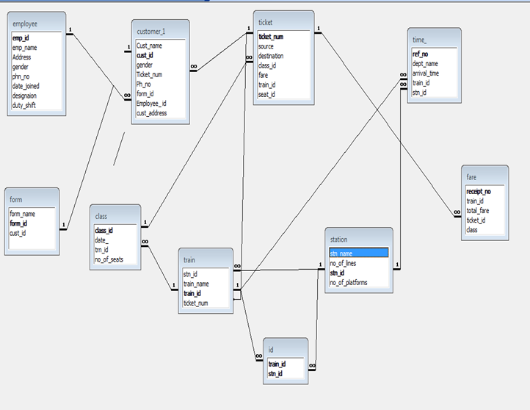
E-R Diagram:

