Slide 1
Snake vs block game
By : Abhishek Rajgaria 2017276 and Shivam Shanker 2017265

Slide 2
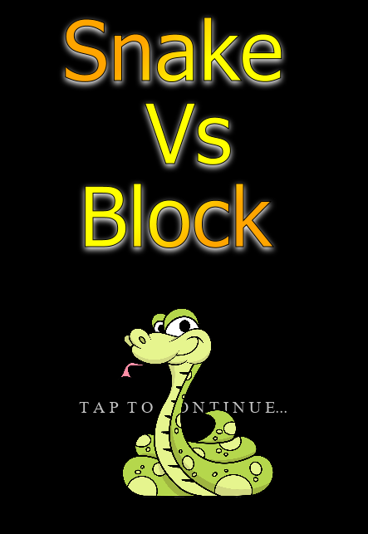
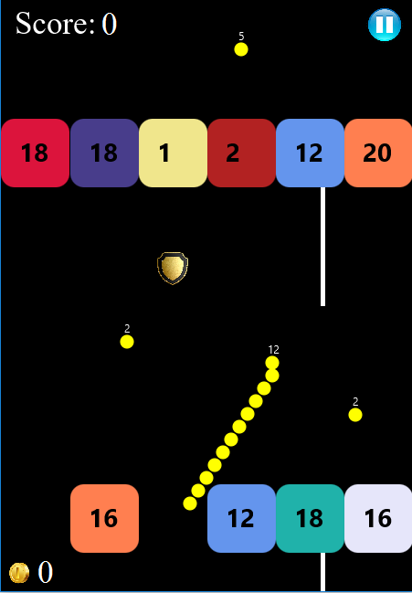
Game Design and implementation
Snake vs block game developed by us is a user interactive game with cool user interface.
You can select any of the 15 avatars available in the avatar page at anytime. Different tokens such as destroy all blocks, magnet and shield enhance the capability and score of snake.
We have also given option of mystery token you can encounter in game play. It can randomly take value of any token at any time.
Leaderboard page stores the top 10 scores made by the user with date.

Slide 3
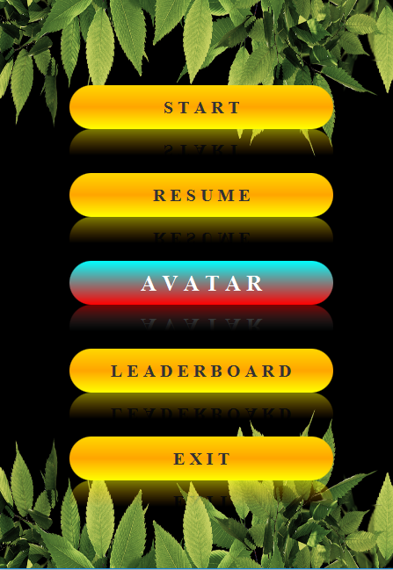
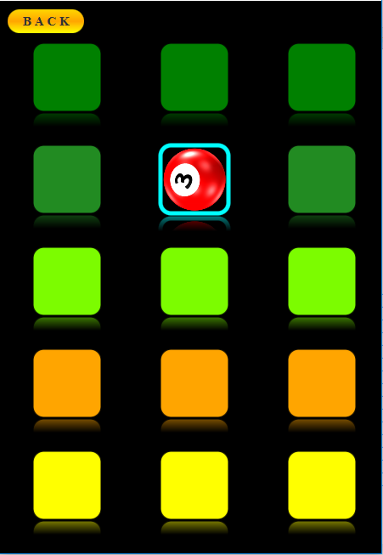
Individual Efforts
Abhishek :- Gameplay implementation. Movement of snake, blocks designing, tokens etc. Collisions of snake with different objects. Animation timelines.
Shivam:- Made different pages like avatar page, leaderboard page, main menu, drop down menu. Added functionality to each page. Serialization of game state at every state. Positioning of buttons on pages and CSS styling.

Slide 4
Bonus
Fluid like movement of snake
Mystery token
Fluid like reduction of block values and snake balls
Different avatars
Background music

