Slide 1

Socially Responsible Engineering
Engineering With Your Stakeholders In Mind
Abhishek Ram (aram@draper.com)
March 08th, 2024
Presented to: Course # MIE 395C, MIE Department, University of Massachusetts

Slide 2
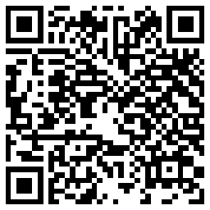
Abhishek Ram
The Charles Stark Draper Laboratory (2022 - )
Current Focus Areas:
Industry 4.0
Cyber-Physical-Human Systems Engineering
Digital Engineering
CAE / ML / AI
Failure Prevention
Reliability Engineering
Safety Engineering
Security Engineering
Digital Engineering Solutions Architect
AIAA Digital Engineering Integration Committee Co-Chair for CAE/HPC/ML/AI
University of Maryland College Park (Center for Advanced Life Cycle Engineering) (2020 – 2022)
M.S.Mechanical Engineering (Focus on Reliability Engineering and Computational Engineering)
Thesis: Application of Diagnostics and Prognostics Techniques to Qualification Against Wear-Out Failure
University of Massachusetts, Amherst (2016 – 2019)
B.S. Mechanical Engineering (Minor in Applied Mathematics)
Personal Interests:
Playing multiple instruments (esp. guitar and bass)
Table-Top Games (e.g., Pathfinder, MTG)
Watching Sports (esp. Hockey) and Playing Sports (esp. Soccer)
North Attleboro, MA
Presented: March 15th, 2024
Please do not redistribute without the author’s permission.
© Abhishek Ram, 2024
2

Slide 3
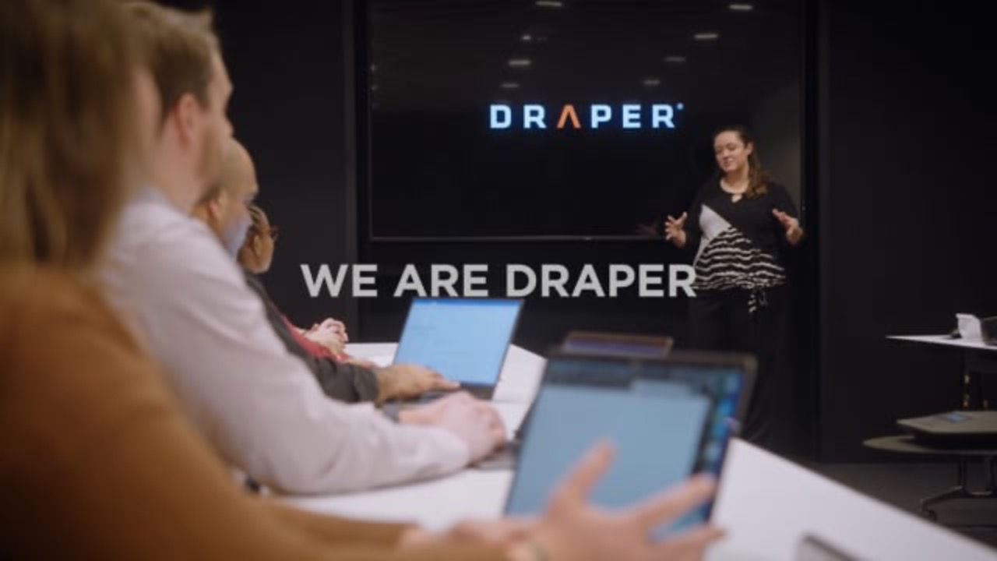
Notes:
Video slide

Slide 4
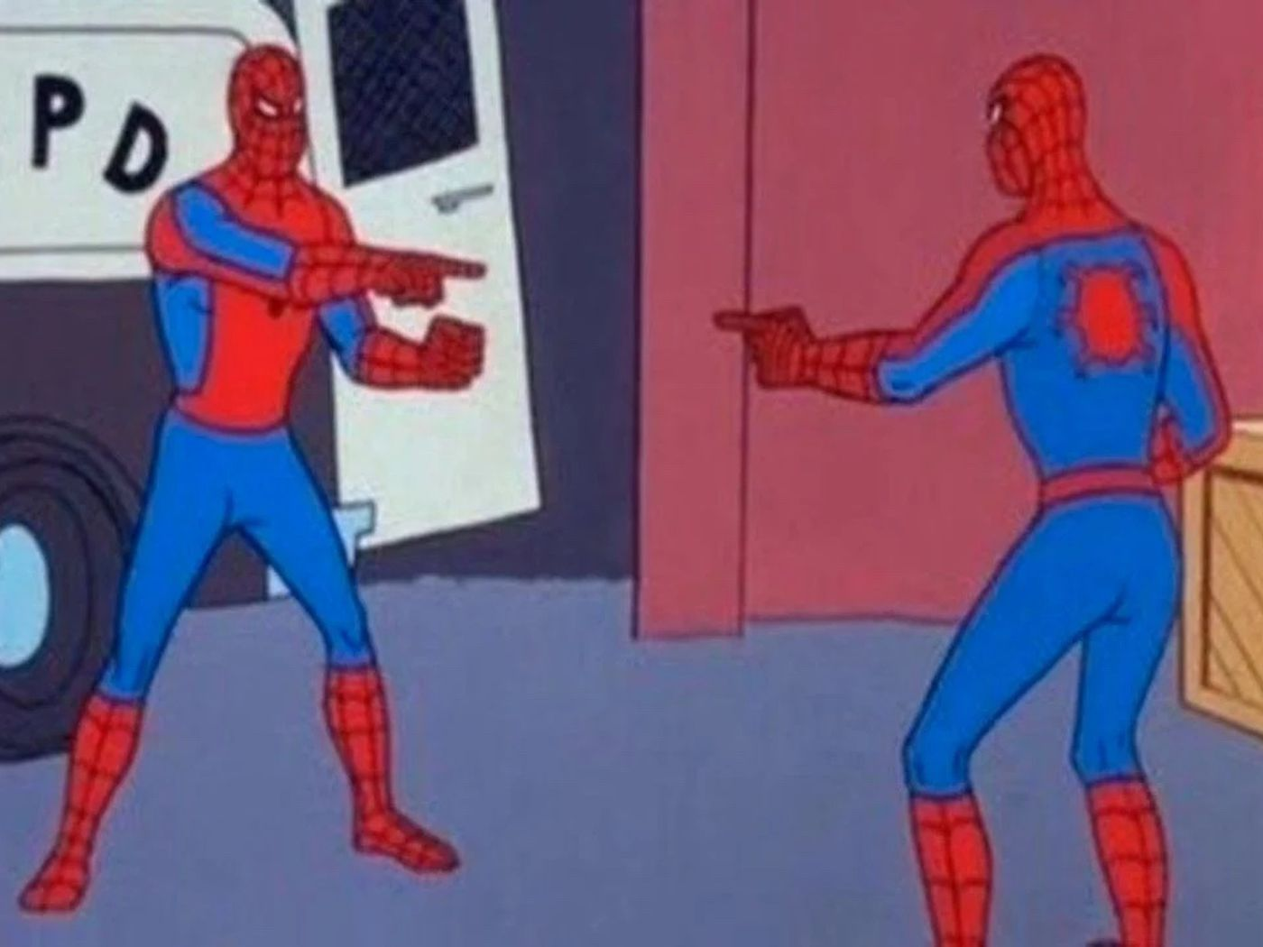
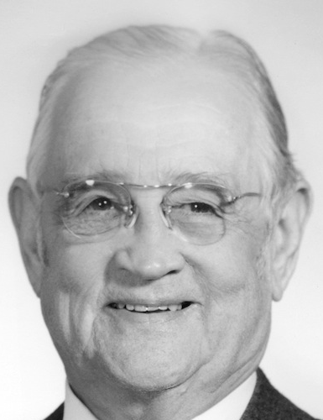
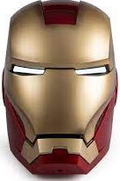
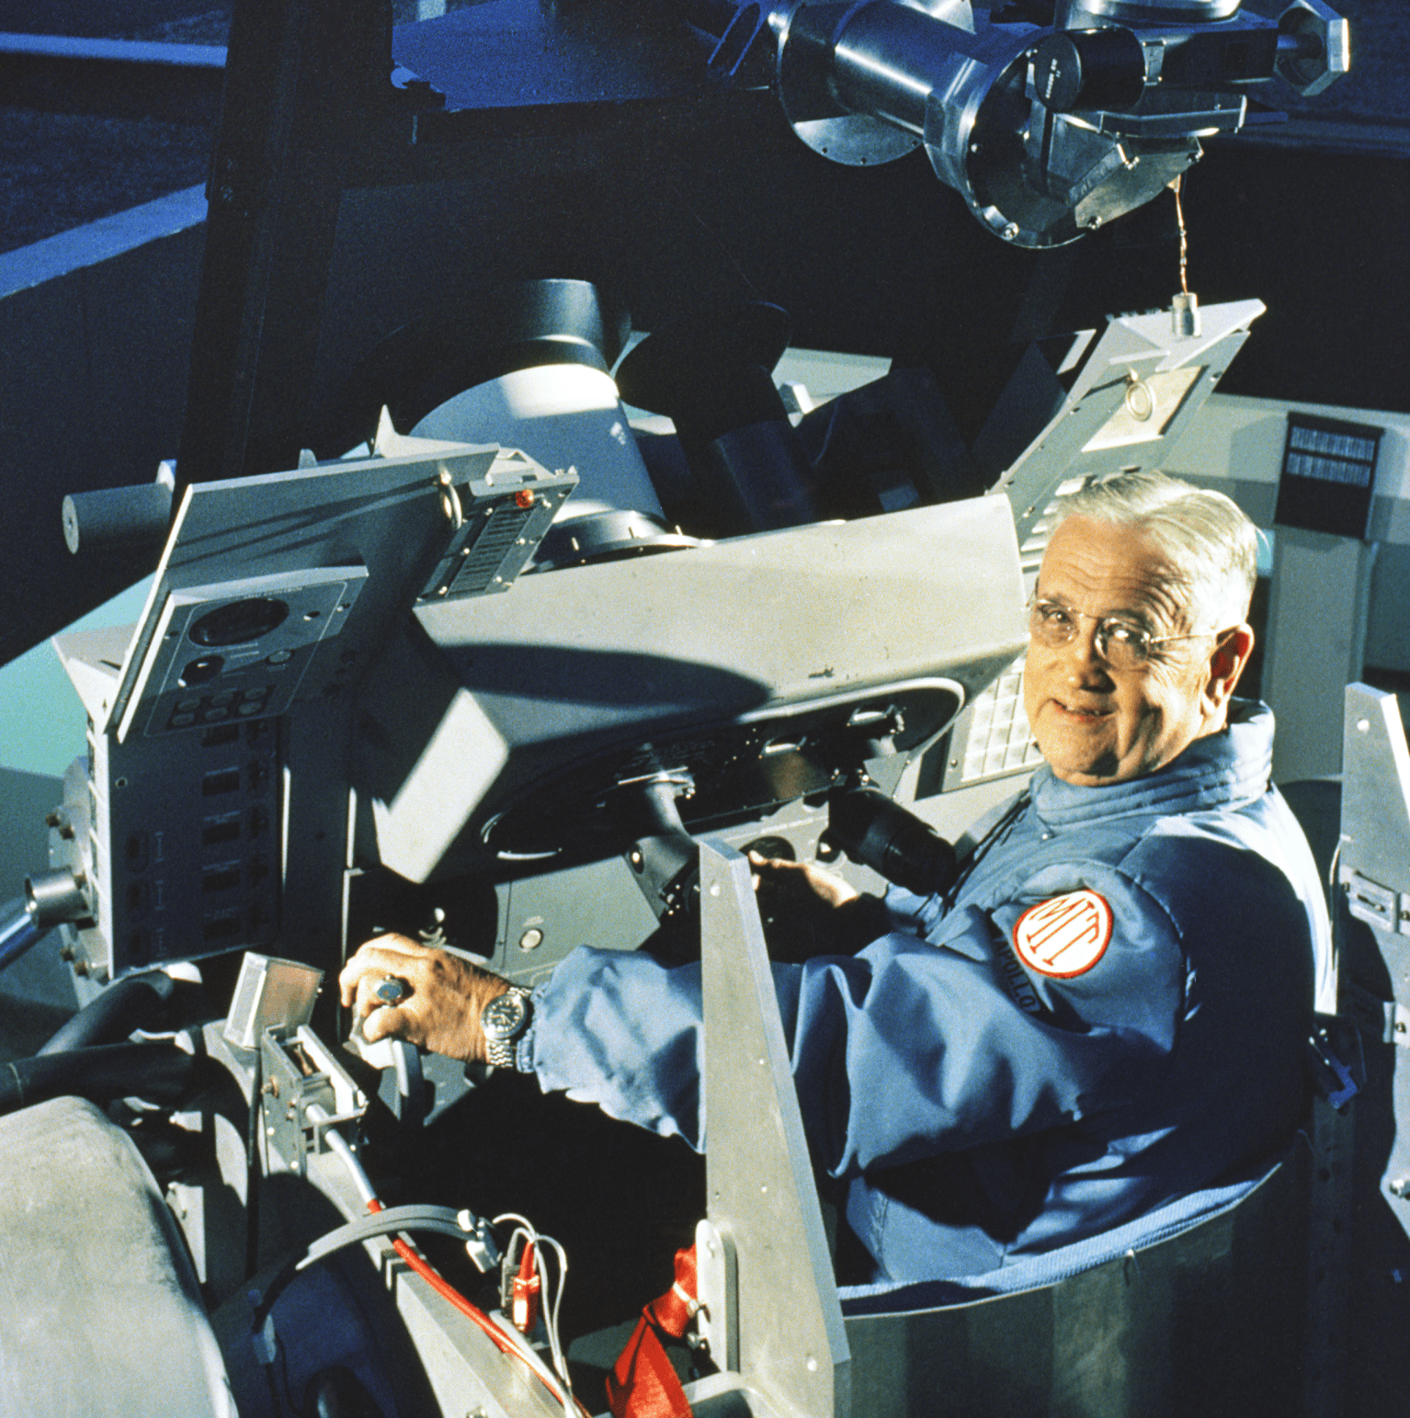
Charles Stark (“Doc”) Draper (1901-1987)
Considered the “Father of Inertial Navigation” and “one of the foremost engineers of the 20th century”

Slide 5
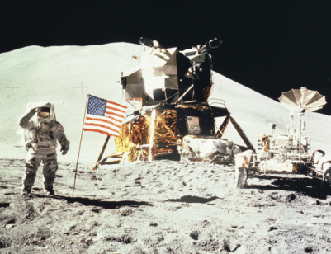
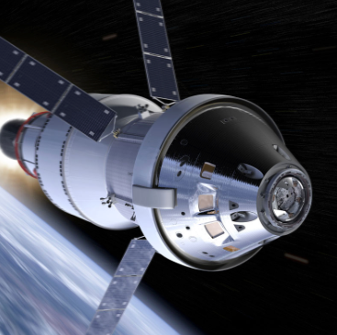
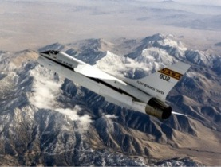
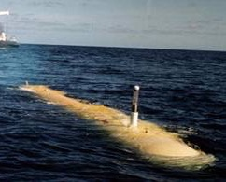
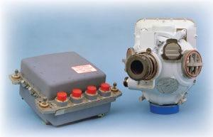
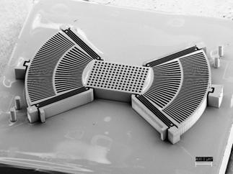
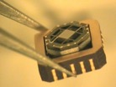
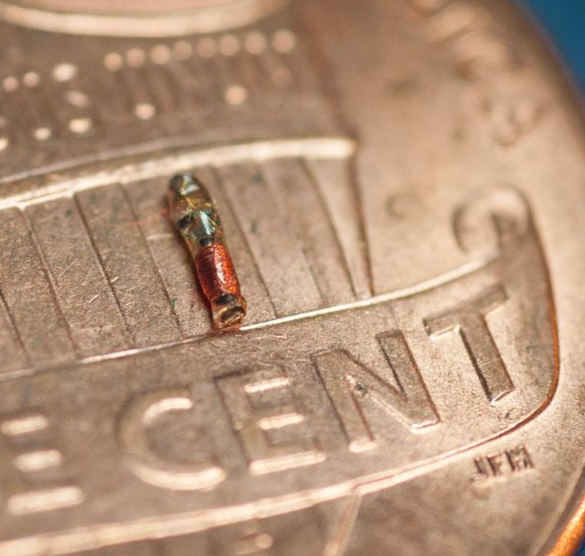

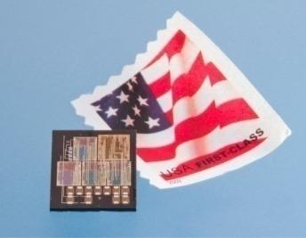
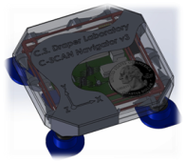
Draper Stats and Innovation Highlights
Independent, not-for-profit
Headquartered in Cambridge, MA
1,800 employees
1,200 engineers and scientists specializing in hardware, software, systems, and materials
600 staff members in supporting functions including accountants, lawyers, program managers, security guards, IT, and more
Apollo Guidance Computer
Orion Reentry Guidance
Digital Fly-by-Wire
Unmanned System Autonomy
Strategic Guidance Systems
MEMS
Cold Atom Sensors
RF-addressable Micro
Neural Stimulator
Micro Fluidics
Ultra-High Density Electronics

Slide 6
Disclaimer Slide
Please do not disseminate this presentation beyond the MIE 395C class or other members of the MIE Department, UMass Amherst, without express permission from the author (Abhishek Ram.)
The content of this presentation represents my perspectives and thoughts. Those of others influenced some of these thoughts and ideas and are cited as such in a working manuscript of a paper to be published.
Please note that the thoughts and opinions represented here do not reflect The Charles Stark Draper Laboratory’s IP / Standard Operating Procedure, and Abhishek Ram is not authorized to comment on official policy / standard operating procedure.
Presented: March 15th, 2024
Please do not redistribute without the author’s permission.
© Abhishek Ram, 2024
6

Slide 7
Some Questions and Discussion
As an engineer living in a society, what is your role?
What does the expression “socially responsible engineering” conjure up?
Do you currently feel equipped to engineer with all types of people in mind?
How do you know if you are or are not familiar with a specific group?
Presented: March 15th, 2024
Please do not redistribute without the author’s permission.
© Abhishek Ram, 2024
7

Slide 8
“Culture of Disengagement” in Engineering
Many studies have found that engineering students tend to find themselves in a “culture of disengagement,” where students get distanced or distance themselves from how they can impact public welfare.
Think of the recent example of the Boeing 737 MAX crashes:
From an engineering perspective, using software (the MCAS) to mask questionable hardware engineering decisions is a band-aid over a bullet wound.
The goal was to reduce the cost and increase the benefit to Boeing, but it severely impacted pilots and passengers and their safety.
It has also severely impacted Boeing’s brand long-term.
Additionally, these incidents highlight an engineer’s needed ability to ensure their organization cannot distance themselves from the product they make.
Investigation revealed that a senior Boeing engineer filed an internal ethics complaint regarding the error-prone angle of attack sensors. He has since said, “I was willing to stand up for safety and quality… Boeing management was more concerned with cost and schedule than safety or quality.”
Presented: March 15th, 2024
Please do not redistribute without the author’s permission.
© Abhishek Ram, 2024
8

Slide 9
Observations of Industry and Academia
Many studies have found that engineering students tend to find themselves in a “culture of disengagement”, where engineering students get distanced or distance themselves from how they can impact public welfare.
Case studies of ethical decision-making often emphasize the single whistleblower as heroes of a story – while true, it obfuscates the fact that accountability in these stories falls on individual engineers or personnel, even though there may be hundreds or thousands of people involved across multiple organizations.
Systematic introduction of “socially responsible engineering” into the burgeoning workforce and the existing workforce can help to enable better ethical decision-making throughout and provide better products driven by more detailed descriptions of cost and benefit.
Presented: March 15th, 2024
Please do not redistribute without the author’s permission.
© Abhishek Ram, 2024
9

Slide 10
Utility Theory for Sociotechnical System Design
Corporate Benefit
Utility theory is the school of thinking where stakeholder satisfaction is modeled based on judgments of preferences, preferability, worth, value, goodness, or other similar concepts.
Traditional evaluations of product success rely on comparing cost and benefit. This approach works for the entity generating the product.
But what about the complex sociotechnical system around the product? How do you determine “benefit” beyond the entity creating the product or service?
Answer: utility theory!
Cost
Traditional View of Cost and Corporate Benefit
Cost
Customer Utility
Corporate Benefit
Comparing Cost to Corporate Benefit and Customer Utility
Presented: March 15th, 2024
Please do not redistribute without the author’s permission.
© Abhishek Ram, 2024
10

Slide 11
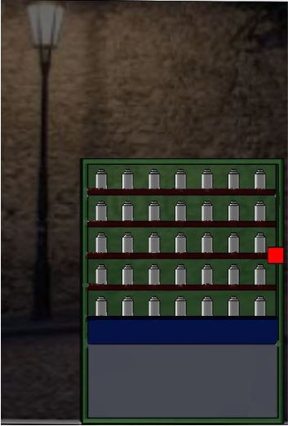
Introduction: OTC-Medicine Dispensing Machine (TransPharm)
You are an engineer developing a vending machine for over-the-counter medicines and related health products.
You are tasked with determining what the design requirements for this machine would be. As a socially responsible engineer, you seek input from stakeholders.
After some contemplation, you identify a high-level set of stakeholders: those in a university campus.
Presented: March 15th, 2024
Please do not redistribute without the author’s permission.
© Abhishek Ram, 2024
11

Slide 12
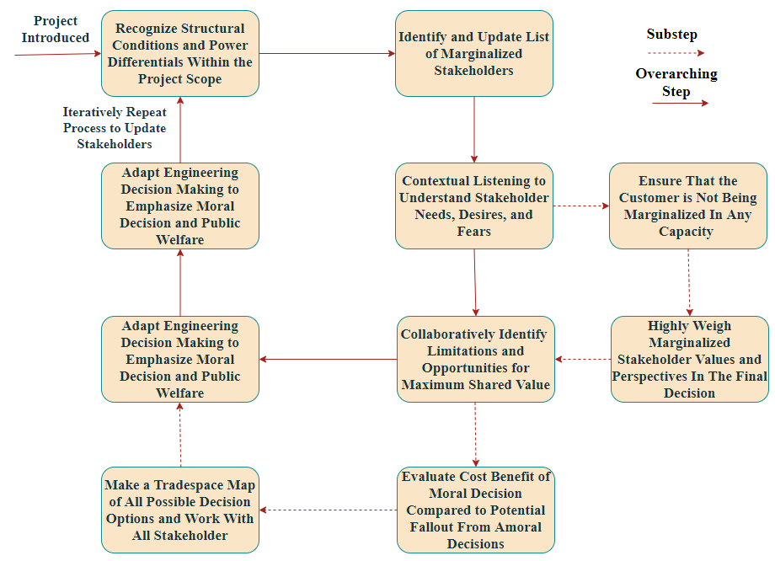
Idealized Framework for Socially Responsible Engineering
Presented: March 15th, 2024
Please do not redistribute without the author’s permission.
© Abhishek Ram, 2024
12

Slide 13
Identifying Requirements for TransPharm
Step 1: Identify your stakeholders in granular detail.
Step 2: Begin generating maps of stakeholder beliefs, decision-making process, and power differentials now and over time using SODA and CBPR. Use specific examples to abstract out generalizable requirements.
Step 3: Create your tradespace and rank priority using SODA and CBPR. As a stakeholder as well, use your knowledge of your company’s capabilities to prioritize as well.
Presented: March 15th, 2024
Please do not redistribute without the author’s permission.
© Abhishek Ram, 2024
13

Slide 14
Example Practice for Identifying Stakeholders
Principles of Stakeholder Identification and Evaluation | Explanation of Stakeholder Identification and Evaluation Principles
The list of stakeholders relevant to a design decision is contextual and time-dependent. | Over time and for different circumstances, the list of stakeholders who (1) may impact the design decision or (2) be impacted by the design decision can change.
Stakeholders can hold multiple roles at any given time and circumstance. They should not become essentialized at all. | Depending on the circumstances, stakeholders could impact the design decision and likewise get impacted by it. Depending on the decision, the stakeholders' roles could change.
Individual stakeholders within a group can have different beliefs, opinions, and values. Complete an inductive (bottom-up) stakeholder assessment. | No two people are the same. They may differ critically, though the group may trend towards one set of beliefs and values.
Over time and in different contexts, stakeholder roles, beliefs, values, and power dynamics could change. | Accumulated experience or changes in the circumstances could yield new roles, updated belief and value systems, and altered power dynamics relevant to design decisions.
Establish defined boundaries for marginalization and exclusion in stakeholder identification. | Marginalization comes in many forms and levels, and it is impossible to account for all marginalized stakeholders. Setting bounds for exclusion allows for stakeholder identification within that bounded set.
Remember that the researchers, those who fund the researchers, and other corporate/industrial leaders are also stakeholders in the design decision. | Consider that the entity generating the product is also a stakeholder in its decision. Additionally, consider that these groups are also impacted by the design decision, along with the customers and other relevant stakeholders.
Stakeholder identification and the assessment of possible design decisions is a coupled problem that should iterate concerning each other. | Identified stakeholders impact the design decision, and the design decision can reveal new stakeholders to the decision. As a result, they feed into each other and should be addressed together and iteratively as needed.
Presented: March 15th, 2024
Please do not redistribute without the author’s permission.
© Abhishek Ram, 2024
14

Slide 15
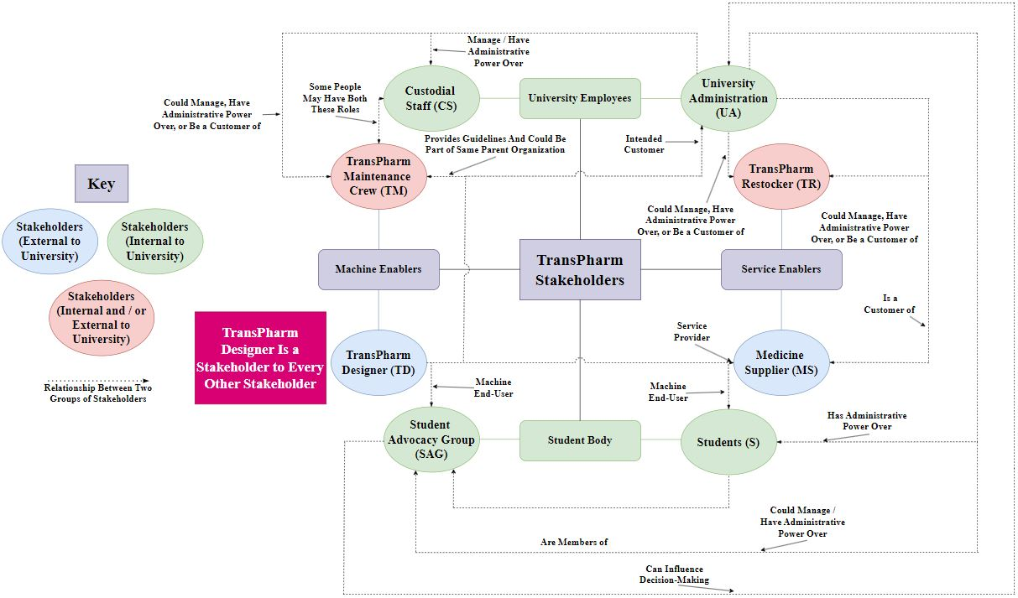
Map of Stakeholders
Presented: March 15th, 2024
Please do not redistribute without the author’s permission.
© Abhishek Ram, 2024
15

Slide 16
Sample List of Stakeholders and Questions to Consider (In the University)
Stakeholders | Questions to Consider
Students (denoted by S) | What do students need today? What have they needed before? What will they continue to need in the future? What requirements would students have for the medicine dispenser?
Student Advocacy Groups (denoted by SAG) | What are the current issues for students on campus? What have been existing issues, and what appears to be continuing issues? What student needs are most often reported to them? What requirements would students have for the medicine dispenser?
University Administration (denoted by UA) | Political/religious concerns about certain medicines/technologies? On a high level, what is the makeup of the student population? What infrastructure is in place for TransPharm, and what would the requirements be for it to be implemented successfully?
Custodial Staff (denoted by CS) | What impacts would this machine have on custodial operations? What are the current responsibilities of custodial staff, now, before, and potentially in the future? What technical skills would a custodial staff have? Would universities want these machines to be accessible to custodial staff?
Presented: March 15th, 2024
Please do not redistribute without the author’s permission.
© Abhishek Ram, 2024
16

Slide 17
Sample List of Stakeholders and Questions to Consider (External to University)
Stakeholders | Questions to Consider
Medicine Supplier (denoted by MS) | What technical skills do medicine suppliers have [pertaining to restocking]? What medicines are they able to provide, and what can they not?
TransPharm Maintenance Crew (denoted by TM) | Training maintenance crew to take care of TransPharm? How do TransPharm requirements from other entities translate to maintenance requirements?
TransPharm Restocker (denoted by TR) | What technical skills do the restocking crew need to have? Can the medicine supplier take charge of this?
TransPharm Designer i.e., us (denoted by TD) | Do we account for other entities’ requirements? What requirements are feasible to meet, and what are infeasible?
Presented: March 15th, 2024
Please do not redistribute without the author’s permission.
© Abhishek Ram, 2024
17

Slide 18
Identifying Requirements for TransPharm
Step 1: Identify your stakeholders in granular detail. (Slide 13)
Step 2: Begin generating maps of stakeholder beliefs, decision-making process, and power differentials now and over time using SODA and CBPR. Use specific examples to abstract out generalizable requirements. (slide 17 and 18)
Step 3: Create your tradespace and rank priority using SODA and CBPR. As a stakeholder as well, use your knowledge of your company’s capabilities to prioritize as well. (Slide 22)
Key for Decision-Making Flow
Decision Made by a Stakeholder
Requirement for the TransPharm Designer (MD)
Presented: March 15th, 2024
Please do not redistribute without the author’s permission.
© Abhishek Ram, 2024
18

Slide 19
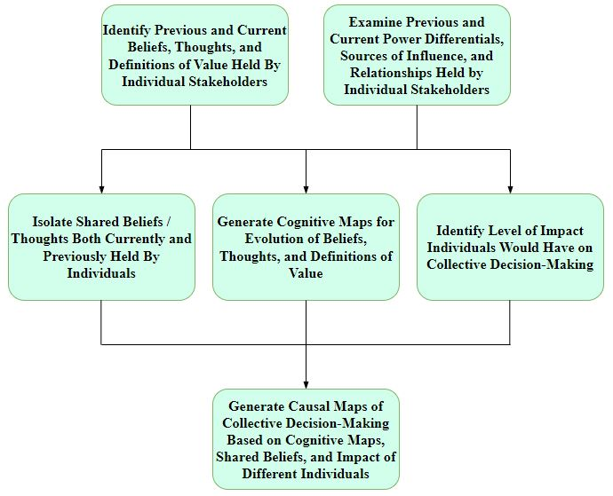
Strategic Options and Development Analysis (SODA)
The goal of SODA is to give a top-down evaluation of how groups or communities come together to perceive a situation and how they would act accordingly.
With stakeholders identified, SODA provides a way to organize the high-level structure of a sociotechnical system and map the individuals within it.
Although SODA requires a complete understanding of different types of interactions within a community, SODA does not provide an inherent way to complete the requisite analysis.
Presented: March 15th, 2024
Please do not redistribute without the author’s permission.
© Abhishek Ram, 2024
19

Slide 20
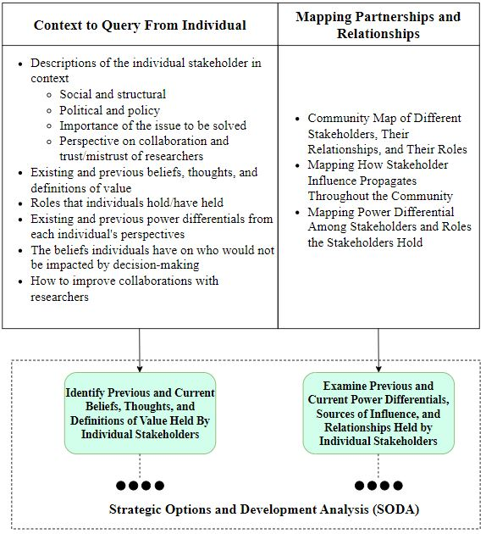
Community-Based Participatory Research (CBPR)
The goal of CBPR is to study and learn about a community from a grassroots (“bottom-up”) perspective.
It is “participatory,” requiring direct communication with affected groups, systematic inquiry, and direct collaboration to prescribe a future change.
Where SODA applies for modeling the community structure, CBPR fills in the gaps in SODA to enable the causal mapping to determine how decisions are made within the community.
Presented: March 15th, 2024
Please do not redistribute without the author’s permission.
© Abhishek Ram, 2024
20

Slide 21
Specific Examples of Applying SODA/CBPR to Creating Use Cases
About meds:
UA places order to MS to provide meds
MS supplies medicine that TR puts in TransPharm.
MD shall ensure TransPharm can dispense a variety of medications.
S decides certain meds need to be available
S informs SAG, and SAG informs UA
UA denies medicine and does not provide alternative
MD shall ensure TransPharm can be restocked by TR.
Questions to ask (CBPR):
What meds could students want readily available?
What would be required to store said medicines securely?
UA denies medicine and orders alternative
MS supplies medicine that TR puts in TransPharm
Questions to ask (CBPR):
What medicines would UA object to? What alternatives might they recommend?
What would cause certain meds to be rejected? Does that change our machine requirements? What would it change?
Ethical question: just because you disagree with someone’s beliefs, should you ignore them or not account for them?
Presented: March 15th, 2024
Please do not redistribute without the author’s permission.
© Abhishek Ram, 2024
21

Slide 22
Specific Examples of Applying SODA/CBPR to Creating Use Cases
UA wants to mitigate risk for liability of any kind.
About machine:
S wants medicine to be readily available.
S expects TransPharm to be always available.
S expects UA to put TransPharm in accessible, open areas.
MD shall ensure TransPharm is secure and mitigates opportunity for stealing medicine.
MD shall ensure TransPharm is self-sufficient and self-powered.
CS expects TransPharm to be simple to maintain.
TM expects TransPharm to be simple to maintain.
MD shall ensure TransPharm is refrigerated / environmentally controlled.
UA pledges more green infrastructure on campus.
MD shall ensure machine is easily maintainable (internally and externally.)
SAG wants more green infrastructure on campus.
MD shall ensure machine can dispense a variety of medications.
Presented: March 15th, 2024
Please do not redistribute without the author’s permission.
© Abhishek Ram, 2024
22

Slide 23
Identifying Requirements for TransPharm
Step 1: Identify your stakeholders in granular detail. (Slide 13)
Step 2: Begin generating maps of stakeholder beliefs, decision-making process, and power differentials now and over time using SODA and CBPR. Use specific examples to abstract out generalizable requirements. (Slide 17 and 18)
Step 3: Create your tradespace and rank priority using SODA and CBPR. As a stakeholder, use your knowledge of your company’s capabilities to prioritize as well. (Slide 22)
Presented: March 15th, 2024
Please do not redistribute without the author’s permission.
© Abhishek Ram, 2024
23

Slide 24
Trade Space Exploration for Evaluating Different Product Possibilities
Cost and “benefit” are two dimensions of a larger puzzle. Is “benefit” just one single dimension, or are multiple dimensions conveniently lumped together?
Trade space exploration supports multi-dimensional evaluations of different options and studies the tradeoffs of choosing one design over another.
Using utility theory can provide an extremely rich trade space, which supports making a more informed decision that accounts for various stakeholders and their values and beliefs.
Some ways to visualize a trade space:
Two-dimensional cost–“utility” visualization
Trade space matrix
Spider chart
Presented: March 15th, 2024
Please do not redistribute without the author’s permission.
© Abhishek Ram, 2024
24

Slide 25
Tradespace of Requirements Priority With Respect to Different Stakeholders
Requirements |  | Stakeholders and Importance of Requirement to Stakeholder (Scale of 1-5, Low to High Priority)
 |  | Students (S) | Student Advocacy Groups (SAG) | University Administration (UA) | Custodial Staff (CS) | Medicine Supplier (MS) | TransPharm Maintenance Crew (TM) | TransPharm Restocker (TR) | TransPharm Designer (TD)
REQ 1 | MD shall ensure machine can dispense a variety of medications. | 5 | 5 | 3 | 1 | 3 | 5 | 5 | 5
REQ 2 | MD shall ensure TransPharm can be restocked by TR. | 5 | 5 | 5 | 2 | 4 | 3 | 5 | 5
REQ 3 | MD shall ensure machine is easily maintainable (internally and externally.) | 4 | 4 | 4 | 5 | 2 | 5 | 2 | 3
REQ 4 | MD shall ensure TransPharm is refrigerated / environmentally controlled. | 5 | 3 | 5 | 1 | 4 | 5 | 2 | 5
REQ 5 | MD shall ensure TransPharm is self-sufficient and self-powered. | 3 | 5 | 4 | 1 | 2 | 5 | 2 | 3
REQ 6 | MD shall ensure TransPharm is secure and mitigates opportunity for stealing medicine. | 2 | 2 | 5 | 1 | 5 | 2 | 2 | 5
Presented: March 15th, 2024
Please do not redistribute without the author’s permission.
© Abhishek Ram, 2024
25

Slide 26
Some Parting Advice
As an engineer, it is your responsibility to build the world → build the kind of world people would want to live in.
Put yourself in the shoes of others → as another person, would you be happy with the decision you are making?
How would the decision you are making impact other people? How would it benefit other stakeholders?
Transparency and accountability are your best friends!
Document why different decisions were made and the justifications for making said decisions → good engineering practice and good approach for enabling traceability
It is better to catch a mistake early on than much later than on → design flaws are far cheaper to correct/easier on the mind to deal with than recalls and lawsuits.
Transparency and communication with your stakeholders ensures a more utilitarian product, improving your reputation, your relationship with your customer base, and product marketability.
Presented: March 15th, 2024
Please do not redistribute without the author’s permission.
© Abhishek Ram, 2024
26

