Slide 1

Self-Learning Tutorial for Homework 4 Healthcare Machine Learning using MIMIC-III
Notes:
GitHub: https://github.com/abhishekraman2001/AI-Health/blob/main/Diabetes_MIMIC_Tutorial_Formatted.pdf Colab: https://colab.research.google.com/drive/1TBd0XnNTQiQdc6XcNJNCgO26btWYuwpY#scrollTo=1ZZ6xjj_yzil

Slide 2
Tutorial Objective
Tutorial: Self Learning:-
Identify diabetic ICU patients from MIMIC-III structured data
Build structured demographic and admission features
Predict ICU length-of-stay category using machine learning

Slide 3
Problem Statement
Diabetes can complicate hospitalization and ICU care
Goal: classify ICU stay as short, medium, or long
classify ICU stay into:
Short stay: less than 2 days
Medium stay: 2 to 7 days
Long stay: more than 7 days

Slide 4
Diabetes Topic Matters
Diabetes is a major contributor to hospitalization and critical care needs
ICU management for diabetic patients is often more complex due to complications and comorbidities
Predicting length of stay can help improve staffing, bed planning, and resource use
Notes:
Speaker notes:
Diabetes is a major contributor to hospitalization and critical care needs in many healthcare settings. Patients with diabetes in the ICU often require more complex management because of complications and comorbidities. This added complexity can influence treatment decisions, monitoring needs, and overall recovery time. Predicting length of stay is important because it can help hospitals improve staffing and bed planning. It can also support better resource allocation and care planning for diabetic ICU patients.

Slide 5
Project Objective
Identify diabetic ICU patients
Build structured features from MIMIC-III
Predict ICU LOS category
Teach the process clearly and reproducibly
Notes:
Speaker notes: This project begins by identifying diabetic patients who were admitted to the ICU using MIMIC-III data. After selecting the cohort, the next step is to build structured features from demographic and admission-related variables. These features may include age, gender, admission type, insurance, ethnicity, and diagnosis counts. The goal is to use these structured inputs to train a machine learning model. The final objective is to predict the ICU length-of-stay category for diabetic patients.

Slide 6
Research Question
Can structured MIMIC-III data predict whether a diabetic ICU patient will have:
Short stay
Medium stay
Long stay
This is framed as a multiclass classification task.
Notes:
Speaker notes:
This slide presents the main research question for the project. The goal is to determine whether structured MIMIC-III data can predict ICU length-of-stay category for diabetic patients.
Instead of predicting an exact number of days, the outcome is grouped into short, medium, and long stay categories. This makes the problem a multiclass classification task that is easier to model and explain. It also helps demonstrate how structured hospital data can be used for practical healthcare prediction.

Slide 7

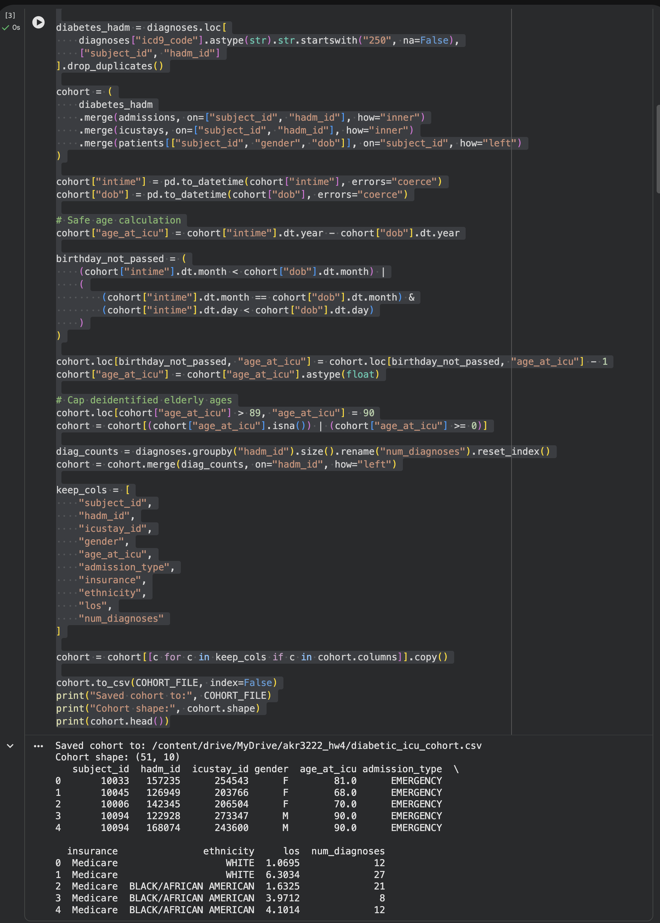
Cohort Selection
ICU patients only
Diabetes identified with ICD-9 codes starting with 250
Merge tables using subject_id and hadm_id
Clean missing or unrealistic values
Use PATIENTS, ADMISSIONS, ICUSTAYS, and DIAGNOSES_ICD tables
Notes:
Speaker notes:
This project focuses only on patients who were admitted to the ICU. Diabetic patients are identified using ICD-9 diagnosis codes that begin with 250. After selecting the cohort, the relevant MIMIC-III tables are merged using subject_id and hadm_id.
These joins allow demographic, admission, and ICU stay information to be combined into one dataset. The final step is to clean missing values and remove unrealistic records before modeling.

Slide 8
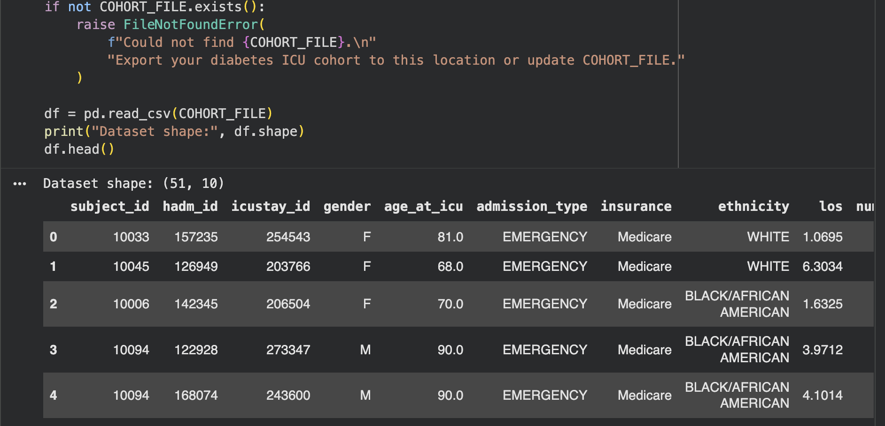
Feature Engineering
Age at ICU admission
Gender
Admission type
Insurance
Ethnicity
Number of diagnoses
Diagnosis count is used as a simple proxy for clinical complexity.
Notes:
Speaker notes:
These are the main structured features used in the model. Age at ICU admission captures the patient’s age at the time of critical care. Gender, admission type, insurance, and ethnicity provide demographic and hospital-related context. The number of diagnoses is included as a simple measure of overall illness complexity. Together, these features help the model predict ICU length-of-stay category for diabetic patients.

Slide 9
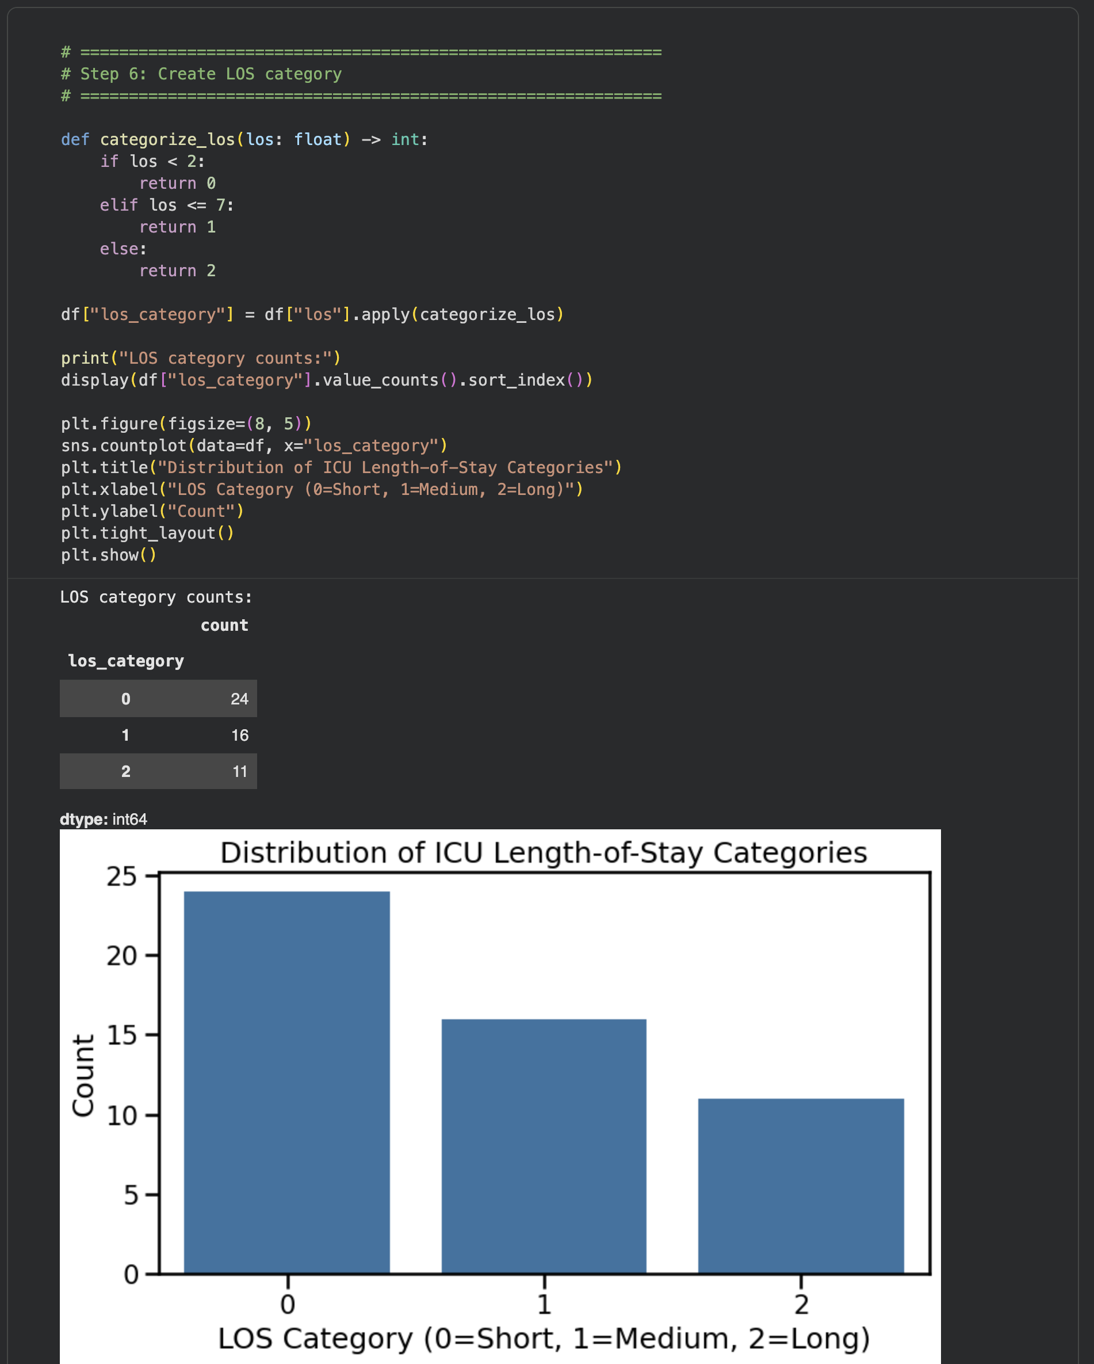
Target Variable
Short stay: < 2 days
Medium stay: 2 to 7 days
Long stay: > 7 days
This converts LOS prediction into a three-class classification problem
Notes:
Speaker notes:The target variable in this project is ICU length of stay. To make the prediction task easier to model, length of stay is divided into three categories. A short stay is defined as less than 2 days, a medium stay is 2 to 7 days, and a long stay is more than 7 days. This converts the problem from predicting an exact number of days into a multiclass classification task. These categories make the results easier to interpret and explain in a tutorial setting.

Slide 10
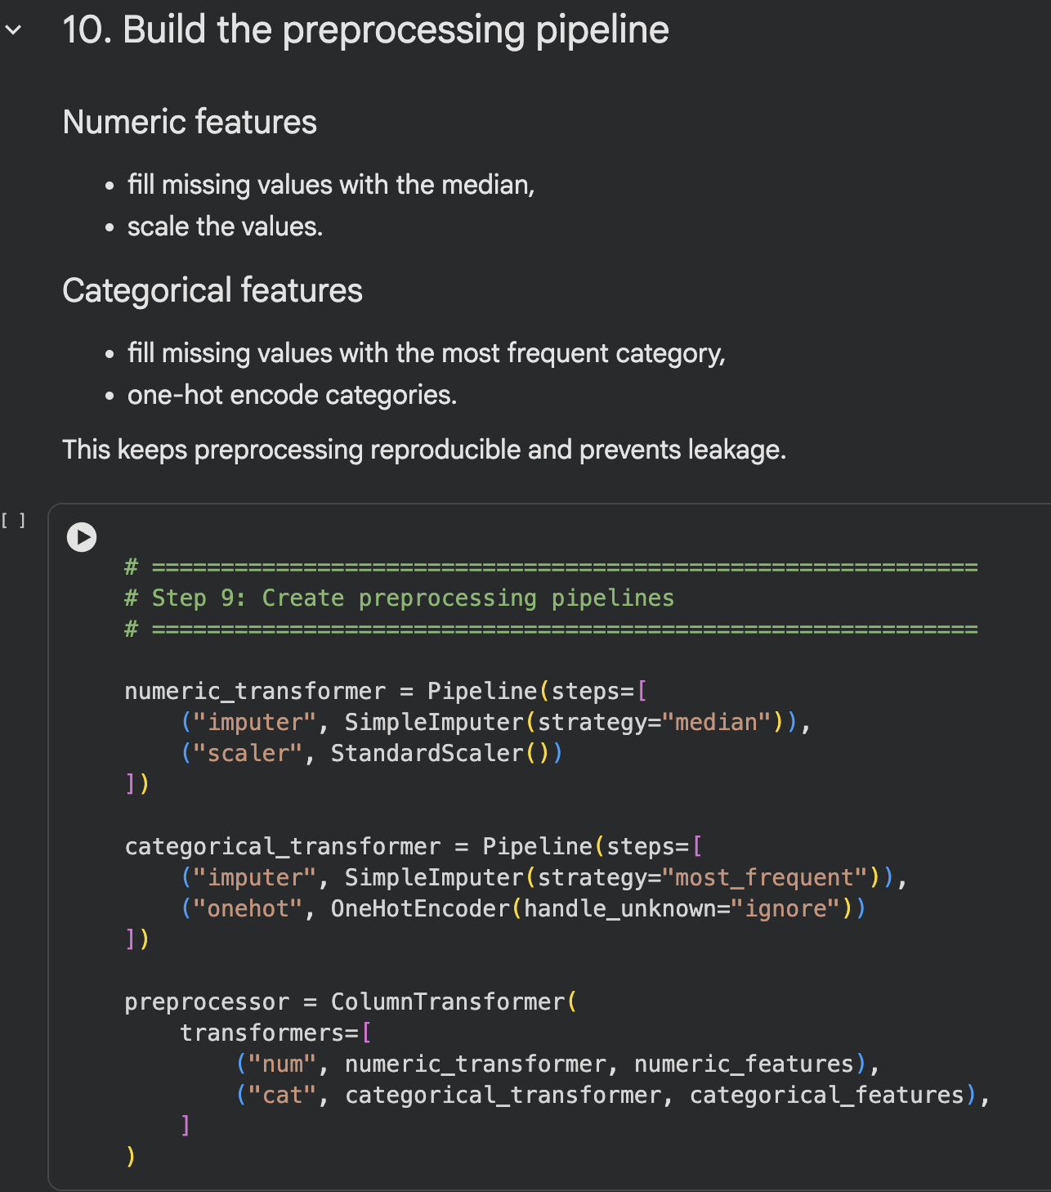
Machine Learning Pipeline
Train/test split Imputation
One-hot encoding
Scaling
Logistic Regression
Random Forest
Stratified 80/20 train/test split
Notes:
Speaker notes:
This slide summarizes the main steps in the machine learning pipeline. The dataset is first divided into training and test sets so model performance can be evaluated fairly. Missing values are handled with imputation, categorical variables are transformed using one-hot encoding, and numeric features are scaled when needed. After preprocessing, Logistic Regression is used as a baseline model and Random Forest is used as a more flexible model. Comparing these models helps show how different machine learning methods perform on the same healthcare prediction task.

Slide 11
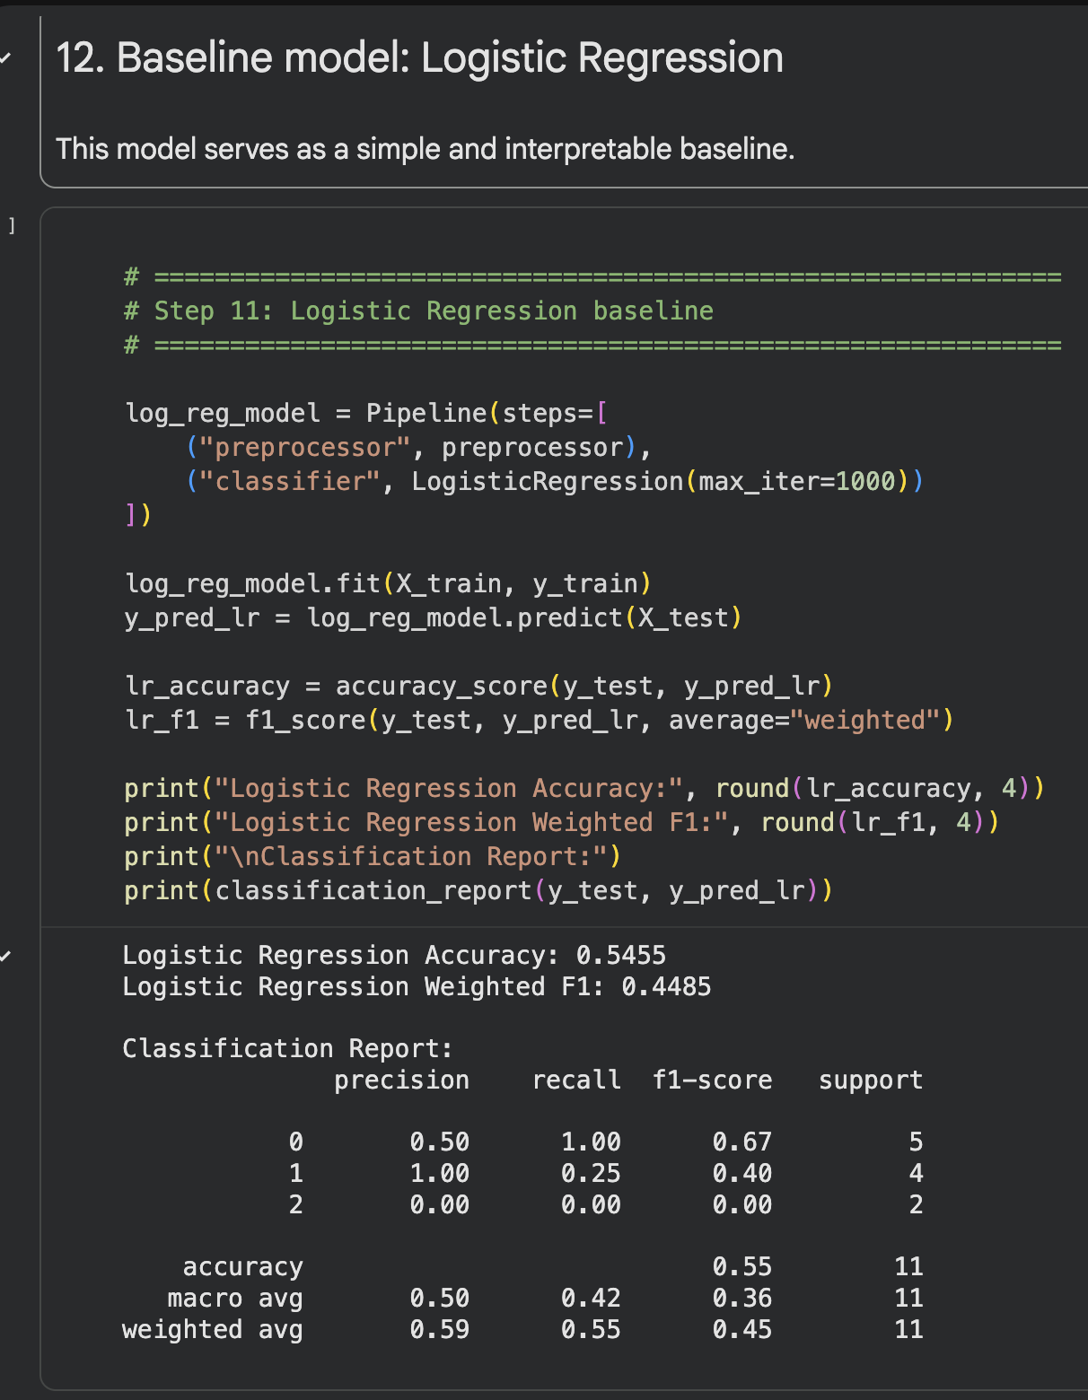
Evaluation-Baseline model: Logistic Regression
Accuracy
Precision
Recall
F1-score
Confusion matrix
Accuracy: 0.5455
Weighted F1: 0.4485
Notes:
Speaker notes:
Logistic Regression serves as the baseline model. It performs moderately, but struggles more than Random Forest, especially on the harder long-stay cases

Slide 12
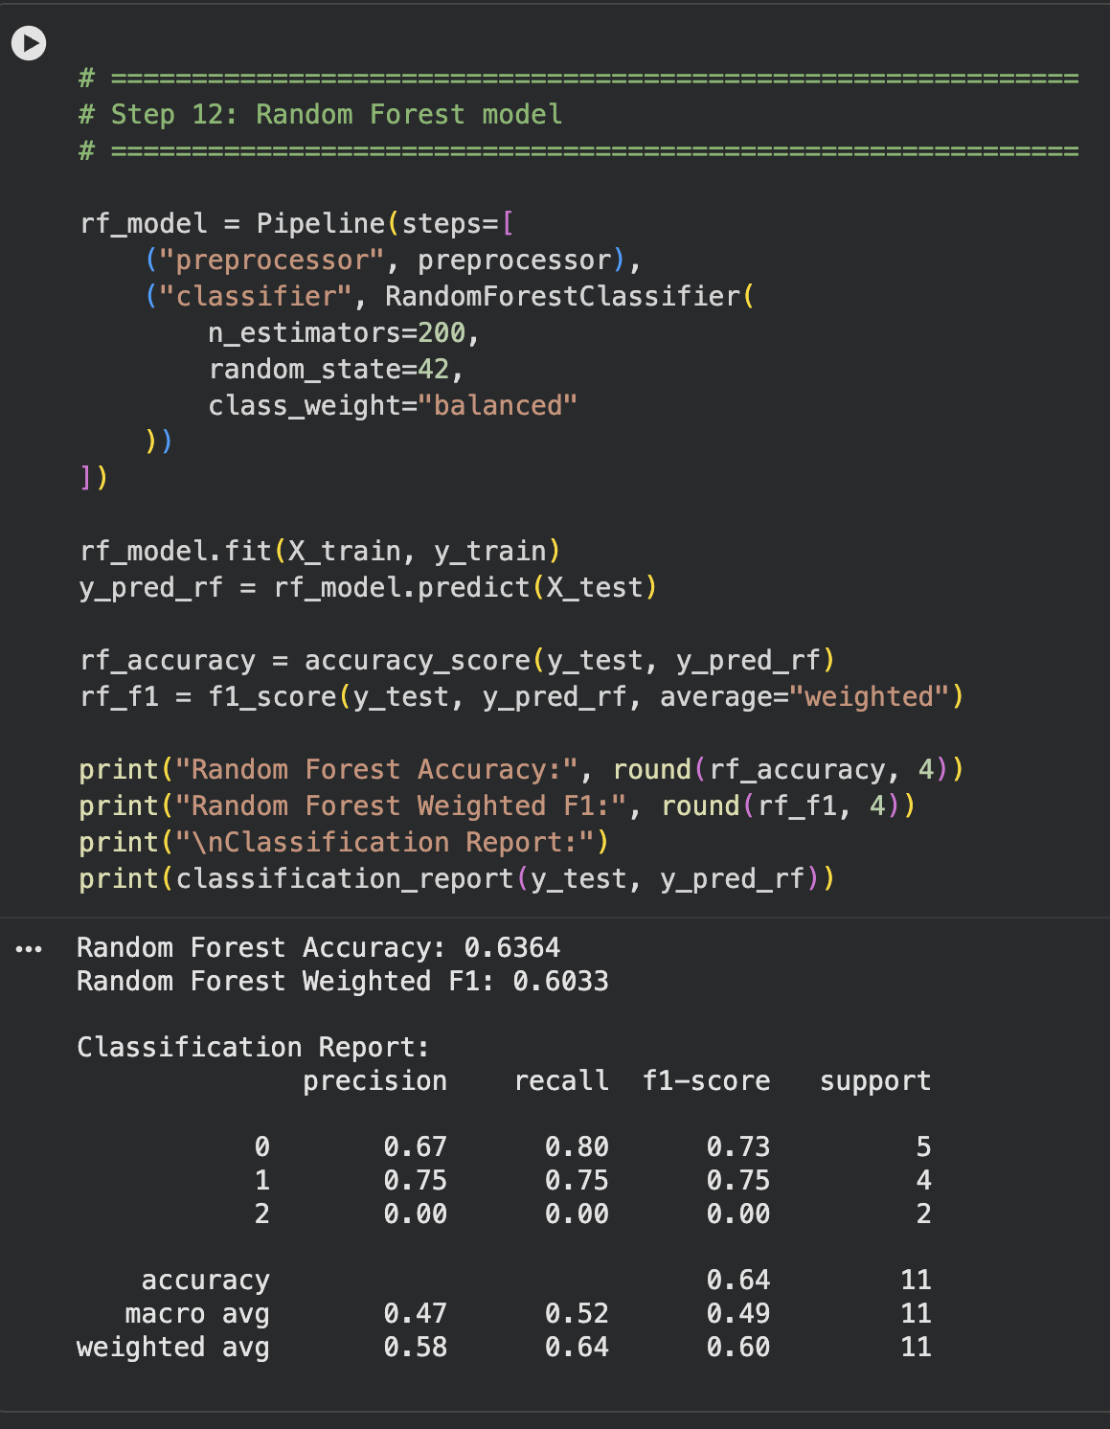
Evaluation Tree-based model: Random Forest
Accuracy
Precision
Recall
F1-score
Confusion matrix
Accuracy: 0.6364
Weighted F1: 0.6033
Random Forest outperformed Logistic Regression on both metrics.
Notes:
Speaker notes:
This slide shows the evaluation results for the Random Forest model, which is the tree-based approach used in this project. Accuracy measures the overall percentage of correct predictions across the ICU length-of-stay categories. Precision, recall, and F1-score provide a more complete view of how well the model performs for each class. The confusion matrix helps visualize where the Random Forest model predicts correctly and where misclassifications occur.
Comparing these results with Logistic Regression helps determine whether the tree-based model performs better on this task.

Slide 13
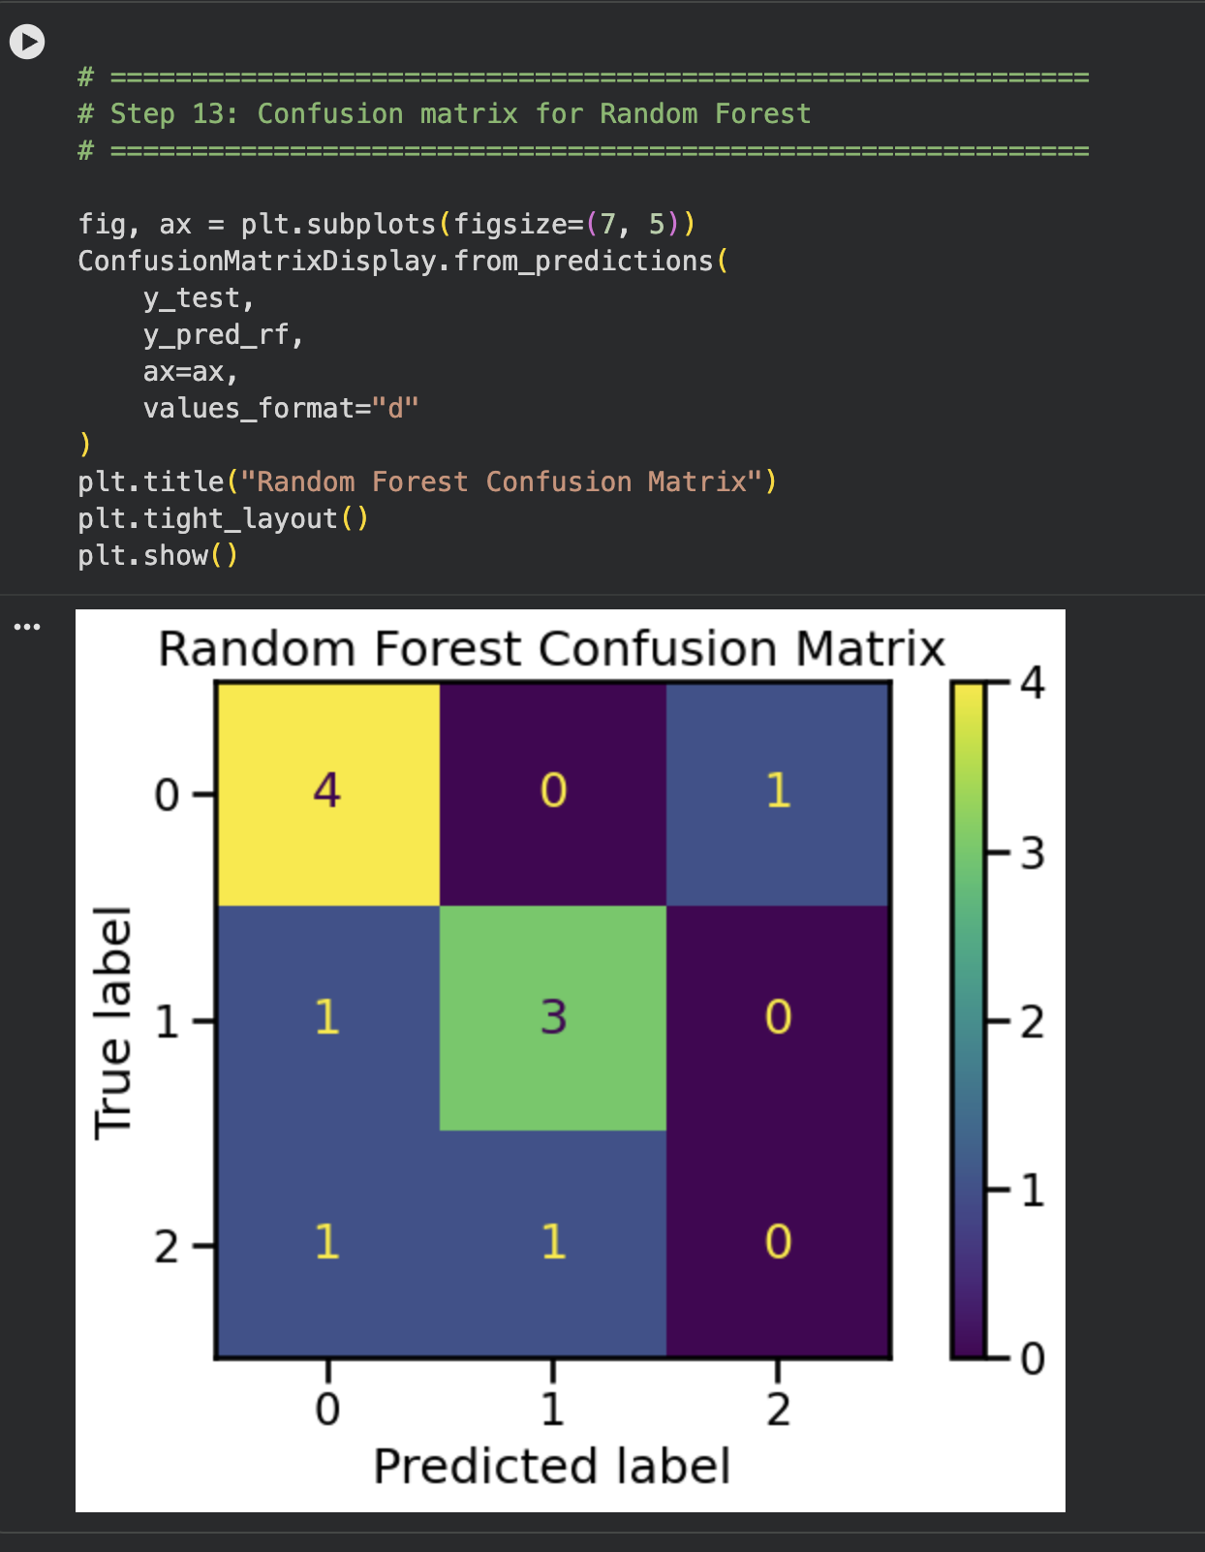
Confusion matrix
A confusion matrix helps show:
which classes are predicted correctly,
which categories are mixed up,
whether the model struggles more with medium vs long stays.
Long-stay cases were the hardest to identify correctly.”
Notes:
This slide explains why the confusion matrix is an important evaluation tool in this project.
It shows which ICU length-of-stay categories are predicted correctly by the model.
It also highlights which classes are commonly confused with one another during prediction.
In this task, the model may struggle more when distinguishing medium stays from long stays.
This makes the confusion matrix useful for understanding model strengths and weaknesses beyond overall accuracy.

Slide 14
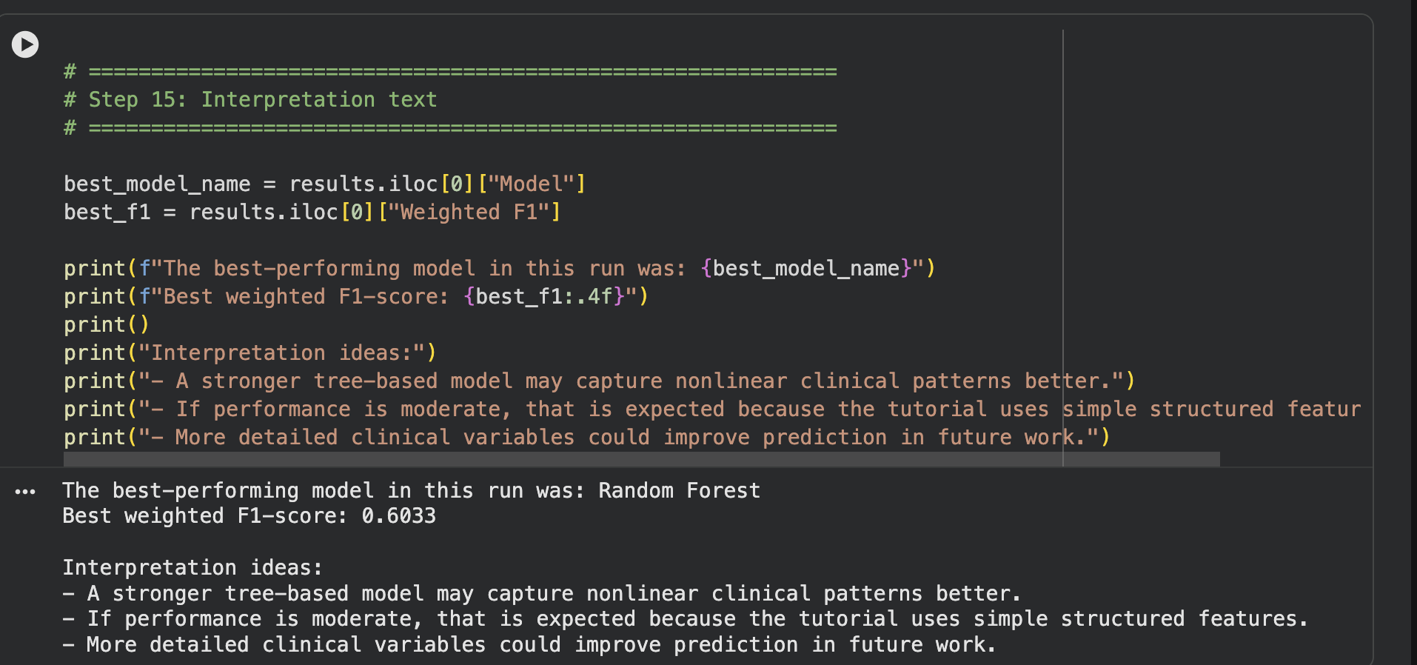
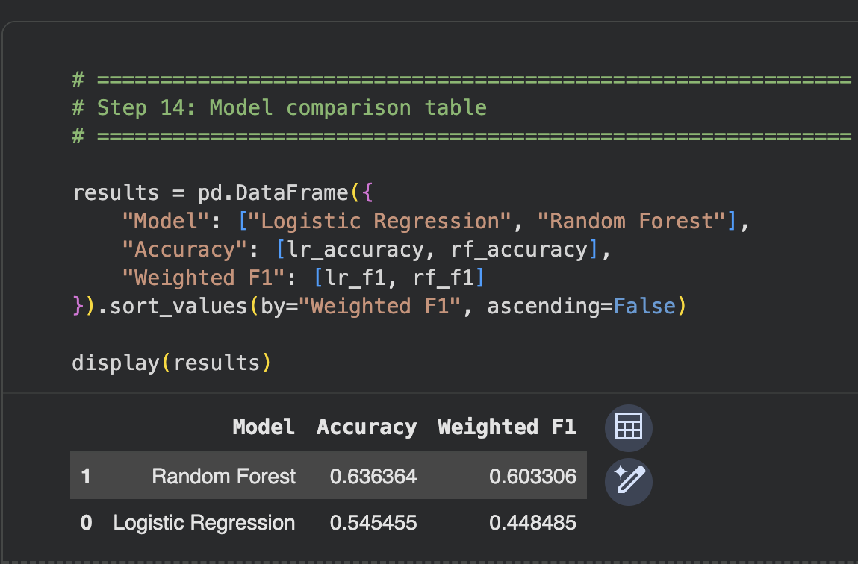
Results and Interpretation
Random Forest was the best-performing model
Structured EHR features carried meaningful signal for LOS prediction
Long-stay cases remained difficult due to small cohort size and class imbalance
This project demonstrates a reproducible healthcare ML tutorial workflow
Notes:
Speaker notes:
This slide summarizes the main findings from the modeling process. The results from Logistic Regression and Random Forest are compared to identify the best-performing model.
It also highlights which structured features appear to be the most useful predictors of ICU length of stay. These findings help interpret how patient and admission characteristics relate to short, medium, or long stays. Overall, the results show that structured EHR data can be used to support healthcare prediction tasks.

Slide 15
Cohort Summary / Key Results
Cleaned cohort size: 51 ICU stays
Short stay: 24
Medium stay: 16
Long stay: 11
Random Forest performed best on the held-out test set

Slide 16
Limitations and Replication
Single dataset
Diabetes defined by diagnosis codes
Simple feature set
Educational use only
Replication:
Place CSV files or prebuilt cohort in data folder
Run notebook cells in order
Speaker notes:
This project is designed for reproducibility and teaching, not clinical deployment.
Run cohort-building cell if needed
Notes:
This slide explains both the limitations of the project and how another learner can reproduce it.
The main limitations are that the analysis uses a single dataset, defines diabetes using diagnosis codes, and relies on a simple structured feature set. Because of these design choices, the project is intended for educational use and not for real clinical deployment. To replicate the work, a learner should first load the cohort file and then run the notebook cells in order. Following the notebook step by step should reproduce the same preprocessing, charts, metrics, and overall results.

