Slide 1
DESIGN AND ANALYSIS OF LINEAR TELESCOPIC MOTION MECHANISM FOR MATERIAL HANDLING
PROJECT BY – GUIDED BY-
AKASH SAMBHUS Prof. S. U. DEOKAR
ABHISHEK RAO
ANEESH PHATAK
ADITI TAMBE

Slide 2
INTRODUCTION
A computer can do only three things: copy information, store and retrieve information, and derive new information from existing information. Everything else a computer can do is a combination of those three things.
Human beings can do those things too. People can copy information, store and retrieve information, and derive new information from existing information.
The differences between people and computers is not in their ability to do those things, but the speed at which they can do them. Anything that a computer can do, a human could do, given enough time..
Sometimes our purpose in automating is to do the "impossible"—that is, to make a qualitative leap, a discontinuous improvement in the quality attributes of a process.
So the most common goal, from a corporate point of view, is to reduce the cost of human labour and thus increase the profits of the business; this is how business managers see the benefits of automation for their business.
The goal of automation for the customer is resetting their expectations about how they invest their time with a business; the customer experience.

Slide 3
ABSTRACT
In various automating industries of INDIA, the issue of OBJECT TRANSFER is not executed at optimum productivity levels.
We aim to replace the conventional transferring system by new TELESCOPIC SHUTTLE SYSTEM.
The new system is fully automated and compact to not only reduce the time required but also the space of housing.

Slide 4
LITERATURE REVIEW
PAPER TITLE | AUTHOR | CONTENTS | EXTRACTED DATA
Dynamic Analysis of Gear and Rack Transmission System. | Xiao Yanjun, He Lihu, Zhu Jiayu and Xiao Yanchun | Gear and rack system is commonly used as a component in mechanical device, so its strength check has practical implications. Typically the contact stress, bending stress of gear and rack are computed by traditional methods. However, the conventional formula to calculate the contact stress in the gear is only on one certain point of time and on one contact surface. | The maximum equivalent stress of the gear and rack occurs in the gear and rack out-meshing contact point, and only in this point, because there is local high stress in the addendum line. This is why gear tooth is patched on the top to avoid the condition of local high stress in engineering.

Slide 5
PAPER TITLE | AUTHOR | CONTENTS | EXTRACT
SIMULATION BASED REGRESSION ANALYSIS FOR RACK CONFIGURATION OF AUTONOMOUS VEHICLE STORAGE AND RETRIEVAL SYSTEM | Banu Y. Ekren ; Sunderesh S. Heragu | In this study, a simulation based regression analysis for rack configuration of an autonomous vehicle storage and retrieval system (AVS/RS) is presented. We develop a mathematical function for rack configuration of an AVS/RS that reflects the relationship between the output (response) and the input variables (factors) of the system. | In this system, autonomous vehicles (AVs) function as storage/retrieval (S/R) devices. The most important difference between an AVS/RS and a traditional crane-based automated storage and retrieval system (AS/RS) is the movement pattern of the S/R device

Slide 6
PAPER TITLE | AUTHOR | CONTENT | EXTRACT
A study on a novel quick return mechanism | Venketesh Babu | quick return mechanism converts rotary motion into reciprocating motion at different rates of strokes. The time required for the stroke during which actual work takes place is higher than the return stroke. As a result, the productivity increases. | The weaknesses of the four bar mechanism and its inversions is that they are bulky and difficult to balance. Mechanisms having linkages are easier to manufacture but if compact space is required then using linkages is not recommended.

Slide 7
PAPER TITLE | AUTHOR | CONTENT | EXTRACT
Design and analysis of rack gear mechanical drive | Haseena Bee | In this paper, modelling of the rack and pinion system is done using CATIA software. Analysis of the system is done using FEM. | The highly stressed parts are recognized from the analysis results and required modifications are carried out in the dimensions and the design of the system. Dynamic vibration analysis is also done

Slide 8
PROBLEM IDENTIFICATION
Thousands of component(Front axle beam of truck) are transferred daily from the loading line to conveyor belt.
The weight of this component is considerably high(150 to 250kg).Hence cranes are used to displace the product
The cranes place these components on a fixture(mounted on a plate) which is operated by a hydraulic cylinder.
The problem rises when there is insufficient space in the housing. One may suggest using a smaller plate but it eventually results into larger strokes and hence larger power consumption.

Slide 9
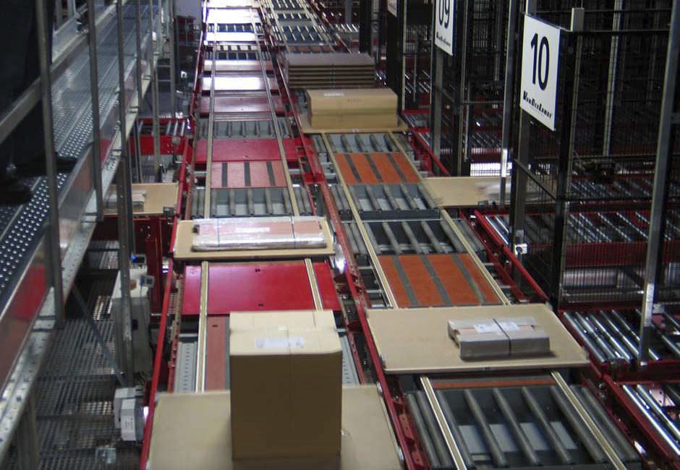
CONVENTIONAL SYSTEM

Slide 10
Aim of our project
By using TELESCOPIC MOTION TABLE, we aim to eliminate the space problem.(Constrain the entire mechanism within 1m longitudinal space)
Also, to increase the speed of the delivery and hence improve productivity.
We also aim to validate our design calculations by performing a CAE analysis of selected parts on ANSYS workbench software

Slide 11
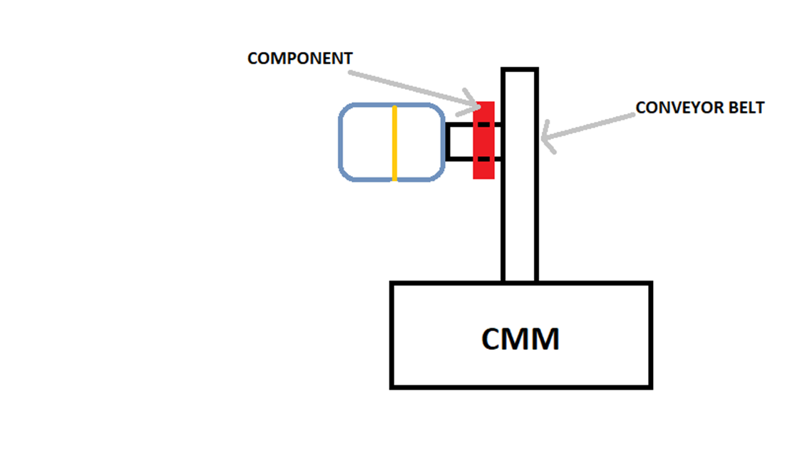
Basic layout of our system

Slide 12
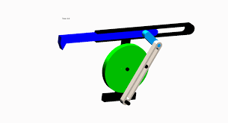
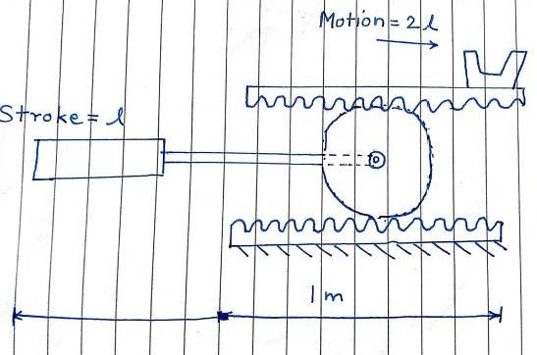
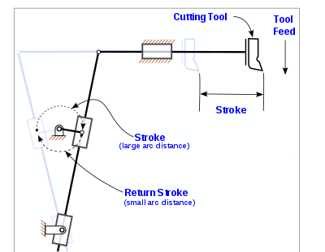
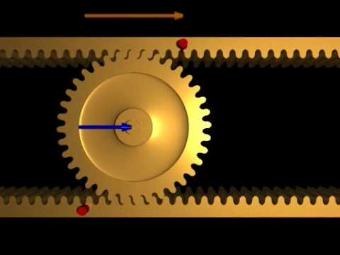
PLAN

Slide 13
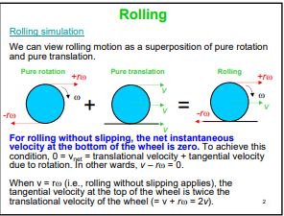
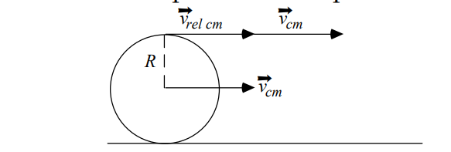

Slide 14
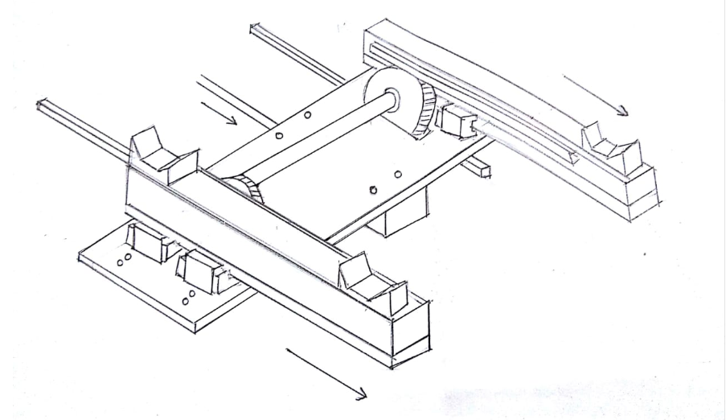
Conceptual Design

Slide 15
PLAN OF WORK(DESIGN)
Deciding the cross-section of rail support block
Determining the total force required to move the base plate
Rack and Pinion selection
Actual force and power calculation using gearing efficiency
Selection of hydraulic cylinder
Selection of auxiliary components

Slide 16
Schedule
Months/ Activity | Jun | Jul | Aug | Sep | Oct | Nov | Dec | Jan | Feb
A
B
C
D
E
F
G
H
Activities
A= Topic finalization
B= Literature Review
C= Formulation of Problem
D= Development of Design of the system
E= Validation
F= Purchasing of components
G= Assembly and Testing
H= Results and Conclusion

Slide 17
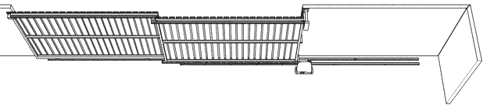
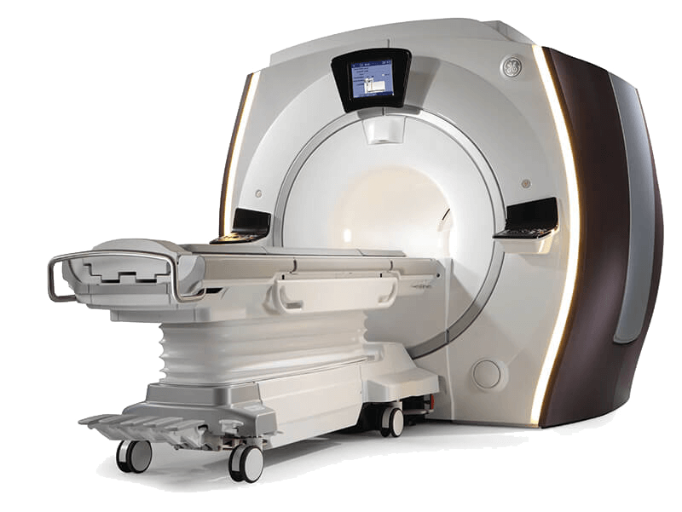
SCOPE SECURITY SOLUTIONS:
MEDICAL USES:
MRI BEDS

Slide 18
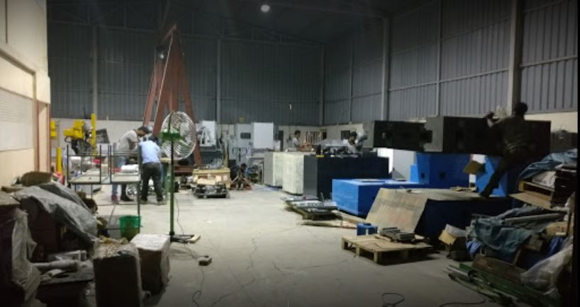
About R2A
R2A Automation is working in handling automation systems. We work for various industries like Automotive, Logistics, Tyre, Glass and more.
R2a Automation Pvt Ltd. has gained immense expertise in supplying & trading of Gantries, conveyors, floor automation etc. The supplier company is located in Pune, Maharashtra and is one of the leading sellers of listed products. Buy Gantries, conveyors, floor automation in bulk from us for the best quality products and services

Slide 19
THANK YOU

