Slide 1


TEAM ~
FIVE BLIND BOYS
Member:
1.Harshit Gupta(Team Leader)
2.Abhishek Khandelwal
3.Ashwin Royal
4.Deepak Nehra
5.Avinash Nagar

Slide 2

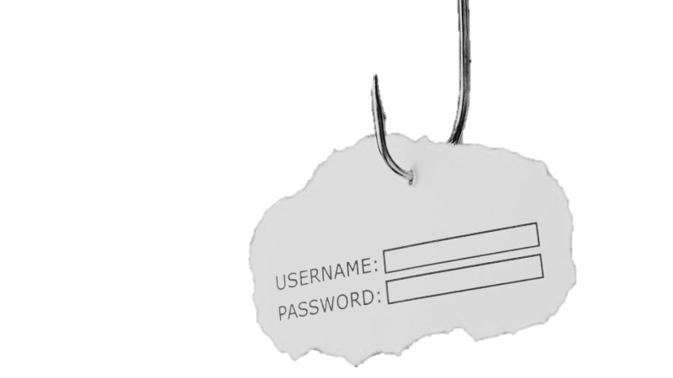
REDUCING PHISHING ATTACKS

Slide 3
Proposed Solution
Making Anti-Phishing Tool.
Every link is checked implicitly by some criteria when it is opened.

Slide 4
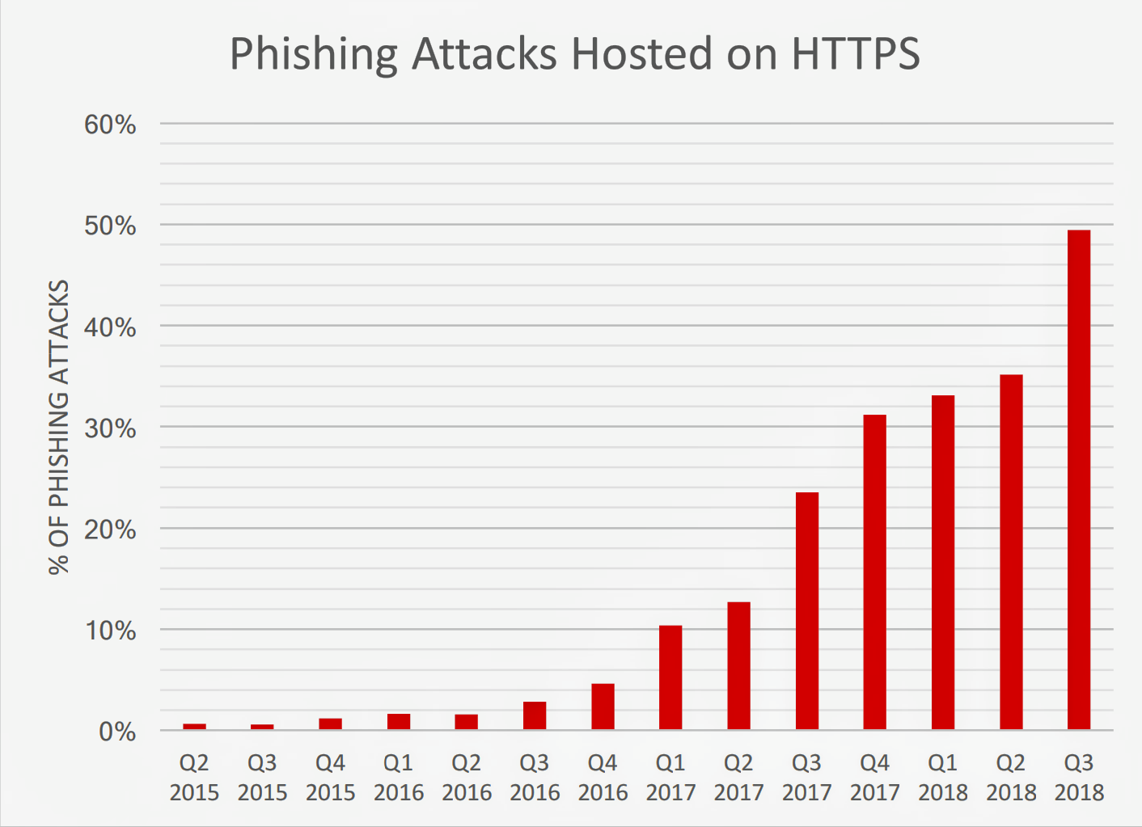
Phishing Attacks Hosted On HTTPS

Slide 5
SEQUENCE DIAGRAM

Slide 6
TECHNOLOGY STACK
Javascript : For making the Chrome Extension.
Php : Used as Gateway between Python and Javascript.
Python : Used for Backend and for OpenCV Module.
Operating System : Google Chrome.

Slide 7
THANK YOU

