Slide 1




Comparison of Models for SMS Spam Classification
Submitted to: Dr. Dan Wu
By Team Code Crafters,
Gyan Karthik Abhishek Sakibanda (110123230)
Shashank Kannan (110122650)
Karan Anandbhai Dhanwani (110122826)

Slide 2
Topics to Cover
Problem Statement
Techniques/Algorithms Used
Literature Review
Experiment Design
Expected Output
Work Done So Far
Work To Be Done

Slide 3
Problem Statement
Automatic identification and filtering of unwanted and potentially harmful spam messages in SMS communication to enhance user experience, privacy, and security.
Develop and compare SMS spam classification models using Multinomial Naive Bayes
Use a Custom implementation and Pre-trained model from Scikit Learn
Explore the performance of other Machine Learning Models

Slide 4
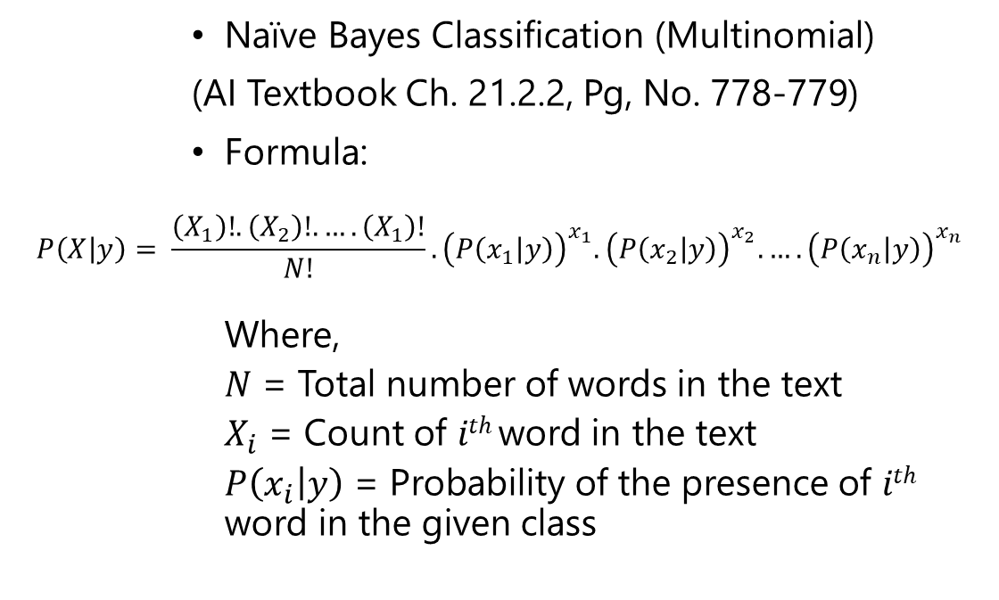
Techniques/Algorithms Used
Naïve Bayes Classification (Multinomial)
(AI Textbook Ch. 21.2.2, Pg, No. 778-779)
Formula:
$$P\left(X | y\right)= \frac{\left(X_{1}\right)!.\left(X_{2}\right)!.….\left(X_{1}\right)!}{N!}.{\left(P\left(x_{1} | y\right)\right)}^{x_{1}}.{\left(P\left(x_{2} | y\right)\right)}^{x_{2}}.….{\left(P\left(x_{n} | y\right)\right)}^{x_{n}}$$
Where,
$N$ = Total number of words in the text
$X_{i}$ = Count of $ith$word in the text
$P\left(x_{i} | y\right)$ = Probability of the presence of $ith$ word in the given class

Slide 5
Techniques/Algorithms Used Contd.
Logistic Regression (AI Textbook Ch. 19.6.5, Pg. No. 702-704)
Used for binary classification
Predict the probability to belong to one of two classes
Random Forest Classifier (AI Textbook Ch. 19.8.2, Pg. No. 715-716)
Learning method for both classification and regression tasks
Makes use of multiple independent decision trees to train
Stochastic Gradient Descent (AI Textbook Ch. 19.6.2, Pg. No. 695-697)
Optimization Algorithm
Well suited for large datasets

Slide 6
Literature Review
Ham or Spam? SMS Text Classification with Machine Learning – 2018
Applied the following algorithm(s):
Naïve Bayes Classification
Visualized the data and classified SMS messages as spam or ham
Uses a pre-trained implementation of the Naïve Bayes Classification Algorithm
Notes:
Made use of only a Naïve Bayes Classifier to get probability.

Slide 7
Literature Review
Spam detection in SMS messages – 2021
Applied the following algorithm(s):
XGBoost
Uses services from AWS to perform ETL on SMS logs
Uses an approach to generate “spam score”, instead of getting a probabilistic value.
Notes:
Model consists of a collection of weak learners that work together to provide a better prediction.
Have to consider cost and pricing of using services from public clouds like AWS to perform ETL.

Slide 8
Experiment Design
Dataset: SMS Spam Collection Dataset (Kaggle)
Dataset consists of over 5500 examples of labelled SMS data (ham or spam)
Perform the following:
Data Cleaning
Get count of individual words from dataset
Create Training and Test dataset
Classify message
Get Accuracy of Model

Slide 9
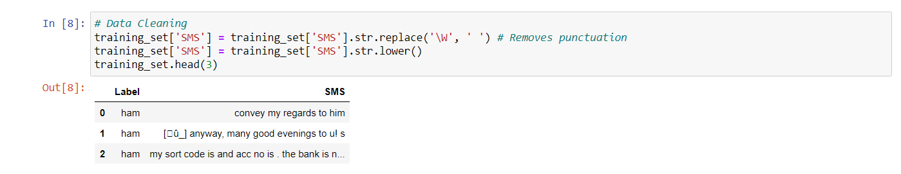
Experiment Design – Data Cleaning

Slide 10
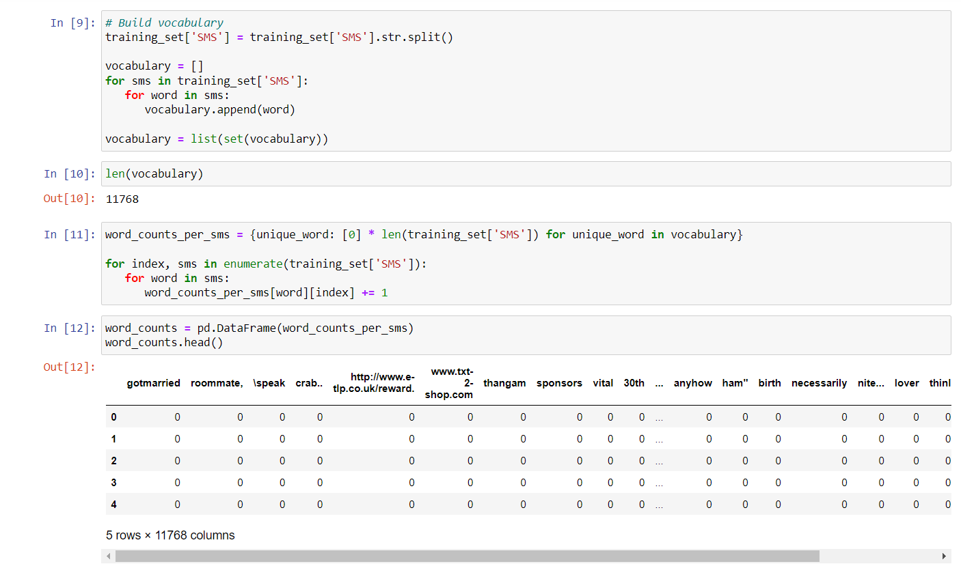
Experiment Design – Get Word Count

Slide 11
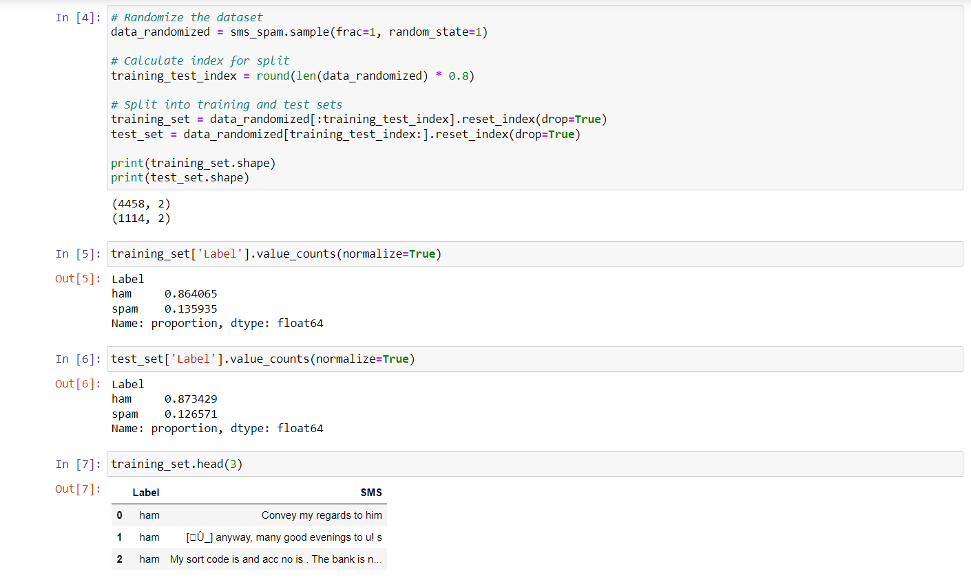
Experiment Design – Create Training and Test Set

Slide 12
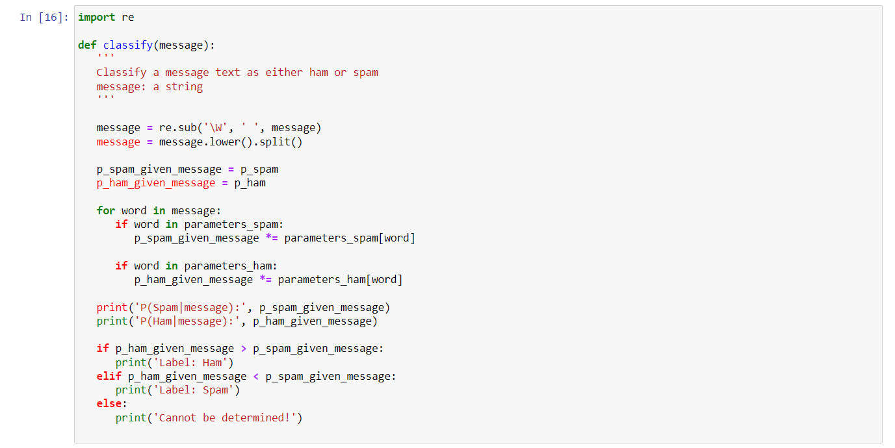
Experiment Design – Classify Message

Slide 13
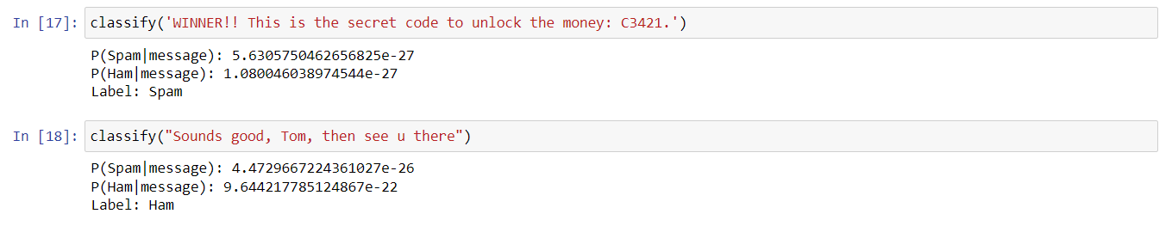
Expected Output
Classification function would be able to predict the probability of the text message being ham or spam.

Slide 14
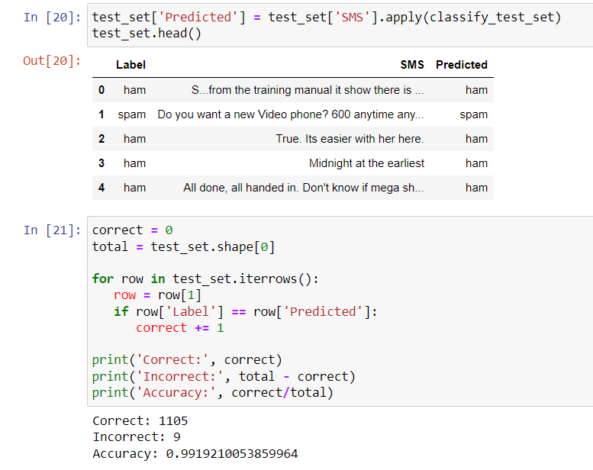
Model Accuracy
The custom-implemented model gave an accuracy of about 99%

Slide 15

Work Done So Far
Implemented Multinomial Naïve Bayes Classification to classify SMS text into Ham and Spam

Slide 16
Work To Be Done
Implement SMS Spam Classification with scikit-learn’s pretrained models,
Logistic Classifier
Multinomial Naïve Bayes Classifier
Random Forest Classifier
Stochastic Gradient Descent

Slide 17
Any Questions?

Slide 18
References
VanderPlas, J. (n.d.). In depth: Naive Bayes classification. Github.io. Retrieved November 26, 2023, from https://jakevdp.github.io/PythonDataScienceHandbook/05.05-naive-bayes.html
Dsilva, D. (2018, August 14). Ham or spam? SMS text classification with machine learning. Tech & Career Nuggets. https://medium.com/tech-career-nuggets/sms-text-classification-a51defc2361c
Benedetto, M. F. (2021, December 20). Spam detection in SMS messages. Towards Data Science. https://towardsdatascience.com/spam-detection-in-sms-messages-3322e03300f5
User guide: contents. (n.d.). Scikit-Learn. Retrieved November 27, 2023, from https://scikit-learn.org/stable/user_guide.html

