Slide 1
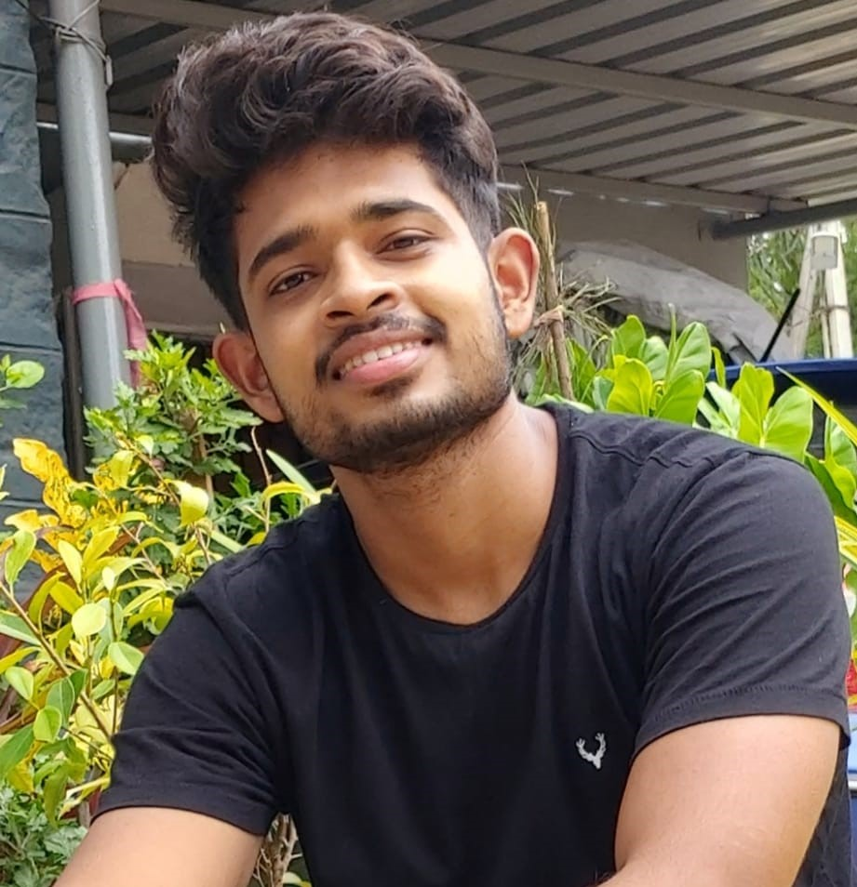



Abhishek Sanchula
Analyst/Software Engineer
Bachelor of Engineering
ECE : 2017 - 2021
Skills
Java 8 /J2EE | Java Basics, OOPS, Generics, Collections, Arrays, Loops, Lambda Exp, Junit, Mockito, Servlets
Spring core | IOC & Dependency Injection, Autowiring
Spring REST | REST controllers, Implementation of GET, POST, PUT & DELETE, Bean Validation & Exception Handling, Testing Services, Controller & Repository layer
Spring Data JPA | Implement DAO layer using spring Data repositories, Transaction Management
Spring Boot Microservices | Spring Boot Starters, annotations, Messaging Service, Swagger API specifications
Spring Cloud | Eureka, Netflix Ribbon, Netflix Hystrix, Netflix Zuul & Config Server
Angular | Components, Services, Modules, Routing, Forms & Validation, Testing using Jasmin & Karma
Database | MongoDB No SQL Advanced
UI Tech | HTML 5 & CSS 3,JavaScript, ES6 & TypeScript Reusable templates, Optimized UI Designed
Tools | Git, Postman, Maven
Add On skills | Communications, Team management. Peer learning
Bangalore
sanchula.sai-abhishek@capgemini.com
+91 9701425511
A4
Full Stack Developer
Hands on experience in creating microservices with Spring-boot, Spring Security, Spring Cloud API Gateway, Eureka server, resilience 4J, load balancing.
Proficient in creating Single page Web Application in Angular with Authentication with route guards, Angular reactive forms, angular routing, Tailwind CSS
Hands on experience in implementing polyglot architecture with Node Js & spring boot
Experience in creating documentation with Java docs and swagger and in unit testing using Junit, Mockito.
Development experience in creating docker images and pushing to Docker Hub with containerized applications using Docker SWARM
In-depth understanding of deploying spring boot applications in AWS Cloud environment
Online Railway Reservation System
Completed end to end case study of Online Railway Reservation Application along with JWT authentication, Swagger and responsive UI with Tailwind CSS and Angular used for user interface.
Check out my work on GitHub & Video Profile

