Slide 1
Artificial Intelligence
Introduction
Ambalika Sarkar

Slide 2
Evaluation Strategy
T1: 20 Marks- 16 - 21 Sep 2018
T2: 20 Marks- 21 - 25 Oct 2018
T3: 35 Marks- 05 - 14 Dec 2018
TA: 25
Assignments+Project
Attendance

Slide 3
Why Study AI?
AI makes computers more useful
Intelligent computer would have huge impact on civilization
AI cited as “field I would most like to be in” by scientists in all fields
Computer is a good metaphor for talking and thinking about intelligence

Slide 4
Why Study AI?
Turning theory into working programs forces us to work out the details
AI yields good results for Computer Science
AI yields good results for other fields
Computers make good experimental subjects
Personal motivation: mystery

Slide 5
What is the definition of AI?
What do you think?

Slide 6
What is the definition of AI?
Systems that think like humans | Systems that think rationally
Systems that act like humans | Systems that act rationally

Slide 7
What is the definition of AI?
Systems that think like humans | Systems that think rationally
Systems that act like humans | Systems that act rationally
Bellman, 1978
“[The automation of] activities that we associate with human thinking, activities such as decision making, problem solving, learning”

Slide 8
What is the definition of AI?
Systems that think like humans | Systems that think rationally
Systems that act like humans | Systems that act rationally
Charniak & McDermott, 1985
“The study of mental faculties through the use of computational models”

Slide 9
What is the definition of AI?
Systems that think like humans | Systems that think rationally
Systems that act like humans | Systems that act rationally
Dean et al., 1995
“The design and study of computer programs that behave intelligently. These programs are constructed to perform as would a human or an animal whose behavior we consider intelligent”

Slide 10
What is the definition of AI?
Systems that think like humans | Systems that think rationally
Systems that act like humans | Systems that act rationally
Haugeland, 1985
“The exciting new effort to make computers think machines with minds, in the full and literal sense”

Slide 11
What is the definition of AI?
Systems that think like humans | Systems that think rationally
Systems that act like humans | Systems that act rationally
Kurzweil, 1990
“The art of creating machines that perform functions that require intelligence when performed by people”

Slide 12
What is the definition of AI?
Systems that think like humans | Systems that think rationally
Systems that act like humans | Systems that act rationally
Luger & Stubblefield, 1993
“The branch of computer science that is concerned with the automation of intelligent behavior”

Slide 13
What is the definition of AI?
Systems that think like humans | Systems that think rationally
Systems that act like humans | Systems that act rationally
Nilsson, 1998
“Many human mental activities such as writing computer programs, doing mathematics, engaging in common sense reasoning, understanding language, and even driving an automobile, are said to demand intelligence. We might say that [these systems] exhibit artificial intelligence”

Slide 14
What is the definition of AI?
Systems that think like humans | Systems that think rationally
Systems that act like humans | Systems that act rationally
Rich & Knight, 1991
“The study of how to make computers do things at which, at the moment, people are better”

Slide 15
What is the definition of AI?
Systems that think like humans | Systems that think rationally
Systems that act like humans | Systems that act rationally
Schalkoff, 1990
“A field of study that seeks to explain and emulate intelligent behavior in terms of computational processes”

Slide 16
What is the definition of AI?
Systems that think like humans | Systems that think rationally
Systems that act like humans | Systems that act rationally
Winston, 1992
“The study of the computations that make it possible to perceive, reason, and act”

Slide 17
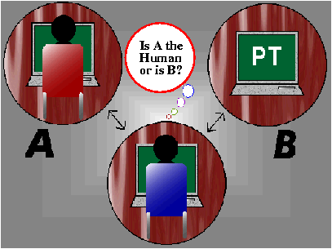
Approach 1: Acting Humanly
Turing test: ultimate test for acting humanly
Computer and human both interrogated by judge
Computer passes test if judge can’t tell the difference

Slide 18
How effective is this test?
Agent must:
Have command of language
Have wide range of knowledge
Demonstrate human traits (humor, emotion)
Be able to reason
Be able to learn
Loebner prize competition is modern version of Turing Test
Example: Alice (Artificial Linguistic Internet Computer Entity), Richard Wallace, Loebner prize winner for 2000 and 2001

Slide 19

Chinese Room Argument
Imagine you are sitting in a room with a library of rule books, a bunch of blank exercise books, and a lot of writing utensils. Your only contact with the external world is through two slots in the wall labeled ``input'' and ``output''. Occasionally, pieces of paper with Chinese characters come into your room through the ``input'' slot. Each time a piece of paper comes in through the input slot your task is to find the section in the rule books that matches the pattern of Chinese characters on the piece of paper. The rule book will tell you which pattern of characters to inscribe the appropriate pattern on a blank piece of paper. Once you have inscribed the appropriate pattern according to the rule book your task is simply to push it out the output slot.
By the way, you don't understand Chinese, nor are you aware that the symbols that you are manipulating are Chinese symbols.
In fact, the Chinese characters which you have been receiving as input have been questions about a story and the output you have been producing has been the appropriate, perhaps even "insightful," responses to the questions asked. Indeed, to the outside questioners your output has been so good that they are convinced that whoever (or whatever) has been producing the responses to their queries must be a native speaker of, or at least extremely fluent in, Chinese.

Slide 20
Do you understand Chinese?
Searle says NO
What do you think?
Is this a refutation of the possibility of AI?
The Systems Reply
The individual is just part of the overall system, which does understand Chinese
The Robot Reply
Put same capabilities in a robot along with perceiving, talking, etc. This agent would seem to have genuine understanding and mental states.

Slide 21
Approach 2: Thinking Humanly
Requires knowledge of brain function
What level of abstraction?
How can we validate this
This is the focus of Cognitive Science
Notes:
What level of abstraction? Knowledge, circuitry, chemical?

Slide 22
Approach 3: Thinking Rationally
Aristotle attempted this
What are correct arguments or thought processes?
Provided foundation of much of AI
Not all intelligent behavior controlled by logic
What is our goal? What is the purpose of thinking?

Slide 23
Approach 4: Acting Rationally
Act to achieve goals, given set of beliefs
Rational behavior is doing the “right thing”
Thing which expects to maximize goal achievement
This is approach adopted by Russell & Norvig

Slide 24
Foundations of AI
Philosophy
450 BC, Socrates asked for algorithm to distinguish pious from non-pious individuals
Aristotle developed laws for reasoning
Mathematics
1847, Boole introduced formal language for making logical inference
Economics
1776, Smith views economies as consisting of agents maximizing their own well being (payoff)
Neuroscience
1861, Study how brains process information
Psychology
1879, Cognitive psychology initiated
Linguistics
1957, Skinner studied behaviorist approach to language learning

Slide 25
History of AI
CS-based AI started with “Dartmouth Conference” in 1956
Attendees
John McCarthy
LISP, application of logic to reasoning
Marvin Minsky
Popularized neural networks
Slots and frames
The Society of the Mind
Claude Shannon
Computer checkers
Information theory
Open-loop 5-ball juggling
Allen Newell and Herb Simon
General Problem Solver

Slide 26
AI Questions
Can we make something that is as intelligent as a human?
Can we make something that is as intelligent as a bee?
Can we make something that is evolutionary, self improving, autonomous, and flexible?
Can we save this plant $20M/year by pattern recognition?
Can we save this bank $50M/year by automatic fraud detection?
Can we start a new industry of handwriting recognition agents?

Slide 27
Which of these exhibits intelligence?
You beat somebody at chess.
You prove a mathematical theorem using a set of known axioms.
You need to buy some supplies, meet three different colleagues, return books to the library, and exercise. You plan your day in such a way that everything is achieved in an efficient manner.
You are a lawyer who is asked to defend someone. You recall three similar cases in which the defendant was guilty, and you turn down the potential client.
A stranger passing you on the street notices your watch and asks, “Can you tell me the time?” You say, “It is 3:00.”
You are told to find a large Phillips screwdriver in a cluttered workroom. You enter the room (you have never been there before), search without falling over objects, and eventually find the screwdriver.

Slide 28
Which of these exhibits intelligence?
You are a six-month-old infant. You can produce sounds with your vocal organs, and you can hear speech sounds around you, but you do not know how to make the sounds you are hearing. In the next year, you figure out what the sounds of your parents' language are and how to make them.
You are a one-year-old child learning Arabic. You hear strings of sounds and figure out that they are associated with particular meanings in the world. Within two years, you learn how to segment the strings into meaningful parts and produce your own words and sentences.
Someone taps a rhythm, and you are able to beat along with it and to continue it even after it stops.
You are some sort of primitive invertebrate. You know nothing about how to move about in your world, only that you need to find food and keep from bumping into walls. After lots of reinforcement and punishment, you get around just fine.

Slide 29
Which of these can currently be done?
Play a decent game of table tennis
Drive autonomously along a curving mountain road
Drive autonomously in the center of Cairo
Play a decent game of bridge
Discover and prove a new mathematical theorem
Write an intentionally funny story
Give competent legal advice in a specialized area of law
Translate spoken English into spoken Swedish in real time
Plan schedule of operations for a NASA spacecraft
Defeat the world champion in chess

Slide 30
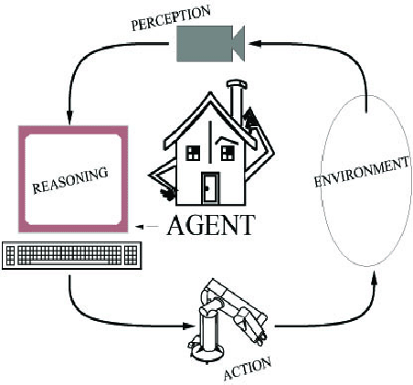
Components of an AI System
An agent perceives its environment
through sensors and acts on the
environment through actuators.
Human: sensors are eyes, ears,
actuators (effectors) are hands,
legs, mouth.
Robot: sensors are cameras, sonar,
lasers, ladar, bump, effectors are
grippers, manipulators, motors
The agent’s behavior is described by its
function that maps percept to action.
Notes:
LADAR is Laser Detection and Ranging
Light radar by uses light

Slide 31
Rationality
A rational agent does the right thing (what is this?)
A fixed performance measure evaluates the sequence of observed action effects on the environment

Slide 32
PEAS
Use PEAS to describe task
Performance measure
Environment
Actuators
Sensors

Slide 33
PEAS
Use PEAS to describe task environment
Performance measure
Environment
Actuators
Sensors
Example: Taxi driver
Performance measure: safe, fast, comfortable (maximize profits)
Environment: roads, other traffic, pedestrians, customers
Actuators: steering, accelerator, brake, signal, horn
Sensors: cameras, sonar, speedometer, GPS, odometer, accelerometer, engine sensors

Slide 34
Environment Properties
Fully observable vs. partially observable
Deterministic vs. stochastic / strategic
Episodic vs. sequential
Static vs. dynamic
Discrete vs. continuous
Single agent vs. multiagent
Notes:
Fully observable vs. partially observable
Environment sensors provide access to complete state of the
relevant environment at each point in time
Deterministic vs. stochastic / strategic
If next state completely determined by current and action,
then deterministic, otherwise stochastic
If deterministic except for actions of other agents,
then strategic
Episodic vs. sequential
Episodic, action choice depends only on current state
Sequential, current action may affect future actions
Static vs. dynamic
Dynamic, environment can change while agent is deliberating
Discrete vs. continuous
Applied to state, time, percepts, or actions
The way the information is represented
Single agent vs. multiagent
How distinguish agent from environment?
if other's behavior maximizes its performance based on
agent, then it is multiagent

Slide 35
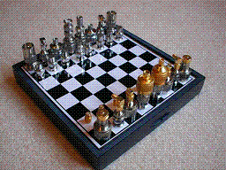
Environment Examples
Environment | Observable | Deterministic | Episodic | Static | Discrete | Agents
Chess with a clock
Chess without a clock
Fully observable vs. partially observable
Deterministic vs. stochastic / strategic
Episodic vs. sequential
Static vs. dynamic
Discrete vs. continuous
Single agent vs. multiagent

Slide 36
Environment Examples
Environment | Observable | Deterministic | Episodic | Static | Discrete | Agents
Chess with a clock | Fully | Strategic | Sequential | Semi | Discrete | Multi
Chess without a clock | Fully | Strategic | Sequential | Static | Discrete | Multi
Fully observable vs. partially observable
Deterministic vs. stochastic / strategic
Episodic vs. sequential
Static vs. dynamic
Discrete vs. continuous
Single agent vs. multiagent

Slide 37
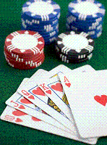
Environment Examples
Environment | Observable | Deterministic | Episodic | Static | Discrete | Agents
Chess with a clock | Fully | Strategic | Sequential | Semi | Discrete | Multi
Chess without a clock | Fully | Strategic | Sequential | Static | Discrete | Multi
Poker
Fully observable vs. partially observable
Deterministic vs. stochastic / strategic
Episodic vs. sequential
Static vs. dynamic
Discrete vs. continuous
Single agent vs. multiagent

Slide 38
Environment Examples
Environment | Observable | Deterministic | Episodic | Static | Discrete | Agents
Chess with a clock | Fully | Strategic | Sequential | Semi | Discrete | Multi
Chess without a clock | Fully | Strategic | Sequential | Static | Discrete | Multi
Poker | Partial | Strategic | Sequential | Static | Discrete | Multi
Fully observable vs. partially observable
Deterministic vs. stochastic / strategic
Episodic vs. sequential
Static vs. dynamic
Discrete vs. continuous
Single agent vs. multiagent

Slide 39
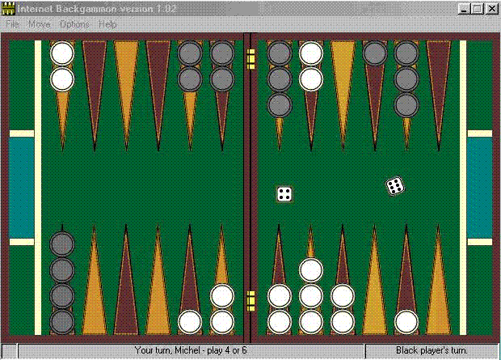
Environment Examples
Environment | Observable | Deterministic | Episodic | Static | Discrete | Agents
Chess with a clock | Fully | Strategic | Sequential | Semi | Discrete | Multi
Chess without a clock | Fully | Strategic | Sequential | Static | Discrete | Multi
Poker | Partial | Strategic | Sequential | Static | Discrete | Multi
Backgammon
Fully observable vs. partially observable
Deterministic vs. stochastic / strategic
Episodic vs. sequential
Static vs. dynamic
Discrete vs. continuous
Single agent vs. multiagent

Slide 40
Environment Examples
Environment | Observable | Deterministic | Episodic | Static | Discrete | Agents
Chess with a clock | Fully | Strategic | Sequential | Semi | Discrete | Multi
Chess without a clock | Fully | Strategic | Sequential | Static | Discrete | Multi
Poker | Partial | Strategic | Sequential | Static | Discrete | Multi
Backgammon | Fully | Stochastic | Sequential | Static | Discrete | Multi
Fully observable vs. partially observable
Deterministic vs. stochastic / strategic
Episodic vs. sequential
Static vs. dynamic
Discrete vs. continuous
Single agent vs. multiagent

Slide 41
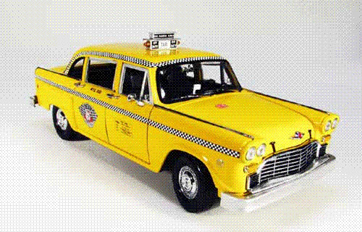
Environment Examples
Environment | Observable | Deterministic | Episodic | Static | Discrete | Agents
Chess with a clock | Fully | Strategic | Sequential | Semi | Discrete | Multi
Chess without a clock | Fully | Strategic | Sequential | Static | Discrete | Multi
Poker | Partial | Strategic | Sequential | Static | Discrete | Multi
Backgammon | Fully | Stochastic | Sequential | Static | Discrete | Multi
Taxi driving | Partial | Stochastic | Sequential | Dynamic | Continuous | Multi
Fully observable vs. partially observable
Deterministic vs. stochastic / strategic
Episodic vs. sequential
Static vs. dynamic
Discrete vs. continuous
Single agent vs. multiagent

Slide 42

Environment Examples
Environment | Observable | Deterministic | Episodic | Static | Discrete | Agents
Chess with a clock | Fully | Strategic | Sequential | Semi | Discrete | Multi
Chess without a clock | Fully | Strategic | Sequential | Static | Discrete | Multi
Poker | Partial | Strategic | Sequential | Static | Discrete | Multi
Backgammon | Fully | Stochastic | Sequential | Static | Discrete | Multi
Taxi driving | Partial | Stochastic | Sequential | Dynamic | Continuous | Multi
Medical diagnosis
Fully observable vs. partially observable
Deterministic vs. stochastic / strategic
Episodic vs. sequential
Static vs. dynamic
Discrete vs. continuous
Single agent vs. multiagent

Slide 43
Environment Examples
Environment | Observable | Deterministic | Episodic | Static | Discrete | Agents
Chess with a clock | Fully | Strategic | Sequential | Semi | Discrete | Multi
Chess without a clock | Fully | Strategic | Sequential | Static | Discrete | Multi
Poker | Partial | Strategic | Sequential | Static | Discrete | Multi
Backgammon | Fully | Stochastic | Sequential | Static | Discrete | Multi
Taxi driving | Partial | Stochastic | Sequential | Dynamic | Continuous | Multi
Medical diagnosis | Partial | Stochastic | Episodic | Static | Continuous | Single
Fully observable vs. partially observable
Deterministic vs. stochastic / strategic
Episodic vs. sequential
Static vs. dynamic
Discrete vs. continuous
Single agent vs. multiagent

Slide 44
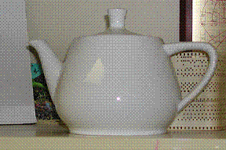
Environment Examples
Environment | Observable | Deterministic | Episodic | Static | Discrete | Agents
Chess with a clock | Fully | Strategic | Sequential | Semi | Discrete | Multi
Chess without a clock | Fully | Strategic | Sequential | Static | Discrete | Multi
Poker | Partial | Strategic | Sequential | Static | Discrete | Multi
Backgammon | Fully | Stochastic | Sequential | Static | Discrete | Multi
Taxi driving | Partial | Stochastic | Sequential | Dynamic | Continuous | Multi
Medical diagnosis | Partial | Stochastic | Episodic | Static | Continuous | Single
Image analysis
Fully observable vs. partially observable
Deterministic vs. stochastic / strategic
Episodic vs. sequential
Static vs. dynamic
Discrete vs. continuous
Single agent vs. multiagent

Slide 45
Environment Examples
Environment | Observable | Deterministic | Episodic | Static | Discrete | Agents
Chess with a clock | Fully | Strategic | Sequential | Semi | Discrete | Multi
Chess without a clock | Fully | Strategic | Sequential | Static | Discrete | Multi
Poker | Partial | Strategic | Sequential | Static | Discrete | Multi
Backgammon | Fully | Stochastic | Sequential | Static | Discrete | Multi
Taxi driving | Partial | Stochastic | Sequential | Dynamic | Continuous | Multi
Medical diagnosis | Partial | Stochastic | Episodic | Static | Continuous | Single
Image analysis | Fully | Deterministic | Episodic | Semi | Discrete | Single
Fully observable vs. partially observable
Deterministic vs. stochastic / strategic
Episodic vs. sequential
Static vs. dynamic
Discrete vs. continuous
Single agent vs. multiagent

Slide 46
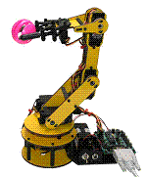
Environment Examples
Environment | Observable | Deterministic | Episodic | Static | Discrete | Agents
Chess with a clock | Fully | Strategic | Sequential | Semi | Discrete | Multi
Chess without a clock | Fully | Strategic | Sequential | Static | Discrete | Multi
Poker | Partial | Strategic | Sequential | Static | Discrete | Multi
Backgammon | Fully | Stochastic | Sequential | Static | Discrete | Multi
Taxi driving | Partial | Stochastic | Sequential | Dynamic | Continuous | Multi
Medical diagnosis | Partial | Stochastic | Episodic | Static | Continuous | Single
Image analysis | Fully | Deterministic | Episodic | Semi | Discrete | Single
Robot part picking
Fully observable vs. partially observable
Deterministic vs. stochastic / strategic
Episodic vs. sequential
Static vs. dynamic
Discrete vs. continuous
Single agent vs. multiagent

Slide 47
Environment Examples
Environment | Observable | Deterministic | Episodic | Static | Discrete | Agents
Chess with a clock | Fully | Strategic | Sequential | Semi | Discrete | Multi
Chess without a clock | Fully | Strategic | Sequential | Static | Discrete | Multi
Poker | Partial | Strategic | Sequential | Static | Discrete | Multi
Backgammon | Fully | Stochastic | Sequential | Static | Discrete | Multi
Taxi driving | Partial | Stochastic | Sequential | Dynamic | Continuous | Multi
Medical diagnosis | Partial | Stochastic | Episodic | Static | Continuous | Single
Image analysis | Fully | Deterministic | Episodic | Semi | Discrete | Single
Robot part picking | Fully | Deterministic | Episodic | Semi | Discrete | Single
Fully observable vs. partially observable
Deterministic vs. stochastic / strategic
Episodic vs. sequential
Static vs. dynamic
Discrete vs. continuous
Single agent vs. multiagent

Slide 48
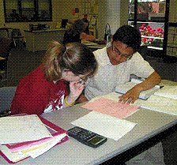
Environment Examples
Environment | Observable | Deterministic | Episodic | Static | Discrete | Agents
Chess with a clock | Fully | Strategic | Sequential | Semi | Discrete | Multi
Chess without a clock | Fully | Strategic | Sequential | Static | Discrete | Multi
Poker | Partial | Strategic | Sequential | Static | Discrete | Multi
Backgammon | Fully | Stochastic | Sequential | Static | Discrete | Multi
Taxi driving | Partial | Stochastic | Sequential | Dynamic | Continuous | Multi
Medical diagnosis | Partial | Stochastic | Episodic | Static | Continuous | Single
Image analysis | Fully | Deterministic | Episodic | Semi | Discrete | Single
Robot part picking | Fully | Deterministic | Episodic | Semi | Discrete | Single
Interactive English tutor
Fully observable vs. partially observable
Deterministic vs. stochastic / strategic
Episodic vs. sequential
Static vs. dynamic
Discrete vs. continuous
Single agent vs. multiagent

Slide 49
Environment Examples
Environment | Observable | Deterministic | Episodic | Static | Discrete | Agents
Chess with a clock | Fully | Strategic | Sequential | Semi | Discrete | Multi
Chess without a clock | Fully | Strategic | Sequential | Static | Discrete | Multi
Poker | Partial | Strategic | Sequential | Static | Discrete | Multi
Backgammon | Fully | Stochastic | Sequential | Static | Discrete | Multi
Taxi driving | Partial | Stochastic | Sequential | Dynamic | Continuous | Multi
Medical diagnosis | Partial | Stochastic | Episodic | Static | Continuous | Single
Image analysis | Fully | Deterministic | Episodic | Semi | Discrete | Single
Robot part picking | Fully | Deterministic | Episodic | Semi | Discrete | Single
Interactive English tutor | Partial | Stochastic | Sequential | Dynamic | Discrete | Multi
Fully observable vs. partially observable
Deterministic vs. stochastic / strategic
Episodic vs. sequential
Static vs. dynamic
Discrete vs. continuous
Single agent vs. multiagent

Slide 50
Agent Types
Types of agents (increasing in generality and ability to handle complex environments)
Simple reflex agents
Reflex agents with state
Goal-based agents
Utility-based agents
Learning agent

Slide 51
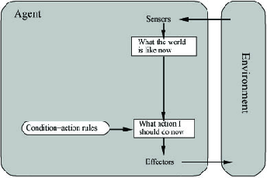
Simple Reflex Agent
Use simple “if then” rules
Can be short sighted
SimpleReflexAgent(percept)
state = InterpretInput(percept)
rule = RuleMatch(state, rules)
action = RuleAction(rule)
Return action

Slide 52
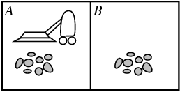
Example: Vacuum Agent
Performance?
1 point for each square cleaned in time T?
#clean squares per time step - #moves per time step?
Environment: vacuum, dirt, multiple areas defined by square regions
Actions: left, right, suck, idle
Sensors: location and contents
[A, dirty]
Rational is not omniscient
Environment may be partially observable
Rational is not clairvoyant
Environment may be stochastic
Thus Rational is not always successful

Slide 53
Reflex Vacuum Agent
If status=Dirty then return Suck
else if location=A then return Right
else if location=B then right Left

Slide 54
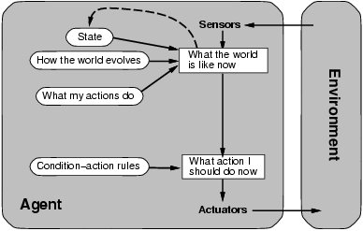
Reflex Agent With State
Store previously-observed information
Can reason about unobserved aspects of current state
ReflexAgentWithState(percept)
state = UpdateDate(state,action,percept)
rule = RuleMatch(state, rules)
action = RuleAction(rule)
Return action

Slide 55
Reflex Vacuum Agent
If status=Dirty then Suck
else if have not visited other square in >3 time units, go there

Slide 56
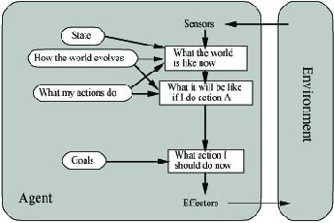
Goal-Based Agents
Goal reflects desires of agents
May project actions to see if consistent with goals
Takes time, world may change during reasoning

Slide 57
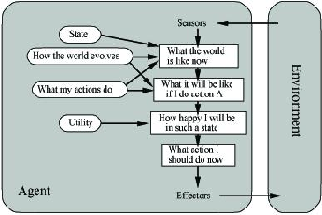
Utility-Based Agents
Evaluation function to measure utility f(state) -> value
Useful for evaluating competing goals

Slide 58
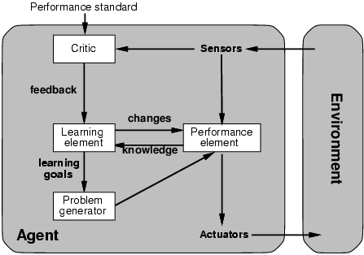
Learning Agents

Slide 59
Xavier mail delivery robot
Performance: Completed tasks
Environment: See for yourself
Actuators: Wheeled robot actuation
Sensors: Vision, sonar, dead reckoning
Reasoning: Markov model induction, A* search, Bayes classification

Slide 60
Pathfinder Medical Diagnosis System
Performance: Correct Hematopathology diagnosis
Environment: Automate human diagnosis, partially observable, deterministic, episodic, static, continuous, single agent
Actuators: Output diagnoses and further test suggestions
Sensors: Input symptoms and test results
Reasoning: Bayesian networks, Monte-Carlo simulations

Slide 61
TDGammon
Performance: Ratio of wins to losses
Environment: Graphical output showing dice roll and piece movement, fully observable, stochastic, sequential, static, discrete, multiagent
World Champion Backgammon Player
Sensors: Keyboard input
Actuator: Numbers representing moves of pieces
Reasoning: Reinforcement learning, neural networks

Slide 62
Factory Floor Scheduling
Performance:
Environment:
Actuators: Ordering of tasks
Sensors: Assembly tree, Bill of materials
Reasoning: Constraint satisfaction, nonlinear and hierarchical planning, genetic algorithms, search

Slide 63
Alvinn
Performance: Stay in lane, on road, maintain speed
Environment: Driving Hummer on and off road without manual control (Partially observable, stochastic, episodic, dynamic, continuous, single agent), Autonomous automobile
Actuators: Speed, Steer
Sensors: Stereo camera input
Reasoning: Neural networks

Slide 64
Talespin
Performance: Entertainment value of generated story
Environment: Generate text-based stories that are creative and understandable
One day Joe Bear was hungry. He asked his friend Irving Bird where some honey was. Irving told him there was a beehive in the oak tree. Joe threatened to hit Irving if he didn't tell him where some honey was.
Henry Squirrel was thirsty. He walked over to the river bank where his good friend Bill Bird was sitting. Henry slipped and fell in the river. Gravity drowned. Joe Bear was hungry. He asked Irving Bird where some honey was. Irving refused to tell him, so Joe offered to bring him a worm if he'd tell him where some honey was. Irving agreed. But Joe didn't know where any worms were, so he asked Irving, who refused to say. So Joe offered to bring him a worm if he'd tell him where a worm was. Irving agreed. But Joe didn't know where any worms were, so he asked Irving, who refused to say. So Joe offered to bring him a worm if he'd tell him where a worm was…
Actuators: Add word/phrase, order parts of story
Sensors: Dictionary, Facts and relationships stored in database
Reasoning: Planning

Slide 65
Robot Soccer
Robot soccer competition
Sensors: Camera image, messages from other players
Reasoning: Planning, image processing
Action: Robot 2D move or kick ball

Slide 66
Webcrawler Softbot
Search web for items of interest
Perception: Web pages
Reasoning: Pattern matching
Action: Select and traverse hyperlinks

Slide 67
Other Example AI Systems
Translation of Caterpillar truck manuals into 20 languages
Shuttle packing
Military planning (Desert Storm)
Intelligent vehicle highway negotiation
Credit card transaction monitoring
Billiards robot
Juggling robot
Credit card fraud detection
Lymphatic system diagnoses
Mars rover
Sky survey galaxy data analysis

Slide 68
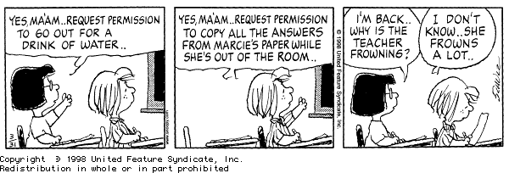
Other Example AI Systems
Knowledge Representation
Search
Problem solving
Planning
Machine learning
Natural language processing
Uncertainty reasoning
Computer Vision
Robotics

