Slide 1
Verinite Agentic Onboarding
Accelerating compliant customer onboarding through
policy-governed Agentic AI.
For enterprise banks, NBFCs, fintechs, and regulated digital businesses.
Confidential | Verinite | Generated 2026-02-16 16:39

Slide 2
Agenda
Client-focused transformation narrative
01. Why onboarding transformation is urgent
02. Current challenges in customer onboarding operations
03. Agentic Onboarding solution overview
04. Business impact and value realization
05. Architecture, control, and governance model
06. Implementation roadmap with Verinite services
Verinite Agentic Onboarding | Agenda

Slide 3
Understanding the Current Challenge
Operational pain points in traditional onboarding models
Challenge
Manual and repetitive verification activities
Delayed turnaround for known onboarding scenarios
Scattered operational knowledge across teams and channels
High dependence on specialist intervention for basic decisions
Business Impact
Higher onboarding cost per application
Inconsistent processing quality and customer experience
Compliance risk due to non-standardized execution
Reduced growth velocity because of slower onboarding throughput
Verinite Agentic Onboarding | Challenge Landscape

Slide 4
Reimagining Onboarding with Agentic AI
A policy-governed, event-driven decision system
Agentic Onboarding combines specialized AI agents, deterministic workflow control, and centralized policy governance to deliver faster, safer, and more explainable customer onboarding decisions.
1. Frontend Data and Document Intake
2. Orchestrator + Trace-Aware State Machine
3. KYC and Address Verification Agents
4. AML and Credit Decision Agents
5. Risk Synthesis + Decision Gateway
6. Full Audit Trail and Explainable Output
Verinite Agentic Onboarding | Solution Overview

Slide 5
Business Value and Outcome Metrics
Indicative targets based on automated onboarding operating models
30-50%
Faster application decision turnaround
40-60%
Reduction in repetitive manual processing
100%
Traceable audit chain for every decision
High
Regulatory confidence with policy-governed controls
Note: Metrics are indicative and refined during discovery and pilot baselining.
Verinite Agentic Onboarding | Business Outcomes

Slide 6
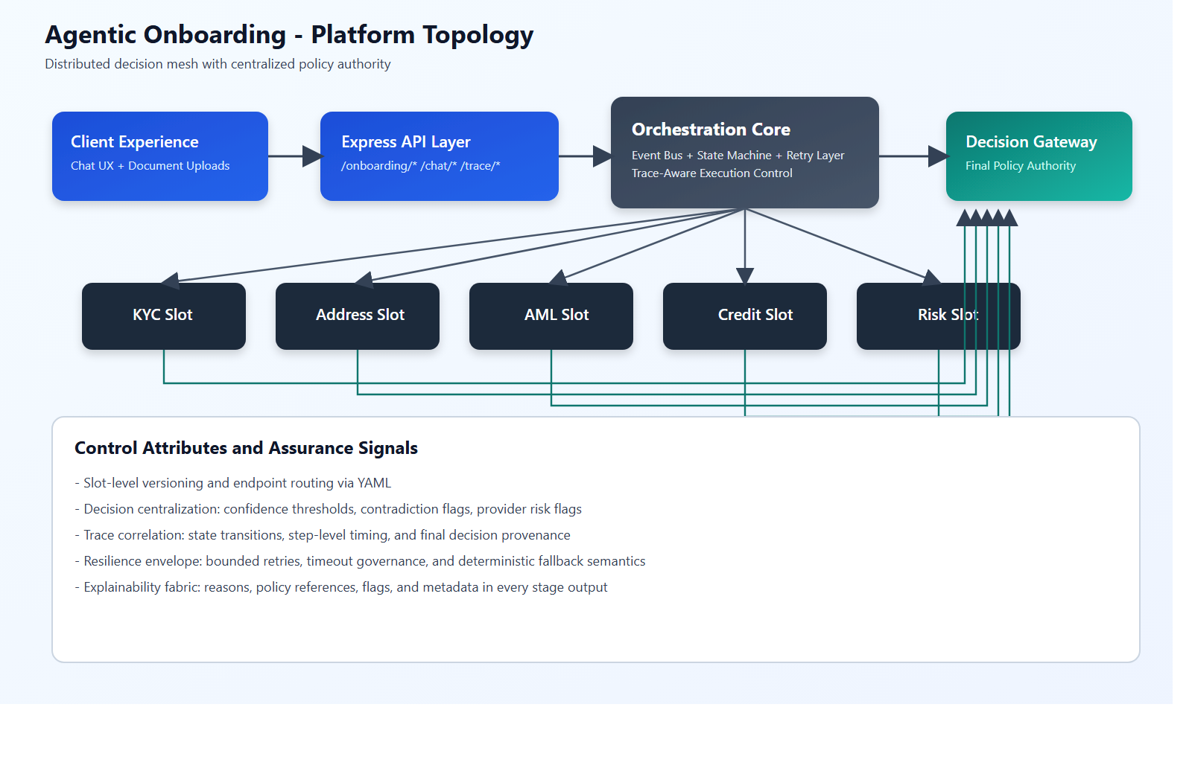
Architecture Overview
Event-driven orchestration with centralized decision governance
Verinite Agentic Onboarding | Architecture Overview

Slide 7
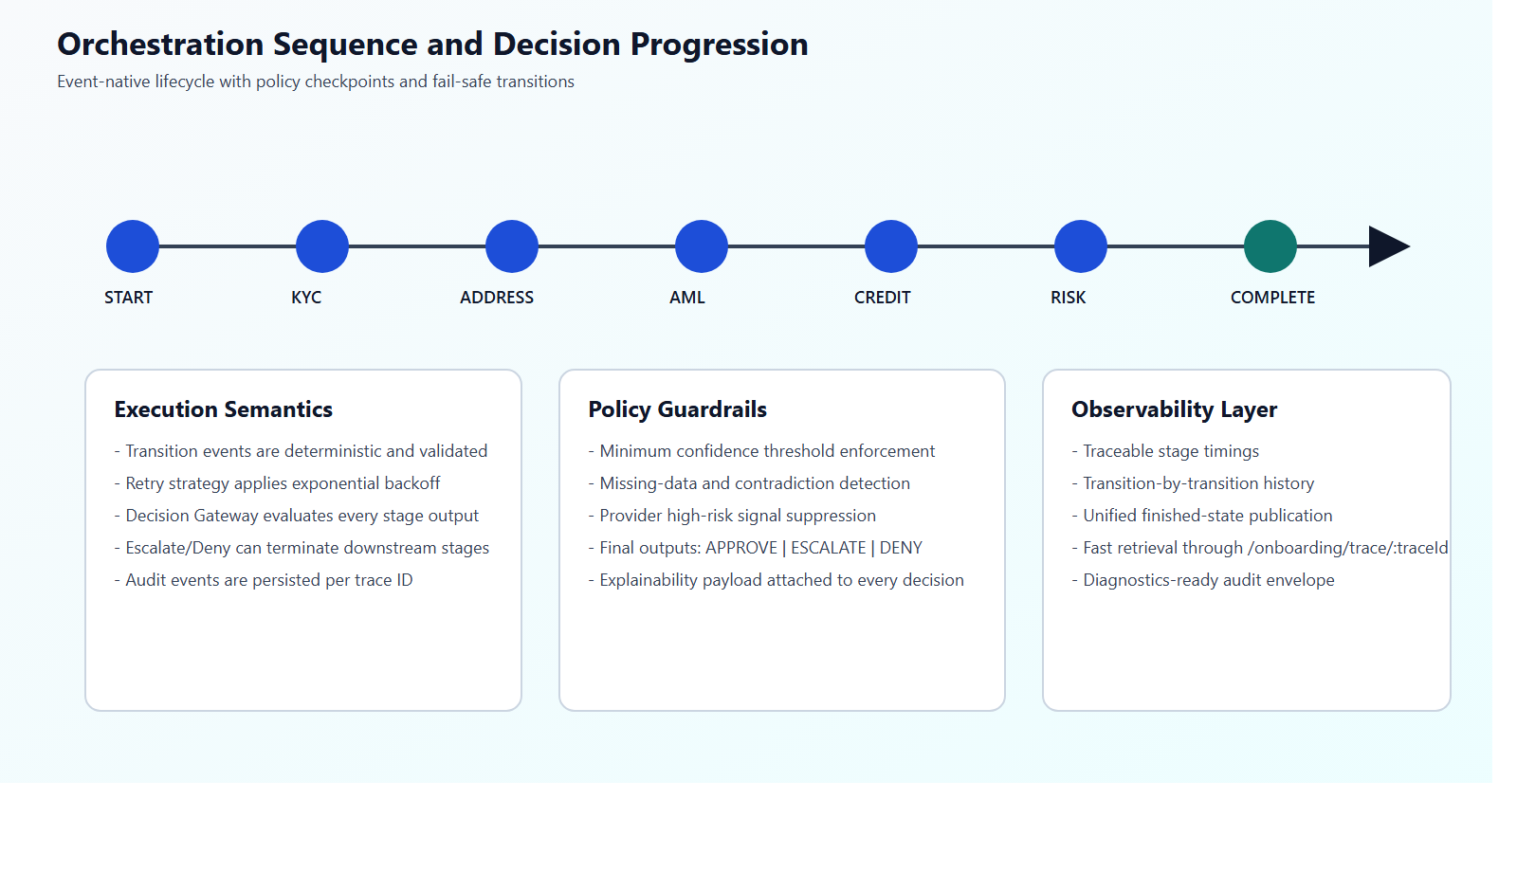
Workflow and Decision Progression
Deterministic stage transitions with policy guardrails
Verinite Agentic Onboarding | Workflow and Decisioning

Slide 8
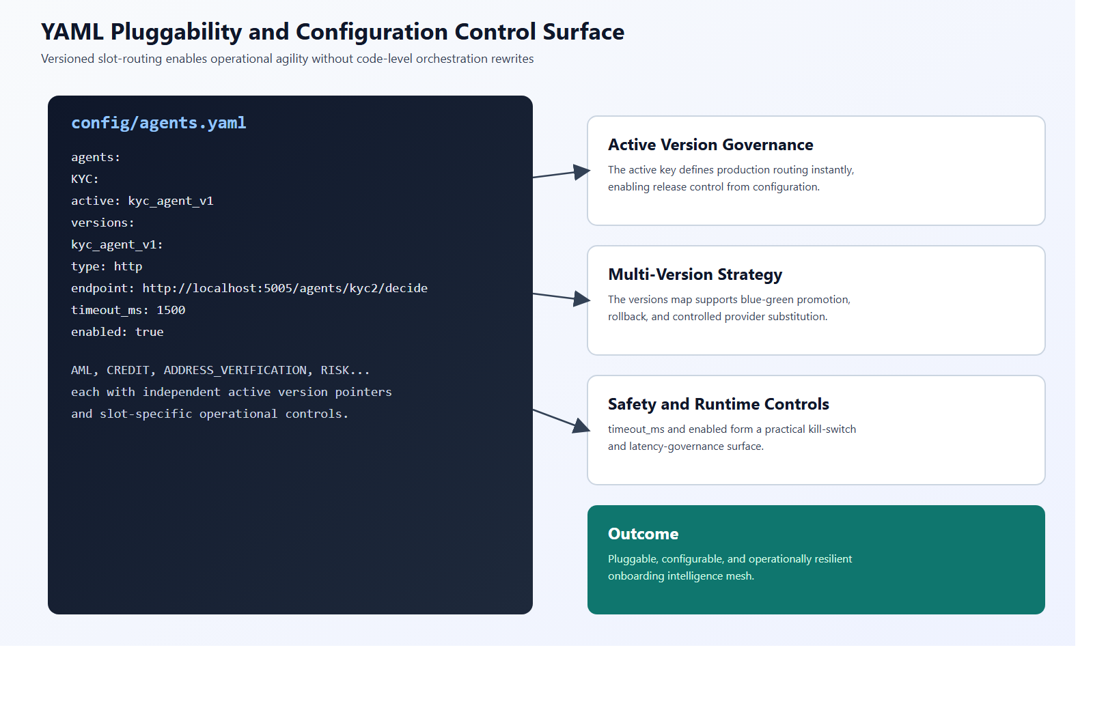
Configuration and Pluggability Control Surface
YAML-driven slot versioning and runtime operational controls
Verinite Agentic Onboarding | YAML Pluggability

Slide 9
Engagement Roadmap
A phased approach for rapid value realization with controlled risk
Phase 1
Discover
Process assessment, compliance baseline, integration mapping
Phase 2
Pilot
Limited-scope rollout with trace, policy, and outcome validation
Phase 3
Scale
Progressive expansion across segments and products
Phase 4
Optimize
Continuous tuning, model-policy refinement, KPI governance
Verinite Agentic Onboarding | Engagement Roadmap

Slide 10
Thank You
Let us co-design your next-generation onboarding experience.
Verinite | IT Services and Digital Transformation

