Slide 1
Agentic Onboarding Visual Architecture
Diagram Deck | Generated 2026-02-13 17:52

Slide 2
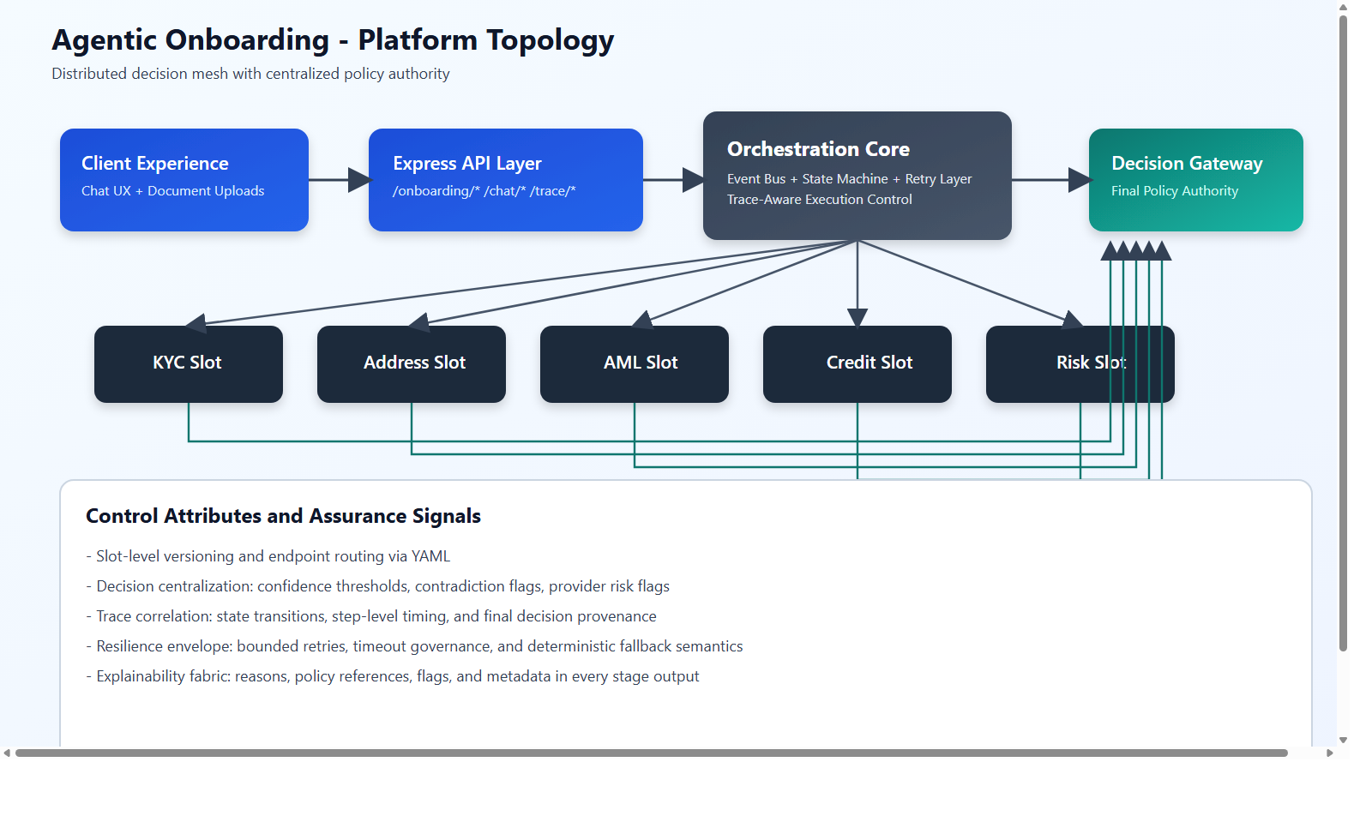
Platform Topology
Source: D:/test/agentOnboarding/agentic-onboarding-orchestrated/documents/diagrams/architecture-topology.png

Slide 3
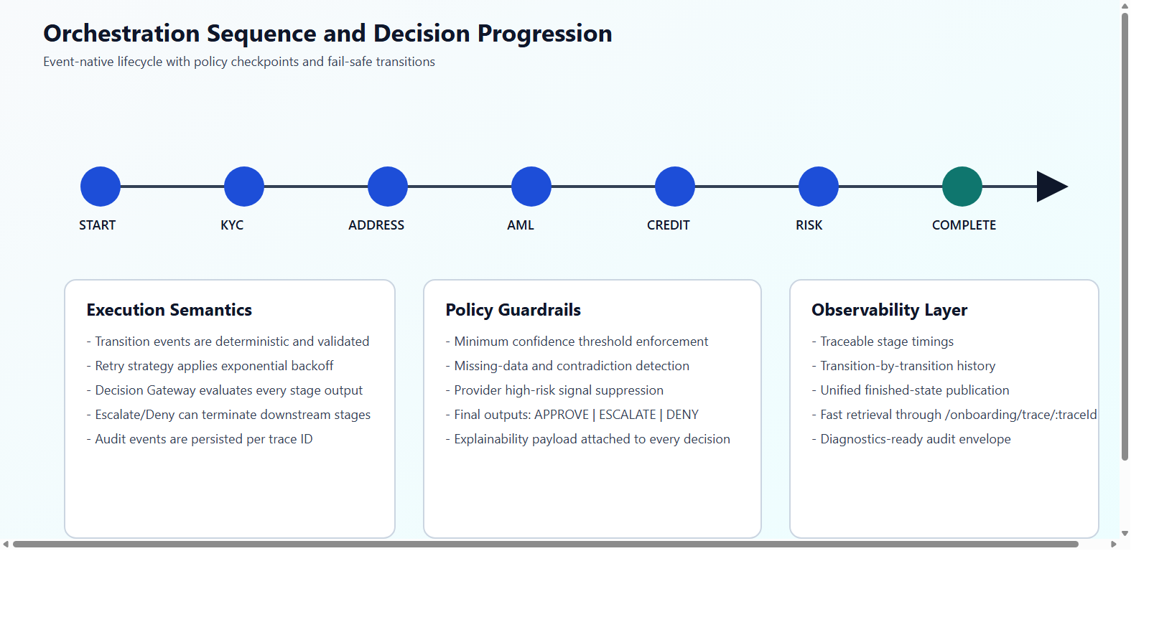
Orchestration Sequence
Source: D:/test/agentOnboarding/agentic-onboarding-orchestrated/documents/diagrams/orchestration-sequence.png

Slide 4
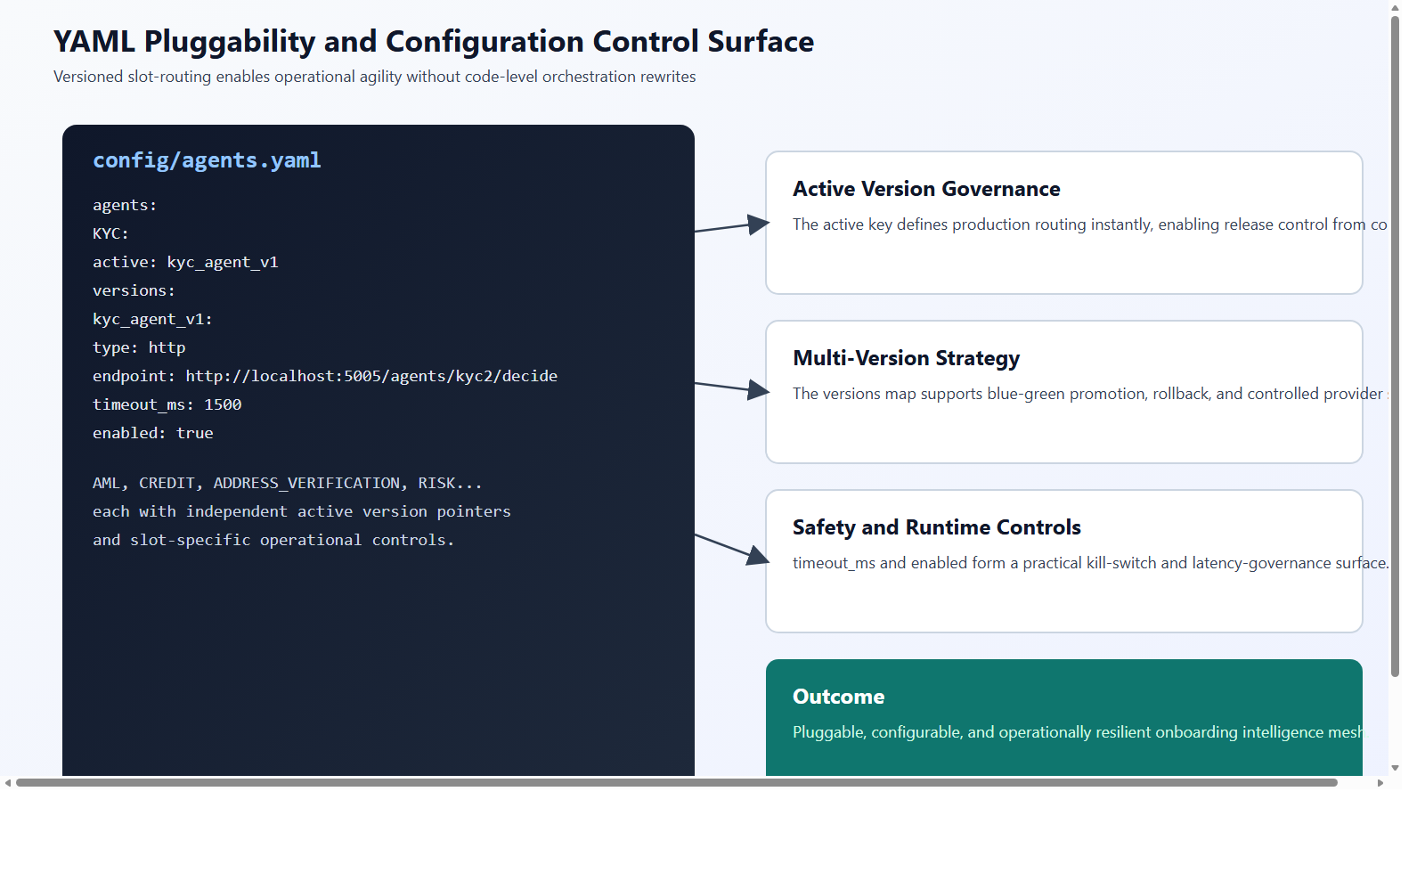
YAML Pluggability Control Surface
Source: D:/test/agentOnboarding/agentic-onboarding-orchestrated/documents/diagrams/yaml-pluggability-control-surface.png

