Slide 1
Agentic Onboarding Visual Architecture
Purpose: Sophisticated technical narrative for product marketing, solution engineering, and stakeholder alignment. | Generated 2026-02-13 17:56

Slide 2
Presentation Scope
This deck includes
1. Platform topology with centralized policy authority and distributed slot execution.
2. End-to-end orchestration sequence with deterministic transitions and guardrails.
3. YAML pluggability control surface with active-version routing and runtime safety controls.
4. Image-first layout with fitted diagrams and on-slide narrative highlights.

Slide 3
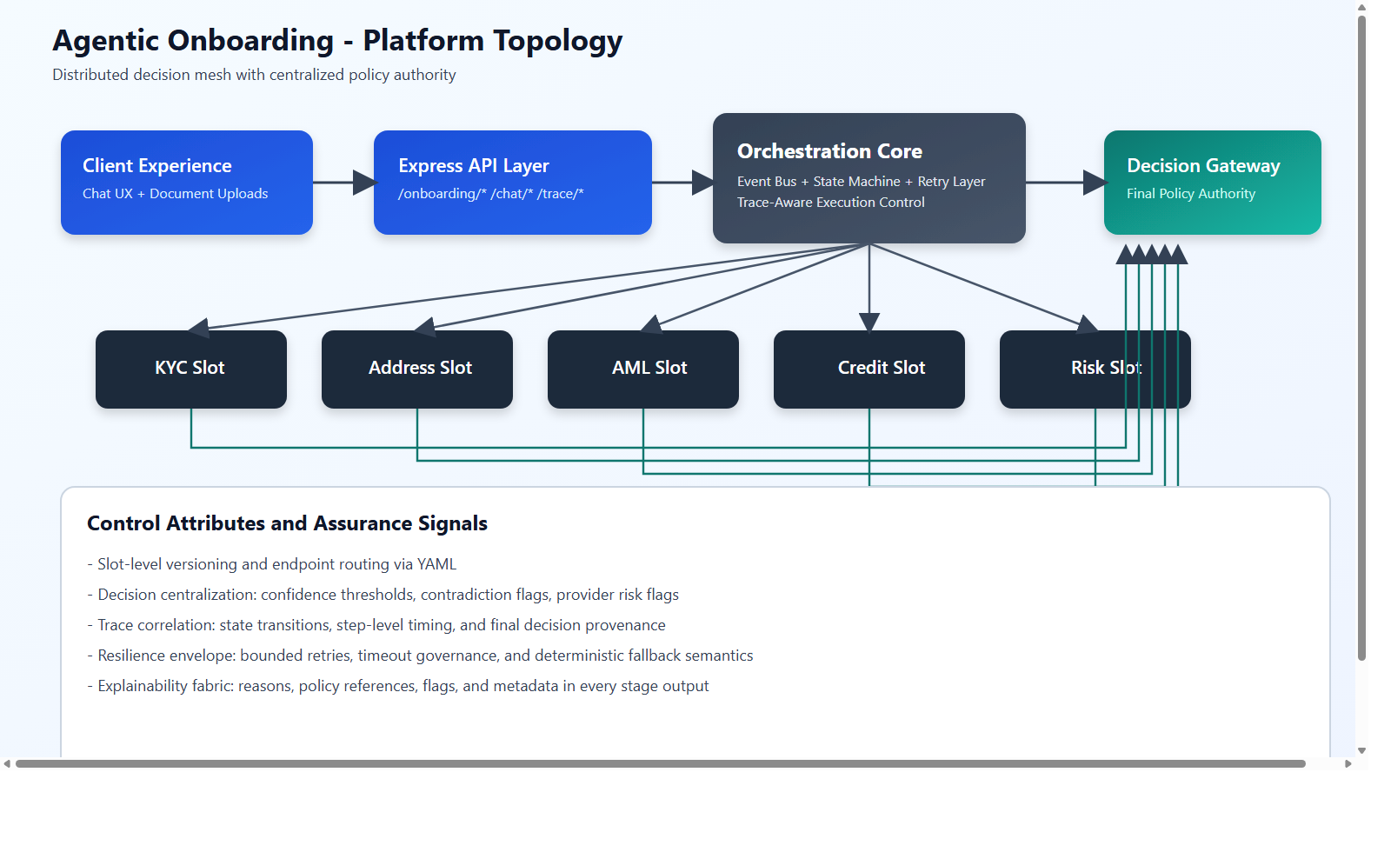
Platform Topology
This diagram illustrates the distributed slot fabric and the centralized policy authority that normalizes outcomes across heterogeneous agent implementations.
Key Highlights
Agentic Onboarding is an event-native underwriting intelligence platform that orchestrates specialized decision agents under a unified governance envelope.
Its architecture is intentionally composable: each slot can evolve independently while the control plane preserves determinism, explainability, and operational safety.
Decision Gateway remains the final policy mandate.
Trace-centric audit signals are preserved across the lifecycle.
Source: D:/test/agentOnboarding/agentic-onboarding-orchestrated/documents/diagrams/architecture-topology.png

Slide 4
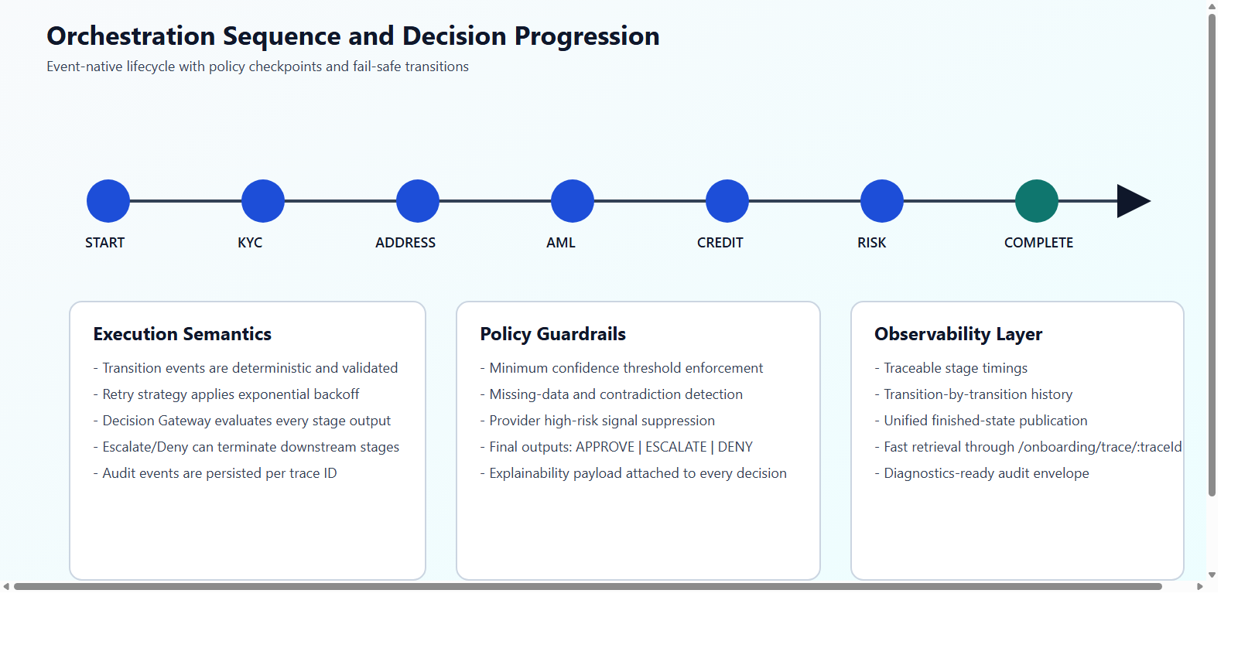
Orchestration Sequence
This sequence highlights deterministic stage progression, bounded retry semantics, and decision gates that can terminate downstream flow on escalation or denial conditions.
Key Highlights
Feature: Event-Native Orchestration | Value: Modular extensibility with clear stage contracts.
Feature: Deterministic State Machine | Value: High-assurance lifecycle governance and audit precision.
Feature: Central Decision Gateway | Value: Unified risk posture and policy-consistent final outcomes.
Feature: Hybrid AI + Rules Intelligence | Value: Better automation while maintaining explainability and control.
Feature: Trace-Centric Observability | Value: Fast diagnostics, governance transparency, and regulator-ready evidence.
Source: D:/test/agentOnboarding/agentic-onboarding-orchestrated/documents/diagrams/orchestration-sequence.png

Slide 5
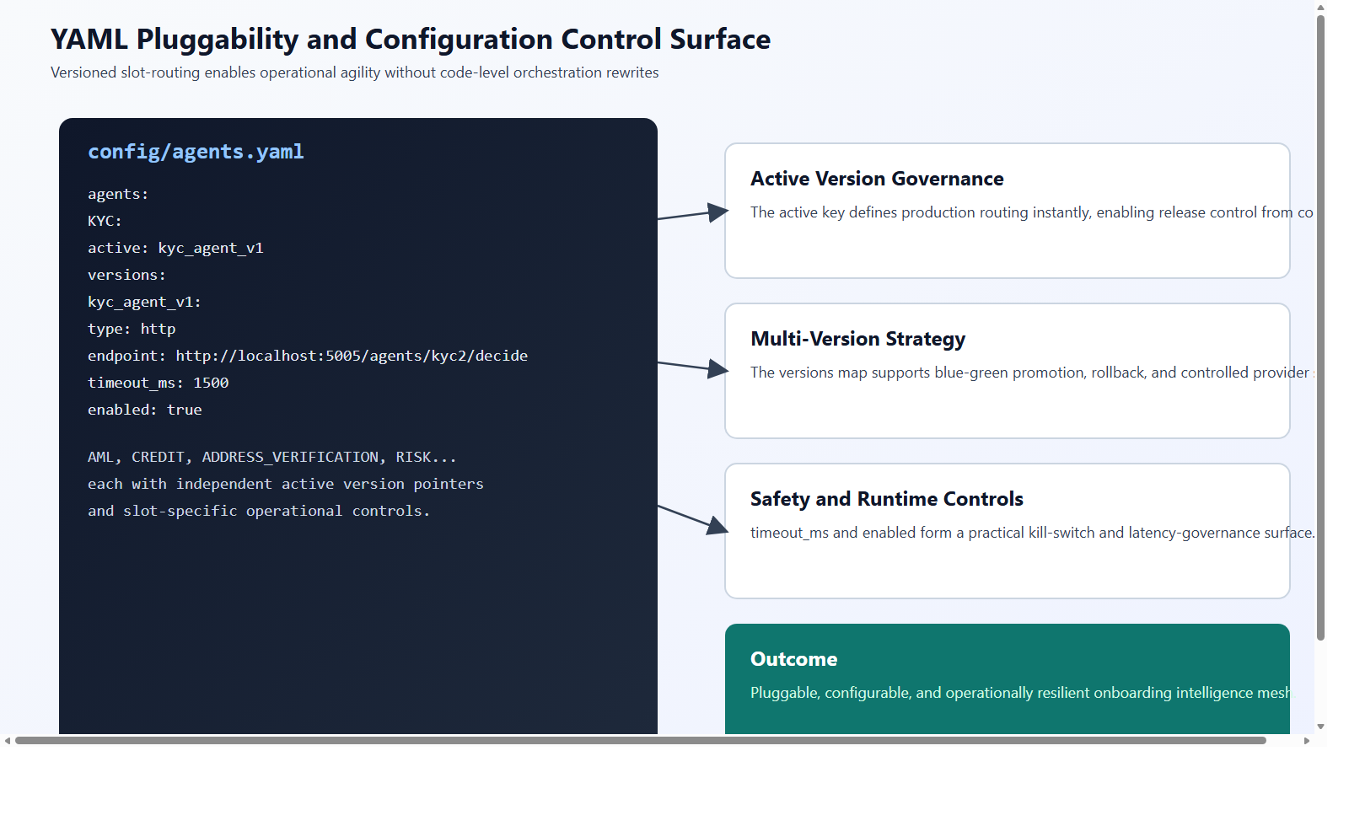
YAML Pluggability Control Surface
This control map shows why the platform is pluggable: slot abstraction, active version pointers, version catalogs, runtime transport independence, and operational kill-switch controls.
Key Highlights
- Slot abstraction separates business capability from provider implementation, enabling clear domain boundaries.
- Active-version routing enables release governance by configuration, not by code redeployment.
- Version catalogs support migration, rollback, and blue-green deployment patterns without orchestration redesign.
- The type dimension enables seamless HTTP and local execution modes under one contract-first runtime.
- timeout_ms and enabled fields form an operational resilience layer for latency and incident control.
Source: D:/test/agentOnboarding/agentic-onboarding-orchestrated/documents/diagrams/yaml-pluggability-control-surface.png

Slide 6
Implementation Anchors
- Entry and API control surface: src/index.ts
- Workflow orchestration: src/orchestrator/orchestrator.ts
- State lifecycle model: src/orchestrator/stateMachine.ts
- Decision governance: src/decisionGateway/decisionGateway.ts
- Config registry and YAML loading: src/registry/agentRegistry.ts + config/agents.yaml
- Conversational document onboarding: src/chatbot/onboardingChatbot.ts

