Slide 1
Agentic Onboarding Visual Architecture
Purpose: Sophisticated technical narrative for product marketing, solution engineering, and stakeholder alignment. | Generated 2026-02-16 12:09

Slide 2
Presentation Scope
This deck includes
1. Platform topology with centralized policy authority and distributed slot execution.
2. End-to-end orchestration sequence with deterministic transitions and guardrails.
3. YAML pluggability control surface with active-version routing and runtime safety controls.
4. Image-first layout with fitted diagrams and on-slide narrative highlights.

Slide 3
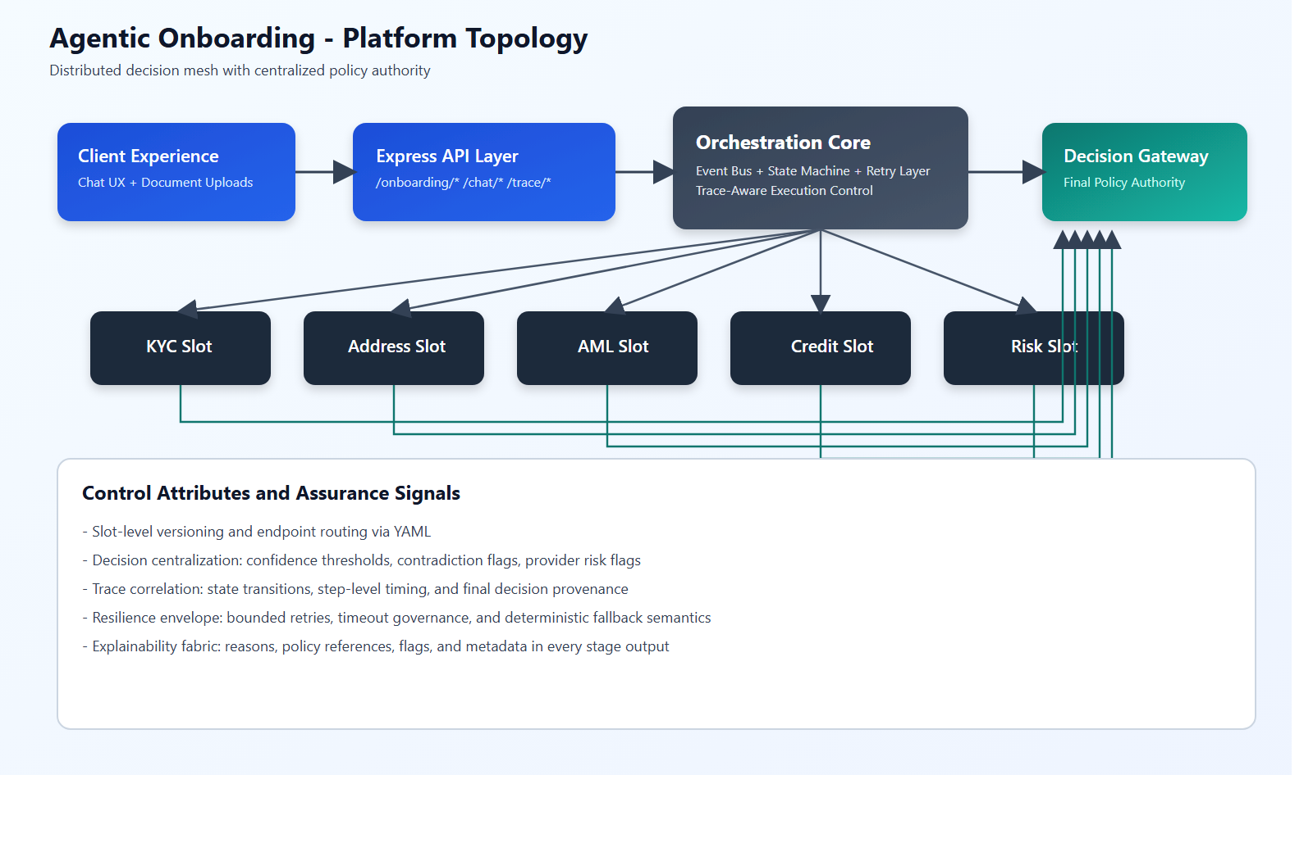
Platform Topology
This diagram illustrates the distributed slot fabric and the centralized policy authority that normalizes outcomes across heterogeneous agent implementations.
Key Highlights
Agentic Onboarding is an event-native underwriting intelligence platform th... | Its architecture is intentionally composable: each slot can evolve independ... | Decision Gateway remains the final policy mandate.
Source: D:/test/agentOnboarding/agentic-onboarding-orchestrated/documents/diagrams/architecture-topology.png

Slide 4
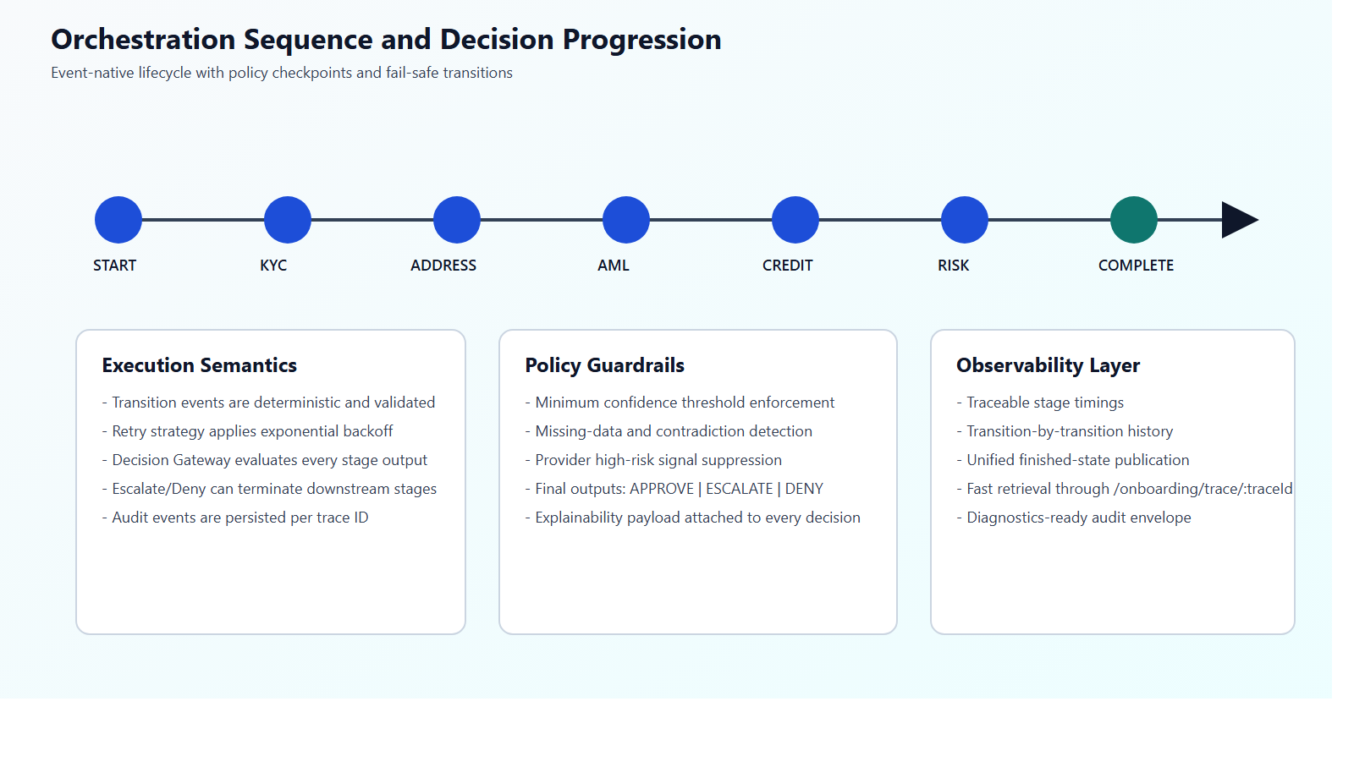
Orchestration Sequence
This sequence highlights deterministic stage progression, bounded retry semantics, and decision gates that can terminate downstream flow on escalation or denial conditions.
Key Highlights
Feature: Event-Native Orchestration | Value: Modular extensibility with cle... | Feature: Deterministic State Machine | Value: High-assurance lifecycle gove... | Feature: Central Decision Gateway | Value: Unified risk posture and policy-...
Source: D:/test/agentOnboarding/agentic-onboarding-orchestrated/documents/diagrams/orchestration-sequence.png

Slide 5
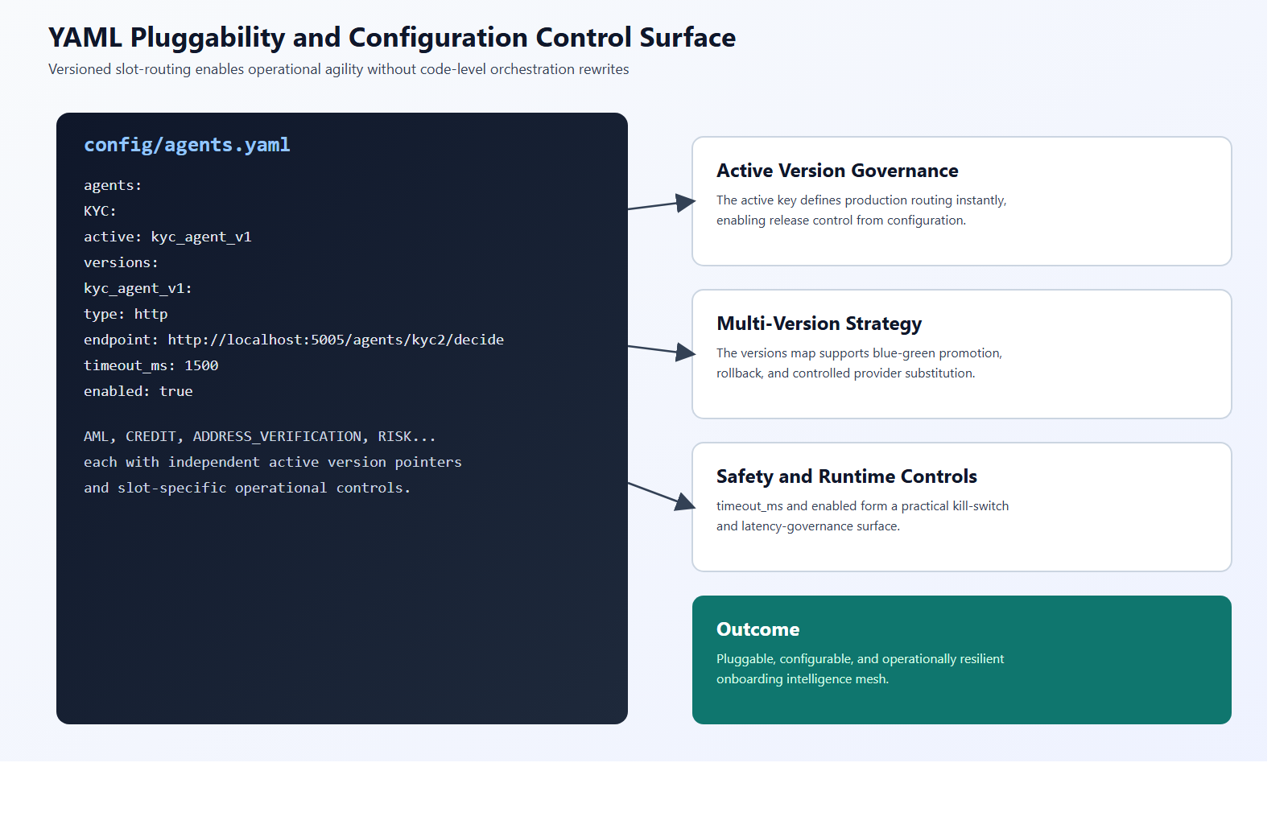
YAML Pluggability Control Surface
This control map shows why the platform is pluggable: slot abstraction, active version pointers, version catalogs, runtime transport independence, and operational kill-switch controls.
Key Highlights
Slot abstraction separates business capability from provider implementation... | Active-version routing enables release governance by configuration, not by... | Version catalogs support migration, rollback, and blue-green deployment pat...
Source: D:/test/agentOnboarding/agentic-onboarding-orchestrated/documents/diagrams/yaml-pluggability-control-surface.png

Slide 6
Implementation Anchors
- Entry and API control surface: src/index.ts
- Workflow orchestration: src/orchestrator/orchestrator.ts
- State lifecycle model: src/orchestrator/stateMachine.ts
- Decision governance: src/decisionGateway/decisionGateway.ts
- Config registry and YAML loading: src/registry/agentRegistry.ts + config/agents.yaml
- Conversational document onboarding: src/chatbot/onboardingChatbot.ts

