Slide 1
FastForward.ai Assignment for the Data Analyst role
By Abhishek Sharma

Slide 2
Data Preprocessing
Data Preprocessing is a very crucial part of data analysis where one needs to perform necessary steps in order to transform raw data into more understandable and useful format.
Datasets consisted of these features – trackTime, userId, page, and event.
trackTime – This feature contains the UNIX format of the time at which user entered certain page of the platform and at what time the user performed any action in the platform. This feature had to be converted into UTC timestamps in order to be understood. It consisted of some Nat values which represented missing date and time, so it had to be dropped.
userId – This feature has the user id of each user who entered the platform and performed any action on it. This consisted of NaN values and had to be corrected by dropping the NaN values as the number of these values were relatively less as compared to the total size of the dataset.
page – This feature has each page of the campaign from the landing page to the booking successful page of each service.
event – This feature has the actions/steps performed by the user in the platform.

Slide 3
Data Preprocessing Steps
Imported the necessary libraries and the dataset to Google Colab.
Converted the time in the feature “Tracktime” to UTC Timestamps in order to begin with the assignment.
Loaded the dataset in a DataFrame with Pandas library and cleaned the data and handled the NaN values in the dataset by dropping them.
Built new features in order to perform a better analysis – spent_time, services, campaign, bookings.

Slide 4
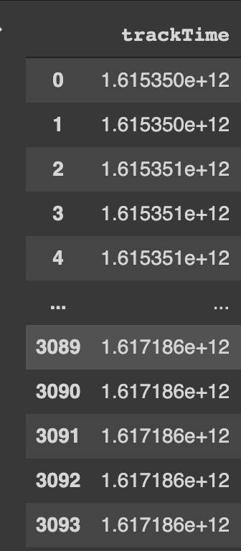
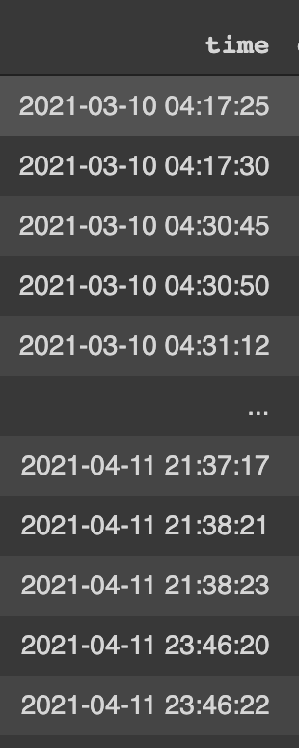
Data Dispensary
trackTime being in the UNIX format and had to be converted into UTC timestamps.
It would have been better for the analysis if each step/action was marked with the campaign page that the user came from.

Slide 5
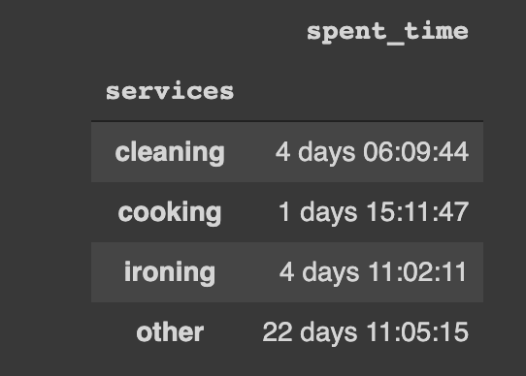
Insights about users on the platform
The total time spent by the users on the platform is 54 days 01:27:43.862000. I have combined the total time spent on the platform as well as their actions/steps performed on the platform.
Even though users spent a lot of time on the ironing service but very few users made the booking for it. This needs to be reviewed by the team.
Cleaning service has the highest number of bookings. Cooking service managed to get good number of bookings even with users spending the least amount of time on it.

Slide 6
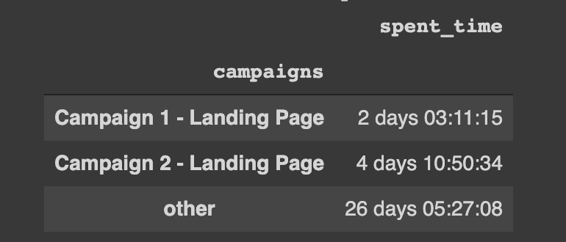
Campaign 1 vs Campaign 2
Users spent more time on Campaign 2.

Slide 7
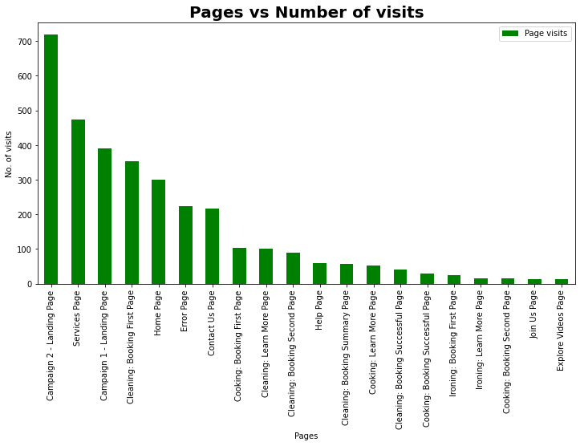

From this histogram we can see that the Campaign 2 - Landing page had more visits as compared to the Campaign 1 - Landing Page.
Campaign 1 needs to be reviewed by the team that why less users coming from this landing page as compared to the other landing page.
A lot of users are also encountering the error page which shows that the platform needs to be checked by the web application team.

Slide 8
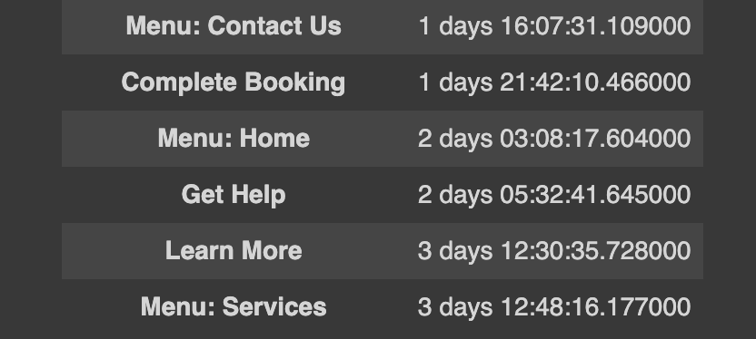
Actions/Steps users spent the most amount of time on
Most time spent by the users on these 3 steps/actions –
3 days 12:48:16.177000 on the Menu: Services
3 days 12:30:35.728000 on the Learn More.
2 days 05:32:41.645000 on the Get Help.
Users are spending a lot of time on Learn More and Get help which shows that user either needs help in the platform or wants to gain more information about the services.

Slide 9
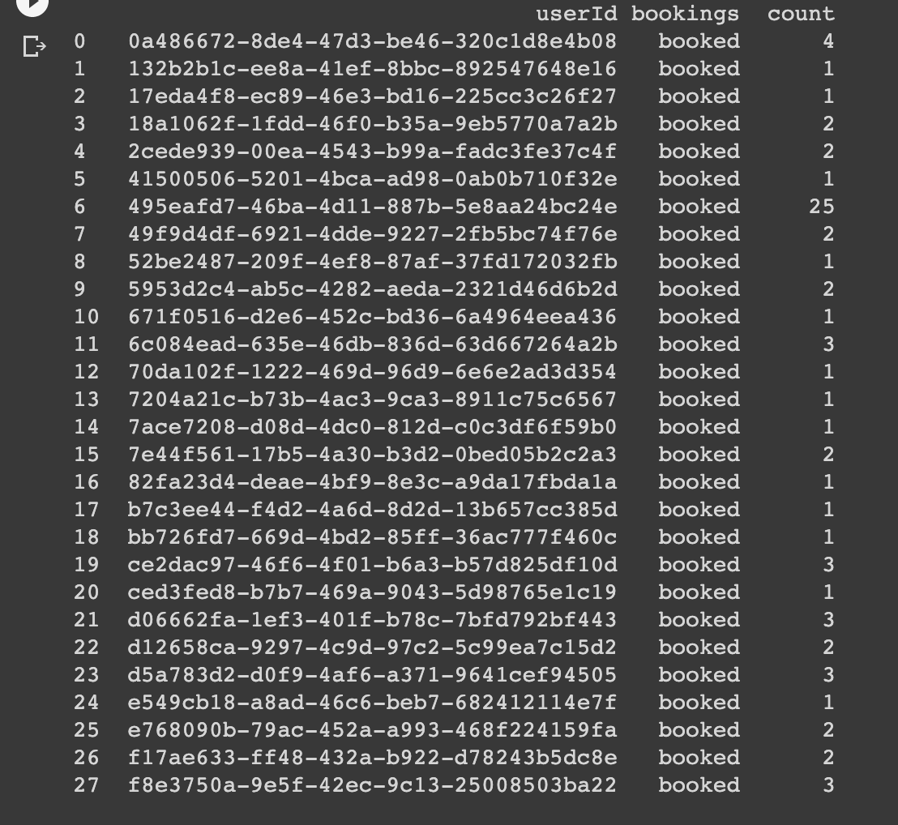
Numbers of completed booking, repeat users, and bookings per user
Total number of completed bookings made by the users are 73.
Number of repeated users are 542.
Please refer the attached image for the number of bookings made by each user.
Number of bookings made by each user

Slide 10
Recommendations
Cleaning was the best overall service.
It can be further amplified to increase more users.
This can also help in retaining the current users and reducing the overall churn rate.
Cooking service has the second highest bookings and in the least amount of time spent by the users.
Users spent the most amount of time on the ironing service but made the least number of bookings.
Users are spending maximum time on this service which shows that specific users are interested in this service. Team needs to assess the problem with this service.
Users spent more time on Campaign 2 – Landing Page whereas Campaign 1 had less time spent by the users.
Campaign 1 – Landing page is also having less visits – further analysis is required by the team to review the problem. If the numbers on this campaign increases, then it will help the platform to have better overall numbers.

Slide 11
Recommendations
Users are spending a lot of time on Get Help and Learn More feature.
Either the platform or the service needs to be improved as the users are seeking help. We need to assess that what help users are trying to get and if all possible solutions are currently present on the platform or not.
Good number of users are visiting the learn more page and spending time on it.
We need to track that whether the users are coming on the platform or not after visiting the learn more page.
Book now button can be put up in the learn more page for the users to straightaway come in the platform.
8. Lot of users are encountering error page in the platform which depicts that the platform needs to be checked by the team to assess the bugs and fix it as soon as possible to provide a better user experience.

