Slide 1
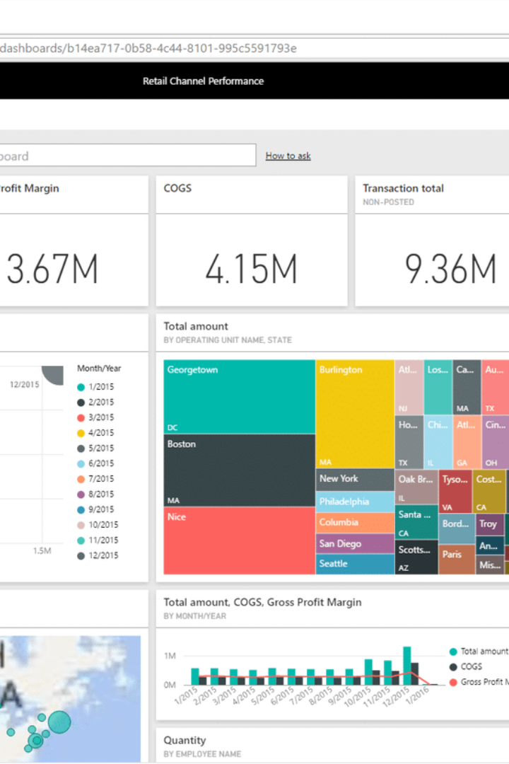

Unlocking Actionable Insights with Dynamic Power BI Dashboard
Discover the power of data visualization with our state-of-the-art Power BI dashboard. Leverage the Sakila DVD Rental Store Database to uncover sales trends, customer behavior, and optimize your business strategies.
by Abhishek Shaw

Slide 2
Introduction
Welcome to Gamma.AI's presentation where we will introduce you to our dynamic Power BI dashboard leveraging the Sakila DVD Rental Store Database. This powerful tool is designed to empower you with actionable insights to make data-driven decisions in the highly competitive DVD rental market.

Slide 3

Power BI Dashboard Overview
Gain a comprehensive overview of our Power BI dashboard that utilizes the Sakila DVD Rental Store Database. Discover the key features and functionalities that will revolutionize the way you analyze and optimize your business strategies.

Slide 4

Sales Trends and Payment Method Distribution
Monthly Sales Trends
Payment Method Distribution
Analyze and visualize the monthly sales trends from the Sakila DVD Rental Store Database. Uncover patterns and identify the key drivers behind your sales performance.
Explore the distribution of payment methods used by customers. Identify the most popular payment methods and tailor your business strategies accordingly.

Slide 5
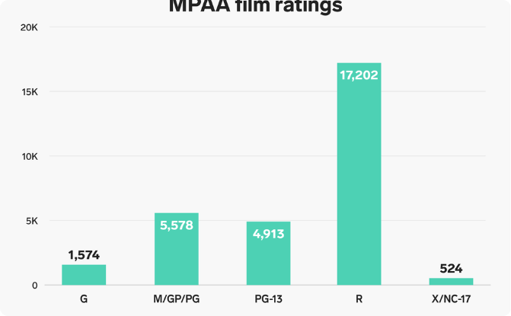
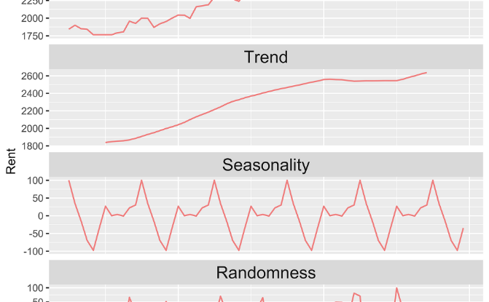
Film Inventory Insights
Film Ratings
Film Categories & Rental Durations
Dive into film ratings within the Sakila DVD Rental Store Database. Discover insights about customer preferences and identify the top-rated films in your inventory.
Explore the film categories and rental durations to optimize your film inventory. Identify the popular categories and rental durations to meet customer demands.

Slide 6

Staff Analytics and Store Performance
1
Staff Analytics
Analyze staff performance metrics and identify areas for improvement. Optimize your team's productivity and enhance customer satisfaction.
2
Store Performance by Location
Compare the performance of your DVD rental stores across different locations. Identify high-performing stores and uncover opportunities for growth.
3
Customer Distribution Across Cities
Analyze the distribution of customers across various cities. Identify potential markets and target your marketing efforts to specific regions.

Slide 7
Actionable Recommendations for Targeted Marketing and Business Optimization
1
Customer Segmentation
2
Inventory Optimization
Segment your customer base to target specific groups with tailored marketing campaigns. Maximize customer engagement and conversion rates.
Optimize your film inventory by analyzing rental patterns and preferences. Ensure you have the right films in stock to meet customer demand.
3
Location Expansion
Identify potential markets for expanding your DVD rental stores. Utilize customer distribution data to make informed decisions about new store locations.

Slide 8

Conclusion
Experience the transformative power of our Power BI dashboard with the Sakila DVD Rental Store Database. Uncover invaluable insights, optimize your business strategies, and gain a competitive edge in the dynamic DVD rental market.

