Slide 1
Intro to Dr. Shantanu Pathak
PhD CSE (Machine Learning), ME-IT, BE-IT
Worked with IT leaders like
Tech-Mahindra, Amdocs, Honeywell, CAT (Caterpillar), Varroc, Envestnet, etc
Total 14+ years of experience as a Developer + Trainer
Holds 1 patent
Author (3 books + more than 10 publications)
shantanu.s.pathak@gmail.com
Linked in : https://www.linkedin.com/in/pathakshantanu/

Slide 2
Introduction to Artificial Intelligence
By
Dr Shantanu Pathak

Slide 3
Agenda
What is AI?
Revolution of AI
Introduction of Applications of AI
AI in Health Sciences
AI in Engineering
AI in Financial Services
H/W and S/W Requirements

Slide 4
What is AI?
AI or Artificial Intelligence is intelligence demonstrated by a software or a machine
As tasks achieved by AI become routine Next level tasks are considered as AI.
Ex. OCR is no longer AI.
Human Speech recognition
Natural Language Generation

Slide 5
Expansion of AI
QA Systems / Chatbots ( Text / Audio)
Driverless Car
Parking Assistance
Intelligent Recommendations
Limitations
Common Sense (General Intelligence)
Creativity

Slide 6
Machine Learning
"Field of study that gives computers the ability to learn without being explicitly programmed" defined by Prof. Arthur Samuel in 1959
Software learns the patterns in Data
Classical Programming::
I/P :: Rules and Sample Data
O/P :: Answers
Machine Learning
I/P :: Huge Data and Answers
O/P :: Patterns / Rules

Slide 7
Why Machine Learning?
Deterministic vs Non-deterministic Solutions
100% success every time ?
Why Statistics ?
Ex. Face Detection , Finger print scanner

Slide 8
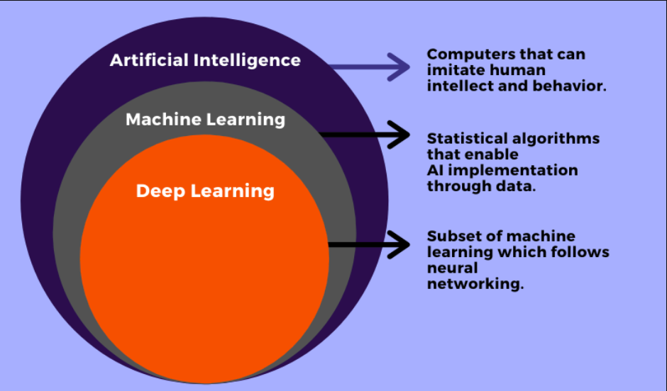
AI vs ML vs DL

Slide 9
How a Machine Learns?
Where do you see learning taking place?
Can a machine learn on its own ?
Supervised (Human Intervention Required)
Un-Supervised (No Human Intervention required)
Semi-Supervised (Mix of both)
Reinforcement Learning (Training from User Feedback)

Slide 10
What is Deep Learning ?
It is branch of AI or Machine Learning which deals with neural networks ( as per Wikipedia )
Deep Learning uses big neural networks and large amount of training data to learn
Deep learning finds the patterns in given data based on artificial neurons ( also known as perceptron)

Slide 11
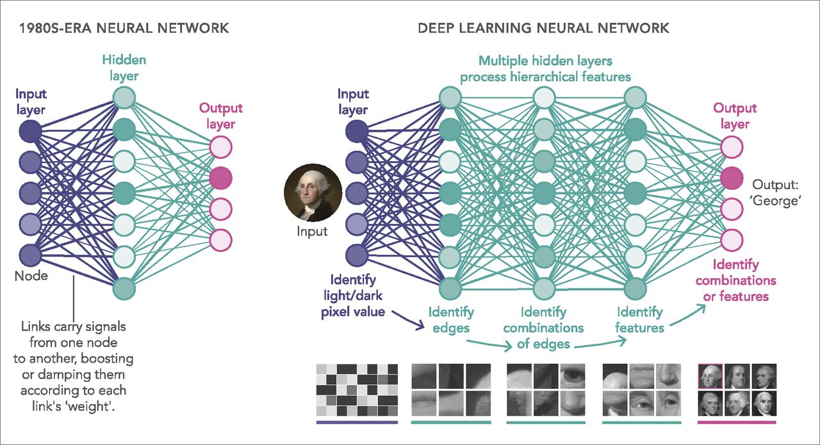
Deep Learning Example

Slide 12
What is Deep Learning
Input
Gross Features
Subtle Features
Output Formatting
Output

Slide 13
Limitations of DL
Computation Power
More Data
General Understanding
Prof Dr Hinton says “What’s Missing ?”

Slide 14
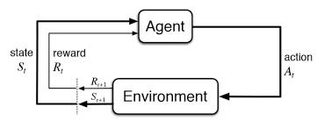
Reinforcement Learning
Intelligent Agent in an environment takes decisions and learns from them based on feedback
Exploration Vs Exploitation

Slide 15
Applications of AI
AI in Health Sciences
Disease Detection
Pro-Active Predictions
AI in Engineering
Intelligent Designs about Flow
AI in Financial Services
Recommendations
Question Answering System

Slide 16
Latest Trends in AI
Generative/Creative AI
Neural Architecture Search
Deep Reinforcement Learning

Slide 17
H/W and S/W Requirement
Individuals::
CPU- i3 +
RAM -4GB +
Organization
GPU
Cloud Computation

Slide 18
Thank You!!
Questions ?

