Slide 1
Structured and Unstructured Data

Slide 2
Structured Data
Fixed Structure
Fixed No of inputs / Variables / Columns
Ex.
Database Table
Excel Files

Slide 3
Un-Structured Data
No Structure
Any number of inputs at any time
Ex
Text – new words / no of words per line
Video
Audio

Slide 4
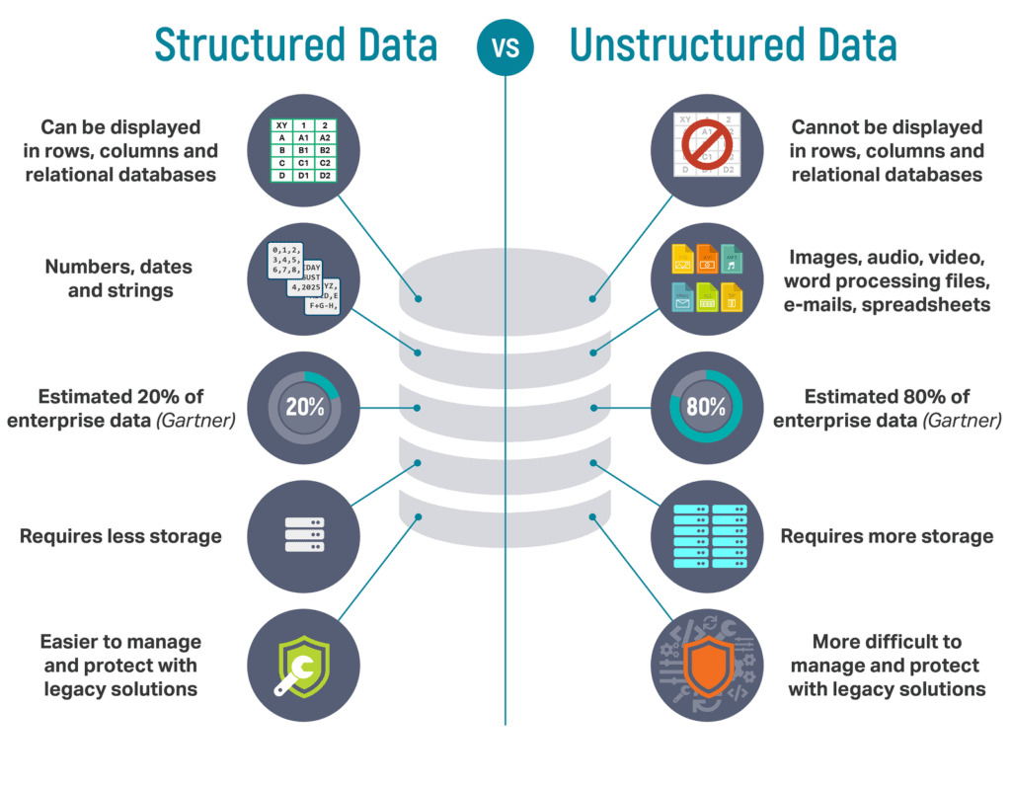

Slide 5
Semi Structured
From Un-Structured to Structured
Process the Data
Ex.
XML
JSON
Extracting names of people/ organization from news

Slide 6
Semi Structured
Semi-Structured Data:
In some applications, data is collected in an ad-hoc manner before it is known how it will be stored and managed.
This data may have a certain structure, but not all the information collected will have identical structure. This type of data is known as semi-structured data.
In semi-structured data, the schema information is mixed in with the data values, since each data object can have different attributes that are not known in advance. Hence, this type of data is sometimes referred to as self-describing data.

Slide 7
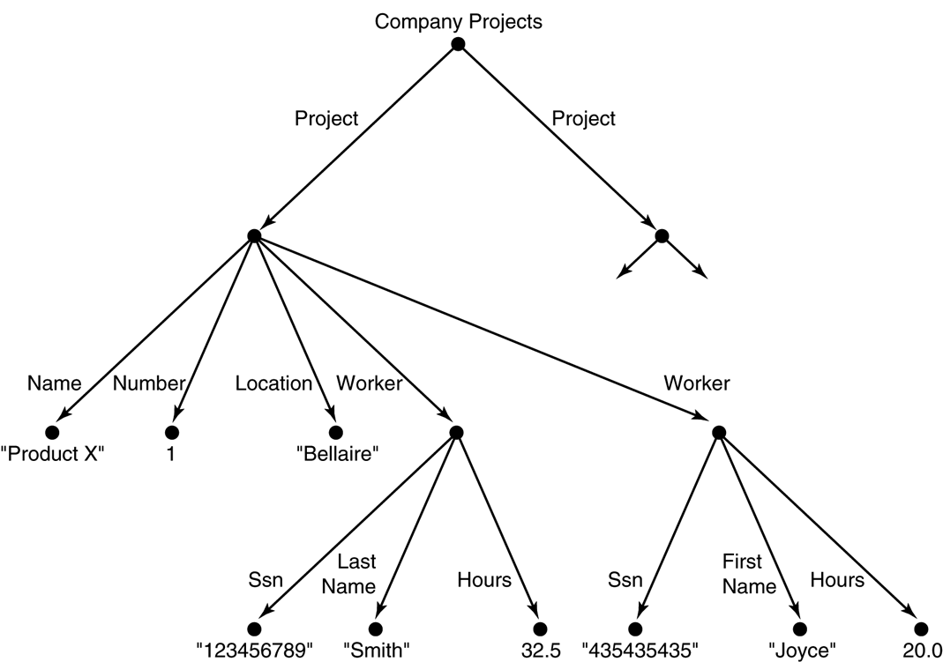
Semi Structured
Semi-structured data may be displayed as a directed graph...
The labels or tags on the directed edges represent the schema names—the names of attributes, object types (or entity types or classes), and relationships.
The internal nodes represent individual objects or composite attributes.
The leaf nodes represent actual data values of simple (atomic) attributes.

Slide 8
Semi Structured data as a graph

Slide 9
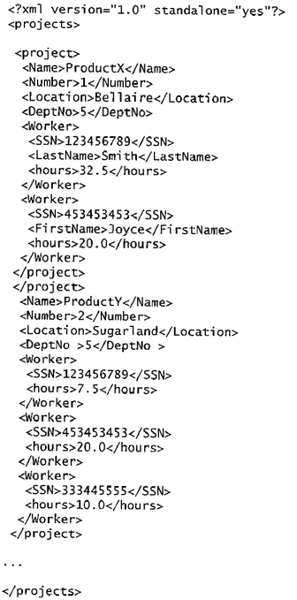
XML Hierarchical (Tree) Data Model
A complex XML element called <projects>

