Slide 1

Hadoop and Spark Technologies for Big Data
By Dr Shantanu Pathak

Slide 2
Hadoop
It is a framework to store and process big data
It is designed to work with low-end, and cost effective hardware
It works over network of computers called as cluster
Hadoop supports storing of large data over multiple computers ( called as Nodes) using HDFS, Hive and other data storage methods
Hadoop supports processing of big data using Map Reduce functionality
Here program (code) is send to nodes containing data for efficient use of network
Hadoop cluster requires computers to be connected with very high speed network, minimum 1 Gbps
It requires multiple computers with not very high storage or computation requirements (commodity hardware)
Ex. Hadoop cluster of 10 Nodes with 4gb RAM and 500GB hard-disk each, with 1 Gbps network connectivity. So total it will be 40gb RAM and 5 TB storage

Slide 3
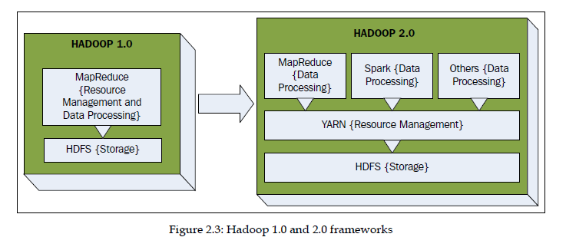
Hadoop Architecture v1 and v2
Major components of Hadoop
HDFS ( Hadoop Distributed File System)
Map reduce
YARN ( Yet Another Resource Negotiator )
Spark
Hive ( Data Ware-house for Hadoop for structured data)
HBase ( Un-structured data for Hadoop)

Slide 4
HDFS
Hadoop Distributed File System
primary storage system used by Hadoop applications
Single file is stored in form of small blocks on various nodes on cluster, so it is distributed file system
When user reads the file then blocks are returned in sequential manner
It is fault-tolerant and designed to be deployed on low-cost, commodity hardware.
For fault tolerance blocks are replicated
Supports storage of large datasets across the cluster

Slide 5

HDFS Architecture

Slide 6
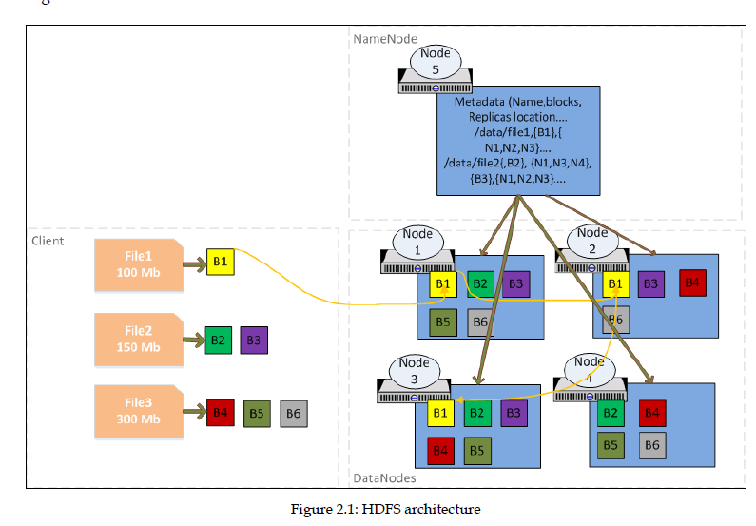
HDFS Architecture Example

Slide 7
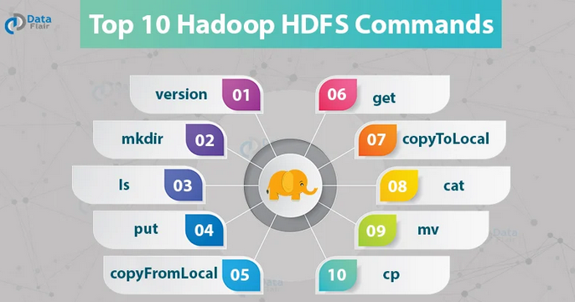
HDFS Commands
Ref: https://data-flair.training/blogs/top-hadoop-hdfs-commands-tutorial/

Slide 8
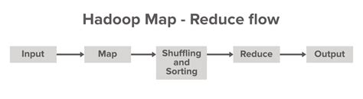
What is Map Reduce ?
programming model of Hadoop
Works using parallel processing
Works in distributed manner
Efficiently uses cluster resources of Hadoop

Slide 9
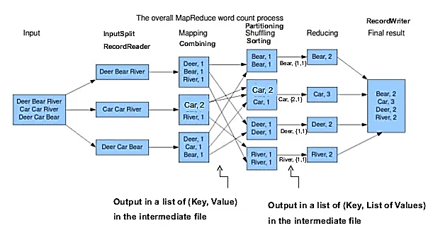
Map Reduce Detailed Example

Slide 10
YARN (Yet Another Resource Negotiator )
a system for managing distributed applications
schedules containers (CPU and RAM ) over the whole cluster.
consists of a central Resource manager (RM)
RM manages all cluster resources and all Node managers
Node manager
responsible for managing available resources on a single node.
YARN is based on a master Slave Architecture with Resource Manager being the master and Node Manager being the slaves.
Resource Manager keeps the meta info about which jobs are running on which Node Manager
Keeps info of CPU and RAM usage
Every job is run by Node Manager and RM never runs any job

Slide 11
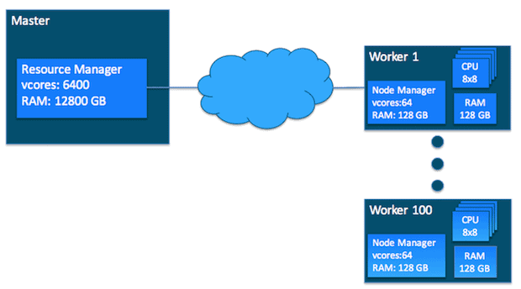
YARN (Yet Another Resource Negotiator )
Ref: https://blog.cloudera.com/untangling-apache-hadoop-yarn-part-1-cluster-and-yarn-basics/

Slide 12
Hadoop ( Map Reduce) vs Spark
 | MR | Spark
Ease of use | not easy to code and use | easy to code and use
Performance | relatively poor when compared with Spark | In-memory performance
Iterative processing | Every MR job writes the data to disk and reads from the disk | Spark caches the data in-memory
Fault tolerance | By replicating the data in HDFS | By Resilient Distributed Dataset (RDD) Lineage
Runtime architecture | Mapper and Reducer runs in a separate JVM (Java Virtual Machine) | Tasks are run in a pre-allocated executor JVM
Data | Stores data on disk | stores data in-memory and on disk
Operations | Map Reduce | Map, Reduce, Join, Cogroup, and many more
Execution model | Batch only | Batch, Interactive, and Streaming
Programming | Java Only | Java, Scala, Python, and R

Slide 13
Spark
Spark features
Speed Spark runs up to 100 times faster than Hadoop MapReduce for large-scale data processing. It is also able to achieve this speed through controlled partitioning.
Powerful Caching Simple programming layer provides powerful caching and disk persistence capabilities.
Deployment It can be deployed through Mesos, Hadoop via YARN, or Spark’s own cluster manager.
Real-Time It offers Real-time computation & low latency because of in-memory computation.
Polyglot Spark provides high-level APIs in Java, Scala, Python, and R. Spark code can be written in any of these four languages. It also provides a shell in Scala and Python.
Can be used to process Graph data and Streaming data

Slide 14
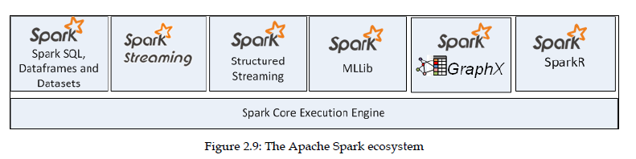
Spark Eco system

Slide 15
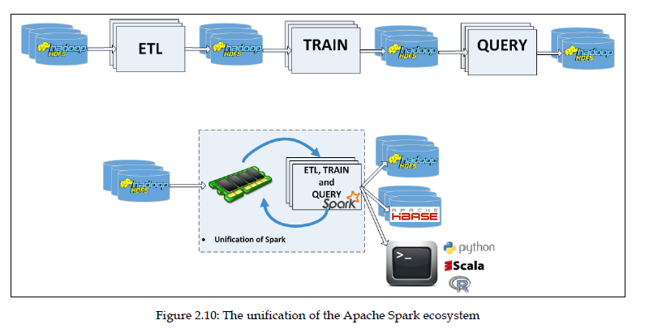
Spark (in-memory working) vs Hadoop

Slide 16
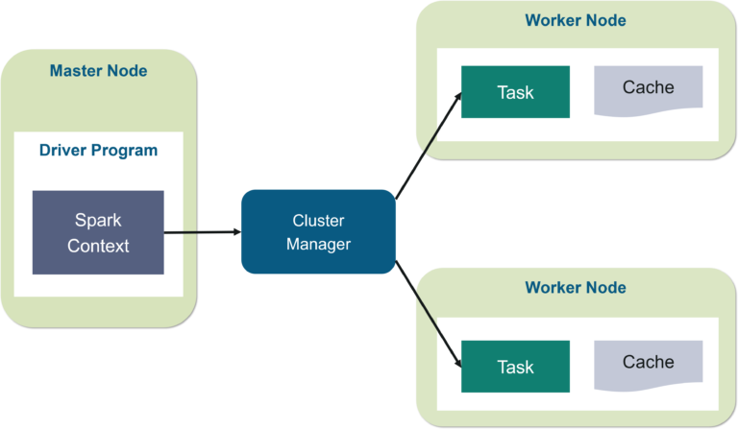
Spark Execution framework

Slide 17
Spark Execution framework
Job : Job submitted by the user ( JAVA jar file / python .py program )
Master Node : Runs driver program and interacts with user
Driver Program : entry point for any job. Creates Spark Context
Spark Context : main interface to interact with Spark (read / write)
Cluster Manager : Allocates resources ( worker nodes )
Operator DAG (Directed Acyclic Graph): Used to track the dependencies or steps of different RDDs. Each edge in graph is a transformation to be done on a RDD.
DAG Scheduler : Convert the DAG into Stages
Stages : set of tasks that can be executed in parallel
( shuffle stages / non-shuffle stages ) data is shuffled between nodes, which is costly
Task Scheduler : Launches task using Cluster manager
Worker Node / Executer : Executes tasks given by task scheduler

Slide 18
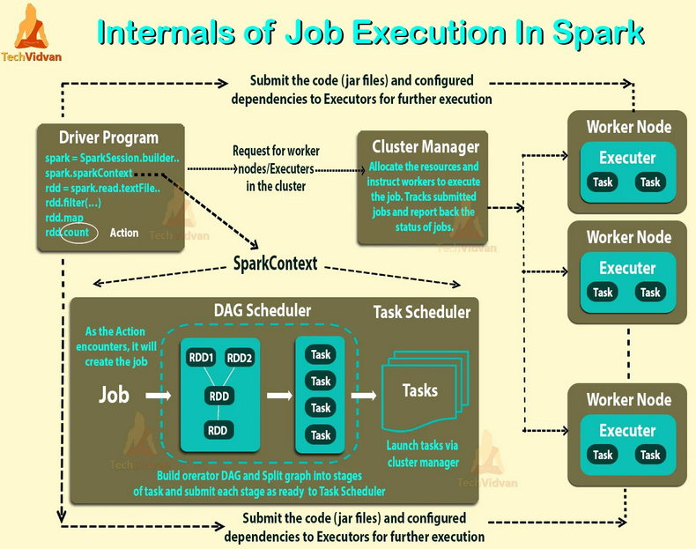

Slide 19
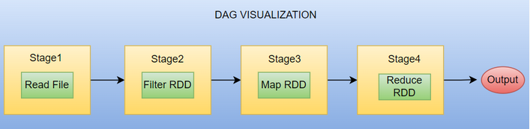
DAG Example
Ref: https://sparkbyexamples.com/spark/what-is-dag-in-spark/
https://www.databricks.com/blog/2015/06/22/understanding-your-spark-application-through-visualization.html

Slide 20
RDD Resilient Distributed Dataset
Resilient: If data in memory is lost, it can be recreated (or recomputed)
Fault tolerance
Distributed: Distributed across clusters
Dataset: Initial data can come from a file or created programmatically
RDDs are a fundamental unit of data in Spark and Spark programming revolves around creating and performing operations on RDDs.
They are immutable collections
partitioned across clusters that can be rebuilt (re-computed) if a partition is lost.
They are created by transforming data in a stable storage using data flow operators (map, filter, group-by) and can be cached in memory across parallel operations
Ref : https://www.databricks.com/glossary/what-is-rdd

Slide 21
RDD Transformations and Actions
Transformation:
Creates new RDD from original
Transformations will be triggered ONLY after action
Transformations are lazy
Performs data preprocessing
They are edges in the DAG for every Job
Action :
Triggers execution of transformations
Produces result
Gives back the result to driver program for further process or displaying or writing to storage

Slide 22
RDD Transformations and Actions Commonly used
Transformations : they generate new RDD from original RDD
filter() : filter elements by condition ex. Select rows where salary > 10k
map() : applies given function on every record of RDD
flatMap(): applies given function on every record of RDD and flatterns the results ( means only single dimensional output )
reduce() : aggregates RDD to a single value
Actions : operations to compute final result and send to driver program
collect() : collects all elements of RDD to driver program
count() : returns number of elements in an RDD
take() : returns first n elements of RDD

Slide 23
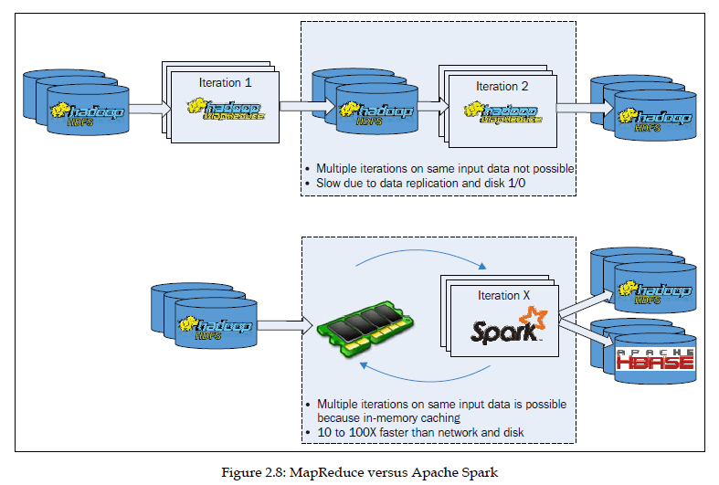
Hadoop Vs Spark

Slide 24
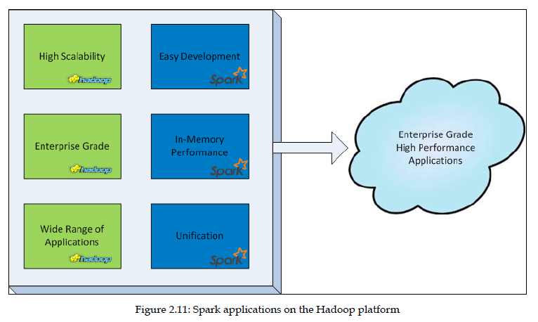
Hadoop and Spark Together

Slide 25
Hardware requirements
Hadoop:
https://docs.informatica.com/data-engineering/data-engineering-integration/h2l/1415-tuning-and-sizing-guidelines-for-data-engineering-integrati/tuning-and-sizing-guidelines-for-data-engineering-integration--1/sizing-recommendations/hadoop-cluster-hardware-recommendations.html
https://stackoverflow.com/questions/32756172/minimum-system-requirements-for-running-a-hadoop-cluster-with-high-availability
Spark :
https://spark.apache.org/docs/latest/hardware-provisioning.html

Slide 26
What is Data Center?
https://www.youtube.com/watch?v=XZmGGAbHqa0

