Slide 1
Text Summarization Using NLP
Presented By.
Abhishek Singh

Slide 2
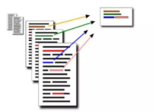
Introduction
The goal of summarization is to produce a shorter version of a source tax by preserving the meaning and the key content of the original document.
A well written summary can be significance reduce the amount of work needed to digest large amount of text.

Slide 3
Types of Text Summarization
Extractive Summaries
Abstractive Summaries

Slide 4
Extractive Summaries
Extractive summaries are created by reusing portions (words, sentences, etc.) of the input text document
The System extracts text from the entire collection, without modifying the text document,
Most of the summarization research today is on extractive summarization.

Slide 5
Abstractive Summaries
Requires deep understanding and reasoning the text.
It provides own summary over input text without using same word or sentence in the text.
Determines the actual and short meaning of each element, such as word, sentences and paragraphs.

Slide 6
“
”
Natural Language Toolkit
Leading platform for building Python program to work with human language data.
NLP is a filed of Computer Science, AI ( ML), linguistics Processing
Interaction between Computer and Human (natural ) language
IT provides suites of text processing libraries.

Slide 7
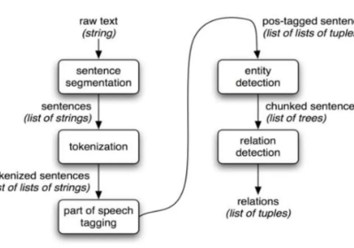
NLTK Libraries used in summarization
Word Tokenizer
Sentence Tokenizer
Stopwords
BrautifulSoup
Numpy Library
Tagging
Parsing

Slide 8
Summarization
Identifies the possible relation between two or more sentences
Segmentation
Tokenization
Identifies the work token from given sentence
Tagging
Assigns appropriate part of speech tag to each word
Identification of predefined categories i.e., Person, location, quantities, organization.
Relation Detection
Entity Detection
Convert raw text into sentences
List of Strings
Sentence Tokenizer
Provides a list of token as output
Extraction of nouns, adverbs, adjective.
Replacement with proper nouns
1
2
3
4
5

Slide 9
Conclusion & Scope
Automatic Text Summarization has been shown to be useful for natural language processing tasks such as questioning answering or text classification and other related fields of computer science such as information retrieval and access time for information searching will be improved.

Slide 10
Thank you…

