Slide 1
DRONE DISASTER MANAGMENT

Slide 2

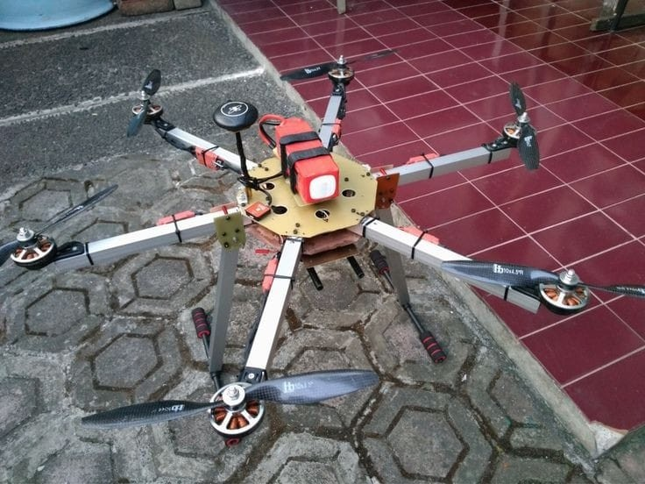
TABLE OF CONTENT
PITCH DECK PRESENTATION
04
STATISTICS
01
PROBLEM AND SOLUTION
05
COMPETITIVE ANALYSIS
02
INTRODUCTION
03
MARKET ANALYSIS

Slide 3
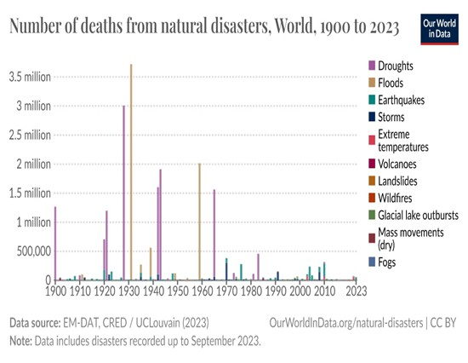
PROBLEMS
ADDRESSING INDIA’S VULNERABILITY TO EXTREME WEATHER EVENTS
01
Despite being
14th India
globally faces floods,
in climate recurrent cyclones,
vulnerability, challenges from
landslides, earthquakes and droughts.
02
03
In 2022, the death toll of 30,704 was three times higher than 2021, emphasizing the urgent need for advanced technologies and improved coordination.
Strategies causalities
must through
prioritize minimizing efficient search and
rescue operations during critical times.

Slide 4
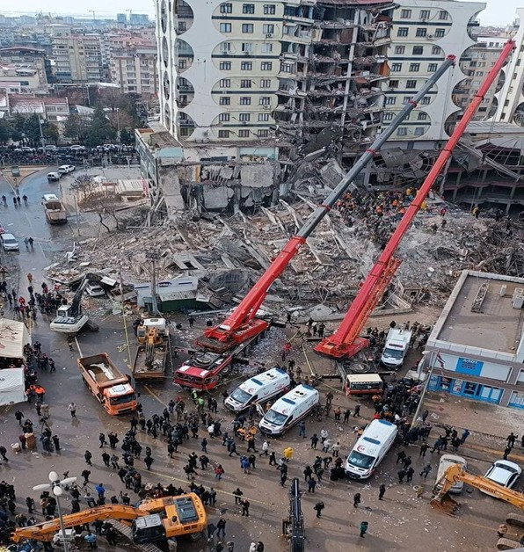

SOLUTIONS
SOLUTIONS OF THE PROBLEMS
UPKRITIrevolutionizes disaster response with its hexacopter technology
Offering real time situational awareness
01
.•Enhanced search and rescue capabilities,
adaptive sensor, gas leak detection .
Detailed 3D mapping and essential delivery
02
supplies
It’s an innovative leap in disaster management, providing efficient and effective response solutions.
03

Slide 5
SOLUTIONS
SOLUTIONS OF THE PROBLEMS
01
UPKRITIrevolutionizes disaster response with its hexacopter technology
Offering real time situational awareness
02
.•Enhanced search and rescue capabilities,
0
adaptive sensor, gas leak detection .
Detailed 3D mapping and essential delivery
supplies
It’s an innovative leap in disaster management, providing efficient and effective response solutions.
02
03

Slide 6
SOLUTIONS
SOLUTIONS OF THE PROBLEMS
01
UPKRITIrevolutionizes disaster response with its hexacopter technology
Offering real time situational awareness
.•Enhanced search and rescue capabilities,
02
adaptive sensor, gas leak detection .
Detailed 3D mapping and essential delivery
supplies
It’s an innovative leap in disaster management, providing efficient and effective response solutions.
02
03

Slide 7
SOLUTIONS
SOLUTIONS OF THE PROBLEMS
01
UPKRITIrevolutionizes disaster response with its hexacopter technology
Offering real time situational awareness
.•Enhanced search and rescue capabilities,
02
adaptive sensor, gas leak detection .
Detailed 3D mapping and essential delivery
supplies
It’s an innovative leap in disaster management, providing efficient and effective response solutions.
03

Slide 8
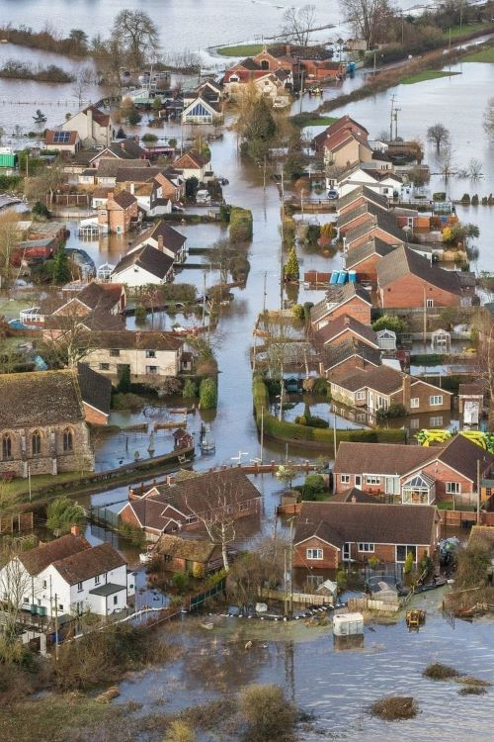
INTRODUCTION
Learn from disasters like the 2011 Japan earthquake and tsunami, earthquakes in Japan, Nepal, Mexico, and Indonesia, and floods in India.
- "UPKRITI" drone initiative aims to save lives, reduce damage, and improve emergency response
.- Inspired by real-world impact, it contributes to creating a safer and more resilient society.

Slide 9
INTRODUCTION
Learn from disasters like the 2011 Japan earthquake and tsunami, earthquakes in Japan, Nepal, Mexico, and Indonesia, and floods in India.
- "UPKRITI" drone initiative aims to save lives, reduce damage, and improve emergency response
.- Inspired by real-world impact, it contributes to creating a safer and more resilient society.

Slide 10
INTRODUCTION
Learn from disasters like the 2011 Japan earthquake and tsunami, earthquakes in Japan, Nepal, Mexico, and Indonesia, and floods in India.
- "UPKRITI" drone initiative aims to save lives, reduce damage, and improve emergency response
.- Inspired by real-world impact, it contributes to creating a safer and more resilient society.

Slide 11

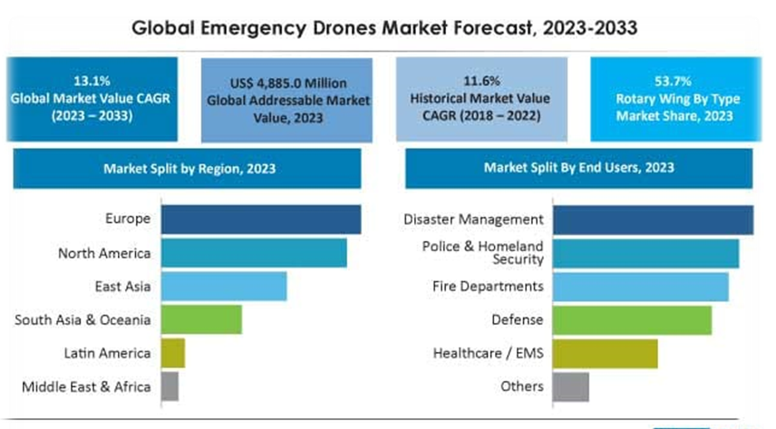
MARKET ANALYSIS
Market Size All Over The World
Rapidly expanding with a global size surpassing
$4245.1 million.
Serviceable Available Market (SAM)
1) Exhibiting a robust 13.1% CAGR, reflecting increasing demand for efficient disaster response
.2 )Integration of AI for real-time analysis, surge in government investments, and advancements in drone technology.
MARKET POTENTIAL
. *TAM, SAM, SOM:* TAM at $127 billion, SAM in the
$4885 million range, and SOM capturing a notable XX%.
b. *CGAR:* Anticipated Compound Annual Growth Rate of 25.82% during forecast region.

Slide 12
MARKET ANALYSIS
Market Size All Over The World
Rapidly expanding with a global size surpassing
$4245.1 million.
Serviceable Available Market (SAM)
1) Exhibiting a robust 13.1% CAGR, reflecting increasing demand for efficient disaster response
.2 )Integration of AI for real-time analysis, surge in government investments, and advancements in drone technology.
MARKET POTENTIAL
. *TAM, SAM, SOM:* TAM at $127 billion, SAM in the
$4885 million range, and SOM capturing a notable XX%.
b. *CGAR:* Anticipated Compound Annual Growth Rate of 25.82% during forecast region.

Slide 13
MARKET ANALYSIS
Market Size All Over The World
Rapidly expanding with a global size surpassing
$4245.1 million.
Serviceable Available Market (SAM)
1) Exhibiting a robust 13.1% CAGR, reflecting increasing demand for efficient disaster response
.2 )Integration of AI for real-time analysis, surge in government investments, and advancements in drone technology.
MARKET POTENTIAL
. *TAM, SAM, SOM:* TAM at $127 billion, SAM in the
$4885 million range, and SOM capturing a notable XX%.
b. *CGAR:* Anticipated Compound Annual Growth Rate of 25.82% during forecast region.

Slide 14
MARKET ANALYSIS
Market Size All Over The World
Rapidly expanding with a global size surpassing
$4245.1 million.
Serviceable Available Market (SAM)
1) Exhibiting a robust 13.1% CAGR, reflecting increasing demand for efficient disaster response
.2 )Integration of AI for real-time analysis, surge in government investments, and advancements in drone technology.
MARKET POTENTIAL
. *TAM, SAM, SOM:* TAM at $127 billion, SAM in the
$4885 million range, and SOM capturing a notable XX%.
b. *CGAR:* Anticipated Compound Annual Growth Rate of 25.82% during forecast region.

Slide 15
MARKET ANALYSIS
Market Size All Over The World
Rapidly expanding with a global size surpassing
$4245.1 million.
Serviceable Available Market (SAM)
1) Exhibiting a robust 13.1% CAGR, reflecting increasing demand for efficient disaster response
.2 )Integration of AI for real-time analysis, surge in government investments, and advancements in drone technology.
MARKET POTENTIAL
. *TAM, SAM, SOM:* TAM at $127 billion, SAM in the
$4885 million range, and SOM capturing a notable XX%.
b. *CGAR:* Anticipated Compound Annual Growth Rate of 25.82% during forecast region.

Slide 16
MARKET ANALYSIS
Market Size All Over The World
Rapidly expanding with a global size surpassing
$4245.1 million.
Serviceable Available Market (SAM)
1) Exhibiting a robust 13.1% CGAR, reflecting increasing demand for efficient disaster response
.2 )Integration of AI for real-time analysis, surge in government investments, and advancements in drone technology.
MARKET POTENTIAL
. *TAM, SAM, SOM:* TAM at $127 billion, SAM in the
$4885 million range, and SOM capturing a notable XX%.
b. *CGAR:* Anticipated Compound Annual Growth Rate of 25.82% during forecast region.

Slide 17
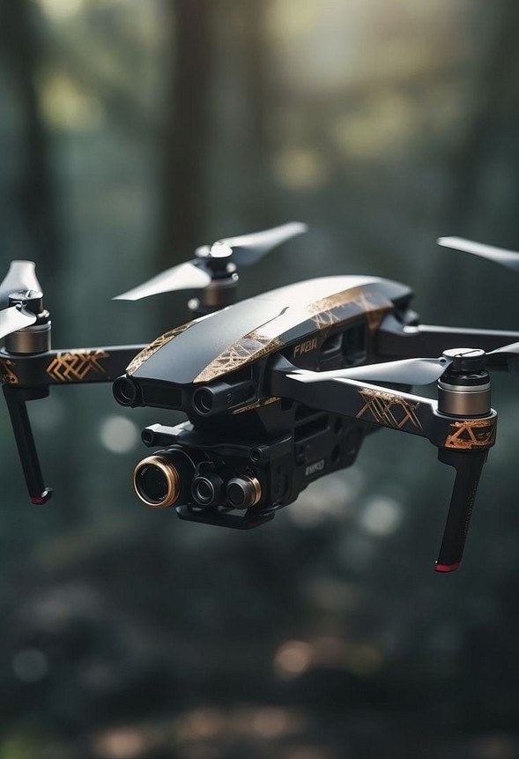
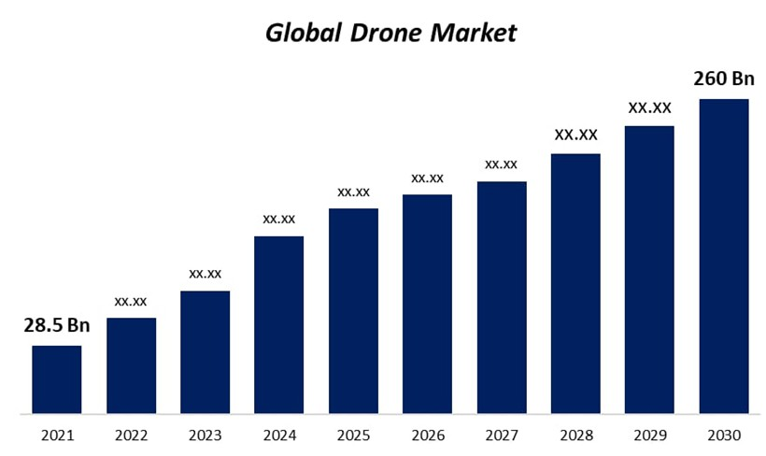
DRONE MARKET ANALYSIS
Search and Rescue Drone Market to Top US$ 11,648.1 Million Globally, Growing with a CAGR of around 13.6%

Slide 18
DRONE MARKET ANALYSIS
Search and Rescue Drone Market to Top US$ 11,648.1 Million Globally, Growing with a CAGR of around 13.6%

Slide 19
STATISTIC
Global search and rescue drone market is poised to expand at a CAGR of 13.6% reaching the valuation of US$ 11,648.1 Million by the end of 2033.
The global search and rescue drone market witnessed a stable CAGR of 9.1% during 2018 to 2022.
By end use vertical segment, fire departments is likely to account for 20.3% of revenue share by obtaining a valuation of US$
660.6 Million in 2023.
East Asia region is expected to register a CAGR of 14.6% over the forecast period, as it will be valued at US$ 637.9 Million by 2023 end.
Under product type segment, hybrid search and rescue drone is estimated to account for approximately a 25.4% share of aftermarket sub-segment in 2023.

Slide 20
STATISTIC
Global search and rescue drone market is poised to expand at a CAGR of 13.6% reaching the valuation of US$ 11,648.1 Million by the end of 2033.
The global search and rescue drone market witnessed a stable CAGR of 9.1% during 2018 to 2022.
By end use vertical segment, fire departments is likely to account for 20.3% of revenue share by obtaining a valuation of US$
660.6 Million in 2023.
East Asia region is expected to register a CAGR of 14.6% over the forecast period, as it will be valued at US$ 637.9 Million by 2023 end.
Under product type segment, hybrid search and rescue drone is estimated to account for approximately a 25.4% share of aftermarket sub-segment in 2023.

Slide 21
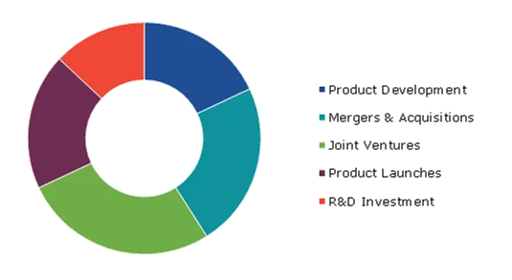
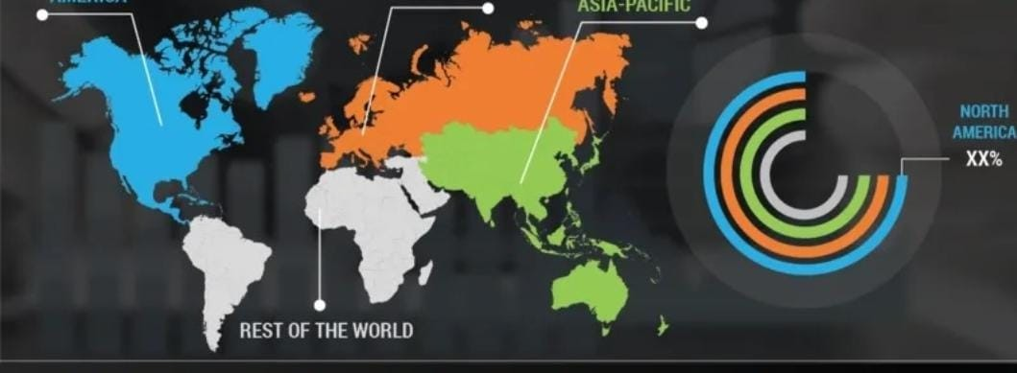
STATISTIC
Global search and rescue drone market is poised to expand at a CGAR of 13.6% reaching the valuation of US$ 11,648.1 Million by the end of 2033.
The global search and rescue drone market witnessed a stable CGAR of 9.1% during 2018 to 2022.
By end use vertical segment, fire departments is likely to account for 20.3% of revenue share by obtaining a valuation of US$
660.6 Million in 2023.
East Asia region is expected to register a CGAR of 14.6% over the forecast period, as it will be valued at US$ 637.9 Million by 2023 end.
Under product type segment, hybrid search and rescue drone is estimated to account for approximately a 25.4% share of aftermarket sub-segment in 2023.

Slide 22
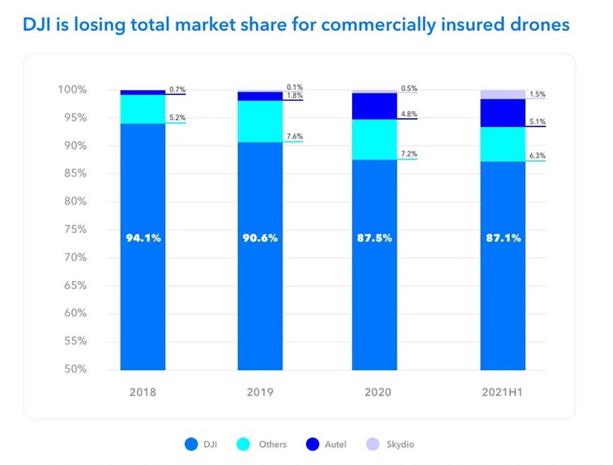
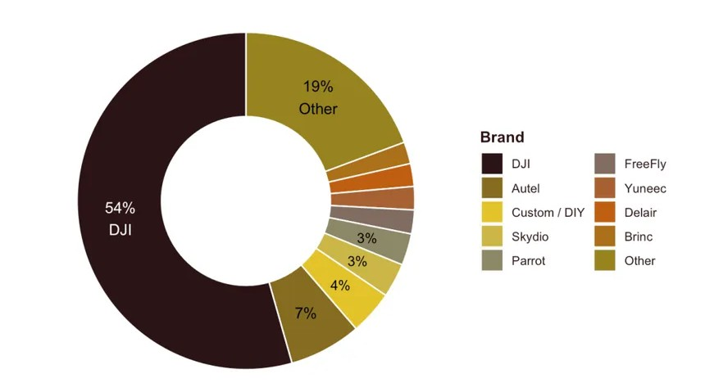
COMPETITIVE ANALYSIS
*Key Competitors:*
DJI Enterprise
Kespry
PrecisionHawk
2.*Market Share:*
DJI Enterprise: 40%
Kespry: 20%
-PrecisionHawk: 15%
3*Market Opportunity:*
-1. Assembling imported drone parts in India expands market scope.
2. Rising demand for automated disaster response solutions boosts opportunities.
3. AI integration enhances analytics, fostering substantial growth.

Slide 23
COMPETITIVE ANALYSIS
*Key Competitors:*
DJI Enterprise
Kespry
PrecisionHawk
2.*Market Share:*
DJI Enterprise: 40%
Kespry: 20%
-PrecisionHawk: 15%
3*Market Opportunity:*
-1. Assembling imported drone parts in India expands market scope.
2. Rising demand for automated disaster response solutions boosts opportunities.
3. AI integration enhances analytics, fostering substantial growth.

Slide 24
COMPETITIVE ANALYSIS
*Key Competitors:*
DJI Enterprise
Kespry
PrecisionHawk
2.*Market Share:*
DJI Enterprise: 40%
Kespry: 20%
-PrecisionHawk: 15%
3*Market Opportunity:*
-1. Assembling imported drone parts in India expands market scope.
2. Rising demand for automated disaster response solutions boosts opportunities.
3. AI integration enhances analytics, fostering substantial growth.

Slide 25
COMPETITIVE ANALYSIS
*Key Competitors:*
DJI Enterprise
Kespry
PrecisionHawk
2.*Market Share:*
DJI Enterprise: 40%
Kespry: 20%
-PrecisionHawk: 15%
3*Market Opportunity:*
-1. Assembling imported drone parts in India expands market scope.
2. Rising demand for automated disaster response solutions boosts opportunities.
3. AI integration enhances analytics, fostering substantial growth.

Slide 26
COMPETITIVE ANALYSIS
*Key Competitors:*
DJI Enterprise
Kespry
PrecisionHawk
2.*Market Share:*
DJI Enterprise: 40%
Kespry: 20%
-PrecisionHawk: 15%
3*Market Opportunity:*
-1. Assembling imported drone parts in India expands market scope.
2. Rising demand for automated disaster response solutions boosts opportunities.
3. AI integration enhances analytics, fostering substantial growth.

Slide 27
THANK YOU
FOR YOUR NICE ATTENTION

