Slide 1

ARMY INSTITUTE OF TECHNOLOGY (AIT), PUNE • DEPARTMENT OF IT
Skill Development Laboratory using Java (BIT25434A0X) | Continuous Internal Evaluation 2 (CIE-2)
ONLINE QUIZ MANAGEMENT SYSTEM
A Fault-Tolerant, Dual-Grading Academic Assessment Platform in Java SE & Glassmorphism Web UI
Class: SE IT B • Course In-charge / Examiner: Mrs. Trupti Najan • Academic Year: 2026
PROJECT TEAM MEMBERS & WORK DISTRIBUTION
GROUP LEADER & ARCHITECT
Aditya Yadav
Roll No: 8108 • SE IT B
• Unit III: Abstract Classes (Question & User)
• Unit IV: Types of Errors & Parameter Boundary Checks
• Implementation: Base class hierarchies & abstract signatures
• Viva Focus: Why use abstract class? vs Interface
POLYMORPHISM SPECIALIST
Abhishekh Singh
Roll No: 8104 • SE IT B
• Unit III: Polymorphism & Dynamic Dispatch (vtable)
• Unit IV: Checked vs Unchecked Exceptions
• Implementation: MCQ, True/False, Numeric & checkAnswer()
• Viva Focus: Dynamic method dispatch resolution via vtable
STRATEGY PATTERN LEAD
Priyam Raj
Roll No: 8134 • SE IT B
• Unit III: Interfaces & Pluggable Strategy Pattern
• Unit IV: try, catch, finally, throw, throws
• Implementation: QuizOperations & Standard vs Negative grading
• Viva Focus: QuizEvaluator design & Open/Closed Principle
QA & EXCEPTION ARCHITECT
Utkarsh Chauhan
Roll No: 8154 • SE IT B
• Unit III: Interface Implementation & Collections
• Unit IV: 5-Tier Custom Checked Exceptions
• Implementation: QuizException tree, InputValidator & Tests
• Viva Focus: Handling custom exceptions & try-catch-finally
🌐 Live Interactive Portal: https://abhisheksinghapsb-gif.github.io/Online-Quiz-Management-System/ | 💻 GitHub: abhisheksinghapsb-gif/Online-Quiz-Management-System

Slide 2
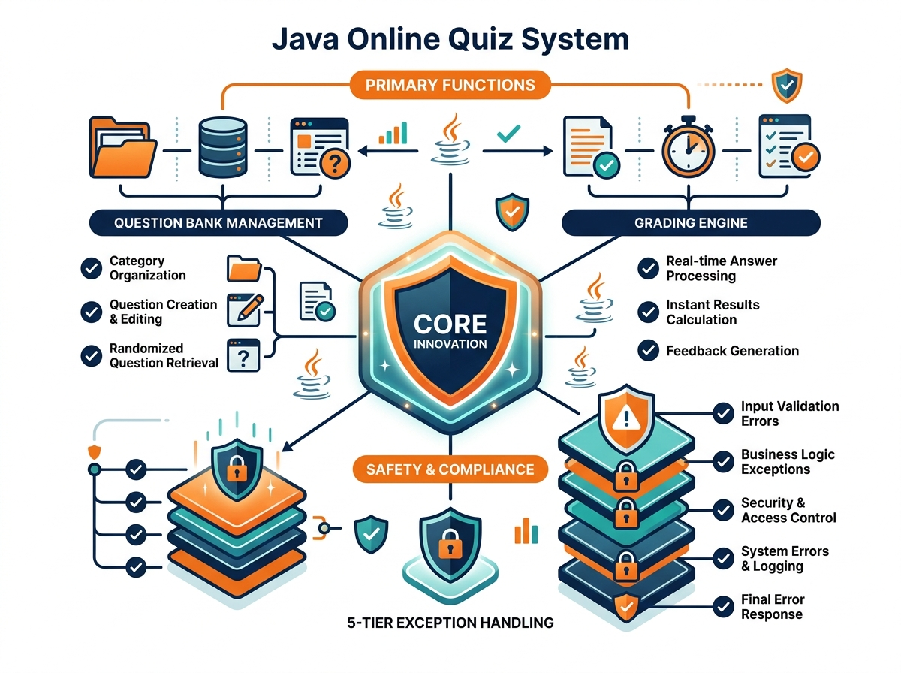
INTRODUCTION: PROBLEM CONTEXT & ARCHITECTURAL VISION
ACADEMIC MOTIVATION, SYSTEM OBJECTIVES & 4 CORE JAVA PILLARS
PROBLEM FORMULATION
The Academic Challenge
• Paper Exam Burden: Manual test administration causes 15+ hours of grading overhead per exam.
• Turnaround Latency: Students wait 3 to 7 days before receiving marks and actionable feedback.
• Human Scoring Errors: Subjective evaluation leads to mathematical calculation discrepancies.
• Rigid Software Tools: Traditional applications lack negative marking and crash on typographical input errors.
UNIT III & IV COMPLIANCE
The 4 Mandatory Java Concepts
• 1. Abstract Classes (Unit III): Question & User base hierarchies encapsulate shared fields (id, marks, topic) while forcing subclasses to implement specialized display and validation logic.
• 2. Interfaces & Strategy (Unit III): QuizEvaluator interface decouples scoring algorithms, enabling StandardGradingPolicy vs NegativeMarkingGradingPolicy without touching runner code.
• 3. Polymorphism in Action (Unit III): Runtime Dynamic Method Dispatch resolves MCQ, True/False, and Numeric questions on the fly. Compile-time Method Overloading provides multi-criteria search.
• 4. Custom Exception Tree (Unit IV): 5-tier checked hierarchy (QuizException, QuizNotFound, DuplicateQuiz, InvalidOption, InvalidQuestion, EmptyQuiz) guarantees bulletproof crash immunity.
CORE INNOVATION
Our Solution: Online Quiz System
• Zero-Crash Architecture: 5-tier custom checked exception tree intercepts typos without fatal crashes.
• Dual Grading Strategies: Instant runtime switch between Standard Linear and 25% Negative Marking.
• Automated Scorecards: Immediate objective score computation, percentages, and letter grades.
• Multi-Age Repositories: 9 pre-loaded quizzes across 4 age demographics (Kids, Teens, College, Pro).
Slide 2 of 4

Slide 3
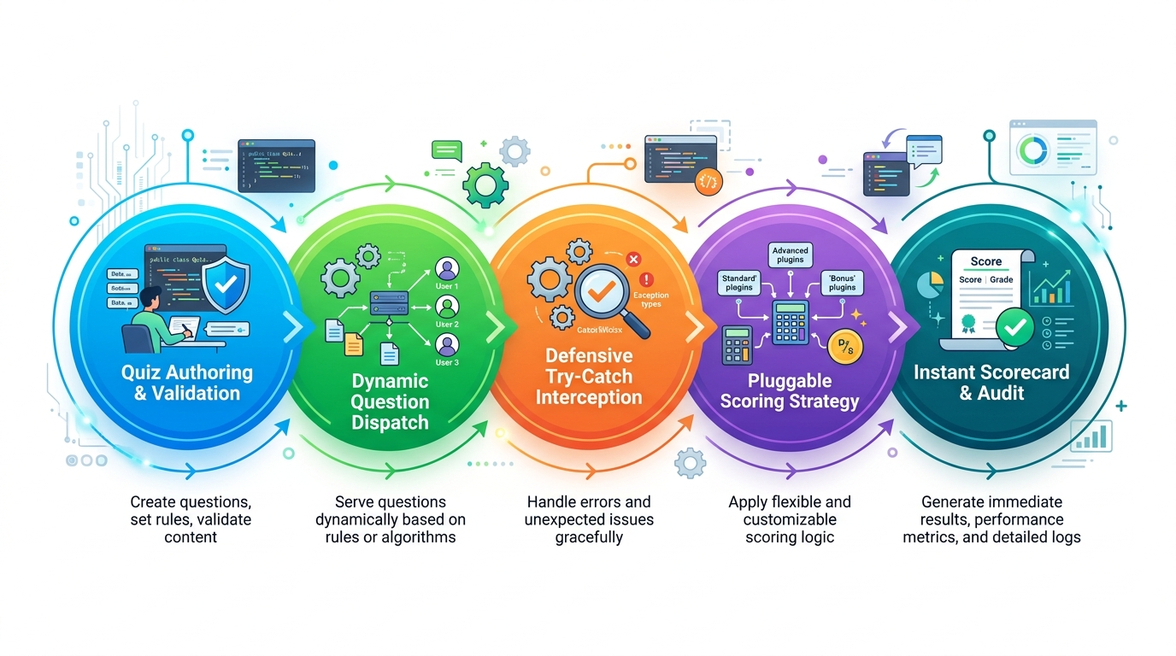
SYSTEM WORKING: EXECUTION LIFECYCLE & ARCHITECTURE
5-STAGE ASSESSMENT PIPELINE, DYNAMIC DISPATCH & TRIPLE DELIVERY MODES
5-STAGE ASSESSMENT LIFECYCLE
[1] Multi-Tier Ingestion
Validates unique Quiz ID, age category (Kids/Teens/College/Pro) & questionCount > 0.
[2] Strategy Injection
Dynamically injects Standard Linear or 25% Competitive Negative Marking policy.
[3] Dynamic Dispatch
Iterates List<Question> polymorphically, delegating to MCQ, TF, or Numeric subclasses.
[4] Defensive Interception
Catches illegal user entries (e.g. typing 'Z') with InvalidOptionException for safe retry.
[5] Scorecard & Audit
Evaluates net scores, percentages, letter grades (A+, A, B, C, F), and logs history.
MODE 1
Terminal CLI (run.bat)
• Pure Core Java: Works directly in Windows Command Prompt without external dependencies.
• Interactive Menus: Student & Faculty dashboards with formatted ASCII table views.
• Zero-Crash Recovery: Entering 'Z' triggers safe retry without terminating application.
MODE 2
Modern Web UI (run_web.bat)
• Embedded Server: Lightweight Java HttpServer on port 8080 with zero external JARs.
• Live Countdown: 10-minute automated quiz timer with radio options & score modals.
• GitHub Pages: Hosted live online for instant browser access without setup.
STRATEGY PATTERN (QuizEvaluator)
• Standard Policy: Score = Sum of correct question marks.
• Competitive Policy: Score = Correct - (0.25 * Incorrect Marks).
• Decoupled Architecture: Zero runner modifications required to add new grading rules (Open/Closed Principle).
MODE 3
Automated Viva Harness (run_tests.bat)
• 60-Second Proof: Specially designed for the 8-10 minute CIE-2 viva demonstration.
• All 4 Concepts: Tests dynamic dispatch, strategy swapping, and overloaded searches.
• Exception Traces: Deliberately triggers and catches all 5 exceptions with finally blocks.
Slide 3 of 4

Slide 4
EXPLAINING THE WEBSITE UI: ARCHITECTURE & USER EXPERIENCE
INTERACTIVE GLASSMORPHISM DASHBOARD, REAL-TIME TIMER & COMPONENT BREAKDOWN
HEADER & NAVIGATION
1. Institution Header & Navigation
• Branding Crest: AIT Pune crest & Department of IT badge with active CIE-2 examination status.
• Persistent Nav Bar: 5-tab navigation: Quizzes, Active Quiz, Score History, Faculty, and Viva Guide.
• Portal Branding: Clean, modern institutional branding with persistent top-level navigation.
SEARCH & FILTERING
2. Interactive Filter & Search Bar
• Live Topic Search: Real-time debounced search by academic keyword (e.g. 'OOP', 'Exceptions').
• Difficulty Filter: Dropdown filter for All Levels, Easy, Medium, and Hard assessments.
• Age Group Selector: Dynamic filter for Kids (8-12), Teens (13-17), College (18-22), and Pro (20+).
QUIZ REPOSITORY GRID
3. Glassmorphism Quiz Cards Grid
• Multi-Card Layout: Responsive CSS grid presenting preloaded and instructor-authored assessments.
• Color Badges: Visual tags for difficulty and colored age badges (pink, cyan, indigo, amber).
• Action Button: Displays question count, total marks, and 1-click 'Start Assessment ✍️' trigger.
ACTIVE ASSESSMENT ENGINE
4. Active Quiz Runner & Countdown Timer
• 10-Minute Timer: Live countdown ticker in header with automated submission upon time expiry.
• Grading Strategy Switch: Student selector to attempt quiz under Standard or 25% Negative Marking.
• Polymorphic Inputs: Renders radio buttons for MCQs, binary toggles for T/F, text fields for Numeric.
SCORECARD & ANALYTICS
5. Instant Scorecard Modal & History
• Instant Feedback: Modal dialog pop-up calculating net marks, percentage, and letter grade (A+, A, B, F).
• Question Audit: Color-coded item-by-item breakdown highlighting student choice vs correct answer.
• Submissions Log: Tabulated history preserving all student attempt timestamps and scores.
FACULTY & AUTHORING PORTAL
6. Faculty Management & Question Authoring
• Quiz Authoring Modal: Allows instructors to create custom quizzes and append polymorphic questions.
• Dynamic Schema Control: Add multiple choice, true/false, or numeric questions with custom marking.
• Submissions Audit Matrix: Comprehensive gradebook table tracking attempts, grading policies, and results.
Slide 4 of 4

