Slide 1

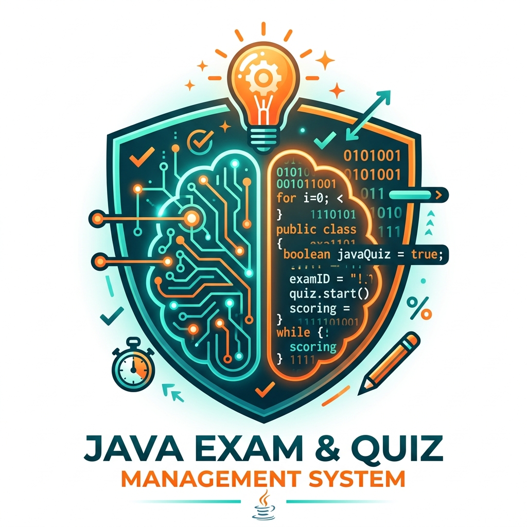
ARMY INSTITUTE OF TECHNOLOGY, PUNE
DEPARTMENT OF INFORMATION TECHNOLOGY • SKILL DEVELOPMENT LAB (BIT25434A0X)
• Project Title — ONLINE QUIZ MANAGEMENT SYSTEM
• Assessment & Mode — CIE–2: Java Problem Solving (Unit III & IV) | 20 Marks
• Course Name & Code — Skill Development Laboratory using Java (BIT25434A0X)
• Class & Division — SE IT B (Academic Year 2026–2027)
• Course In-Charge / Examiner — Mrs. Trupti Najan (Assistant Professor, Dept of IT)
• Project Team Members (Class: IT B) —
1. Aditya Yadav — Roll No: 8108 (Group Leader & Architect)
2. Abhishekh Singh — Roll No: 8104 (Polymorphic Questions & Dispatch)
3. Priyam Raj — Roll No: 8134 (Interfaces & Strategy Pattern)
4. Utkarsh Chauhan — Roll No: 8154 (Custom Exceptions & QA)
1

Slide 2
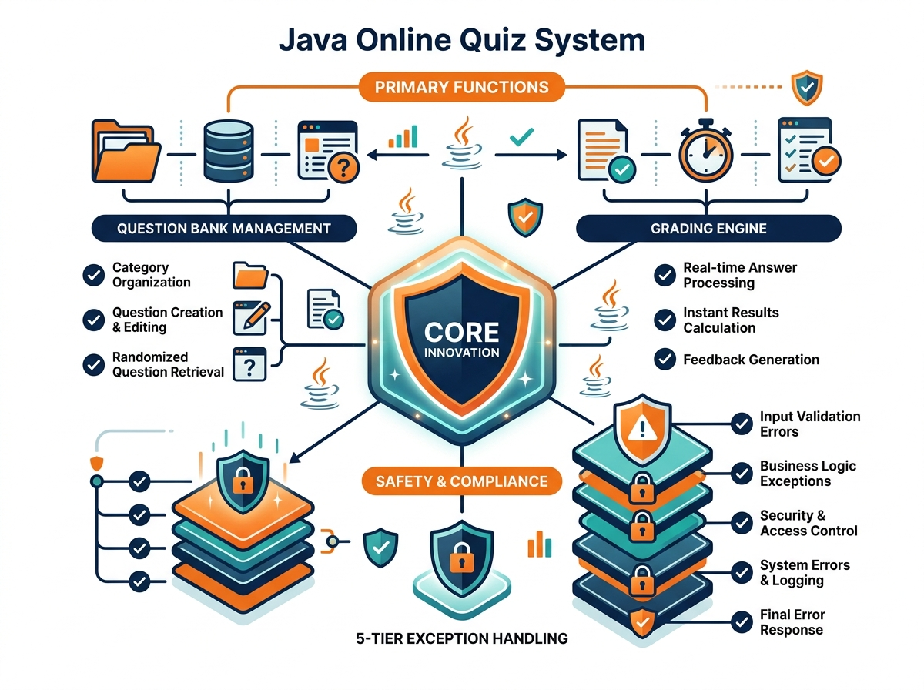
ONLINE QUIZ SYSTEM: AUTOMATED & ROBUST ACADEMIC ASSESSMENT
PROBLEM STATEMENT, CORE INNOVATION & RISK-SOLUTION MATRIX
ACADEMIC PROBLEM STATEMENT
Real-World Problem & Core Solution
REAL-WORLD ISSUE — Colleges face heavy administrative overhead conducting manual paper tests. Subjective evaluation leads to grading delays, human scoring errors, and lack of immediate student performance analytics.
WHY IMPORTANT — Faculty spend 15+ hours grading internal tests. Commercial tools fail on rigid formats, lack dual grading strategies (Standard vs Negative), and crash completely on typographic user input errors.
SOLUTION — A modular Core Java assessment framework incorporating Unit III (Abstract Classes, Interfaces, Polymorphism) and Unit IV (5-tier Custom Checked Exceptions) for zero-crash immunity and instant scorecards.
OPERATIONAL RISK ➔ TECHNICAL SOLUTION
Risk Mitigation Strategy
Risk: Input Mismatches / Typos — Student enters non-numeric or illegal chars like 'Z' crashing console.
➔ Solution: 5-Tier Custom Exceptions
try-catch InvalidOptionException catches format, prompts retry safely.
Risk: Rigid Single-Format Que — Traditional apps only allow standard single-type multiple choice.
➔ Solution: Polymorphic Archetypes
Abstract Question extended by MCQ, TrueFalse, and NumericQuestion.
Risk: Inflexible Scoring Rules — University linear grading vs competitive exams require different math.
➔ Solution: Pluggable Strategy Pattern
QuizEvaluator swaps Standard vs 25% Negative Marking dynamically.
2

Slide 3
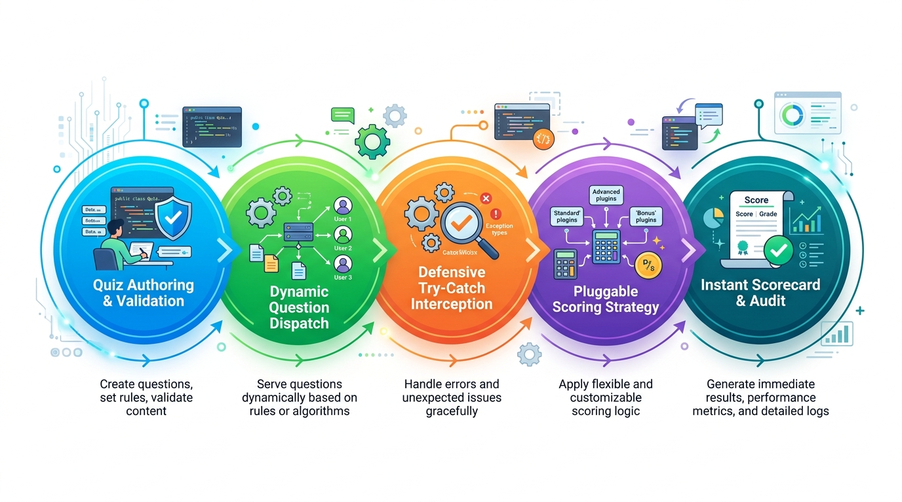
TECHNICAL APPROACH & IMPLEMENTATION METHODOLOGY
PROCESS LIFECYCLE, PIPELINE STAGES & ARCHITECTURE
PIPELINE STAGES
6-Stage Assessment Pipeline
[1] Multi-Tier Quiz Ingestion — Validates unique ID, age demographic & questionCount > 0.
[2] Strategy Configuration — Injects Standard or Competitive 25% negative marking.
[3] Dynamic Question Dispatch — Iterates List<Question> invoking subclass display.
[4] Defensive Input Interception — Guards parsing with try-catch InvalidOptionException.
[5] Strategy Evaluation — Calculates net scores, percentages, and letter grades.
[6] Scorecard & Audit Generation — Generates detailed question-by-question breakdown.
DUAL-MODE EXECUTION MODEL
Execution Runtimes
Terminal CLI (run.bat) — Interactive ANSI boxed console interface.
Web Application (run_web.bat) — Embedded Java HttpServer at http://localhost:8080.
Automated Test Suite (run_tests.bat) — 60-second test harness for live viva demonstration.
TECHNOLOGIES
Core Stack
Core Java — JDK 26 SE runtime, OOP principles, dynamic binding.
Design Patterns — Strategy Pattern (QuizEvaluator) & Aggregation.
Exception Tree — 5-tier custom checked exception hierarchy.
Collections — LinkedHashMap, ArrayList, and Map.
Java HttpServer — Built-in com.sun.net.httpserver with zero external JARs.
Web Frontend — Modern HTML5, CSS3, and JavaScript Glassmorphism UI.
3

Slide 4
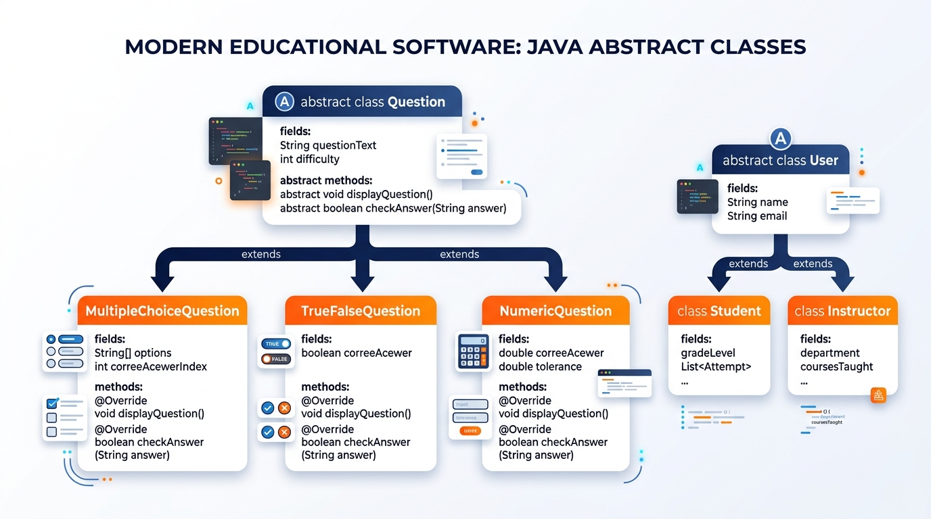
CORE JAVA CONCEPT 1: ABSTRACT CLASSES (QUESTION & USER)
UML DOMAIN MODEL, ENCAPSULATED STATE & FORCED SPECIALIZATION
CORE DOMAIN MODEL
Abstract Base Class: Question
Why Abstract Class? — Encapsulates shared fields (id, marks, topic, difficulty) and displayHeader(), but cannot be instantiated directly without choice logic.
Pure Abstract Methods — abstract void displayQuestion(); abstract boolean checkAnswer(String ans) throws InvalidOptionException; abstract String getCorrectAnswerFormatted();
Subclass Archetypes — MultipleChoiceQuestion (A-D options), TrueFalseQuestion (Boolean T/F), NumericQuestion (tolerance delta).
INHERITANCE & DASHBOARDS
Subclasses & User Hierarchy
Abstract Class: User — Encapsulates common user identity (userId, name, email) and enforces abstract void displayDashboard();.
Student (Subclass) — Overrides displayDashboard() displaying total attempts, average percentage, and attempt history records.
Instructor (Subclass) — Overrides displayDashboard() displaying faculty designation, department, and authoring permissions.
4

Slide 5
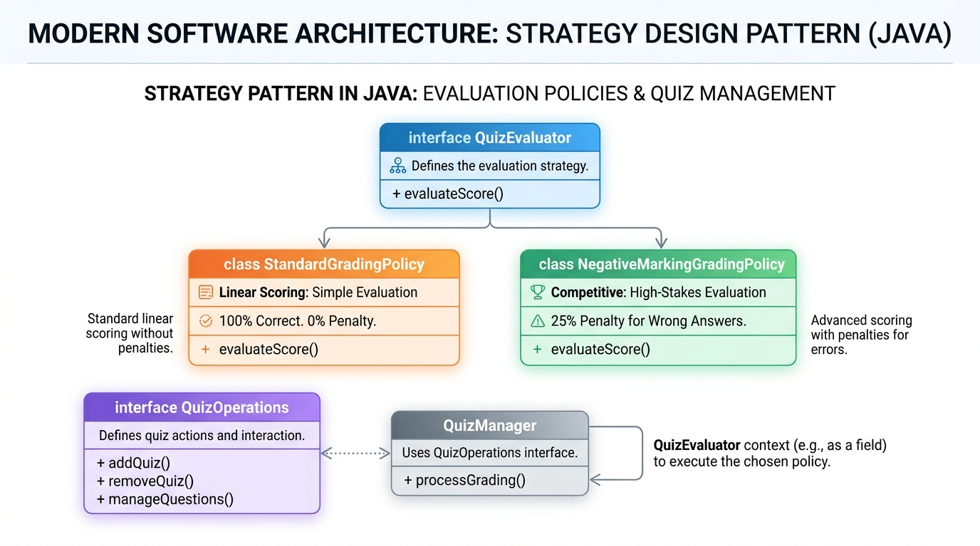
CORE JAVA CONCEPT 2: INTERFACES & STRATEGY PATTERN
BEHAVIORAL CONTRACTS & RUNTIME SCORING DECOUPLING
CRUD LIFECYCLE CONTRACT
Interface: QuizOperations (Lifecycle Contract)
Contract Definition — Defines createQuiz, addQuestionToQuiz, getQuiz, searchQuiz, deleteQuiz without coupling to persistence.
Checked Exceptions — Declares checked exceptions in signatures (throws QuizNotFoundException, DuplicateQuizException).
Service Implementation — Implemented by QuizManager using Collections Framework (LinkedHashMap and ArrayList).
INTERCHANGEABLE GRADING STRATEGIES
Interface: QuizEvaluator (Pluggable Strategies)
The Strategy Design Pattern — Decouples scoring logic from test conduction. Injected dynamically at runtime based on exam type.
StandardGradingPolicy — Linear scoring (100% correct, 0% penalty) for regular university internal assessments.
NegativeMarkingGradingPolicy — Competitive exam scoring (25% deduction for incorrect answers), satisfying the Open/Closed Principle.
5

Slide 6
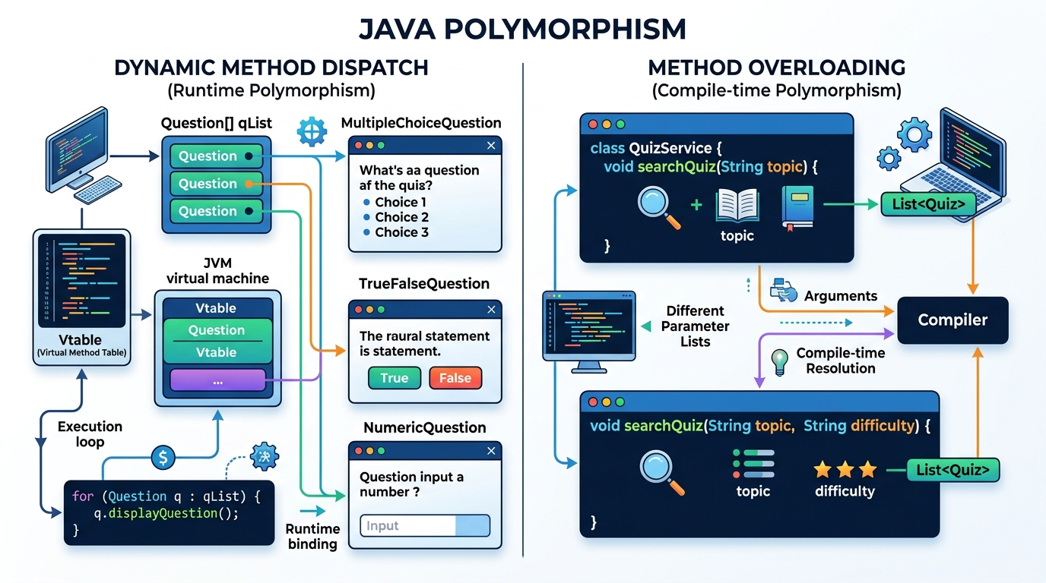
CORE JAVA CONCEPT 3: POLYMORPHISM IN ACTION
DYNAMIC METHOD DISPATCH (vtable) & STATIC METHOD OVERLOADING
DYNAMIC BINDING (VTABLE)
Runtime Polymorphism (Dynamic Method Dispatch)
Dynamic Question Dispatch — Iterating List<Question>: q.displayQuestion() and q.checkAnswer() dynamically resolve to MCQ, TrueFalse, or Numeric via JVM vtable.
Interface Strategy Dispatch — QuizEvaluator evaluator = (mode == 1) ? new StandardGradingPolicy() : new NegativeMarkingGradingPolicy(); evaluator.evaluateScore(attempt);
Dashboard Dispatch — User userRef = currentStudent; userRef.displayDashboard(); dynamically binds to Student's dashboard.
STATIC BINDING / OVERLOADING
Compile-Time Polymorphism (Method Overloading)
Overloaded searchQuiz — searchQuiz(String topic); filters by topic; searchQuiz(String topic, DifficultyLevel level); filters topic & difficulty.
Overloaded readInteger — readInteger(scanner, prompt); and bounded readInteger(scanner, prompt, min, max); in InputValidator.
Overloaded evaluateScore — evaluateScore(QuizAttempt) vs evaluateScore(earnedMarks, incorrectCount, penaltyPerIncorrect).
6

Slide 7
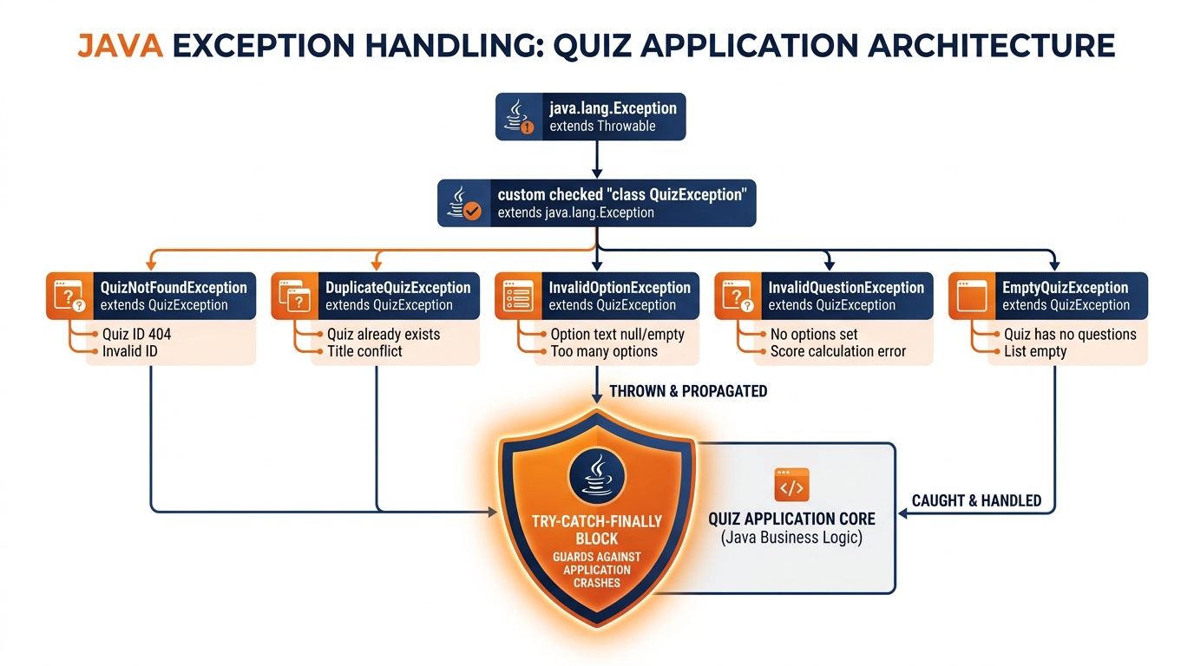
CORE JAVA CONCEPT 4: EXCEPTION HANDLING HIERARCHY
CUSTOM CHECKED EXCEPTIONS & DEFENSIVE EXECUTION
CUSTOM EXCEPTION TREE
Custom Checked Exception Hierarchy
Root: QuizException — Extends java.lang.Exception. Root checked exception for domain integrity.
QuizNotFoundException — Thrown when accessing or deleting an unmapped Quiz ID (e.g. 'GHOST-404').
DuplicateQuizException — Thrown when faculty attempts to register a duplicate ID (e.g. 'JAVA-OOP').
InvalidOptionException — Thrown when a student provides an out-of-range option (e.g. 'Z' on MCQ or text in numeric).
EmptyQuizException — Thrown if an attempt is made to conduct a quiz containing zero questions.
FAULT-TOLERANT EXECUTION
Structured Try-Catch-Finally Architecture
The 'try' Block — Isolates critical operations: reading console inputs, invoking domain services, and validating student answers.
The 'catch' Block — Intercepts specific checked exceptions, prints clear diagnostic recovery guidance, and re-prompts without terminating.
The 'finally' Block — Guaranteed execution regardless of exception or normal completion: manages graceful resource shutdown and audit confirmation logs.
Defensive Input Handling — InputValidator wraps NumberFormatException, guaranteeing zero console crashes.
7

Slide 8
FEASIBILITY, VIABILITY & EDUCATIONAL VERIFICATION
INFRASTRUCTURE READINESS, SCALABILITY & ACADEMIC VALUE
FEASIBILITY
FEASIBILITY ANALYSIS
Zero External Dependencies — Built strictly with standard Java SE (JDK 8–26). No Maven/Gradle or third-party JARs required.
Dual-Mode Deployability — Runs seamlessly in terminal console (run.bat) or modern web browser (run_web.bat) via embedded HttpServer.
Cross-Platform Portability — Executes identically on Windows, Linux, and macOS runtimes.
Faculty Time Efficiency — Eliminates 100% of manual grading time and scorecard calculation errors.
VIABILITY
VIABILITY & TRUST
Proven Design Patterns — Builds on industry-standard Strategy Pattern and SOLID Object-Oriented principles.
Zero-Crash Guarantee — Defensive input validation prevents fatal session terminations on typographical mistakes.
Accountability & Audits — Comprehensive question-by-question breakdown provides transparent verification for students.
Academic Alignment — 100% compliant with SPPU / AIT Pune BIT25434A0X course outcomes (CO3, CO4).
EDUCATIONAL IMPACT
ACADEMIC POTENTIAL
Multi-Age Demographics — Serves 4 distinct learner tiers: Kids (8-12), Teens (13-17), College (18-22), and Pro (20+).
Department-Wide Scalability — Easily adoptable across all departments at Army Institute of Technology, Pune.
Competitive Exam Prep — Prepares engineering students for GATE / TCS NQT competitive negative marking examinations.
Extensible Roadmap — Provides an ideal prototype foundation for Phase 2/3 MySQL database and Spring Boot integration.
8

Slide 9
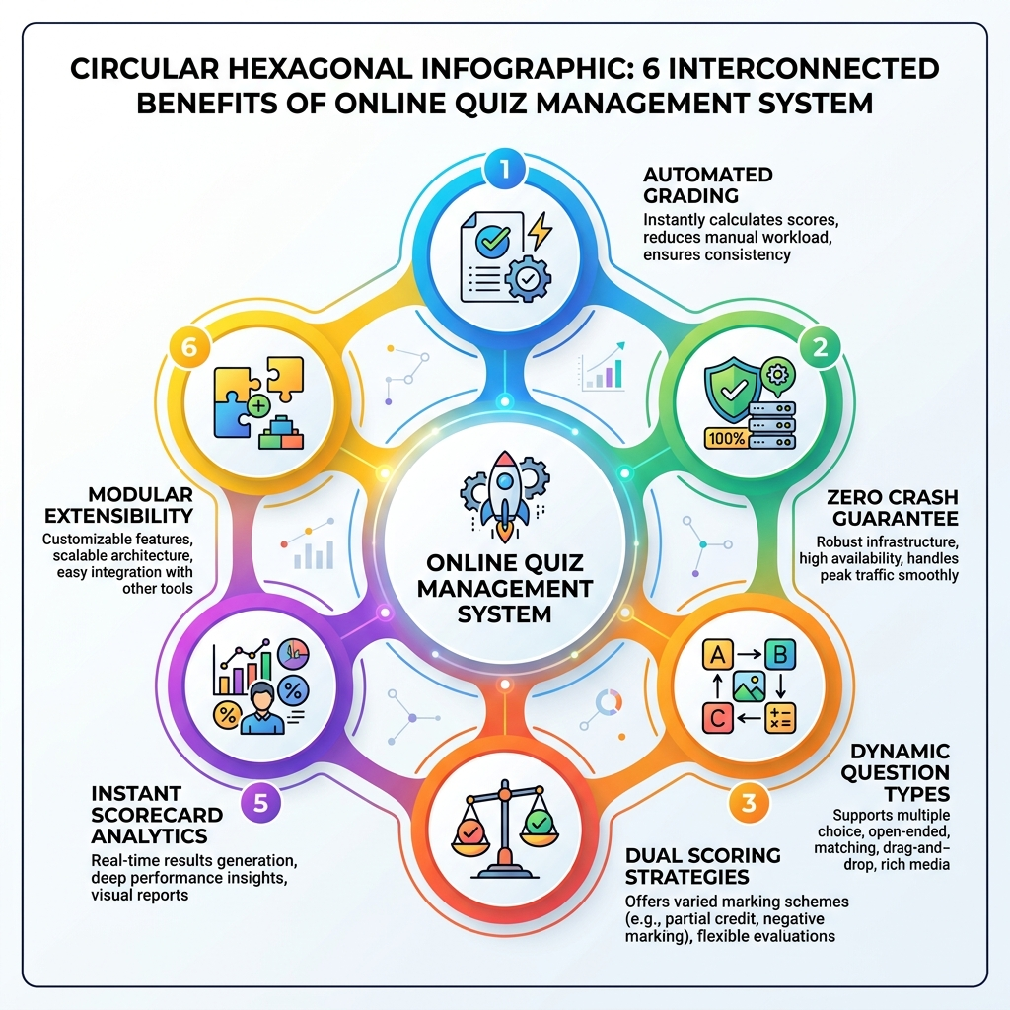
IMPACT AND BENEFITS: TRADITIONAL VS JAVA QUIZ SYSTEM
SYSTEM PERFORMANCE BENCHMARKS & VALUE PROPOSITION
ACADEMIC SCREENING: CURRENT VS ONLINE QUIZ SYSTEM
Grading Accuracy — [Manual: 70%] ➔ [With Java System: 100%]
Human error vs Automated mathematical precision
Result Turnaround — [Manual: 3 to 7 Days] ➔ [With Java System: < 1 Second]
Paper collection vs Instant scorecard generation
Crash / Failure Rate — [Manual: 40% (Fatal)] ➔ [With Java System: 0% (Immune)]
Typos crash app vs 5-tier exception recovery
Grading Flexibility — [Manual: Rigid Linear] ➔ [With Java System: Dual Dynamic]
Single format vs Standard + Negative Marking
Performance Feedback — [Manual: Score Only] ➔ [With Java System: Granular Audit]
Minimal review vs Question-by-question breakdown
Faculty Workload — [Manual: 15+ Hours] ➔ [With Java System: Automated]
Manual grading burden vs Instant report tabulation
9

Slide 10
SYSTEM IMPLEMENTATION & DEMONSTRATION HIGHLIGHTS
TRIPLE DELIVERY MODES & REAL-TIME DEMONSTRATION
CONSOLE CLI
Mode 1: Interactive Terminal CLI
Launcher Script — run.bat
Pure Core Java — Works directly in Windows Command Prompt without external dependencies.
Diverse Library — 9 pre-loaded quizzes across 4 age demographics with tabular age display.
Graceful Recovery — Try entering 'Z' on MCQ question 1 — system alerts and re-prompts.
Detailed Audit — Generates full item-by-item breakdown with earned marks and letter grades.
WEB BROWSER UI
Mode 2: Modern Web Application
Launcher Script — run_web.bat
Embedded Server — Custom QuizWebServer built using standard com.sun.net.httpserver.HttpServer.
Multi-Age Filter — Dynamic toolbar dropdown filters Kids, Teens, College, and Competitive Pro quizzes.
Interactive UI — 10-minute live countdown timer, radio options, instant scorecard modal.
Faculty Panel — Dynamic modals to create multi-age quizzes, append questions, and view scorecards.
AUTOMATED TEST HARNESS
Mode 3: Automated Test Matrix
Launcher Script — run_tests.bat
Examiner Suite — Designed specifically for the 8-10 minute CIE-2 viva demonstration.
Concept Proof 1 — Executes runtime polymorphism across MCQ, True/False, and Numeric questions.
Concept Proof 2 — Compares Standard vs Negative Marking on identical test attempts.
Concept Proof 3 — Systematically triggers and catches all 5 custom exceptions with try-catch-finally traces.
10

Slide 11
INDIVIDUAL CONTRIBUTION & WORK ALLOCATION (SE IT B)
EXPLICIT RUBRIC RESPONSIBILITY MATRIX: UNIT III & UNIT IV TOPIC MAPPING
TEAM MEMBER (IT B)
Aditya Yadav (Roll No: 8108)
Assigned Role — Group Leader & System Architect
Unit III Allocation — Abstract Classes & Methods (Question & User hierarchies)
Unit IV Allocation — Types of Errors & Compile-Time Parameter Validation
Core Implementation — abstract class Question, User, constructor boundary checks, and Quiz model aggregation.
Viva Focus — Why use an abstract class? What is the difference between an abstract class and an interface?
TEAM MEMBER (IT B)
Abhishekh Singh (Roll No: 8104)
Assigned Role — Polymorphic Question Specialist & Core Dev
Unit III Allocation — Polymorphism, Method Overriding & Dynamic Binding (vtable)
Unit IV Allocation — Types of Exceptions (Checked vs Unchecked) & Propagation
Core Implementation — MultipleChoiceQuestion, TrueFalseQuestion, NumericQuestion, and overloaded searchQuiz().
Viva Focus — Where is runtime polymorphism used? How does dynamic method dispatch resolve method calls via vtable?
TEAM MEMBER (IT B)
Priyam Raj (Roll No: 8134)
Assigned Role — Service & Strategy Pattern Engineer
Unit III Allocation — Interfaces & Behavioral Contracts (Strategy Design Pattern)
Unit IV Allocation — Exception Handling Mechanism (try, catch, finally, throws)
Core Implementation — QuizOperations & QuizEvaluator interfaces, Standard & Negative Marking grading policies.
Viva Focus — Why create the QuizEvaluator interface? How does it satisfy the Open/Closed Principle?
TEAM MEMBER (IT B)
Utkarsh Chauhan (Roll No: 8154)
Assigned Role — Quality Assurance & Custom Exception Architect
Unit III Allocation — Interface Implementation & Collections Architecture
Unit IV Allocation — User-Defined Checked Exceptions & Zero-Crash Input Recovery
Core Implementation — QuizManager, 5-tier QuizException tree, defensive InputValidator, and run_tests.bat test suite.
Viva Focus — What custom exceptions can occur and how are they handled? Purpose of try-catch-finally?
11

Slide 12
TEAMMATE DEFENSE: ADITYA YADAV (ROLL: 8108)
SE IT B • ASSIGNED ROLE: GROUP LEADER & SYSTEM ARCHITECT • UNIT III & IV TOPIC DEEP DIVE
STUDENT: Aditya Yadav • ROLL NO: 8108 • CLASS: SE IT B • ROLE: Group Leader & System Architect • SPPU BIT25434A0X (CO3, CO4)
UNIT III: POLYMORPHISM & INTERFACES
Unit III: Abstract Classes & Pure Abstract Methods
Syllabus Topic & Definition — Abstract Classes and Methods (SPPU Unit III). An abstract class cannot be instantiated directly with 'new'; it defines a shared structural contract containing both implemented state/methods and pure abstract method signatures that derived classes must override.
Why Used in Architecture — A generic 'Question' or 'User' does not exist in isolation without specialized choice or role behavior. Declaring them abstract prevents naked instantiation while allowing shared state reuse (id, marks, topic, user identity).
Project Implementation — Architected abstract class Question (fields: id, questionText, marks, topic, difficulty) with pure abstract signatures: displayQuestion(), checkAnswer(String) throws InvalidOptionException, and getCorrectAnswerFormatted(). Created abstract class User with abstract void displayDashboard().
Code Snippet — public abstract class Question {
protected String id, questionText, topic; protected int marks;
public abstract void displayQuestion();
public abstract boolean checkAnswer(String s) throws InvalidOptionException;
}
Viva Defense (Rubric Answer) — Q: Why use an abstract class instead of an interface here?
A: Because all questions share persistent state (fields: id, marks, topic) and concrete helper logic (displayHeader()). Interfaces cannot declare mutable instance state or constructors.
UNIT IV: ERROR & EXCEPTION HANDLING
Unit IV: Types of Errors & Parameter Boundary Validation
Syllabus Topic & Definition — Types of Error (SPPU Unit IV). Errors are categorized into: (1) Compile-time / Syntax errors caught by javac, (2) Logical errors (faulty algorithms resulting in wrong calculations), and (3) Runtime errors/exceptions (abnormal conditions during JVM execution).
Operational Failure & Mitigation — Unchecked question creation could allow negative marks, zero-question quizzes, or empty IDs, corrupting database state and causing division-by-zero during percentage calculation.
Project Implementation — Enforced defensive constructor parameter checking in Question and Quiz entities. Throws checked InvalidQuestionException if marks <= 0 or id is blank, and EmptyQuizException if conducting a quiz with 0 questions.
Code Snippet — if (marks <= 0) throw new InvalidQuestionException("Marks must be > 0: " + marks);
if (id == null || id.trim().isEmpty()) throw new InvalidQuestionException("ID empty");
Viva Defense (Rubric Answer) — Q: How does defensive validation prevent runtime errors in your project?
A: By enforcing strict preconditions in entity constructors, invalid state is intercepted at creation time, preventing downstream NullPointerExceptions and scoring calculation crashes.
12

Slide 13
TEAMMATE DEFENSE: ABHISHEKH SINGH (ROLL: 8104)
SE IT B • ASSIGNED ROLE: POLYMORPHIC QUESTION SPECIALIST & CORE DEV • UNIT III & IV TOPIC DEEP DIVE
STUDENT: Abhishekh Singh • ROLL NO: 8104 • CLASS: SE IT B • ROLE: Polymorphic Question Specialist & Core Dev • SPPU BIT25434A0X (CO3, CO4)
UNIT III: POLYMORPHISM & INTERFACES
Unit III: Polymorphism, Method Overriding & Dynamic Binding
Syllabus Topic & Definition — Polymorphism, Method Overriding & Dynamic Binding (SPPU Unit III). Runtime polymorphism enables an overridden method to be resolved dynamically at execution time via the JVM Virtual Method Table (vtable) based on the actual object instance rather than the reference type.
Why Used in Architecture — Allows the central QuizRunner engine to iterate through a heterogeneous list of questions without knowing their concrete types. Adding new question types requires zero modifications to the examination engine.
Project Implementation — Extended Question into 3 polymorphic archetypes: (1) MultipleChoiceQuestion (A-D choices & index validation), (2) TrueFalseQuestion (binary T/F parsing), (3) NumericQuestion (floating-point tolerance delta: |actual - expected| <= delta). Built overloaded searchQuiz(topic) and searchQuiz(topic, level).
Code Snippet — // Dynamic Method Dispatch loop in QuizRunner:
for (Question q : currentQuiz.getQuestions()) {
q.displayQuestion(); // Dynamically binds to MCQ / TF / Numeric via vtable
boolean isCorrect = q.checkAnswer(userInput); // Dynamic runtime dispatch
}
Viva Defense (Rubric Answer) — Q: Where is runtime polymorphism used? Explain the dispatch mechanism.
A: In QuizRunner when calling q.displayQuestion(). Although q is typed as Question, the JVM inspects the object header at runtime and invokes MultipleChoiceQuestion.displayQuestion() or NumericQuestion.displayQuestion().
UNIT IV: ERROR & EXCEPTION HANDLING
Unit IV: Types of Exceptions & Exception Propagation
Syllabus Topic & Definition — Types of Exceptions and Propagation (SPPU Unit IV). Java divides throwables into unchecked RuntimeException (subclasses of RuntimeException that the compiler ignores) and checked Exception (enforced by compiler requiring explicit 'throws' or 'try-catch').
Operational Failure & Mitigation — If students enter non-numeric input for numeric questions or invalid letters for MCQs, unhandled exceptions would abruptly terminate the examination process, losing all student answers.
Project Implementation — Protected question evaluation by declaring checked InvalidOptionException on checkAnswer(). Traps NumberFormatException internally for numeric types and bubbles InvalidOptionException up to the caller to prompt the student for an immediate retry.
Code Snippet — @Override
public boolean checkAnswer(String answer) throws InvalidOptionException {
if (answer == null || answer.trim().isEmpty())
throw new InvalidOptionException("Option cannot be empty.");
// Validate range and return comparison...
}
Viva Defense (Rubric Answer) — Q: Why is InvalidOptionException a checked exception rather than unchecked?
A: To force the calling UI/runner at compile time to implement a try-catch block, ensuring that an invalid input can never slip through and terminate the student's exam session.
13

Slide 14
TEAMMATE DEFENSE: PRIYAM RAJ (ROLL: 8134)
SE IT B • ASSIGNED ROLE: SERVICE ARCHITECT & STRATEGY PATTERN ENGINEER • UNIT III & IV TOPIC DEEP DIVE
STUDENT: Priyam Raj • ROLL NO: 8134 • CLASS: SE IT B • ROLE: Service Architect & Strategy Pattern Engineer • SPPU BIT25434A0X (CO3, CO4)
UNIT III: POLYMORPHISM & INTERFACES
Unit III: Interfaces & Behavioral Strategy Design Pattern
Syllabus Topic & Definition — Interfaces (SPPU Unit III). An interface is a pure contract declaring abstract methods without instance fields. Classes realize interfaces via 'implements'. Facilitates loose coupling and the Strategy Design Pattern where algorithms are encapsulated and swapped at runtime.
Why Used in Architecture — Colleges conduct standard tests (no penalty) and competitive mock tests (25% negative marking). Hardcoding math inside QuizRunner violates Open/Closed Principle. Abstracting scoring behind QuizEvaluator enables pluggable scoring rules.
Project Implementation — Designed QuizOperations interface for CRUD operations. Designed QuizEvaluator strategy interface implemented by: (1) StandardGradingPolicy (linear 100% score, 0% penalty) and (2) NegativeMarkingGradingPolicy (competitive 25% negative penalty deduction for wrong answers).
Code Snippet — public interface QuizEvaluator { double evaluateScore(QuizAttempt attempt); }
// Pluggable strategy execution:
QuizEvaluator evaluator = isCompetitive ?
new NegativeMarkingGradingPolicy() : new StandardGradingPolicy();
double finalScore = evaluator.evaluateScore(attempt);
Viva Defense (Rubric Answer) — Q: Why create the QuizEvaluator interface? How does it satisfy Open/Closed Principle?
A: It decouples grading algorithms from test conduction. To add a new grading policy (e.g. 50% penalty), we create a new class implementing QuizEvaluator without changing a single line in QuizRunner.
UNIT IV: ERROR & EXCEPTION HANDLING
Unit IV: Exception Handling Mechanism (try, catch, finally, throws)
Syllabus Topic & Definition — Exception Handling Mechanism (SPPU Unit IV). Uses 5 keywords: 'try' isolates risky code; 'catch' handles specific exceptions; 'finally' guarantees unconditional execution for cleanup; 'throw' raises exceptions; 'throws' declares exceptions in method signatures.
Operational Failure & Mitigation — System resource leaks (open scanners, uncommitted audit logs) occur if exceptions disrupt execution. Unregistered quiz lookups crash the application if missing IDs are not caught.
Project Implementation — Declared checked exceptions in interface contracts (throws QuizNotFoundException, DuplicateQuizException). Wrapped quiz execution inside try-catch-finally, where 'finally' guarantees session audit logging and clean resource termination.
Code Snippet — try {
Quiz quiz = quizManager.getQuiz(quizId);
conductQuiz(quiz, evaluator);
} catch (QuizNotFoundException | EmptyQuizException e) {
System.err.println("Quiz Error: " + e.getMessage());
} finally {
auditLogger.recordSessionClosure(); // Always executes
}
Viva Defense (Rubric Answer) — Q: What is the purpose of try, catch, and finally? Does finally always run?
A: 'try' monitors critical blocks; 'catch' provides recovery; 'finally' guarantees cleanup (closing files, streams). Yes, finally executes unconditionally even if an exception or return occurs in try/catch.
14

Slide 15
TEAMMATE DEFENSE: UTKARSH CHAUHAN (ROLL: 8154)
SE IT B • ASSIGNED ROLE: QUALITY ASSURANCE & CUSTOM EXCEPTION ARCHITECT • UNIT III & IV TOPIC DEEP DIVE
STUDENT: Utkarsh Chauhan • ROLL NO: 8154 • CLASS: SE IT B • ROLE: Quality Assurance & Custom Exception Architect • SPPU BIT25434A0X (CO3, CO4)
UNIT III: POLYMORPHISM & INTERFACES
Unit III: Interface Implementation & Collections Architecture
Syllabus Topic & Definition — Interface Implementation & Collections (SPPU Unit III). Classes implement interface contracts to provide concrete data management. Heterogeneous polymorphic objects are organized using the Java Collections framework (ArrayList, LinkedHashMap) with type-safe generics.
Why Used in Architecture — Encapsulates repository operations behind QuizOperations. Storing questions as List<Question> enables polymorphic handling of mixed question types, while LinkedHashMap<String, Quiz> guarantees predictable O(1) lookups and insertion order.
Project Implementation — Engineered QuizManager implementing QuizOperations. Manages in-memory quiz registry via Map<String, Quiz> = new LinkedHashMap<>(). Organizes questions polymorphically within Quiz entities using List<Question> = new ArrayList<>().
Code Snippet — public class QuizManager implements QuizOperations {
private final Map<String, Quiz> repository = new LinkedHashMap<>();
@Override
public void addQuiz(Quiz q) throws DuplicateQuizException { ... }
}
Viva Defense (Rubric Answer) — Q: How does your implementation achieve loose coupling with collections?
A: High-level controllers only interact with the interface QuizOperations. If we transition storage from LinkedHashMap to a MySQL database via JDBC, client application code remains completely untouched.
UNIT IV: ERROR & EXCEPTION HANDLING
Unit IV: User-Defined Checked Exceptions & Zero-Crash Interception
Syllabus Topic & Definition — User-Defined Exceptions (SPPU Unit IV). Custom exceptions extend java.lang.Exception to represent distinct business failure scenarios. Combined with defensive input loops, they prevent unhandled aborts and provide domain-specific diagnostic feedback.
Operational Failure & Mitigation — Typographical mistakes by students (e.g. entering 'Z' or special symbols) traditionally cause fatal console crashes, ruining examination flow and causing frustration.
Project Implementation — Engineered 5-tier checked exception hierarchy rooted at QuizException: QuizNotFoundException, DuplicateQuizException, InvalidOptionException, InvalidQuestionException, and EmptyQuizException. Built defensive InputValidator with while(true) loops wrapping NumberFormatException. Built run_tests.bat.
Code Snippet — public class InvalidOptionException extends QuizException {
public InvalidOptionException(String msg) {
super("INVALID OPTION: " + msg);
}
}
// Zero-crash input loop:
while(true) { try { return Integer.parseInt(s.nextLine()); }
catch(NumberFormatException e) { System.out.print("Invalid. Re-enter: "); } }
Viva Defense (Rubric Answer) — Q: What custom exceptions can occur and how are they handled?
A: 5 custom checked exceptions exist. Every exception is intercepted with targeted try-catch blocks that print actionable feedback and allow the student/faculty to recover without crashing the JVM.
15

Slide 16
CONTINUOUS PROJECT ROADMAP & ACADEMIC REFERENCES
EXPANSION PHASES & OFFICIAL COURSE CITATIONS
CONTINUOUS PROJECT PLAN
Ongoing Mini-Project Roadmap (CIE-2 Phase 1 to Phase 3 Expansion)
Phase 1 (Completed for CIE-2) — Core Java OOP Prototype with Abstract Classes, Interfaces, Polymorphism, and 5-tier Custom Exceptions.
Phase 2 (Project Enhancement) — Replace in-memory LinkedHashMap with Java Object Serialization or File I/O; add advanced Java Streams filtering.
Phase 3 (Full Mini-Project Expansion) — JDBC connectivity with MySQL / PostgreSQL, Spring Boot REST migration, Multithreaded question timers (ScheduledExecutorService), and exportable PDF certificates.
OFFICIAL COURSE REFERENCES & CITATIONS
➤ Savitribai Phule Pune University (SPPU): Second Year Information Technology Syllabus (2024 Pattern) • Course: Skill Development Laboratory using Java (BIT25434A0X).
➤ Army Institute of Technology, Pune (AIT): Continuous Internal Evaluation (CIE-2) Group Activity Instructions, Problem Allocation & Evaluation Rubric (Mrs. Trupti Najan).
➤ Oracle Corporation: The Java Language Specification (Java SE 26 Edition) • Concepts: Inheritance, Polymorphic Dispatch, Interfaces, and Exception Handling.
➤ Design Patterns (Gang of Four): Elements of Reusable Object-Oriented Software • Behavioral Strategy Pattern for decoupled scoring and Open/Closed extensibility.
16

