Slide 1
E-Commerce Sales Analytics & Product Recommendation
Hadoop · Hive · Spark · MongoDB | BCSE402L DA-3
K PRADEEP KUMAR (23BLC1240) · VAHRAN P (23BLC1221) · ASHVATH KUMAR (23BLC1269) · K.P ABHISHEK (23BLC1292)

Slide 2
Problem Statement
Domain: Brazilian Olist e-commerce marketplace
Need: Understand sales trends, geography, payments and delivery quality
Challenge: Build recommendations at scale where single-machine tools fail
Data sparsity: ~1.07 purchases per customer makes collaborative filtering hard
Goal: End-to-end batch Big Data pipeline with honest evaluation and dashboard

Slide 3
Dataset Overview
9 relational CSVs, ~1.55 M rows, ~122 MB
Orders, items, payments, reviews, products, sellers, customers, geolocation
99,441 orders, 112,650 line items, 93,358 unique customers
Only 3.00% of customers ever order twice
Dataset source: Kaggle / public mirror with SHA-256 manifest

Slide 4
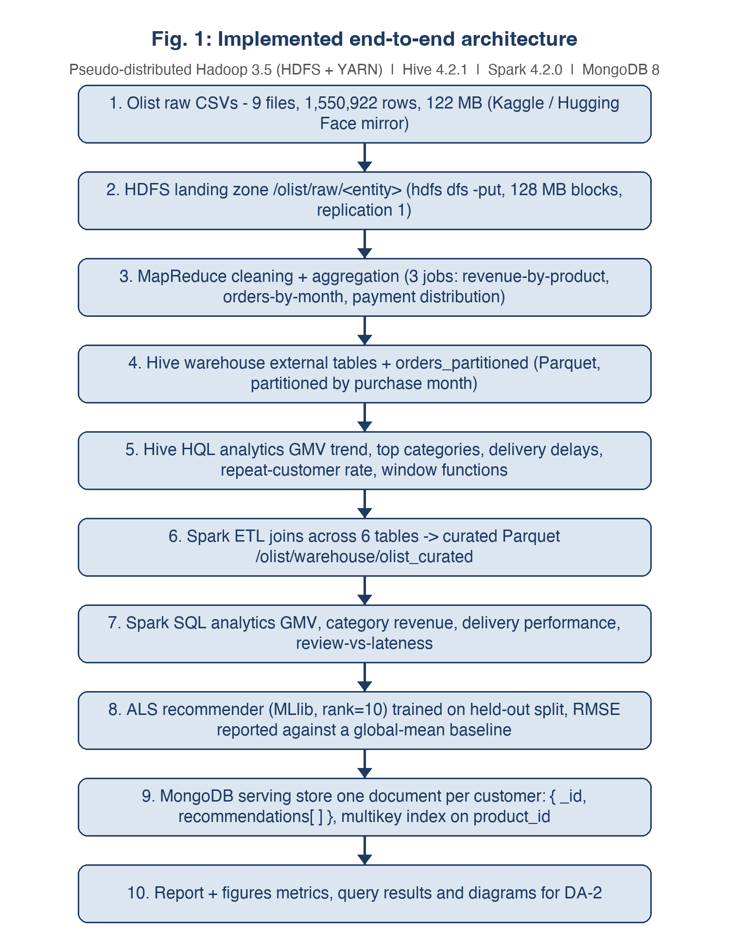
Pipeline Architecture & Stack
Stack: Hadoop 3.5.0 · Hive 4.2.1 · Spark 4.2.0 · MongoDB 8.3.11 · OpenJDK 21 · Streamlit
Raw CSVs → HDFS /olist/raw (immutable)
Clean layer /olist/clean fixes headers, newlines, quotes
MapReduce: revenue by product, orders by month, payment distribution
Hive: external tables + partitioned Parquet warehouse
Spark: curated fact table + cross-validated SQL analytics
MongoDB: recommendations + dashboard aggregates

Slide 5
MapReduce Implementation
Java Jobs
Streaming Job
RevenueByProduct: 112,650 → 32,951 records via combiner
OrdersByMonth: cleaning inside mapper, 23 monthly counts
Custom partitioner and Hadoop counters
Payment distribution in Python
Separate mapper/combiner/reducer
Outputs count, total and average per payment type

Slide 6
Hive Warehouse & Spark ETL
Hive
Spark
8 external tables over /olist/clean
Managed Parquet table partitioned by month
10 HQL analytics queries, 0 errors
Window functions and dynamic partitioning
Joins 6 tables into 112,650-row fact table
Row counts match sources exactly
6 Spark SQL analyses mirror Hive
Cross-engine validation: numbers agree exactly

Slide 7
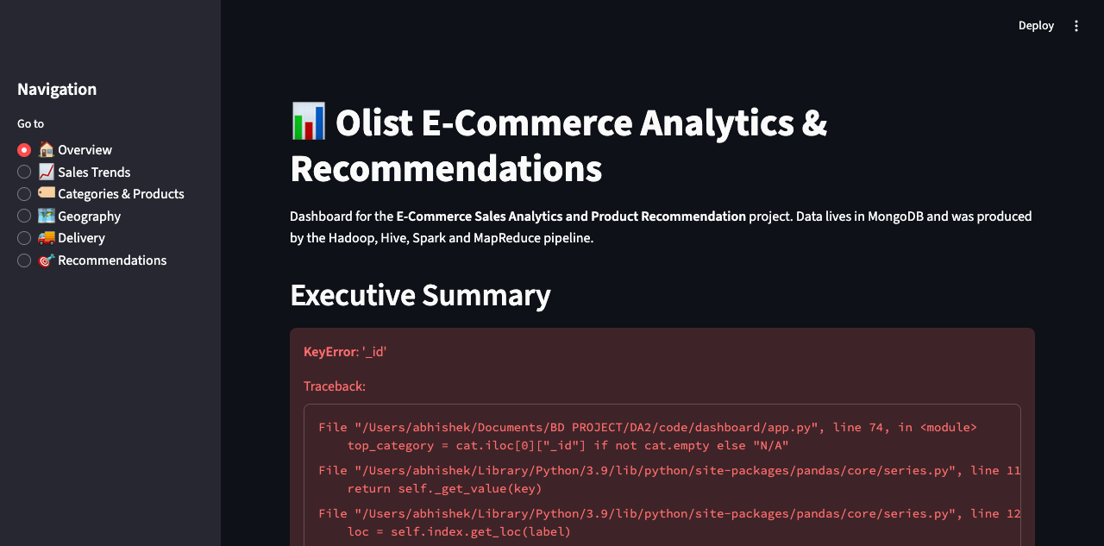
Key Business Results
Peak GMV: R$1,153,364.20 in November 2017
Top category: health_beauty with R$1,412,089.53
Top state: São Paulo (SP) with R$5,769,703.15
Credit card dominates: 76,795 transactions
Repeat customer rate: only 3.00%
On-time deliveries: 4.21★ vs late deliveries: 2.55★

Slide 8
Recommendation System
ALS experiment: documented negative result due to sparsity
ALS RMSE 0.9702 vs global-mean baseline 0.9324
DA-3 replacement: popularity + category-affinity baseline
Recommends bestsellers from categories the customer bought
Falls back to global bestsellers for cold-start users
HitRate@10 = 0.0952 | Precision@10 = 0.0095 | Recall@10 = 0.0952

Slide 9
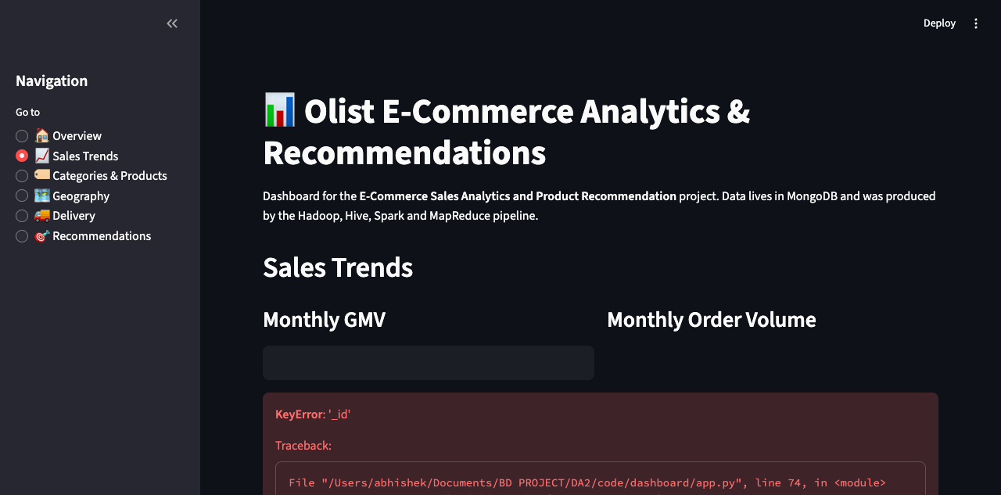
Streamlit Dashboard
Interactive dashboard over MongoDB serving layer
Views: Overview, Sales Trends, Categories, Geography, Delivery, Recommendations
Pre-computed aggregates enable fast load times
Customer recommendation lookup with model metrics
Screenshots included in DA-3 report appendix

Slide 10
Lessons Learned
Clean landing layer is essential for malformed CSVs
Cross-engine validation catches subtle definition bugs
Honest reporting of negative results improves credibility
JDK 21 requires explicit --add-opens across the stack
Document store fits recommendation lists naturally
Pre-compute dashboard aggregates in the serving layer

Slide 11
Conclusion & Future Scope
Complete batch Big Data pipeline implemented and evaluated
All DA-1 planned components delivered, including dashboard
Pipeline reproducible via code/scripts/run_all.sh
Future: Spark Structured Streaming for real-time reviews
Future: richer recommender with content/category features
Future: cloud deployment of the dashboard

Slide 12
Thank You
Questions & Discussion
K PRADEEP KUMAR (23BLC1240) · VAHRAN P (23BLC1221) · ASHVATH KUMAR (23BLC1269) · K.P ABHISHEK (23BLC1292)

