Slide 1
E-Commerce Sales Analytics & Product Recommendation
Hadoop · Hive · Spark · MongoDB · Portuguese NLP | BCSE402L DA-3
K PRADEEP KUMAR (23BLC1240) · VAHRAN P (23BLC1221) · ASHVATH KUMAR (23BLC1269) · K.P ABHISHEK (23BLC1292)

Slide 2
Problem Statement & Dataset
Domain: Brazilian Olist e-commerce marketplace
Need: Understand sales trends, geography, payments, delivery and recommendations
Challenge: ~1.07 purchases per customer makes collaborative filtering hard
Dataset: 9 CSVs, ~1.55 M rows, ~122 MB
99,441 orders, 112,650 line items, 93,358 customers
Only 3.00% of customers ever order twice

Slide 3
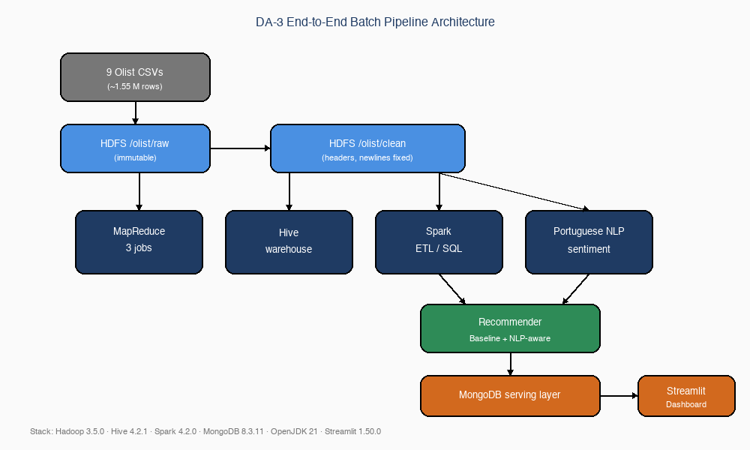
Pipeline Architecture & Stack
Stack: Hadoop 3.5.0 · Hive 4.2.1 · Spark 4.2.0 · MongoDB 8.3.11
Raw CSVs → HDFS /olist/raw (immutable)
Clean layer /olist/clean fixes headers, newlines, quotes
MapReduce: revenue by product, orders by month, payment distribution
Hive: external tables + partitioned Parquet warehouse
Spark: curated fact table + cross-validated SQL analytics
Portuguese NLP sentiment enriches the recommender
MongoDB: recommendations + dashboard aggregates

Slide 4
MapReduce Implementation
Java Jobs
Streaming Job
RevenueByProduct: 112,651 → 32,951 records via combiner
OrdersByMonth: cleaning inside mapper, 23 monthly counts
Custom partitioner and Hadoop counters
Payment distribution in Python
Separate mapper/combiner/reducer
Outputs count, total and average per payment type

Slide 5
Hive Warehouse & Spark ETL
Hive
Spark
8 external tables over /olist/clean
Managed Parquet table partitioned by month
10 HQL analytics queries, 0 errors
Window functions and dynamic partitioning
Joins 6 tables into 112,650-row fact table
Row counts match sources exactly
6 Spark SQL analyses mirror Hive
Cross-engine validation: numbers agree exactly

Slide 6
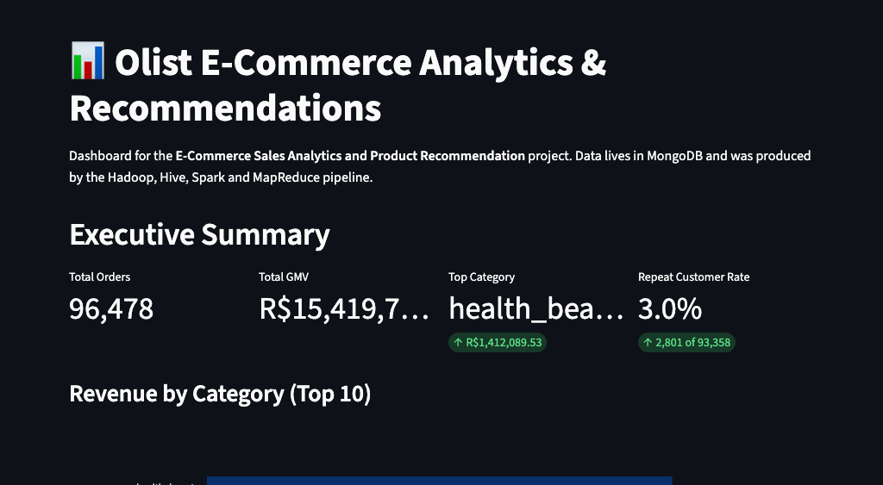
Key Business Results
Peak GMV: R$1,153,364.20 in November 2017
Top category: health_beauty with R$1,412,089.53
Top state: São Paulo (SP) with R$5,769,703.15
Credit card dominates: 76,795 transactions
Repeat customer rate: only 3.00%
On-time deliveries: 4.21★ vs late deliveries: 2.55★

Slide 7
Portuguese NLP Sentiment Pipeline
Uses real Portuguese review text (40,950 of 99,224 reviews)
Curated lexicon: 1,260 tokens (720 positive, 540 negative)
Normalisation: lower-case, accent removal, punctuation cleaning
Negation handling: 'nao gostei' flips to negative
Sentiment attributed to products weighted by revenue share per order
Product sentiment scores in [-1, 1] for 18,908 products

Slide 8
Recommendation System Comparison
Baseline: popularity + category affinity
NLP model: popularity (60%) + confidence-adjusted sentiment (40%)
Both evaluated with leave-one-out on customers with 2+ items
Baseline: HitRate@10 = 0.0621 | NLP: HitRate@10 = 0.0654
NLP improves HitRate@10 by 0.33 percentage points
Cold-start users fall back to global bestsellers

Slide 9
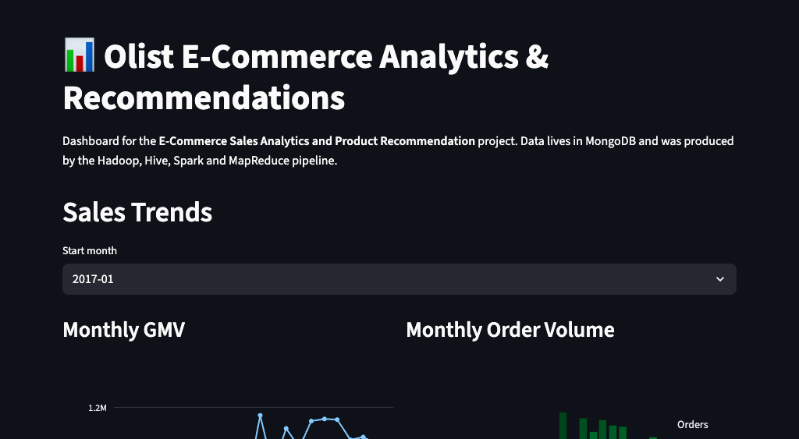
Streamlit Dashboard
Interactive dashboard over MongoDB serving layer
Views: Overview, Sales Trends, Categories, Geography, Delivery, Recommendations
Pre-computed aggregates enable fast load times
Customer recommendation lookup with model metrics
Screenshots included in DA-3 report

Slide 10
Evaluation & Limitations
Leave-one-out on 5,334 customers with 2+ delivered items
One held-out set sampled once, used for both models
Popularity, category lists and sentiment computed from training data only
Held-out order reviews excluded from sentiment
After evaluation, deployed MongoDB recommendations are rebuilt from the full dataset
Reviews are order-level → product sentiment is a proxy
Sparse data: ~1.07 purchases per customer
Same-dataset benchmark, not a time-based future estimate
Future work: time-based split, pretrained Portuguese model

Slide 11
Conclusion
Complete batch Big Data pipeline + dashboard delivered
Portuguese NLP sentiment pipeline processes real review text
NLP-aware recommender improves over popularity baseline
Pipeline reproducible via run_project.sh
Future: pretrained Portuguese/multilingual sentiment model
Future: Spark Structured Streaming for real-time reviews

Slide 12
References & Thank You
Olist. Brazilian E-Commerce Public Dataset by Olist, v6. Kaggle, 2018.
Apache Hadoop 3.5.0, Hive 4.2.1, Spark 4.2.0 documentation.
MongoDB Community Server 8.3.11 manual.
Streamlit 1.50.0 documentation.
Questions & Discussion
K PRADEEP KUMAR (23BLC1240) · VAHRAN P (23BLC1221) · ASHVATH KUMAR (23BLC1269) · K.P ABHISHEK (23BLC1292)

