Slide 1



Category review: Chips
June 2020
Retail Analytics

Slide 2
Notes:
To view Privacy video explaining how important data privacy is to Quantium, please click here: https://www.youtube.com/watch?v=Zq1QDAkoRzU
or here Q:\Company Reference\Brand & Design\Brand videos\Q Privacy.mp4
At Quantium, we believe that data is the behavioural footprint of humanity and that it has to be treated with the utmost care and responsibility.
Histories, attitudes, indeed lives are stored within it in ways that aren’t always apparent – and that’s what makes its potential so powerful.
To work with it responsibly, sensitively, we set ourselves the highest data privacy protection and governance standards.
We have spent 17 years perfecting privacy-by-design and secure-by-design principles. Central to this is not holding any personally identifiable information about people –
we neither receive it, and put the necessary protections in place to be unable to decipher it.
Every aspect of handling data is safeguarded: from its de-identification, to its encryption – data security is paramount and of the highest grade.
We pride ourselves on gaining the trust of iconic organisations around the world through years of securely working with their data,
and in turn the trust that builds with their stakeholders.

Slide 3
Executive summary
01
Task 1
Here we cleared data with very deep understanding of data set removed outliers and items that are not about chips
02
Task 2
Here for you I have divided dataset in four groups with machine to understand market better

Slide 4
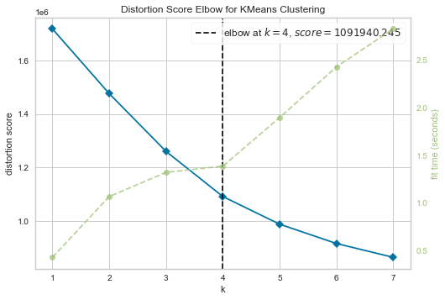
For better understanding of market we have divided data in 4 groups with k means algorithm

Slide 5
01
Category

Slide 6
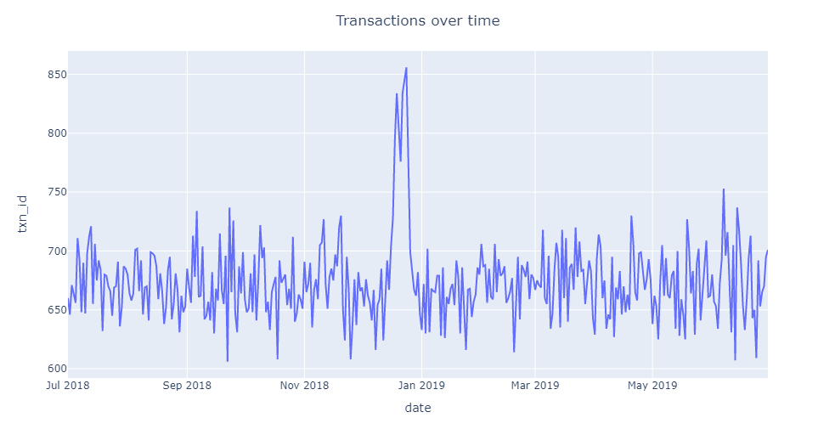
Clearly we can observe the sales through out the year

Slide 7
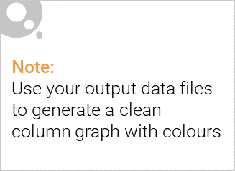
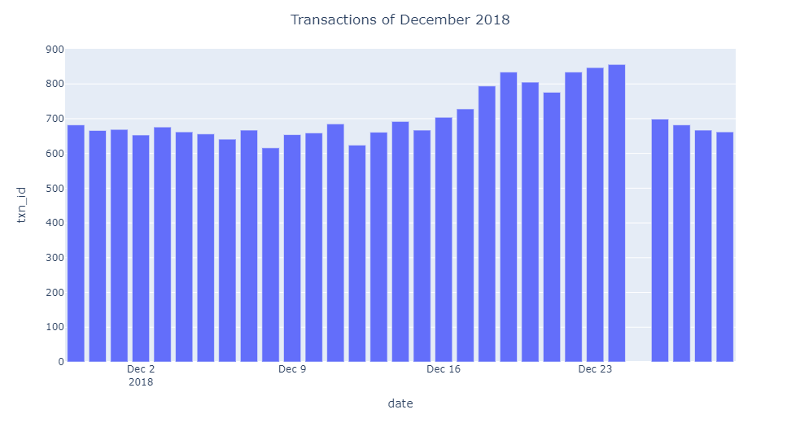
In last slide we realized sales where high in 12th month

Slide 8
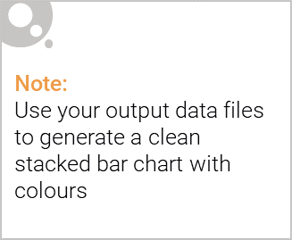
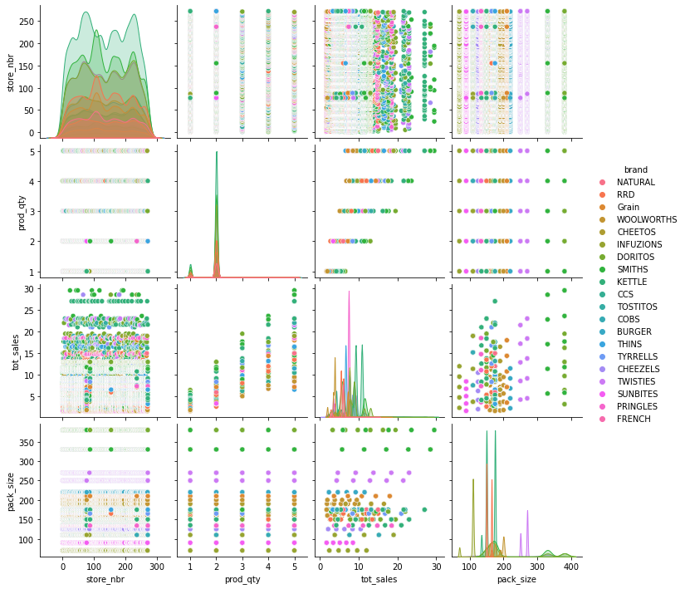
Editable (delete this)

Slide 9
02
Trial store performance

Slide 10
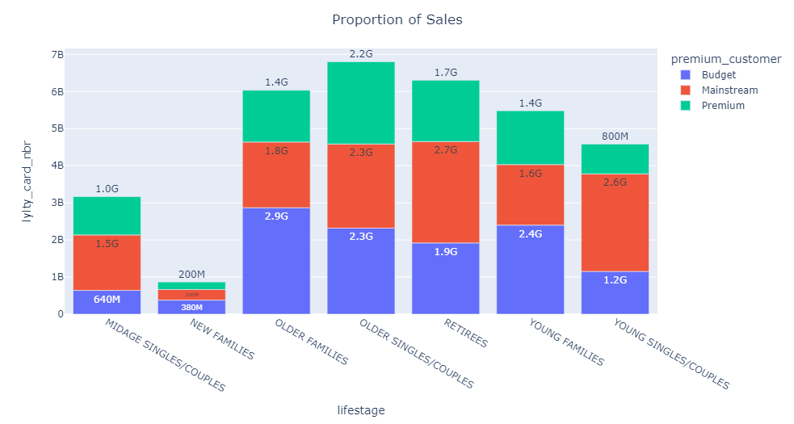
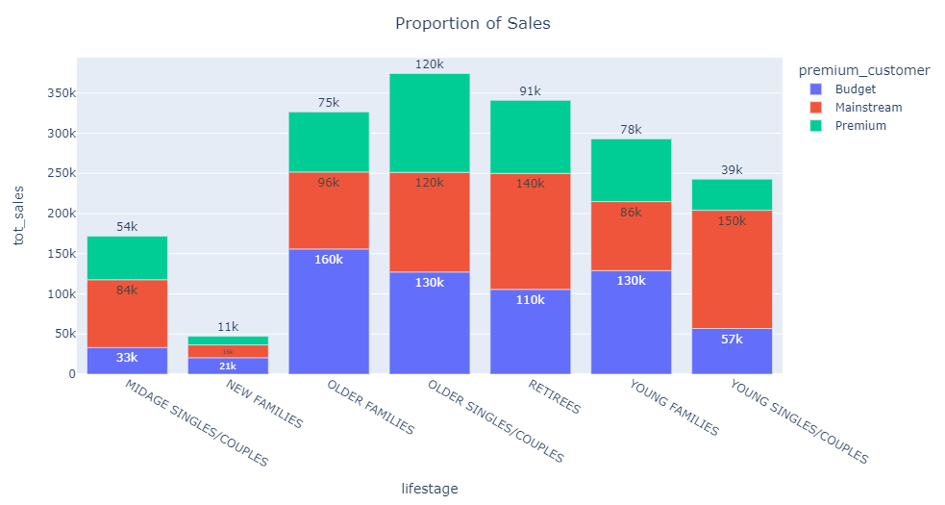

Slide 11
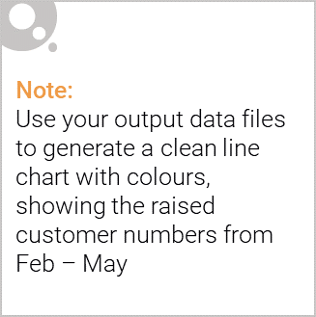
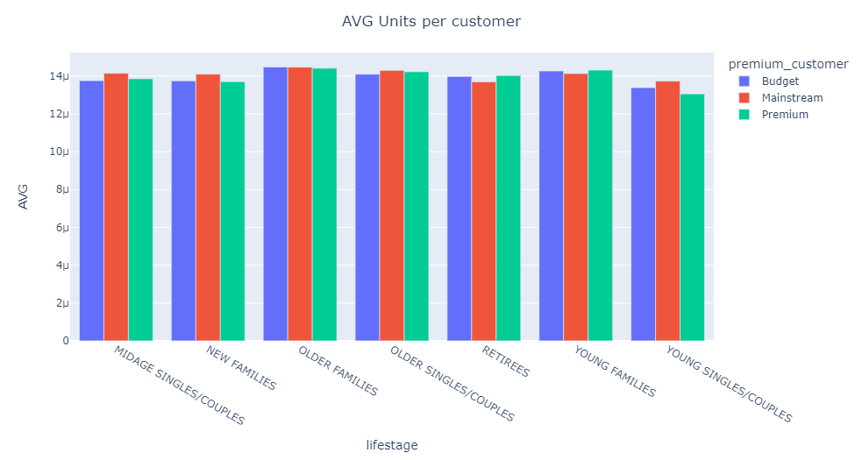
Average unit per customer

Slide 12
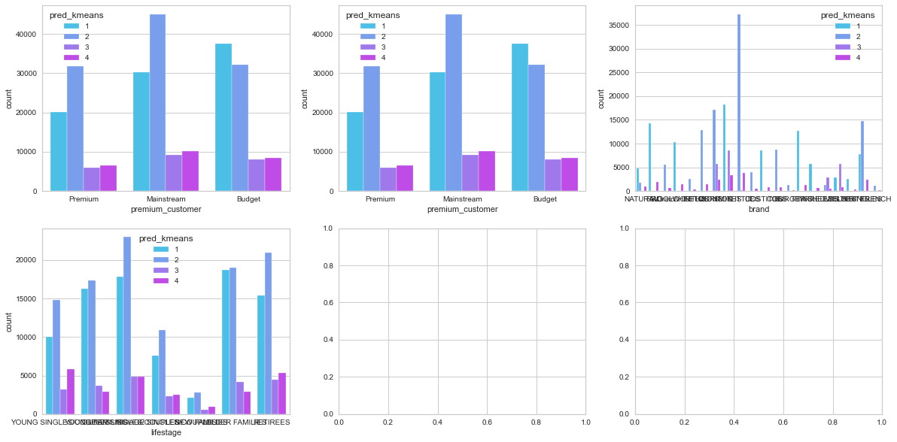
The analysis of market

Slide 13
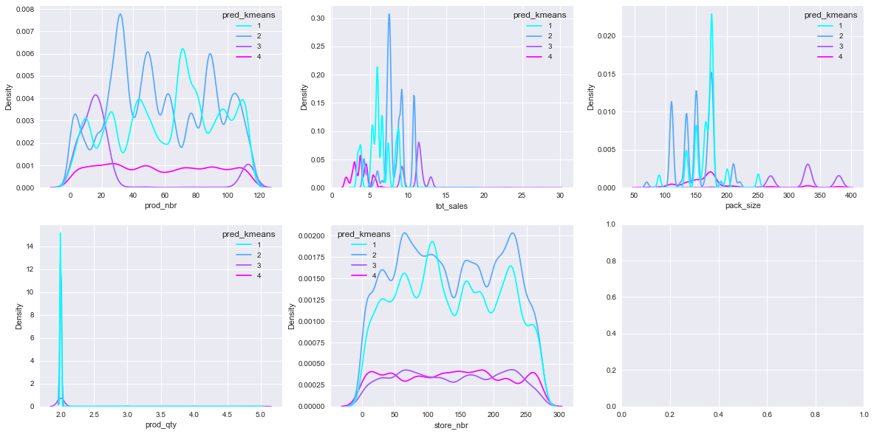
Analysis of numbers

