Slide 1


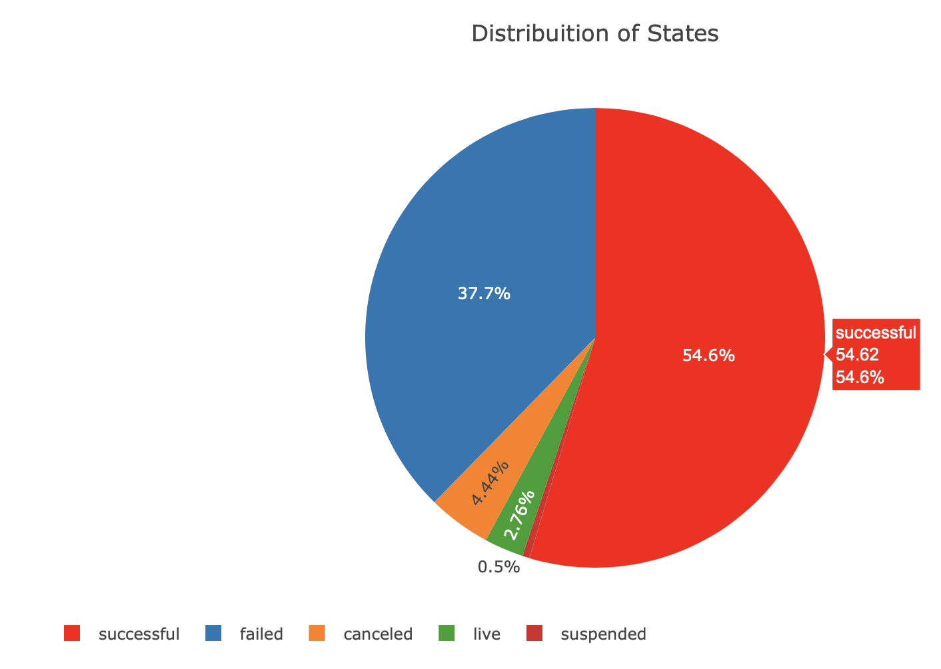
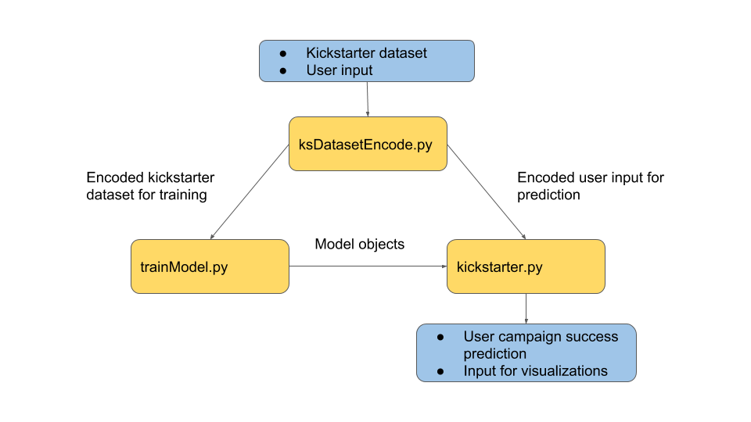
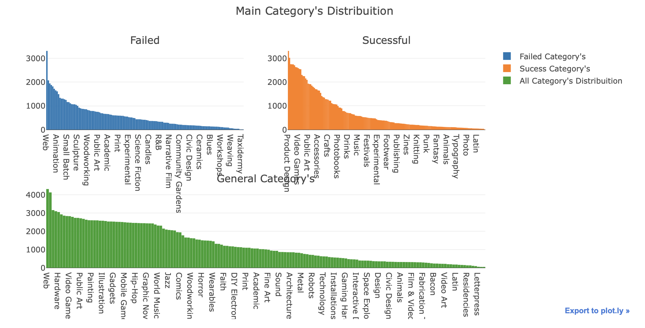
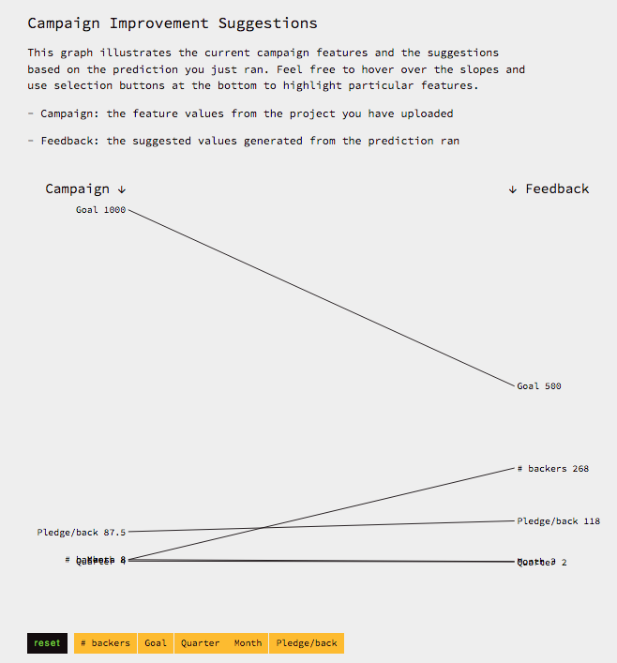
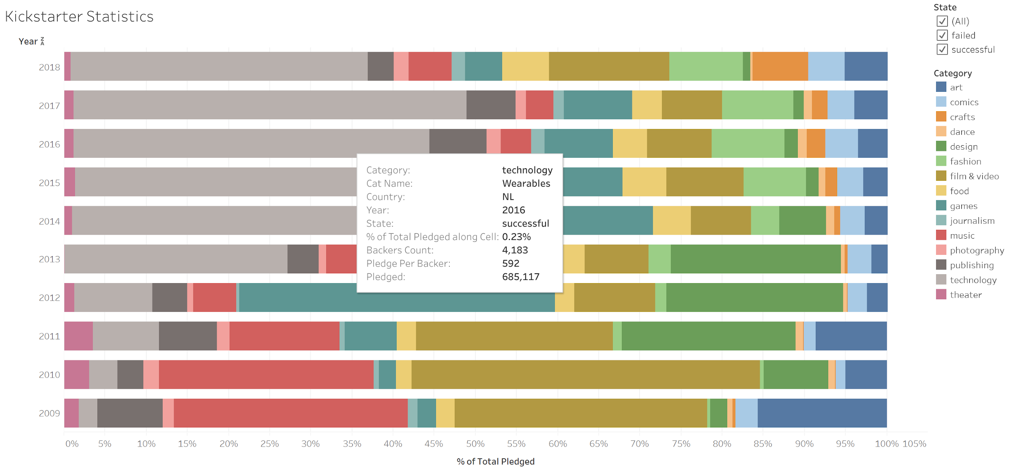
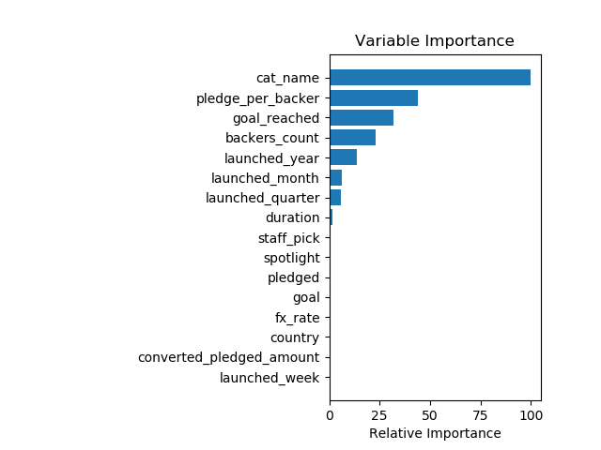
DETERMINING KICKSTARTER PROJECT SUCCESS
Team #48
Tim Dufala tdufala3 | Bui Thi Thu Giang gbui8 | Rashmi Raju rraju6 | Abhishek Surya asurya6 | Fernanda Tello mtello3
Summary
As of today more than 50% of the launched projects on Kickstarter fail to meet their funding goals. We wanted to know what factors make a Kickstarter project successful. Kickstarter Project Success Predictor is a web-based tool that uses predictive machine learning under the hood to highlight influential factors in a project campaign’s success via interactive visualizations.
Model Building & Prediction
Tools/Libraries: Python ScikitLearn (model building and training), Pandas and Numpy (dataframe manipulation), Pickle (data persistence for i/o transfer), Matplotlib (generate an image of most important features)
Models:
Logistic Regression | Random Forest Classifier | Gradient Boosting Machine | KMeans Clustering
L2 ridge regression: avoids overfit and considers all features LIBLINEAR: classifies large data quickly Test Accuracy: 96% Result: Not used for prediction. Random forest provides higher accuracy | 20 estimators: largest amount to avoid overfitting Cross Validation 10 folds Test Accuracy: 98% Result: used to predict success of campaign | Tried variations of depth and # estimators Test Accuracy:100% Result: not used due to risk of overfitting | 50 buckets: trains fairly evenly distributed values for ‘backers_count’, ‘goal’, and ‘pledge_per_backer’ features Result: average values provide thresholds and ultimately, suggestions to drive visual#2
Approach
Our application allows users to upload data about their project and receive analysis and visualizations back. which can predict and suggest ways in which Kickstarter project can be improved. This will be successful because it will help the project creators focus on the weak variables to improve them.
Dataset
The Dataset used for machine learning prediction model and statistical visualization has been downloaded (18 October 2018) from webrobots.io. Web Robots scrapes Kickstarter data once-a-month. The raw dataset (~ 1 GB) was cleaned up by removing empty columns and rows. Size of dataset after data cleanup is (~ 23 MB) having in-total 186,337 project records.
Approach: Overall Backend Model Building flow
Evaluation Results
Prediction model gives overall ‘Success’/’Failure’ verdict for the provided project data. Output includes suggested feature values
Statistical evaluation of dataset
A – Distribution of Categories across successful and failed projects
B – Distribution of all project states
Visualizations
Besides the overall prediction result, an interactive visualization (B) in the form of slope-graph is provided to show comparison between existing feature data and recommended feature parameters for project success.
Statistical evaluation & Visualization
We did a thorough evaluation of the dataset to generate an interactive horizontal bar chart in Tableau to give an overview of the Kickstarter project data.
A
B
Visualizations
left – Relative feature importance of given Kickstarter project using Python Matplotlib library
right – Campaign feedback for improvement using D3.js
Visualization#1 – Interactive statistical overview of Kickstarter projects using Tableau
(sources – webrobots dataset)
Conclusion
Our product makes use of the best of both worlds: Visualization and Data Analytics to provide an enhanced UX. It takes advantage of the dataset statistics with improved visualization driven by the campaign success/failure prediction using the Random Forest with prediction of ~98% (greater than 85% we initially aimed) and KMeans Clustering. Furthermore, our diverse set of visualizations allows the user to understand their campaign success in various dimensions. Our application will be further validated with usability, unit and regression testing combined to cover frontend, backend, and model capabilities.
Min values | Mean values | Median values | Max values
goal 0 pledged 0 pledge_per_backer 0 duration 1 backers_count 1 | goal 45633 pledged 13600 pledge_per_backer 89 duration 34 backers_count 144 | goal 5000 pledged 1530 pledge_per_backer 46 duration 30 backers_count 26 | goal 100000000 pledged 23343872 pledge_per_backer 356374 duration 91 backers_count 105857

