Slide 1

GLA University Mathura
Department of computer engineering and applications
Manufacturer Rating Prediction System
Presented By:-
Abhishek Yadav
Nikunj Khandelwal
Supervised By:-
Mr. Ashutosh Shankadhar

Slide 2
Overview of the presentation
Outline of this project
Hardware and Software requirements
Dataset Required
Method Used
Analysis of dataset
Results

Slide 3
Overview of the Project
Nowadays , manufacturers are completely dependent on the rating of their products if there product is good they will have huge profit otherwise they have to close their business. In this project we are predicting the rating of the manufacturers items so that manufactures can know what is the rating of their product in nowadays scenario .

Slide 4
Hardware and Software Required
Hardware Requirements
Processor –Intel I5/ AMD Ryzen 5
Operating System – Windows 8/10 , Linux or Mac OS
RAM – 4GB(Minimum)
HDD – 64GB
A PC having all above configuration
Software Requirements
Jupyter Notebook /Google Collaboratory
MS Excel (For dataset)

Slide 5
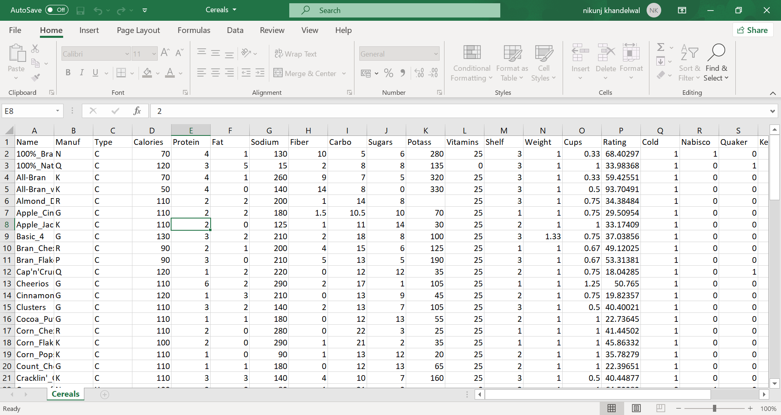
Dataset Required

Slide 6
Method Used
For Predicting the rating we have used K-means Clustering Algorithm.
It is a very powerful machine learning Algorithm and is used to predict the output using clusters.
It is widely used in data mining
We have used matplotlib to plot the graphs and histogram to predict the rating

Slide 7
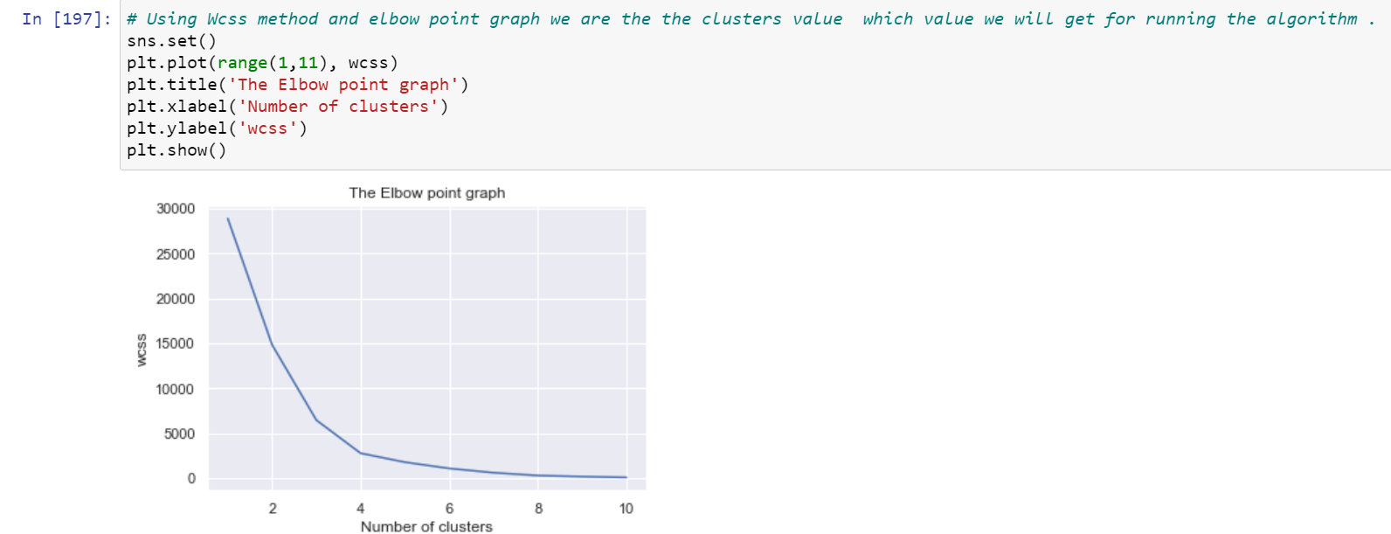
Analysis of Data Set
Choosing the number of clusters using elbow graph below

Slide 8
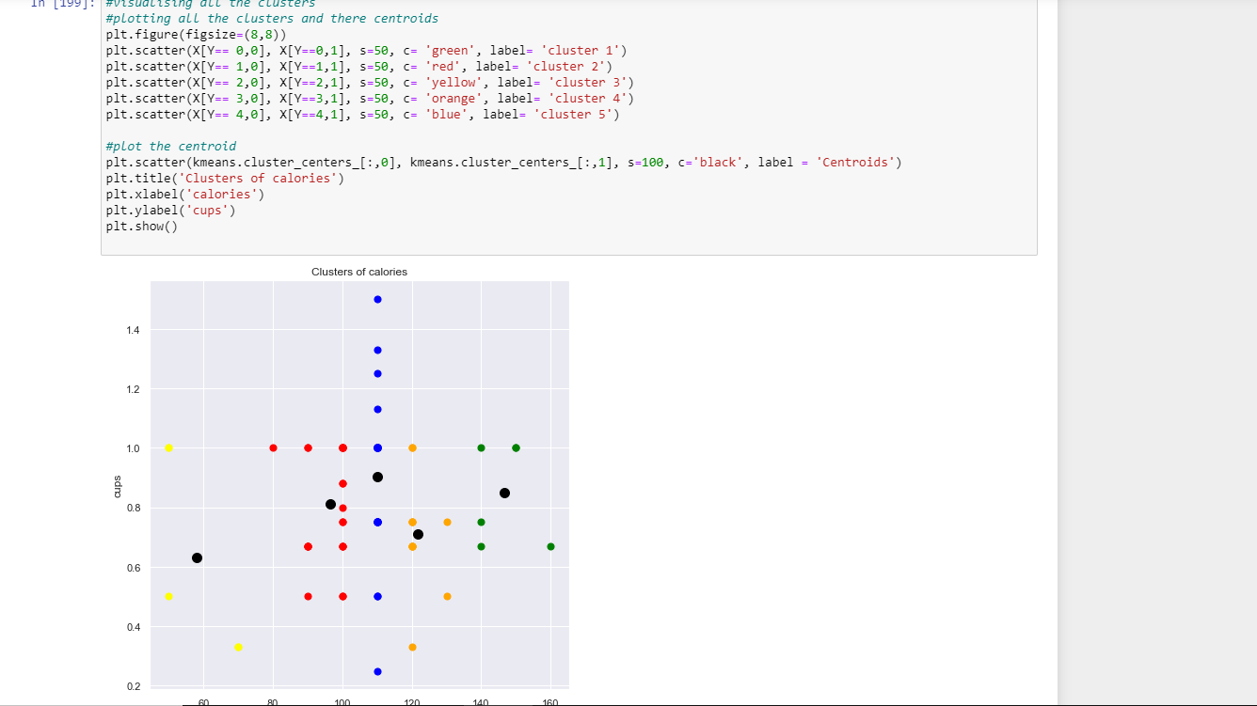
So from above graph we got two clusters K=3 and k=5 .
Now we are visualizing the data with K=5 value.

Slide 9
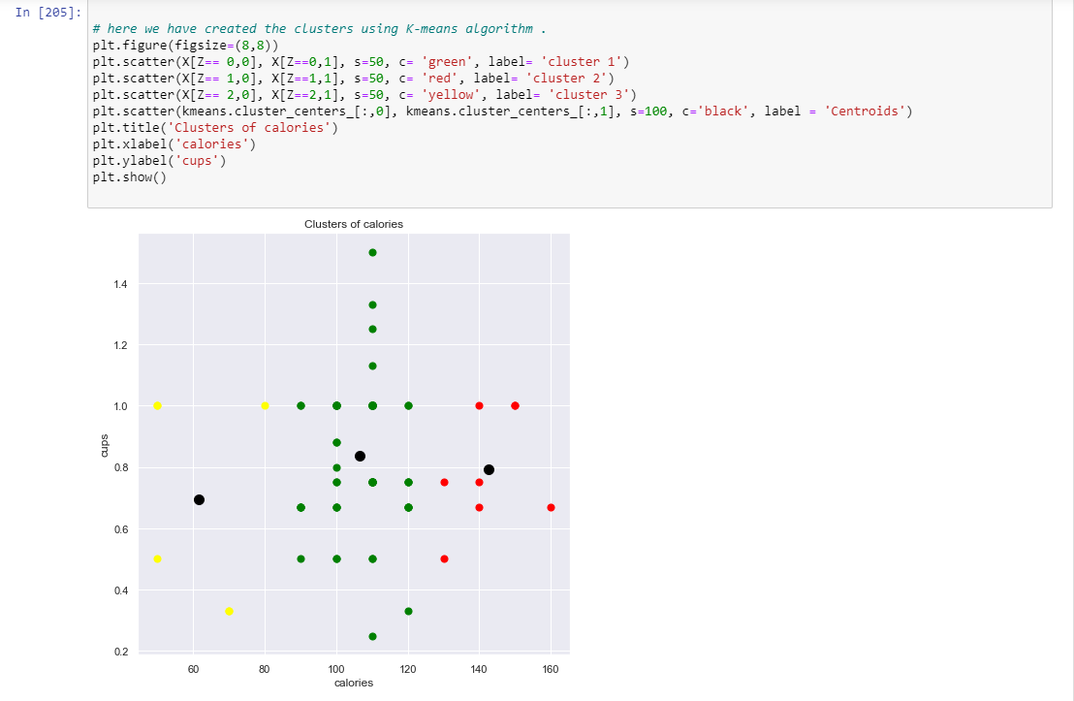
Now we are visualizing the data with K=3 value.

Slide 10
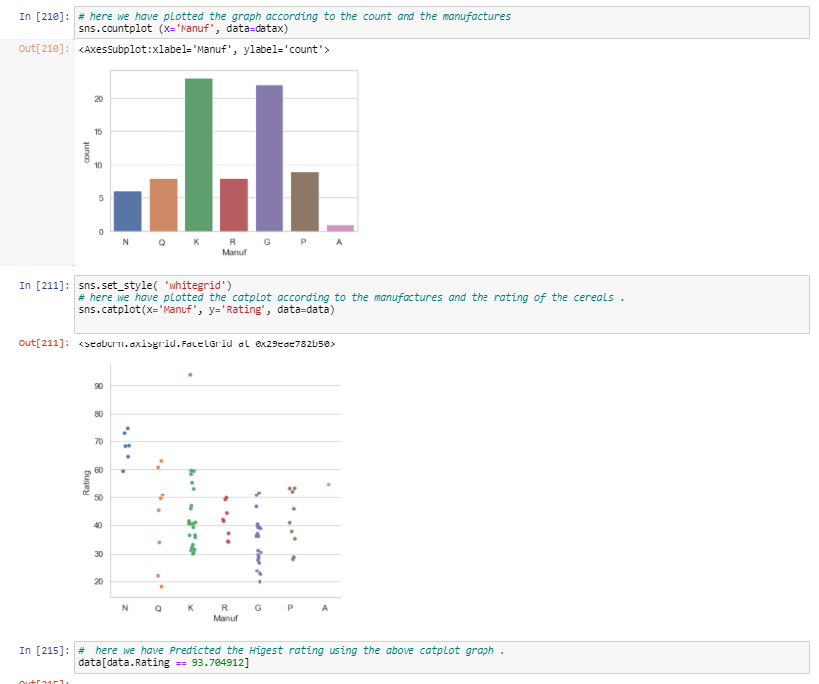
Now we have drawn the histogram to predict the highest rating.

Slide 11
Results
From above histogram we predicted the highest rating of the cereals and got the ouput of 93 .
THANKYOU

