Slide 1

VIBIN
Presented By:
Kinjal Varshney
Karan Chaurasia
Suraj Mishra
Abhishek Yadav
Sani Chaturvedi
Free Powerpoint Templates

Slide 2
OUTLINE
About the Project
Objective
Requirements
Snapshots from the website

Slide 3
ABOUT THE PROJECT
Social media is an digital application that allows the user to create and share information’s, ideas, careers etc., with each other. We can say social media is an online communication and information sharing platform. This sharing is done through virtual communities and networks.
Many individuals uses social network to be in touch with friends and family. To interact with them to share their memories and so on.
Similarly various fields use social media according to their required necessity, So, we thought of developing a application which allow users to post interesting events that happened in their lives. Adding to its feature, some of the recent Posts will pop-up onto the home page.
Moreover, this application can be used by anyone who is interested in sharing their recent happening in their life with people all around the world.

Slide 4
OBJECTIVE
The purpose of this project is to develop Online Social Media Application. The main purpose of this Online Social Media App project is to allow users to post interesting events that happened in their lives.
Motivation: we wanted to build an app which allows you to reach people locally, regionally, nationally and even internationally. To provide a platform where people can connect with other people around the world to share their thoughts and get to know other cultures around the world.

Slide 5
REQUIREMENTS
Software Specification Used:-
Technology implemented: MERN
Database: MongoDB Cluster
User Interface Design: React
IDE Used: Visual Studio Code
Web Browser: Google Browser

Slide 6
Hardware Specification Used:-
Processor Used: Intel 5
Operating System: Window 10
RAM: 16 GB
Hardware Devices: Computer System
Hard Disk: 512 GB

Slide 7
THIS IS HOW OUR WEBSITE LOOKS

Slide 8
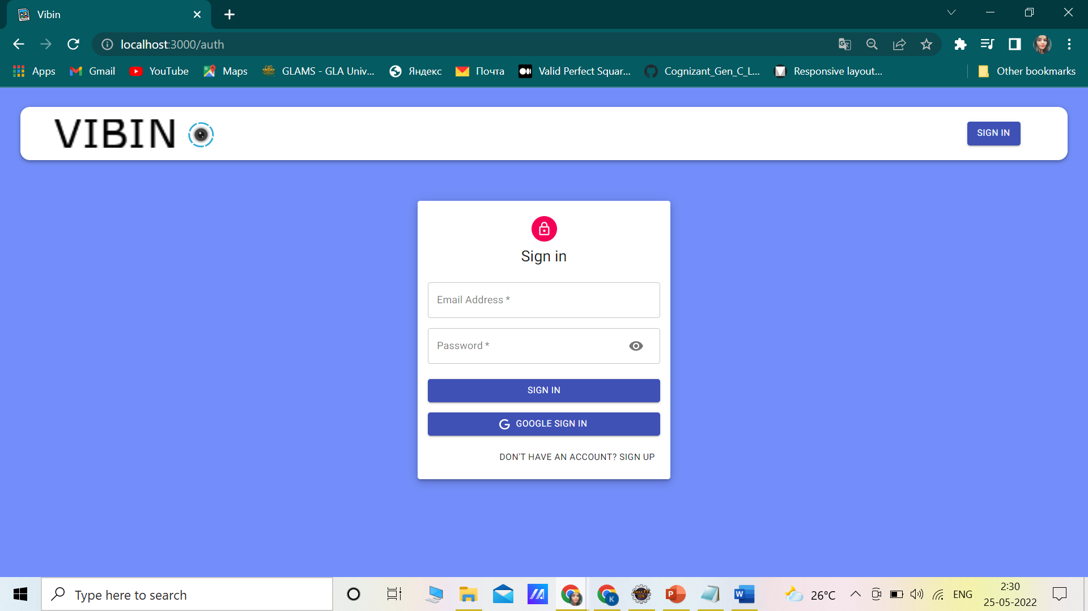
Log-in/ Sign-up

Slide 9
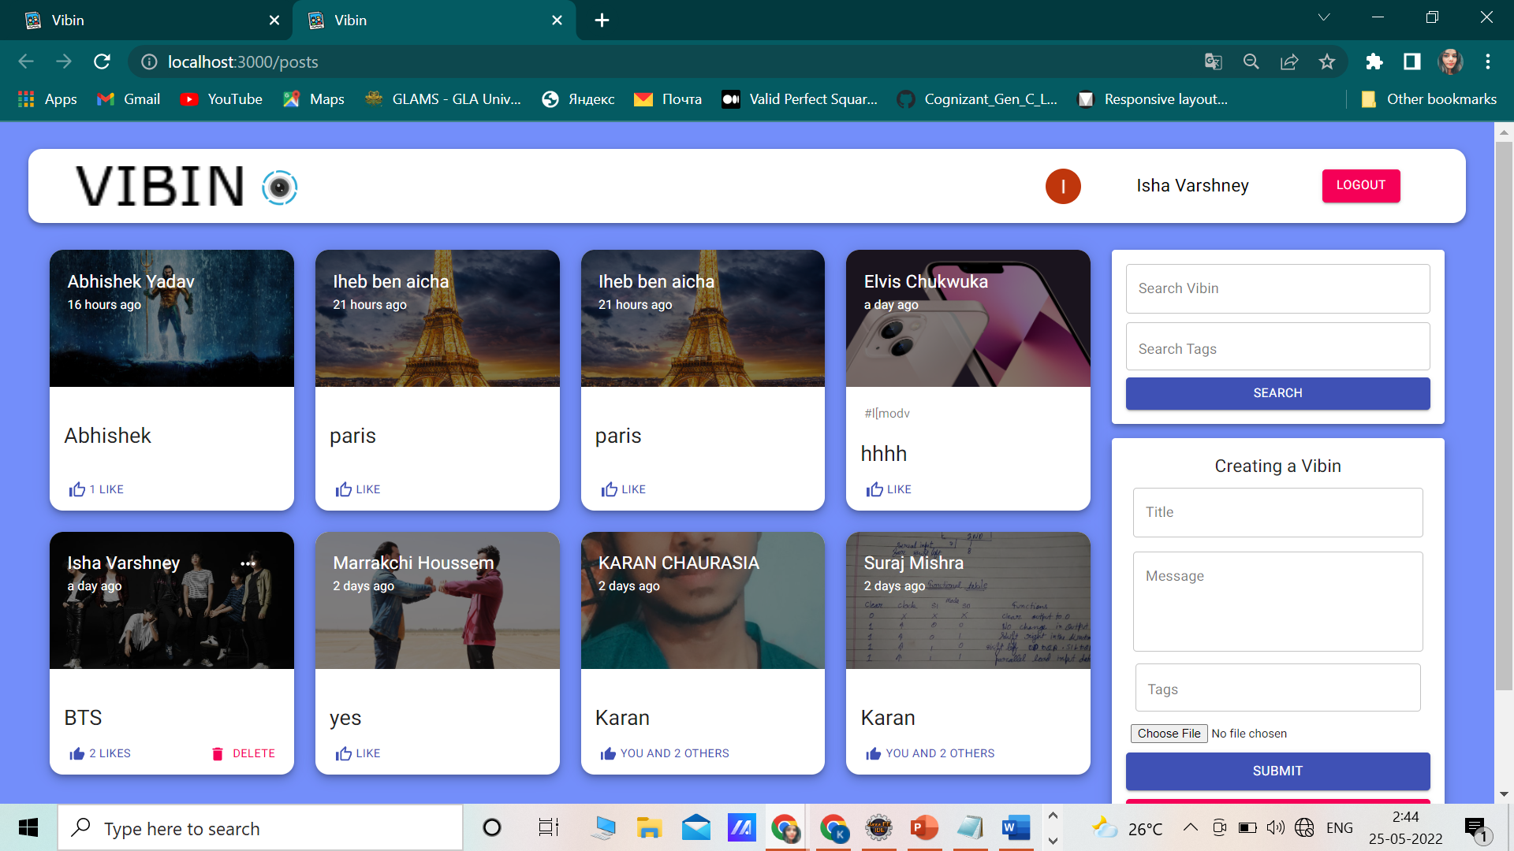
Home Page

Slide 10
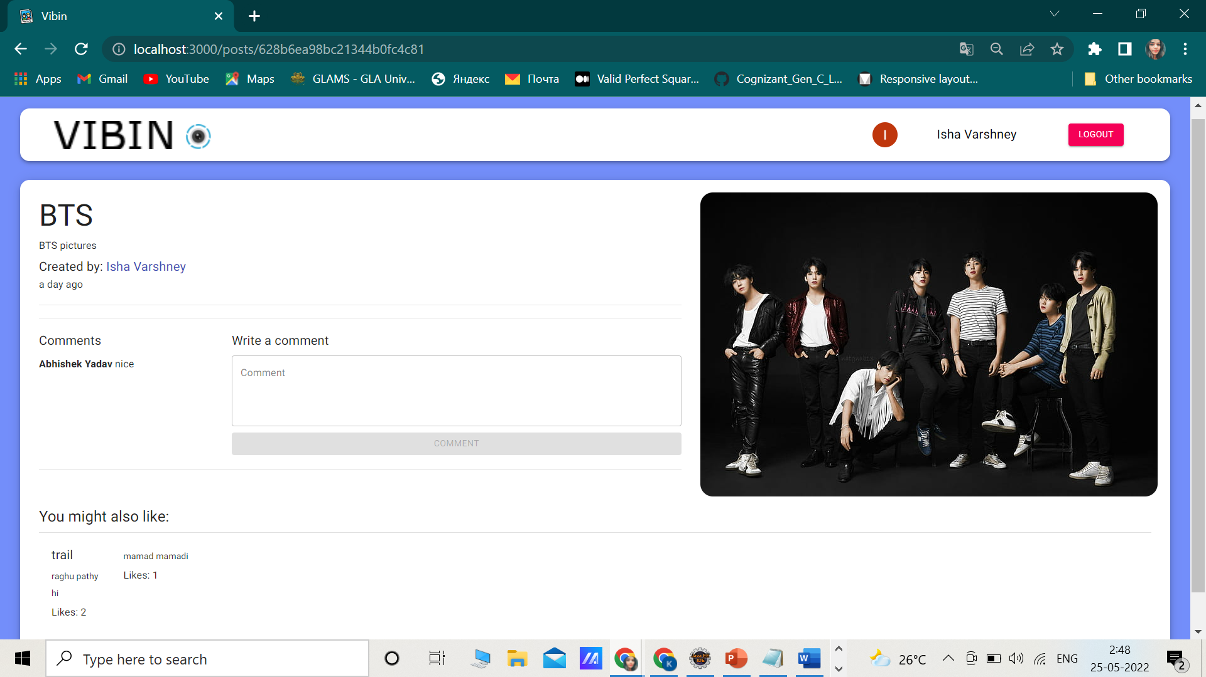
Profile Post Section

Slide 11
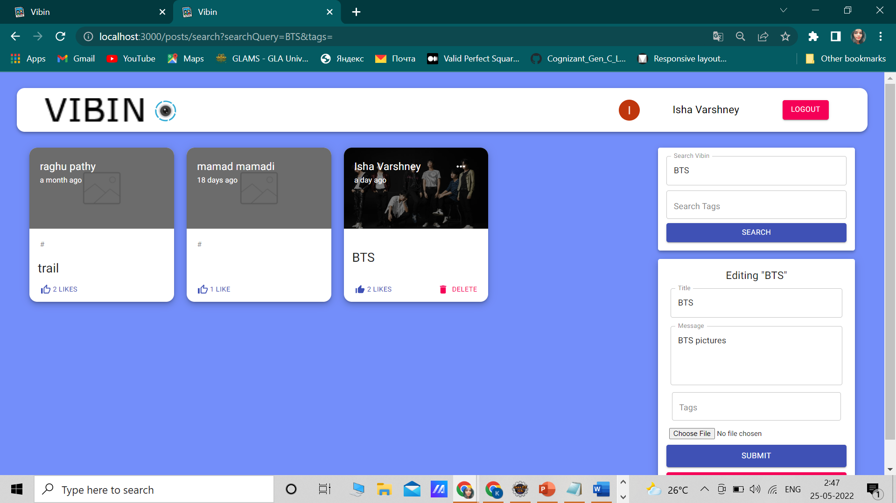
Editing Post

Slide 12
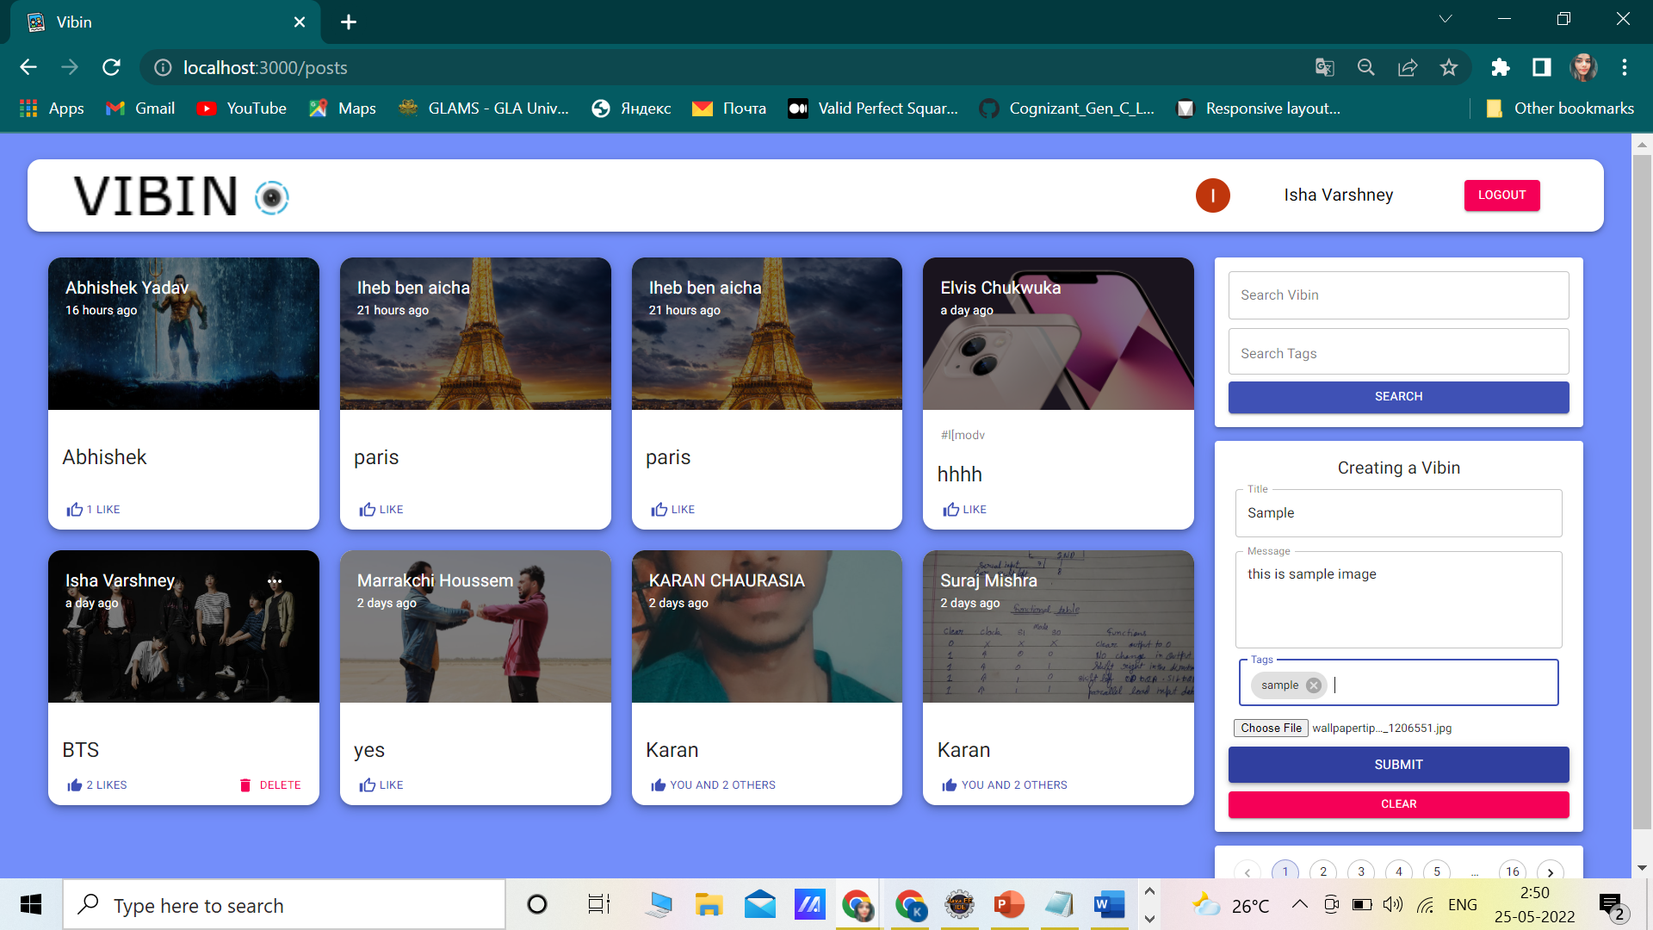
Create Section

Slide 13
CONCLUSION
The project has been developed using NodeJS and ExpressJS as Backend and MongoDB as Database and React for the Front- end work. The user is provided with a database where the information is stored and can be retrieved any time when required. Security is maintained for the system, there is a User Mail and Password for an authorized person only that person can access the data in the system.

Slide 14
THANK YOU!

