Slide 1

Presentation on EDA Project
Playbook Patterns: A Data-Driven Analysis of Run vs. Pass in the NFL
Team Details
Team No. | Team D9
Sl. No. | Name | SRN.
1 | Shrushti Hulbutte | 02FE23BCI034
2 | Bhagyavathi Shetty | 02FE23BCI023
3 | Arun Kumar Mokashi | 02FE23BCI057
4 | Abhishek Timmanagoudar | 02FE23BCI024
KLE Technological University, Belagavi campus

Slide 2
Agenda
Introduction
Problem Statement
Objectives
Literature Survey
Methodology
Results and Discussion
Conclusion
References
KLE Technological University, Belagavi campus

Slide 3
Introduction
Predicting NFL Offensive Play Types
Accurately forecasting whether a play will be a run or pass gives defenses a strategic edge. Early research used game theory and decision analysis to identify key play-calling factors. The evolving role of tight ends, who both block and receive, added complexity to offensive strategies. With the rise of machine learning, models like logistic regression and random forests improved prediction accuracy. However, challenges like overfitting highlighted the need for more robust, interpretable models. Booz Allen’s ensemble approach, using richer features, led to better results on unseen data. Our work, using the NFL Big Data Bowl 2025 dataset, focuses on building interpretable, real-time models using key features like down, yardage, time, formation, and team identity—bridging the gap between data and sideline decision-making.
KLE Technological University, Belagavi campus

Slide 4
Problem Statement
The NFL Big Data Bowl 2025 challenges participants to analyze pre-snap player tracking data to uncover actionable insights into team and player tendencies before the ball is snapped. Rather than predicting play outcomes, the focus is on understanding behaviors and decision-making patterns based on formation, player positioning, and motion. Participants are expected to develop interpretable and practical models that can help coaches and analysts anticipate play types or player roles in real time. The ultimate goal is to translate complex tracking data into insights that can directly support sideline strategy and enhance football decision-making.
KLE Technological University, Belagavi campus

Slide 5
Analyze pre-snap tracking data to study player alignment and motion.
Identify team and player tendencies before the play starts.
Build interpretable models useful for coaches and analysts.
Generate actionable insights to aid real-time in-game decisions.
Support coaching, play-calling, and strategy adjustments.
Promote innovation in sports analytics using machine learning.
Objectives
KLE Technological University, Belagavi campus

Slide 6
Literature Survey
Early machine learning models (e.g., logistic regression, decision trees) predicted offensiveplay types using features like game state, average yards, and play history—proving interpretable models aid coaching decisions [6].
McGarrity and Linnen analyzed quarterback injury scenarios and found teams use mixed-strategy playcalling, aligning with game theory rather than optimization expectations [7].
Broader research supports minimax strategies in sports like football and tennis, showing rational strategic behavior in real-world playcalling [8].
KLE Technological University, Belagavi campus

Slide 7
Literature Survey
Studies using clustering, factor analysis, and SVMs identified key traits of championship teams, emphasizing metrics like defensive strength and 3rd down conversion rates [9]
Other works proposed using machine learning to simulate play outcomes (e.g., yards gained, binary success, progress score)—highlighting the value of real-time decision support tools for coaches [10].
Bajaj and Sandwar (2025) applied pre-snap tracking data to predict man vs. zone coverage, showing that defensive positioning reveals play intent [11].
KLE Technological University, Belagavi campus

Slide 8
Methodology
Data Collection & Understanding
Data Preprocessing
Feature Selection
Model Building
Interpretability & Visualization
Evaluation Metrics
KLE Technological University, Belagavi campus

Slide 9
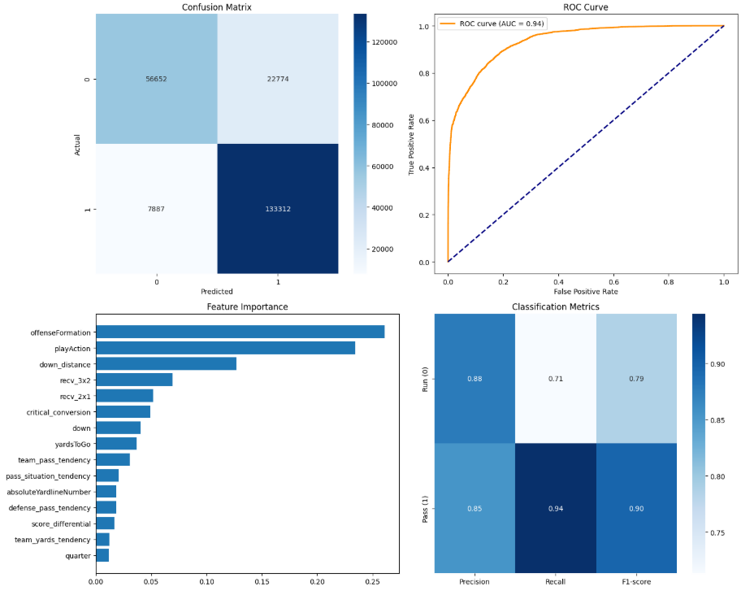
Results and Discussion
KLE Technological University, Belagavi campus

Slide 10
Results and Discussion
Model | Mean Accuracy | Standard Deviation | Remarks
Regularized Random Forest | 86.10% | 0.0006 | High accuracy, reduced overfitting, strong consistency
Logistic Regression | 79.25% | 0.0006 | Interpretable, but struggles with non-linear patterns
Ensemble Method | 83.63% | 0.0006 | Balanced performance leveraging multiple model strengths
KLE Technological University, Belagavi campus

Slide 11
Conclusion
This research illustrates an important improvement in football analytics by utilizing a Regularized RF model that attains 86.10% cross-validation accuracy. By strictly using bottom-up pre-snap features and adding regularization to prevent overfitting, the method provides both robustness and interpretability. By including comprehensive tracking data example: receiver separation and player location—the method is especially useful for enhancing the accuracy of pass play predictions. Ongoing model refreshes also enable adjustment to changing team strategies, keeping the model up to date during the season. Through the implementation of powerful algorithms such as XGBoost and real-time deployment on sideline tablets or servers, this solution provides quick, in-game information that can assist coaches with making tactical decisions in real time. Overall, the findings underscore the increasing influence of machine learning in the NFL in accordance with the primary objectives of the NFL Big Data Bowl by merging innovation, precision, and usable insights into real-game scenarios .
KLE Technological University, Belagavi campus

Slide 12
References
Alamar, B. (2013). Sports Analytics: A Guide for Coaches, Managers, and Other Decision Makers. Columbia University Press.
Alamar & Weinstein-Gould (2008). Effect of Linemen on Passing Game. J. Quant. Anal. Sports, 4(2).
Burton & Dickey (2015). NFL Play Predictions. Joint Statistical Meeting.
Lee, Chen & Lakshman (2016). Predicting Offensive Play Types. Stanford Univ. Paper
Fernandes et al. (2020). Predicting NFL Plays. J. Sports Analytics, 6(1), 35–43.
Lutz, Kassarnig & Teich. NFL Play Prediction Repo. GitHub
Mulholland & Jensen (2014). Predicting Tight End Success. J. Quant. Anal. Sports, 10(4).
McGarrity & Linnen (2010). Pass or Run: Matching Pennies Game. Southern Economic J., 76(3).
Fokoue & Foehrenbach (2013). Factors of Championship Teams.
Lutz, Kassarnig & Teich. NFL Play Prediction Repo. GitHub
Bajaj & Sandwar (2025). Exposing Coverage Tells. NFL Big Data Bowl Submission. Kaggle
KLE Technological University, Belagavi campus

Slide 13
THANK YOU !
KLE Technological University, Belagavi campus

