Slide 1

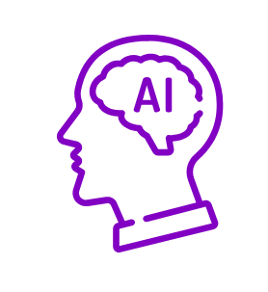
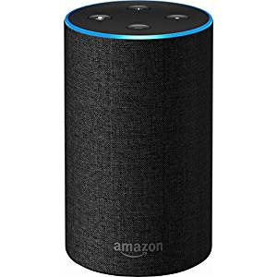
HereToHear
Team WeUseTabs

Slide 2
“Mental pain is less dramatic than physical pain, but it is more common and also harder to bear.”
--- C.S. Lewis

Slide 3
DEPRESSION STATISTICS
According to a WHO report, 6.9% of the Indian population suffers from depression and other forms of mental illness.
The average suicide rate in India is 10.9 for every 1 lakh people.

Slide 4
FEATURES:
Mood evaluation by a empathetic Alexa Bot.
Suicidal intention detection and prevention attempt.
Location-based therapy recommendations.
Suggestions for small activities to improve the user’s mood.
Displays informative cards in Alexa app.

Slide 5
CHALLENGES
People rarely acknowledge that they are in depression.
They are afraid to admit being “mentally ill” for fear of society calling them “freaks”.
Mental Health is not a field that is well advertised.
People do not know how to deal with it.

Slide 6
WORKFLOW
Alexa skill activate if
It recives too much
Negative input from
User.
Alexa asks the person
Questions to cheer him
up.
Will encourage the
Person to do activities
Which people in
Depression tend to
avoid
If found depressed then
Will suggest ways to
Handle depression.
Will do sentiment
Analysis of person’s
Social media accounts
In background

Slide 7
TECHNOLOGY STACK
Fronted : Amazon Alexa
Backend :
  Alexa Skills Kit
  Flask-Ask
  Python
3) External API: Google Maps API
4) Infrastructure:
1) Amazon API Gateway
2) AWS Lambda

Slide 8
BUSINESS MODEL
New product idea. Therefore, no competition in market.
Amazon Echo is getting more popular everyday, which means the product can reach a majority of the Indian population.
As more and more people get educated, the need for curing depression will be realised and this product will gain popularity.

Slide 9
FUTURE SCOPE
This product can be developed into an API to be used with other Home Assistants.
Presently, Amazon itself is working on multi-user recognition through Alexa AI. So in the not-so-distant future, this alexa skill will be able to understand memebers of the person’s family.

