Slide 1
GAAD Hackathon
Project Name: Next Gen Accessibility
Team Name: ADA Ninjas

Slide 2
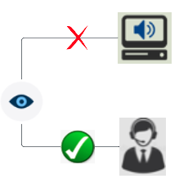
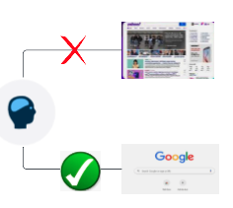
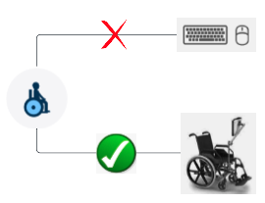

Why Next Gen Accessibility
Challenging: Even the fully compliant WCAG 2.2 websites/apps with AAA compliance levels can be challenging to consume for the people with disabilities.
One Size Doesn’t Fit All: It is unfair to ask people with disabilities to consume a website/app that is not tailor made for them.
A blind person will generally prefer to call in rather than using screen readers
A person with learning disability will prefer minimalistic layout and plain language
A person with motor disability will prefer websites that work better with assistive technologies
The Need of the Hour → Websites/apps that adapt to a disability and offer personalized content

Slide 3
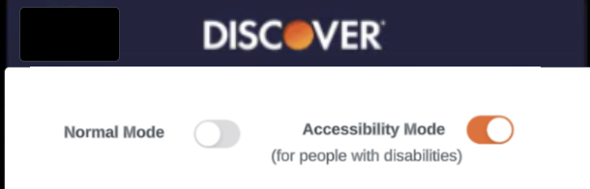
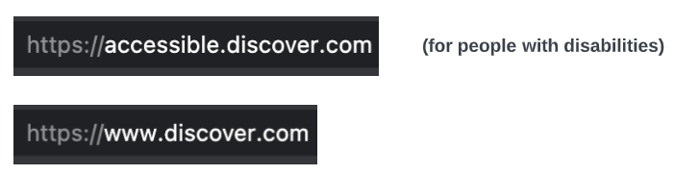
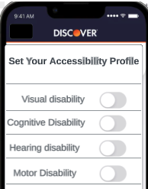
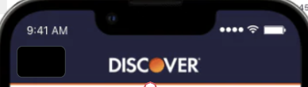
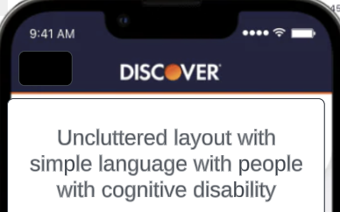
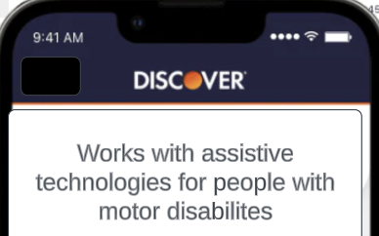
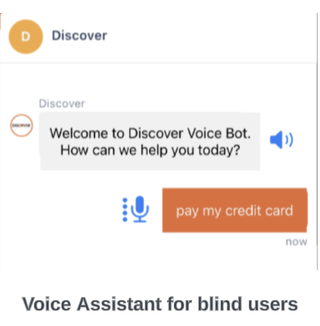
What Next Gen Accessibility
Accessible Mode: Website/apps should have dedicated areas only for accessibility needs.
Landing Page: Configure your Accessibility Profile
Adaptive: Website/App adapts to a particular disability.

Slide 4
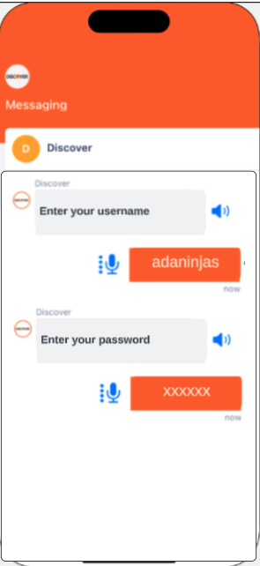
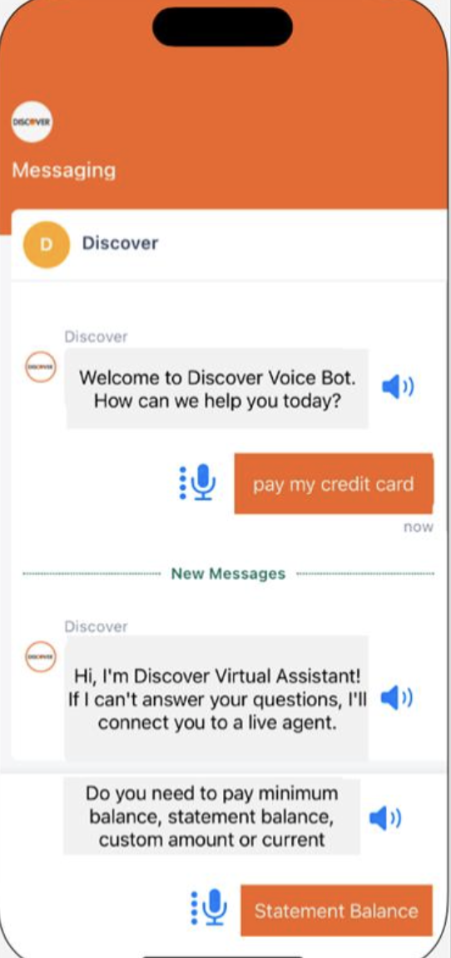
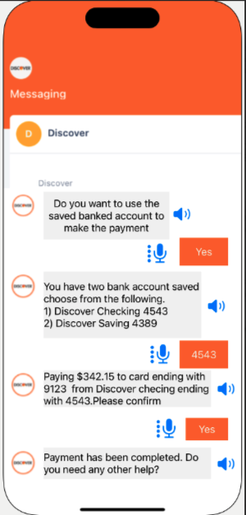
Where Next Gen Accessibility
A blind person is paying off his credit card bill using Discover Voice Assistant
Login Flow
Make a payment flow

Slide 5
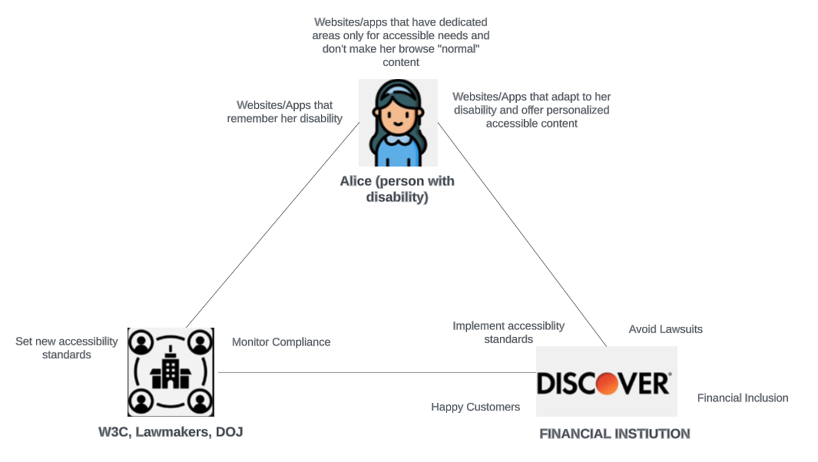
Who Next Gen Accessibility

Slide 6
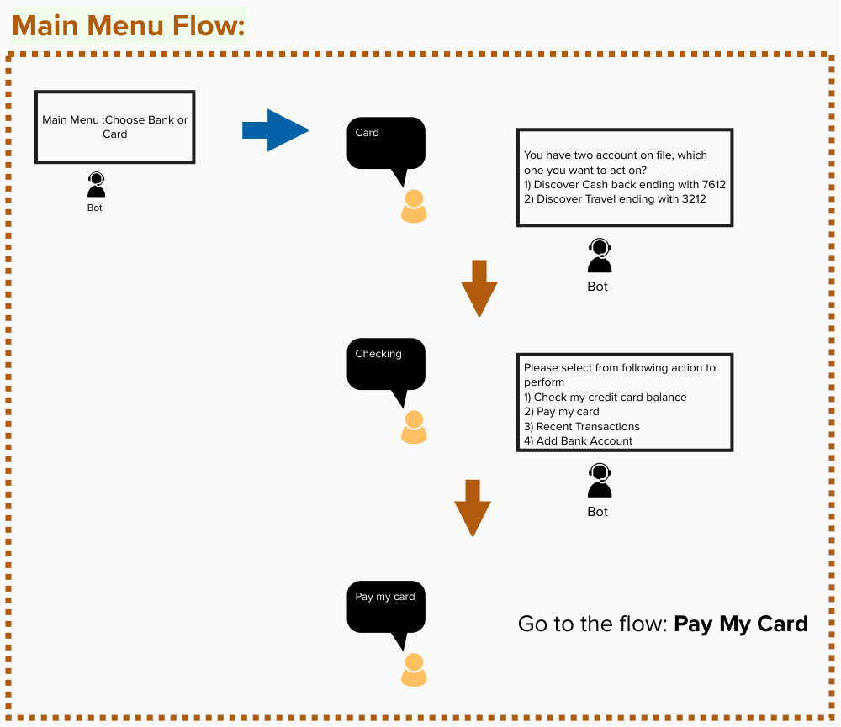
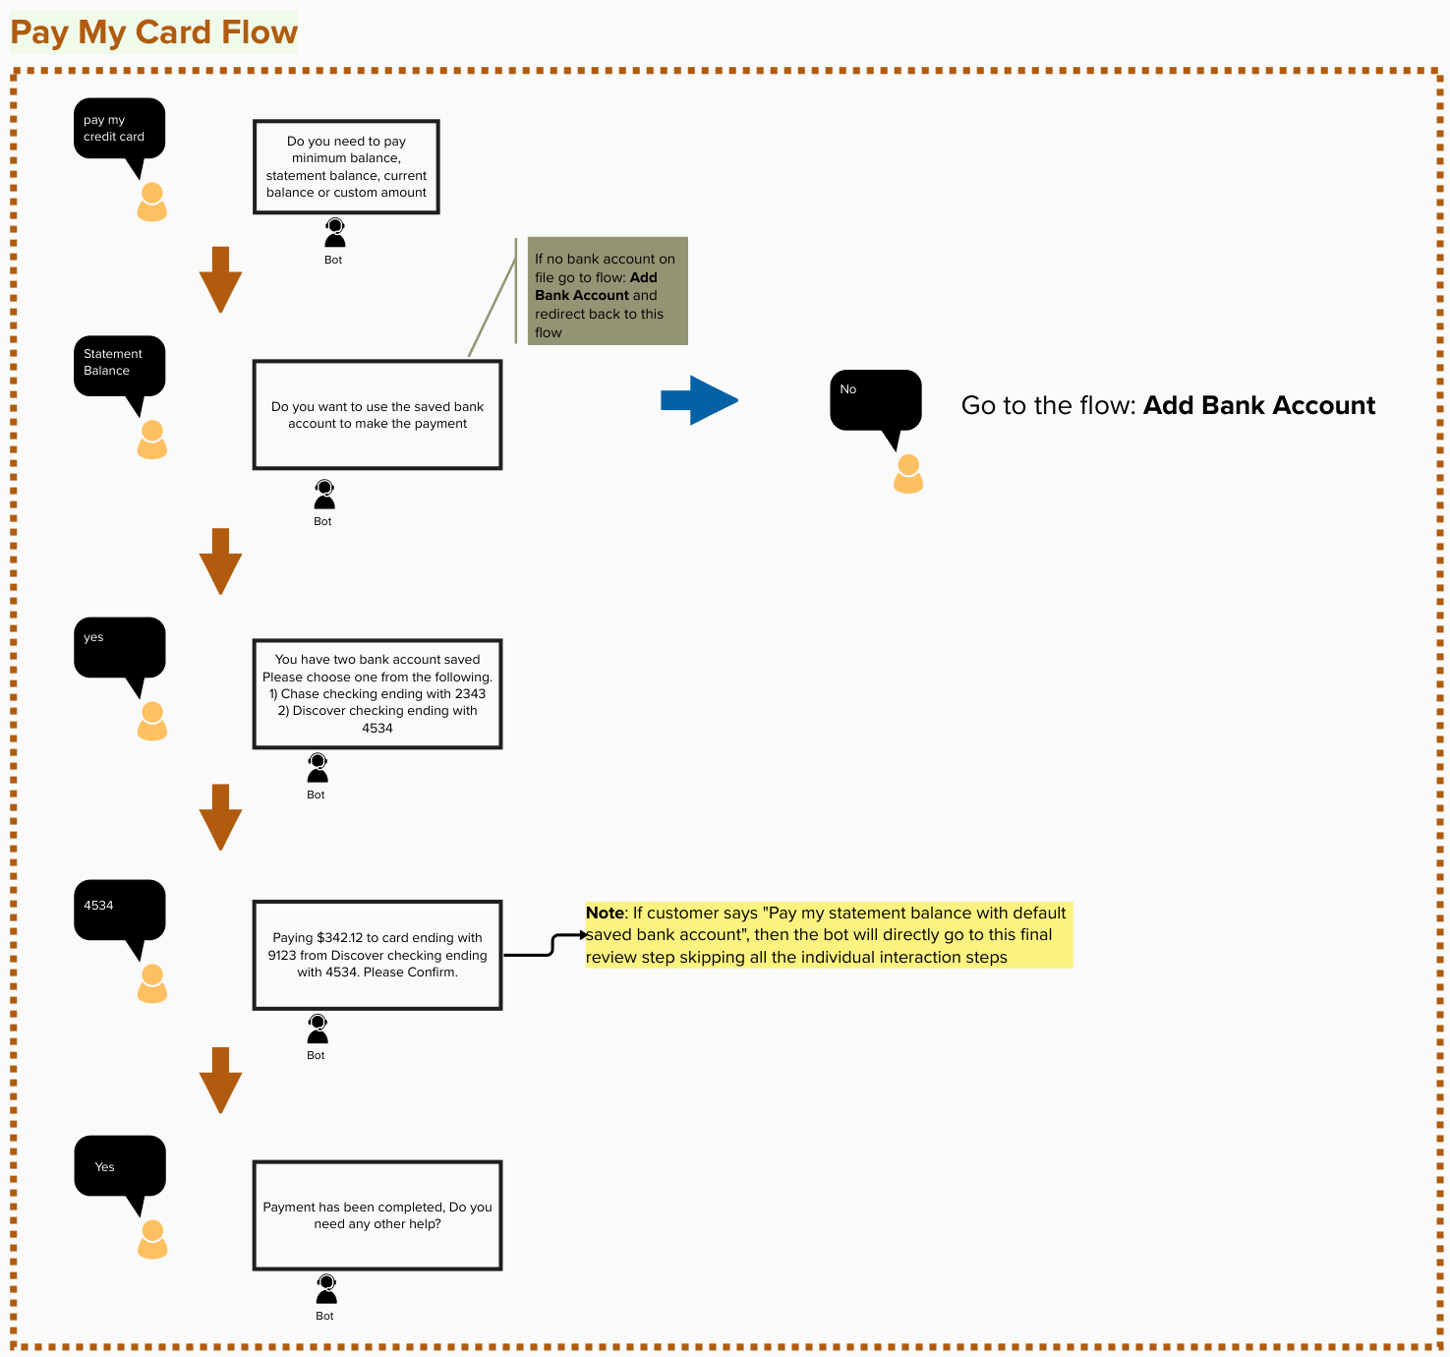

Slide 7
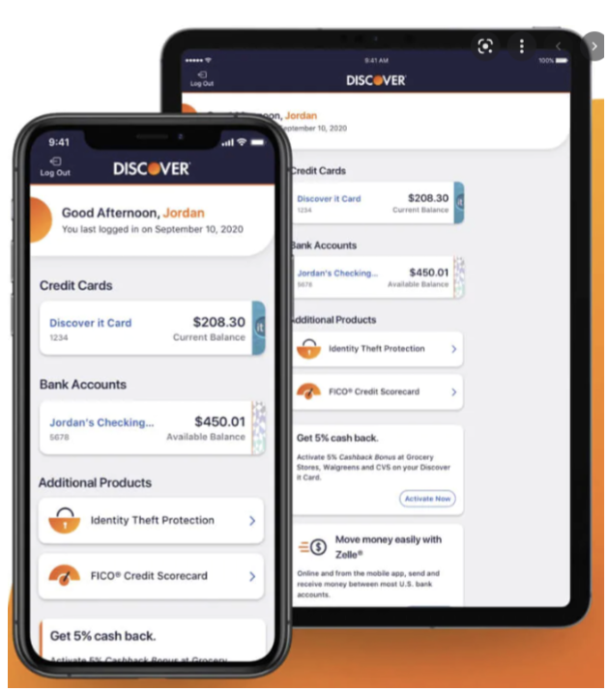
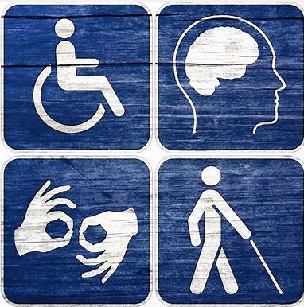
When Next Gen Accessibility
Whenever a person with a disability is trying to use Discover Mobile App or Discover Web Site for his/her financial needs.
Next Gen Accessibility

Slide 8
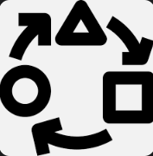



Wow Next Gen Accessibility
Financial institutions can offer personalized digital content that is tailored for a particular disability
Happy Customers
Avoid Lawsuits
Financial Inclusion

Slide 9
Project Name: Next Gen Accessibility Team Name: ADA Ninjas

